Slide 1
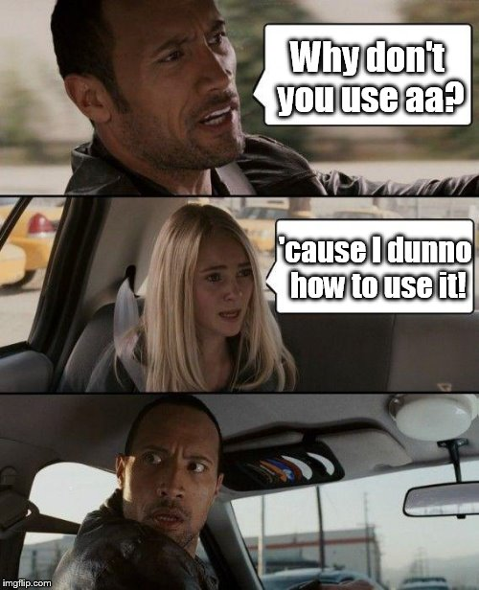
aa: magic explained (MRI)
Tibor Auer
MRC Cognition and Brain Sciences Unit Methods group
Notes:
Prepare:
/imaging/ta02/Workshop
Wiki

Slide 2
Recap
aa-natomy
autoidentifyseries_timtrio
get_dicom_structural
get_dicom_epi
get_dicom_fieldmap
convert_structural
convert_epis
convert_fieldmaps
fieldmap2VDM
tsdiffana
smooth
norm_write_dartel
worm_write_meanepi_dartel
coreg_extended_2epi
realignunwarp
slicetiming
biascorrect_structural
coreg_extended_1
segment8_multichan
dartel_createtemplate
dartel_norm_write
+
freesurfer_initialise
freesurfer_autorecon_all
firstlevel_model
firstlevel_contrasts
firstlevel_threshold
firstlevel_threshold_register2FS
secondlevel_model
paper_maker ???

Slide 3
Recap
aa-natomy
Modules
Header¹ – Data encapsulation
Defines inputs and outputs (streams)
Defines domain (i.e. once per study/subject/session/scan)
Set parameter defaults²
Ensures independence → Parallel processing on cluster or cloud
Body¹ – Code encapsulation
Low overhead, Expandable
Notes:
Show example!
You can overwrite in UMS

Slide 4
Recap
aa-natomy
Data streams¹
Modules explicitly define their inputs and outputs.
e.g. (fragment from aamod_realignunwarp.xml)
<inputstreams>
<stream>epi</stream> → Takes a set of EPI volumes
<stream>fieldmap</stream> → and a fieldmap;
</inputstreams>
<outputstreams>
<stream>realignment_parameter</stream> → produces realignment parameters,
<stream>epi</stream> → another set of EPI volumes
<stream>meanepi</stream> → and a mean EPI volume
</outputstreams>
Provenance (flow of data) → parallel computing, report generating
Easy reordering of the modules without worrying for prefixes
Notes:
1. Filename independent

Slide 5
What you need
Tasklist
Pipelines describing a series of modules to be executed
<?xml version="1.0" encoding="utf-8"?>
<aap>
<tasklist>
<initialisation>
<module><name>aamod_checkparameters</name></module>
<module><name>aamod_evaluatesubjectnames</name></module>
<module><name>aamod_study_init</name></module>
<module><name>aamod_newsubj_init</name></module>
</initialisation>
<main>
<!-- Data -->
<module><name>aamod_autoidentifyseries_timtrio</name></module>
<module><name>aamod_get_dicom_structural</name></module>
<module><name>aamod_get_dicom_epi</name></module>
<module><name>aamod_get_dicom_fieldmap</name></module>
<module><name>aamod_convert_structural</name></module>
<module><name>aamod_convert_epis</name></module>
<module><name>aamod_convert_fieldmaps</name></module>
…
</main>
</tasklist>
</aap>

Slide 6
What you need
Tasklist
Pipelines describing a series of modules to be executed
<main>
…
<!-- Structural -->
<module><name>aamod_biascorrect_structural</name></module>
<module><name>aamod_coreg_extended_1</name></module>
<module><name>aamod_freesurfer_initialise</name></module>
<module><name>aamod_freesurfer_autorecon_all</name></module>
<module><name>aamod_segment8_multichan</name></module>
<module><name>aamod_structuralstats</name></module>
<module><name>aamod_dartel_createtemplate</name></module>
<module><name>aamod_dartel_normmni</name></module>
<module><name>aamod_normalisebytotalgrey</name></module>
<module><name>aamod_roi_extract</name></module>
<module><name>aamod_roi_valid_structural</name></module>
<module><name>aamod_dartel_norm_write</name></module>
…
</main>

Slide 7
What you need
Tasklist
Pipelines describing a series of modules to be executed
<main>
…
<!-- Functional -->
<module><name>aamod_fieldmap2VDM</name></module>
<module><name>aamod_tsdiffana</name></module>
<module><name>aamod_realignunwarp</name></module>
<module><name>aamod_slicetiming</name></module>
<module><name>aamod_tsdiffana</name></module>
<module><name>aamod_coreg_extended_2epi</name></module>
<module><name>aamod_norm_write_dartel</name></module>
<module><name>aamod_norm_write_meanepi_dartel</name></module>
<module><name>aamod_tsdiffana</name></module>
<module><name>aamod_smooth</name></module>
<module><name>aamod_tsdiffana</name></module>
<!-- Modelling -->
<module><name>aamod_firstlevel_model</name></module>
<module><name>aamod_firstlevel_contrasts</name></module>
<module><name>aamod_firstlevel_threshold</name></module>
<module><name>aamod_firstlevel_threshold_register2FS</name></module>
<module><name>aamod_secondlevel_model</name></module>
<module><name>aamod_rois_dartel_denormepi</name></module>
</main>

Slide 8
What you need
User Master Script (UMS)
Specifies and runs the analysis
Initialise: setup aa
Loads in: default parameters and the tasklist
Customises: parameters and tasks
Specifies: data and model
Runs and cleans up: the main (p)art
Generates: report

Slide 9
What you need
User Master Script (UMS)
Specifies and runs the analysis
Initialise: setup aa
% Automatic analysis
% User master script example (aa version 5.*.*) - c.a. 2.5h
%
% Tibor Auer, MRC-CBSU
% 01-02-2016
clear
aa_ver5

Slide 10
What you need
User Master Script (UMS)
Specifies and runs the analysis
Loads in: default parameters and the tasklist
%% DEFINE SPECIFIC PARAMETERS
% Default recipe with model
aap = aarecipe('aap_parameters_defaults_CBSU.xml','/imaging/xy01/Workshop/Material/4_aa/fmri_takslist.xml');
aap = aas_configforSPM12(aap);

Slide 11
What you need
User Master Script (UMS)
Specifies and runs the analysis
Customises: parameters and tasks
% Modify standard recipe module selection here if you'd like
aap.options.wheretoprocess = 'qsub'; % queuing system % OPTIONS: 'localsingle'|'qsub' for aa engine, typical value 'qsub'
aap.options.email = 'xy01@mrc-cbu.cam.ac.uk';
aap.options.autoidentifyfieldmaps = 1;
aap.tasksettings.aamod_roi_extract_structural.ROIfile = '/imaging/camcan/templates/Juelich-maxprob-thr25-2mm.nii';
aap.tasksettings.aamod_realignunwarp.mfp.run = 1; % Motion FingerPrint, typical value 0
% Set slice order for slice timing correction
aap.tasksettings.aamod_slicetiming.autodetectSO = 1;
aap.tasksettings.aamod_slicetiming.refslice = 16; % reference slice (first acquired)
aap.tasksettings.aamod_smooth.FWHM = 5; % smoothing kernel size, typical value 10
aap.tasksettings.aamod_roi_extract_epi.ROIfile = '/imaging/camcan/templates/Juelich-maxprob-thr25-2mm.nii';
aap.tasksettings.aamod_firstlevel_model.xBF.name = 'hrf (with time and dispersion derivatives)';
aap.tasksettings.aamod_firstlevel_model.xBF.UNITS = 'secs'; % OPTIONS: 'scans'|'secs' for onsets and durations, typical value 'secs'
aap.tasksettings.aamod_firstlevel_model.includemovementpars = 1; % Include/exclude Moco params in/from DM, typical value 1
aap.tasksettings.aamod_firstlevel_threshold.threshold.correction = 'FWE';
aap.tasksettings.aamod_firstlevel_threshold.threshold.p = 0.05;
aap.tasksettings.aamod_secondlevel_threshold.threshold.correction = 'none';
aap.tasksettings.aamod_secondlevel_threshold.threshold.p = 0.1;
aap.tasksettings.aamod_secondlevel_threshold.threshold.extent = 1000;

Slide 12
What you need
User Master Script (UMS)
Specifies and runs the analysis
Specifies: data
% Directory for analysed data
aap.acq_details.root = '/imaging/xy01/Workshop';
aap.directory_conventions.analysisid = 'aa_fMRI1';
aap.directory_conventions.subject_directory_format = 3;
% Add data
aap = aas_addsession(aap,'Loc');
aap = aas_addsubject(aap,'S1',90973,'structural',2,'functional',{7});
aap = aas_addsubject(aap,'S2',90979,'structural',2,'functional',{7});
aap = aas_addinitialstream(aap,'rois',{...
'/imaging/xy01/Workshop/Material/4_aa/SMC_L.nii',...
'/imaging/xy01/Workshop/Material/4_aa/SMC_R.nii',...
'/imaging/xy01/Workshop/Material/4_aa/SSC_L.nii',...
'/imaging/xy01/Workshop/Material/4_aa/SSC_R.nii'...
});

Slide 13
What you need
User Master Script (UMS)
Specifies and runs the analysis
Specifies: model
% Add model
% Obtain TR from the first session
h = dicominfo(mri_finddcm(aap, 90973,7));
TR = h.RepetitionTime/1000; % in seconds
% The "hard"(-coded) way
aap = aas_addevent(aap,'aamod_firstlevel_model','S1','*',...
'REST',... % name
[30.0560 100.1620 160.2800 200.3700 280.5340 340.6670]-aap.acq_details.numdummies*TR,... % onsets
[10.0070 10.0230 10.0230 10.0220 10.0210 10.0230]); % durations
aap = aas_addevent(aap, 'aamod_firstlevel_model','S1','*',...
'RIGHTFINGER',... % name
[70.0960 140.2360 170.3030 240.4600 320.6220 350.6890]-aap.acq_details.numdummies*TR,... % onsets
[10.0220 10.0220 10.0220 10.0220 10.0230 10.0230]); % durations
aap = aas_addevent(aap, 'aamod_firstlevel_model','S2','*',...
'REST',... % name
[30.0570 100.1310 160.1990 200.2380 270.3610 330.4300]-aap.acq_details.numdummies*TR,... % onsets
[10.0070 10.0220 10.0060 10.0220 10.0070 10.0220]); % durations
aap = aas_addevent(aap, 'aamod_firstlevel_model','S2','*',...
'RIGHTFINGER',... % name
[70.0970 140.1860 170.2050 240.3110 310.4020 340.4510]-aap.acq_details.numdummies*TR,... % onsets
[10.0060 10.0070 10.0210 10.0220 10.0210 10.0220]); % durations
aap = aas_addcontrast(aap,'aamod_firstlevel_contrasts','*','singlesession:Loc','+1xRIGHTFINGER|-1xREST','Loc_RightFinger-Rest','T');

Slide 14
What you need
User Master Script (UMS)
Specifies and runs the analysis
Specifies: model (alternative way)
Prerequisite: condition files in “SPM format“¹
One per subject and per session²
for s = 1:numel(aap.acq_details.subjects) % for each subject
load(['/imaging/xy01/Workshop/Material/4_aa/condition_vol_' aas_getsubjname(aap,s) '-Loc.mat']);
for ev = 1:numel(names) % for each EV
aap = aas_addevent(aap,'aamod_firstlevel_model',aas_getsubjname(aap,s),'*',...
names{ev},... % name
onsets{ev}-aap.acq_details.numdummies*TR,... % onsets
durations{ev}); % durations
end
end
Notes:
Load and show
Flexibility according to programming skill

Slide 15
What you need
User Master Script (UMS)
Specifies and runs the analysis
Specifies: data and model (alternative way – aa-specific)
Prerequisite:
“Input list”: CSV-file¹
Condition files
‘condition_vol_<subject name>-<session name>.mat’
“SPM format“
aap.acq_details.input.list = '/imaging/xy01/Workshop/Material/4_aa/Input.txt';
aap.acq_details.input.selected_sessions = 1; % Only session "Loc"
aap.acq_details.input.referencedirectory_tmpl = '/imaging/xy01/Workshop/Material/4_aa';
aap = aas_processinput(aap);
Notes:
Explain format

Slide 16
What you need
User Master Script (UMS)
Specifies and runs the analysis
Specifies: data and model (alternative way – standard)
Prerequisite: dataset in BIDS-format
aap.directory_conventions.rawdatadir = '/imaging/xy01/Workshop/Material/4_aa/BIDS';
aap.acq_details.numdummies = 0;
aap = aas_processBIDS(aap);

Slide 17
What you need
User Master Script (UMS)
Specifies and runs the analysis
Runs and cleans up: the main (p)art
aa_doprocessing(aap);

Slide 18
What you need
User Master Script (UMS)
Specifies and runs the analysis
Generates: report
aa_report(fullfile(aas_getstudypath(aap),aap.directory_conventions.analysisid));

Slide 19
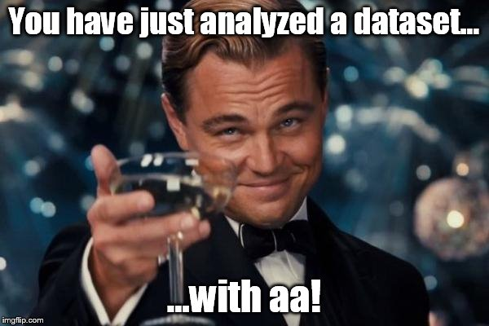
Congratulations!

