Slide 1
Targeting Frames

Slide 2
Targets
When you use links in a frames environment you will need to specify an additional attribute called TARGET.
The target attribute specifies where to open the linked document.
The TARGET attribute uses the NAME attribute of the FRAME element.
Example: If we were to place a link in doc1.html that linked to doc3.html and we wanted doc3.html to be displayed in the right windowpane; the HTML code would appear in doc1.html as follows:
<A HREF=“doc3.html” TARGET=“right_pane”>
Link to Document 3 </A>

Slide 3
Special Targets
_blank
_self
_top
_parent

Slide 4
Special Targets
TARGET=“_blank” : This is the most commonly used target—it opens the link in an entirely new browser window (and your old window stays open). The back is turned off.
TARGET=“_self” : opens the new document in the same window and frame where the anchor was {Clicked}. "_self" works the same as if you had not used target attribute at all. This is the default target for any anchor tag. The back is turned on.
TARGET=“_top” : loads the linked document into the top level window of the browser ie., it cancels all frames, and loads in full browser window. All frames disappear, leaving the new linked page to occupy the entire window. The back is turned on.
TARGET=“_parent” : is used in the situation where a frameset file is nested inside another frameset file. A link in one of the inner frameset documents, which uses "_parent", will load the new document where the inner frameset file had been. It means _parent loads the page into the frame that is superior to the frame the hyperlink is in. The back is turned on.
Note: If there is only one frameset, the document will be loaded into the browser window. If there are nested framesets, the document will be loaded into the next level frameset up.

Slide 5
1. <A HREF="stuff.html" TARGET="_blank">
If a frame contains this link, then clicking the link opens a new, unnamed browser window that contains the content defined in stuff.html.
2. <A HREF="stuff.html" TARGET="_self">
If a frame contains this link, then clicking the link will simply cause the frame which contains the link to clear, and its content will be replaced with whatever is in stuff.html.
3. <A HREF="stuff.html" TARGET="_top">
If a frame contains this link, clicking the link replaces the entire browser window(remove all frames) with the contents of stuff.html.
4. <A HREF="stuff.html" TARGET="_parent">
If a frame contains this link, the frameset that contains the frame that contains this link will be replaced by stuff.html.

Slide 6
Targeting links to frames
The TARGET attribute allows you to specify the frame into which a page is to be loaded into in a frames setting.
<A HREF=“chap1.html” TARGET=“_self”> [Chapter 1]</A>
<A HREF=“chap2.html” TARGET=“_parent”> [Chapter 2]</A>
Parent window
chap1.html
Learning HTML
[Chapter 1][Chapter 2]
chap2.html

Slide 7
Targeting links to frames
The TARGET attribute allows you to specify the frame into which a page is to be loaded into in a frames setting.
<A HREF=“chap1.html” TARGET=“bottom”> [Chapter 1]</A>
<A HREF=“chap2.html” TARGET=“bottom”> [Chapter 2]</A>
<A HREF=“chap3.html” TARGET=“bottom”> [Chapter 3]</A>
chap1.html
Learning HTML
[Chapter 1][Chapter 2][Chapter 3]
chap2.html
chap3.html

Slide 8
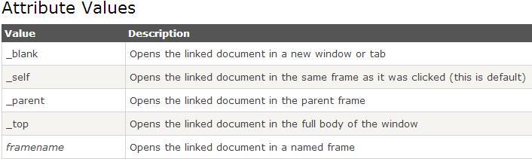
Syntax:
<a target="_blank|_self|_parent|_top|framename">

