Slide 1
Real Estate Price Prediction

Slide 2
Contributors …
Navneet Kaur
Web Application, GitHub Repository,
Deployment
Anargha Manoj
Dataset selection, Data Pre-processing,EDA
Simranjeet Kaur
EDA, Model Selection, Model Evaluation
Lakshmi Kumari
Pickle-Files, Web Application
Sharon Victor
Model Evaluation,
Hyperparameter Tuning, Pickle-Files

Slide 3
Overview
Project Plan …
Data
Preprocessing
Model Selection and Evaluation
Introduction and Objective
…
Exploratory Data Analysis
Feature Selection

Slide 4
Dataset Overview
Our dataset has 4,600 rows and 18 columns that were taken from Kaggle. It includes location information, financial indicators, chronological data, and important property aspects.
This dataset offers a diverse collection of features, including square footage, bedrooms, bathrooms, neighborhood types, and the year of construction.
Our analysis of real estate price forecast is based on this extensive information, which provides a comprehensive picture of transactions.

Slide 5
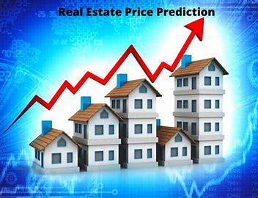
INTRODUCTION The real estate industry is a vital and constantly changing part of the world economy. Legislators, developers, investors, and homeowners have long placed a high priority on the assessment and forecasting of real estate values. Recent developments in artificial intelligence, machine learning, and data analytics have enabled experts and scholars to create complex models for predicting real estate prices.
..

Slide 6
Objectives
Identify Influential Factors:
Predicting Future Prices
Dive into the dataset to identify and comprehend the key factors that significantly influence real estate prices.
Uncover correlations and patterns within property features, location data, and financial metrics.
Develop predictive models that leverage historical data to forecast future real estate prices.
Provide stakeholders with actionable insights for strategic decision-making in the dynamic real estate market.

Slide 7


Data cleaning and preprocessing
Handling Missing Values:
Identified and addressed missing data points through imputation or removal, ensuring a complete and reliable dataset.
Outlier Management:
Detected and managed outliers to prevent skewed insights and model bias.
Applied appropriate techniques, such as capping or transformation, to maintain data integrity.
Feature Engineering:
Introduced new features or modified existing ones to enhance model performance.
This involved scaling, encoding categorical variables, or creating composite features to capture nuanced relationships.

Slide 8
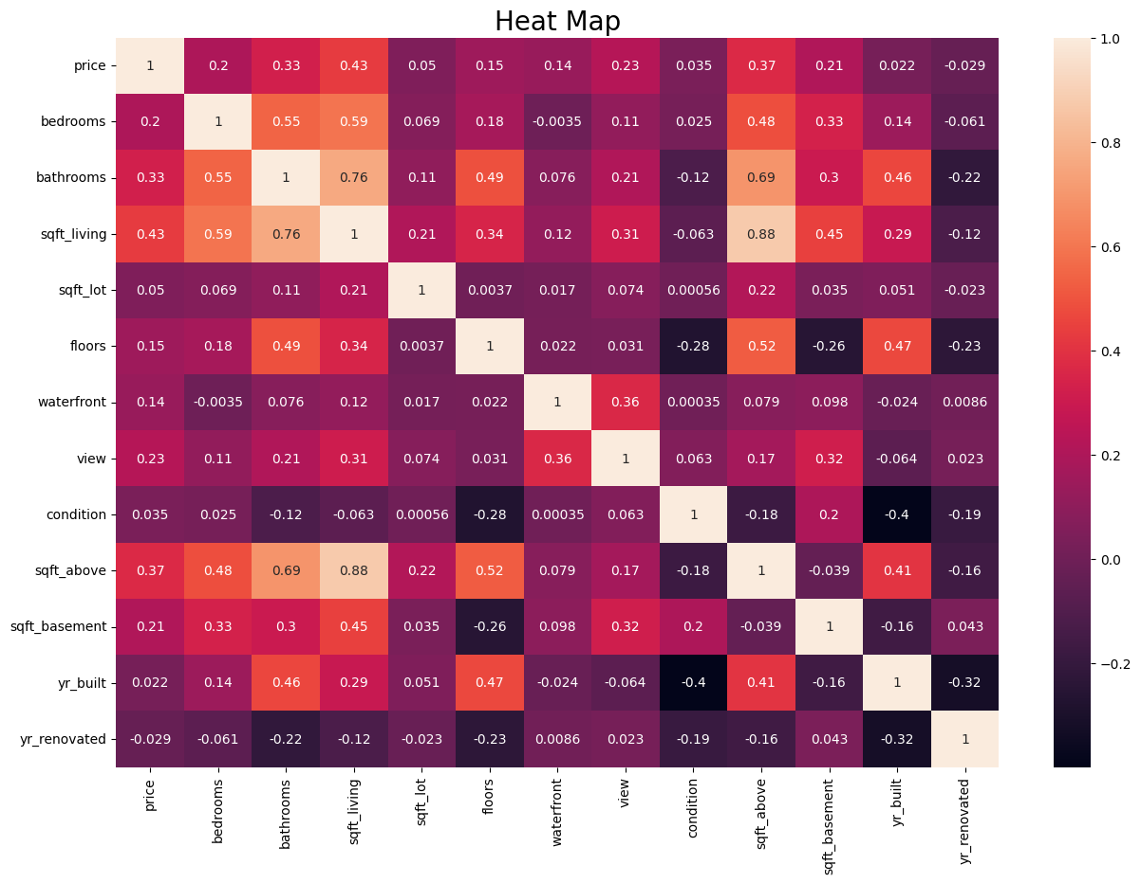
EDA
Larger Living Areas, Higher Prices:
Strong positive correlation (0.43) between "sqft_living" and "price.“
More Bathrooms, Higher Prices:
Positive correlation (0.33) between bathroom count and property prices.
Multi-story Impact:
Moderate positive correlation (0.15) between "floors" and property prices.
Above-Ground Space Matters:

Slide 9
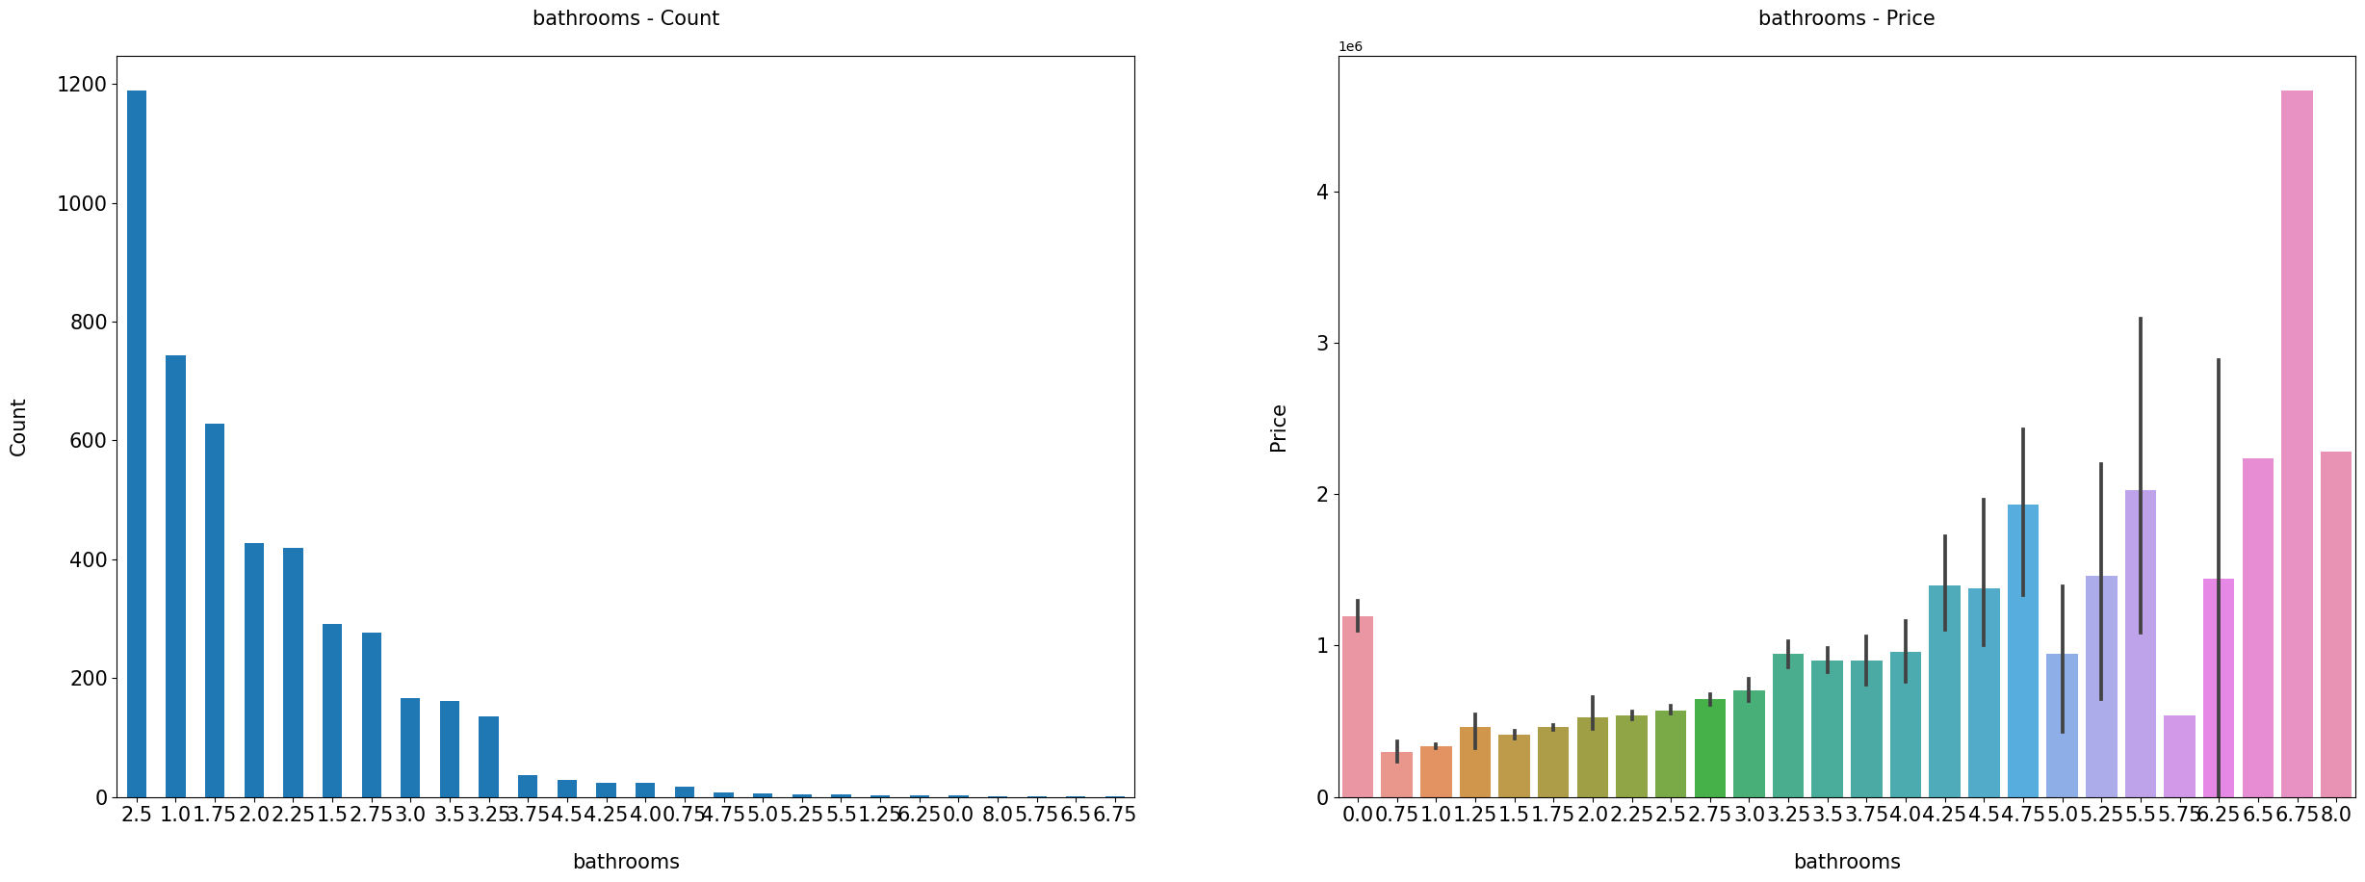
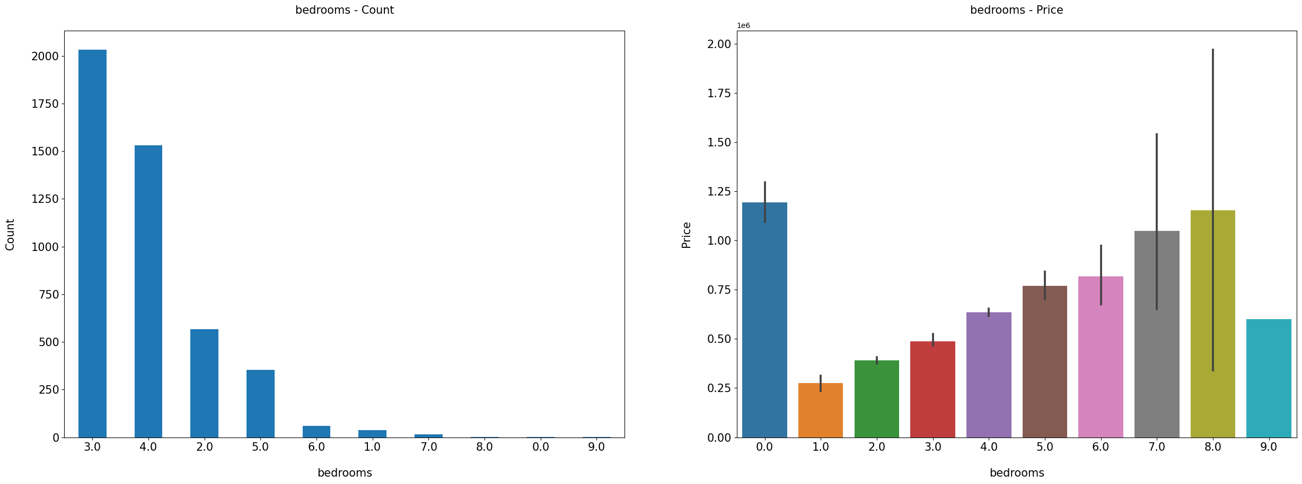
Medina has most expensive houses whether the Milton city is affordable.
These visualisations are showing that the houses with more number of bathrooms ,bedrooms are more expensive.

Slide 10
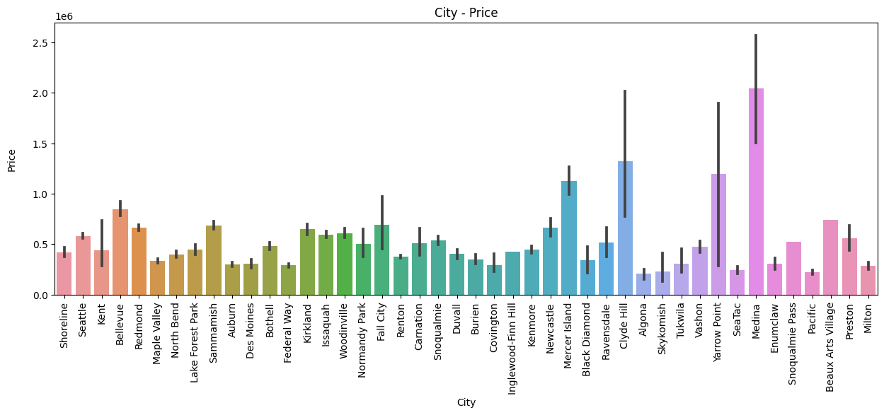

Slide 11
Feature Selection
Prioritized Significance:
Emphasized features with a strong correlation to house prices.
Focused on known real estate influencers like square footage and bedroom count.
Multicollinearity Management:
Mitigated multicollinearity by excluding highly correlated features for model clarity.
EDA Insights:
Leveraged EDA findings for informed feature selection, emphasizing distinctive patterns.

Slide 12

Model selection
Simple Linear Regression:
Baseline for simplicity and interpretability.
Random Forest:
Suitable for both regression and classification
Artificial Neural Network (ANN):
Models intricate patterns and interactions.

Slide 13
Model selection
Training:
Trained using least squares method.
Grid search and cross-validation for optimization.
Trained with backpropagation; and hyperparameter tuning via grid search.
Reasons of choosing these models:
Linear Regression for transparency.
Random Forest for Robustness.
ANN for Pattern Recognition

Slide 14
Model Evaluation
Linear Regression – Using Grid Search CV
Accuracy – 66%
Random Forest – Random Search CV
Accuracy – 68%
ANN
Accuracy- 60.7%

Slide 15
Flask Web App: Developed a Flask web application for real estate price prediction. Repository Structure: Organized code, data, templates, and static files in a structured GitHub repository. Deployment Platform: Chose Render for cloud deployment due to its simplicity and scalability. Deployment Steps: Connected GitHub repository to Render for seamless deployment. Configured environment variables on Render for secure parameter storage.Choose

Slide 16
GITHUB LINK: .
https://github.com/4nargha/Real-Estate-Price-Prediction-Dataset-Analysis

Slide 17
Thank You

