Slide 1
Background Subtraction applied to Object Recognition
By using Convolutional Neural Networks
Cristian Muriel
Guillem Pascual

Slide 2
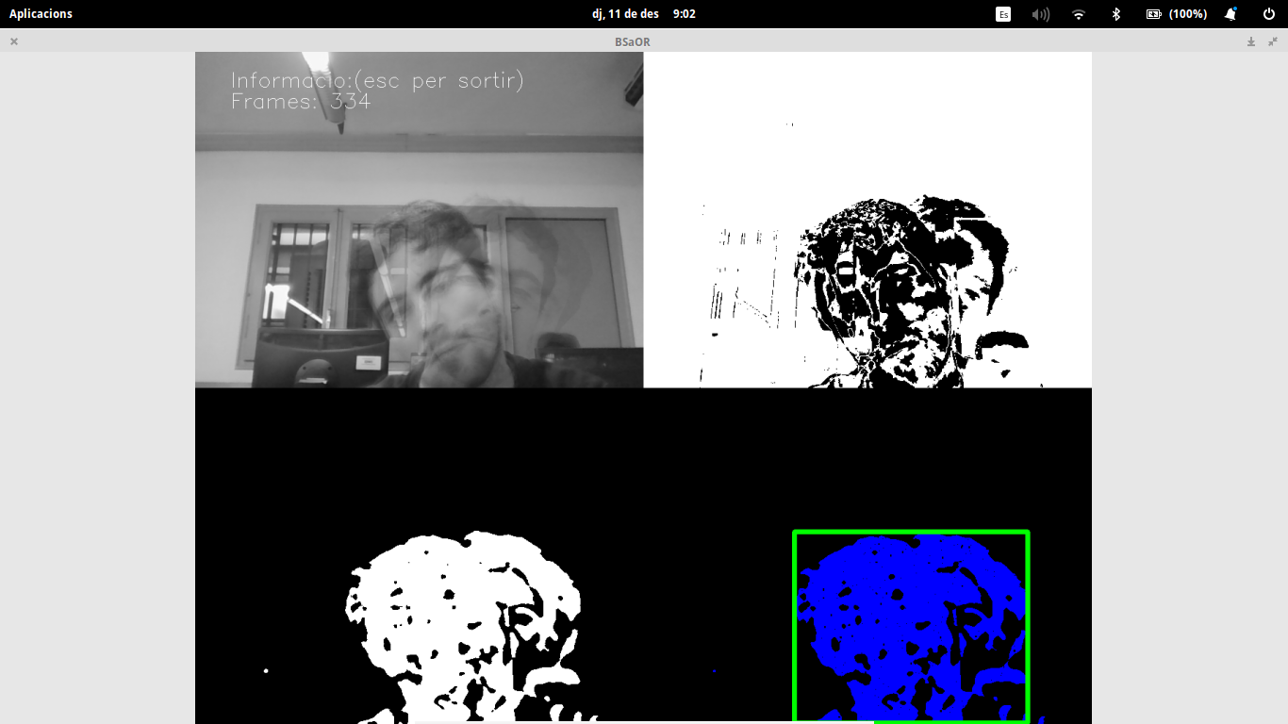
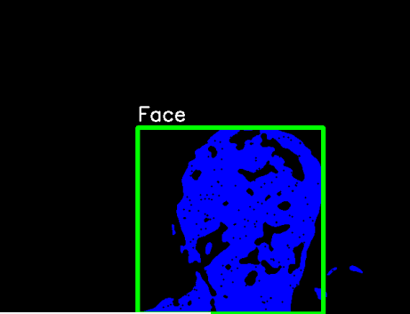
Goals
Background Subtraction
Contours
Object Segmentation
Conv. Neural Net.
Object Recognition
Running Average

Slide 3
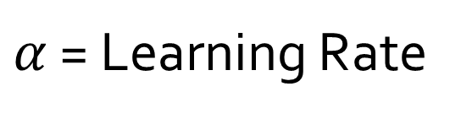
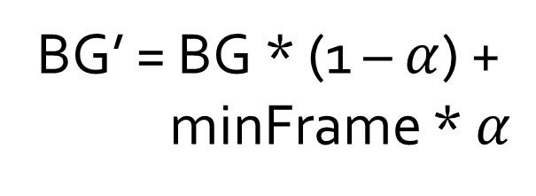
Running Average
Variable background
$α$ = Learning Rate
Compute Difference
Frame 1
Compute Difference
Frame 2
Compute Difference
Frame k
BG’ = BG * (1 – $α$) +
minFrame * $α$

Slide 4
Object Segmentation
Subtract background to current frame
Threshold and noise reduction
Apply distance function to avoid mixing/merging two close objects
Threshold image by a small amount (avoid close objects again)
Find external contours by using Canny

Slide 5
Convolutional Neural Network
CNN:
Jia, Yangqing
Caffe: Convolutional Architecture for Fast Feature Embedding
C++/CUDA Library with wrappers for Python and Matlab
Deep Learning
Training time of 6 hours, with:
GPU: NVIDIA GTX 650 TI 2GB
CPU: Intel i7 3.60GHz
Images:
15.000 Faces including body
18.000 Faces (bare face)
800 black
800 white
800 red
800 blue
800 black
800 gray
800 skin color
1000 Suitcase

Slide 6
Conclusions
Background Subtraction is an efficient and fast method for mobile objects detection
Segmentation through external contours works but might mix objects
Convolutional neural networks are perfect solutions for multiple object classifying, although:
Small datasets might proof insufficient and cause the net to misclassify
High computational training cost
Applicable to Video Surveillance and Lost/Forgot object detection

