Slide 1
Linear Discriminant Analysis (Part II)
Lucian, Joy, Jie

Slide 2
Questions - Part I
Paul:
Figure 4.2 on p. 83 gives an example of masking and in text, the authors go on to say, "a general rule is that...polynomial terms up to degree K - 1 might be needed to resolve them". There seems to be an implication that adding polynomial basis functions according to this rule could be detrimental sometimes. I was trying to think of a graphical representation of a case where that would occur but can't come up with one. Do you have one?

Slide 3

Computations For LDA
Diagonalize
    For both LDA and QDA
Sphering the data with respect to
    Classify to the closest centroid, modulo π_{k}

Slide 4
Reduced Rank LDA
Sphered data is projected onto the centroid determined space
    K-1 dimensional
    No information loss for LDA
    Residual dimensions are irrelevant
Fisher Linear Discriminant
    Projection onto an optimal (in the LSSE sense) subspace H_{L} ⊆ H_{K-1}
Resulting classification rule is still Gaussian

Slide 5
Sphering
Transform X → X*
    Components of X* are uncorrelated
    Common covariance estimate of X* is the identity
    * = I
Whitening transform always possible
Popular method: Eigenvalue Decomposition

Slide 6
EVD for Sphering
= EDE^{T}
    E is orthogonal matrix of eigenvectors of
    D is diagonal matrix of eigenvalues of
Whitening
    X* = D^{-1/2}E^{T}X
    Hence, *= I
No loss – only scaling

Slide 7
Effects of Sphering
Reduces # of parameters to be estimated
    An orthogonal matrix has n(n-1)/2 degrees of freedom (vs. n² parameters originally)
    Reduces complexity
PCA reduction
    Given the EVD, discard eigenvalues which are too small
      Reduce noise
      Prevents overlearning

Slide 8
Dimensionality Reduction
Determine a K-1 dimensional space H_{K-1} based on centroids
Project data onto this space
    No information loss since pair-wise distance inequalities are preserved in H_{K-1}
    Orthogonal components to H_{K-1} do not affect pair-wise distance inequalities (i.e. projections maintain ordering structure)
P+1 → K-1 dimensionality reduction

Slide 9
K-1 Space
x
x
K=2
K=3
p_{i}
p_{i}

Slide 10
Fisher Linear Discriminant
Find optimal projection space H_{L} of dimensionality
    L <= K-1
    Optimal in a data discrimination / separation sense – i.e. projected centroids are spread out as much as possible in terms of variance

Slide 11
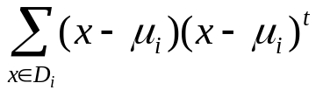
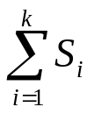
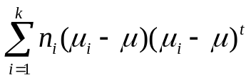
Fisher Linear Discriminant Criterion
X* = W^{t}X
Maximize the Rayleigh quotient:
  J(w) = |S_{B}|/|S_{W}| = |W^{t}S_{B}W| / |W^{t}S_{W}W|
    Sample class scatter matrix
      S_{i} =
    Sample within class scatter matrix
      S_{w} =
    Sample between class scatter matrix
      S_{B} =
    Total scatter matrix
      S_{T} = S_{W} + S_{B}

Slide 12
Solving Fisher Criterion
The columns of an optimal W are the generalized eigenvectors that correspond tot the largest eigenvalues in
    S_{B}w_{i} = λ_{i}S_{W}w_{i}
    Hence, by EVD, one can find optimal w_{i}s
    EVD can be avoided by computing root of
      |S_{B} – λ_{i}S_{W}| = 0
    For LDA, as S_{W} can be ignored because of sphering
    Find the principle component of S_{B}

Slide 13
Role of Priors
Question:
Weng-Keen:
(Pg 95 paragraph 2) When describing the log pi_k factor, what do they mean by: "If the pi_k are not equal, moving the cut-point toward the smaller class will improve the error rate". Can you illustrate with the diagram in Figure 4.9?

Slide 14
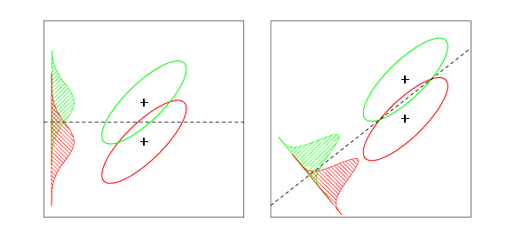
Role of Priors

Slide 15
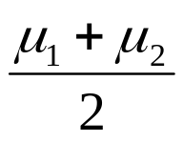

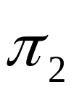
Role of Priors
Frequent
Rare

Slide 16
Role of Priors
(modulo π_{k})
Frequent
Rare

Slide 17
Separating Hyperplane
Another type of methods for linear classification
Construct linear boundaries that explicitly try to separate classes
Classifiers:
  Perceptron
  Optimal Separating Hyperplanes

Slide 18
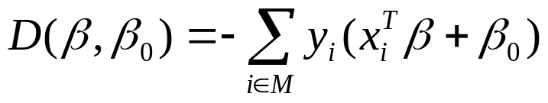
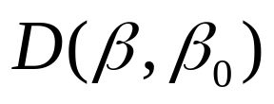
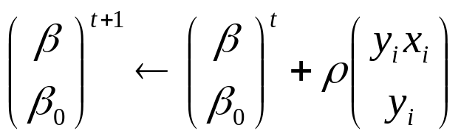
Perceptron Learning
The distance of misclassified points to the decision boundary
  M: misclassified points
  y_{i}=+1/-1 for positive/negative class
Find a hyperplane to minimize:
Algorithm: gradient descent

Slide 19
Perceptron Learning
There are more than one solutions when data is separable. Solution depends on the starting values.
  Add additional constraints to get one unique solution
It can take too many steps before solution can be found
Algorithm will not converge if data not separable
  Seeking hyperplanes in the enlarged space

Slide 20
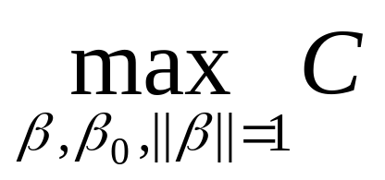
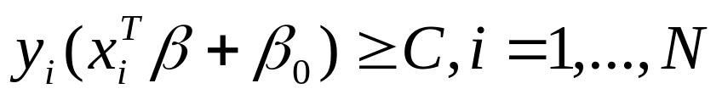
Optimal Separating Hyperplanes
Additional constraint: the hyperplane needs to maximize the margin of the slab
  Subject to
  Provide a “unique” solution
  Better classification on test data

Slide 21
Question
Weng-Keen:
  How did max C bet, beta_0, || beta || = 1 in (4.41)
  become min 1/2 ||beta||^2 in (4.44) beta,beta_0
  I can see how || beta || = 1/C makes
  max C = max 1 / ||beta|| = min || beta ||
  But where does the square and the 1/2 come from?
  Answer:
  Minimize ||beta|| is equivalent to minimize ½||beta||^2, by doing so, it is easier to apply derivative to the Lagrange function

Slide 22
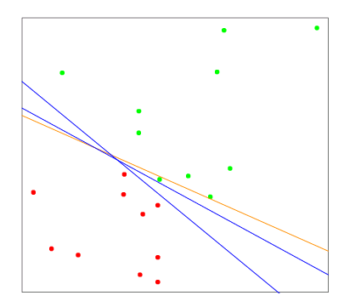
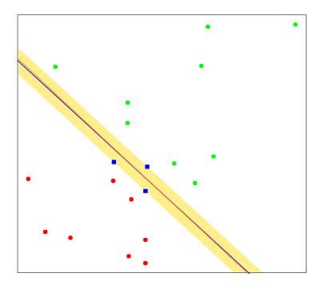
Hyperplane Separation
Logistic Regression
Least Sq/LDA
Perceptron
SVM

Slide 23
Classification by Linear Least Squares vs. LDA
Two-class case, simple correspondence between LDA and classification by linear least squares
  The coefficient vector from least squares is proportional to the LDA direction in its classification rule (page 88)
For more than two classes, the correspondence between regression and LDA can be established through the notion of optimal scoring (Section 12.5).
  LDA can be performed by a sequence of linear regressions, followed by classification to the closet class centroid in the space of fits.

Slide 24
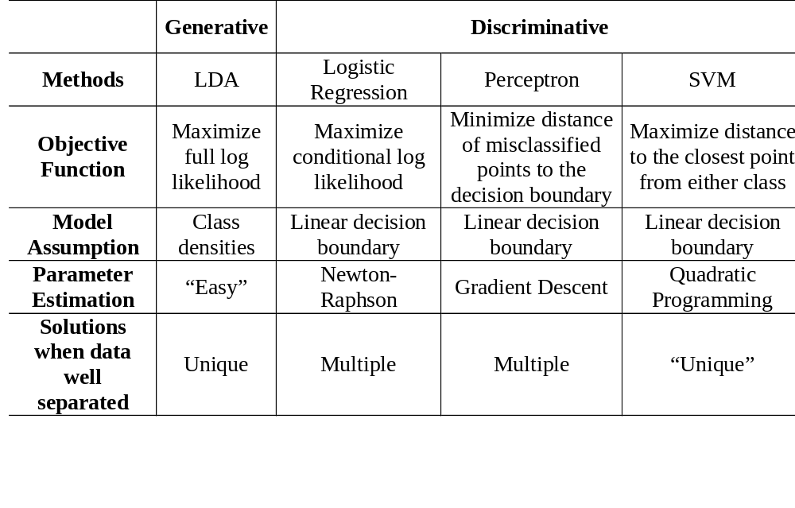
Comparison

Slide 25
LDA vs. Logistic Regression
LDA (Generative model)
  Assumes Gaussian class-conditional densities and a common covariance
  Model parameters are estimated by maximizing the full log likelihood, parameters for each class are estimated independently of other classes, Kp+p(p+1)/2+(K-1) parameters
  Makes use of marginal density information Pr(X)
  Easier to train, low variance, more efficient if model is correct
  Higher asymptotic error, but converges faster
Logistic Regression (Discriminative model)
  Assumes class-conditional densities are members of the (same) exponential family distribution
  Model parameters are estimated by maximizing the conditional log likelihood, simultaneous consideration of all other classes, (K-1)(p+1) parameters
  Ignores marginal density information Pr(X)
  Harder to train, robust to uncertainty about the data generation process
  Lower asymptotic error, but converges more slowly

Slide 26




Generative vs. Discriminative Learning
(Rubinstein 97)
 | Generative | Discriminative
Example | Linear Discriminant Analysis | Logistic Regression
Objective Functions | Full log likelihood: | Conditional log likelihood
Model Assumptions | Class densities: e.g. Gaussian in LDA | Discriminant functions
Parameter Estimation | “Easy” – One single sweep | “Hard” – iterative optimization
Advantages | More efficient if model correct, borrows strength from p(x) | More flexible, robust because fewer assumptions
Disadvantages | Bias if model is incorrect | May also be biased. Ignores information in p(x)

Slide 27
Questions
Ashish:
p92 - how does the covariance of M* correspond to the between class covariance?
Yan Liu:
This question is on the robustness of LDA, logistic regression and SVM: which one is more robust to uncertainty of the data? Which one is more robust when there is noise in the data? (Will there be any difference between the conditions that the noise data lie near the decision boundary and that the noise lies far away from the decision boundary?)

Slide 28
Question
Paul:
Last sentence of Section 4.3.3. p.95 (and exercise 4.3) "A related fact is that if one transforms the original predictors X to Yhat, then LDA using Yhat is identical to LDA in the original space."
If you have time, I would like to see an overview of the solution.
Jerry:
  Here is a question: what's the two different views of LDA (dimensionality reduction), one by the authors, the other by Fisher? The difference is mentioned in the book but it would be interesting to explain them intuitively.
  A question for the future: what's the connection between logistic regression and SVM?

Slide 29
Question
The optimization solution outlined on p.109-110 seems to suggest a clean separation of the two classes is possible; i.e., the linear constraints y_i(x_i^T beta + beta_0)>=1 for i=1...N are all satisfiable. But I suspect in practice it's often not the case. Under overlapping training points, how does one proceed in solving the optimized solution of beta? Can you give a geometric interpretation of what impact of the overlapping points may bring to the supporting points? (Ben)

Slide 30
References
Duda, Hart, Stork, Pattern Classification.

