Slide 1
Pointing Calibration System Of the DS3 Deep-space antenna of the european space agency
Steven Bachiu
October 21, 2010
Saskatoon, SK

Slide 2
Outline
What is DS3?
What does a pointing calibration system do?
How does it do it?

Slide 3
What is DS3?
DS3 is the third Deep Space antenna of the ESA deep space network
Communicates with
Venus Express

Slide 4
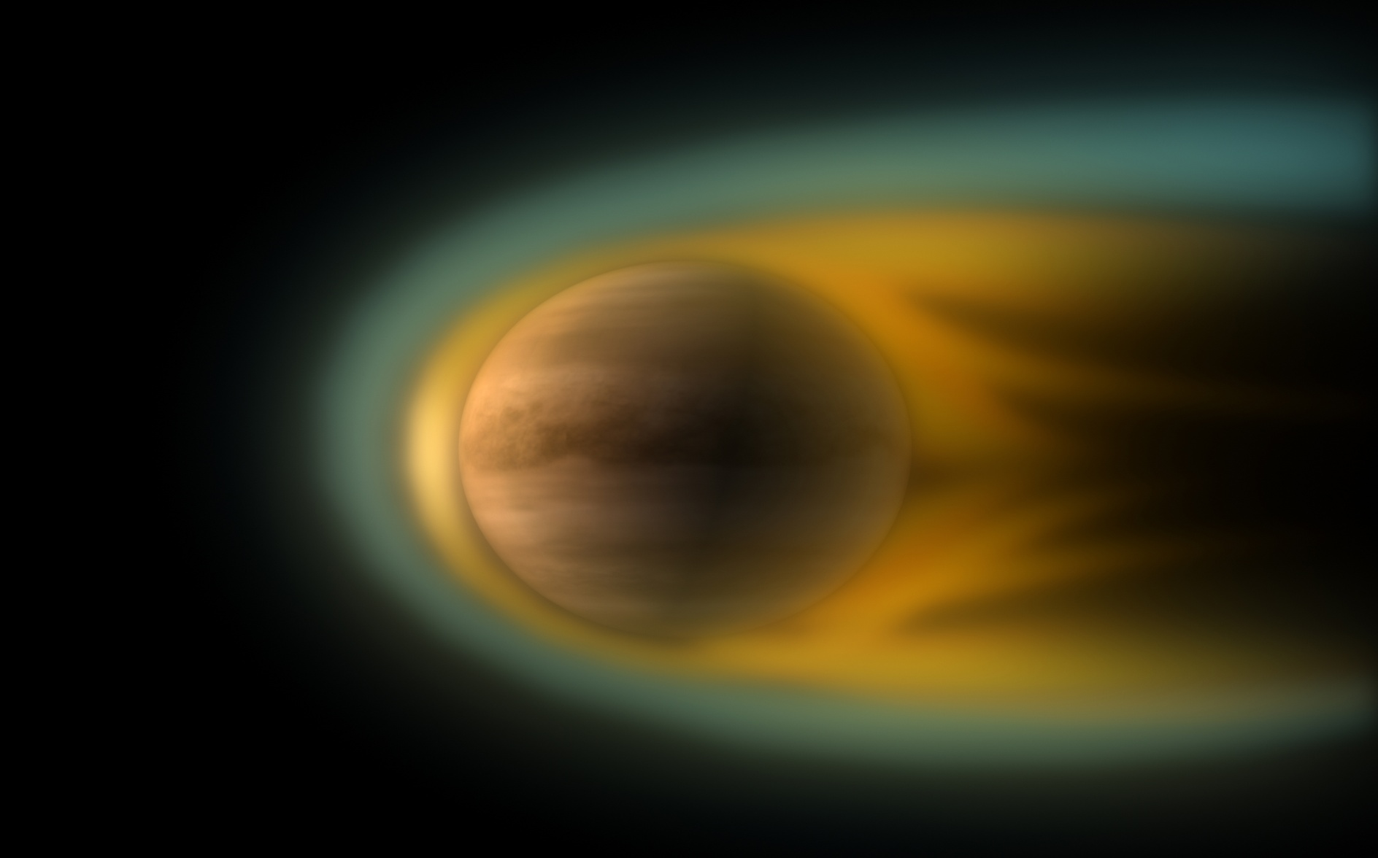
Image of Solar Wind from Venus Express

Slide 5
What is DS3?
DS3 is the third Deep Space antenna of the ESA deep space network
Communicates with
Venus Express
Mars Express

Slide 6

MARS!!!

Slide 7
What is DS3?
DS3 is the third Deep Space antenna of the ESA deep space network
Communicates with
Venus Express
Mars Express
Planck
Herschel
Rosetta
And so on…

Slide 8
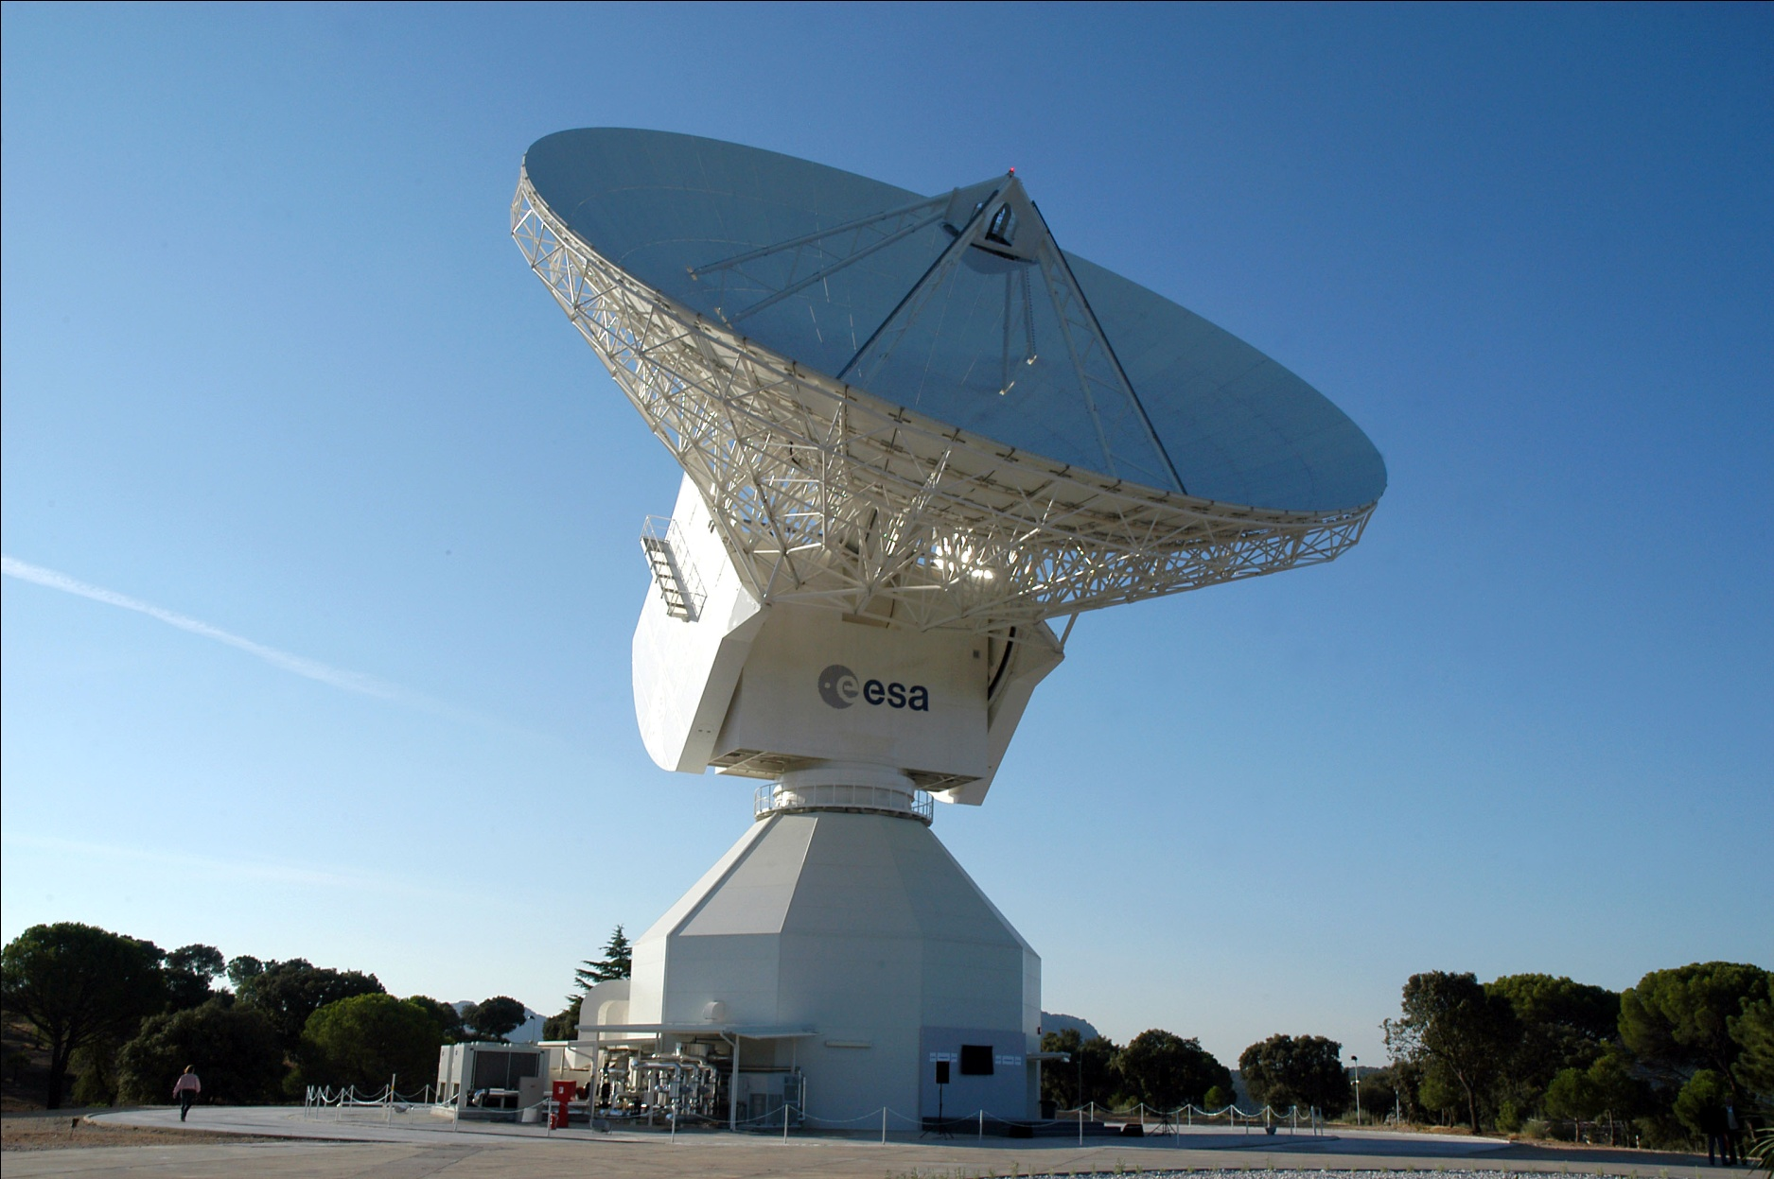
Deep Space Network

Slide 9
Pointing Calibration – Say What Now?
Three things needed to direct an antenna properly
How accurately you can point
Where the target is
Are you pointing where you think you are?
THIS is what the pointing calibration system is for!!

Slide 10
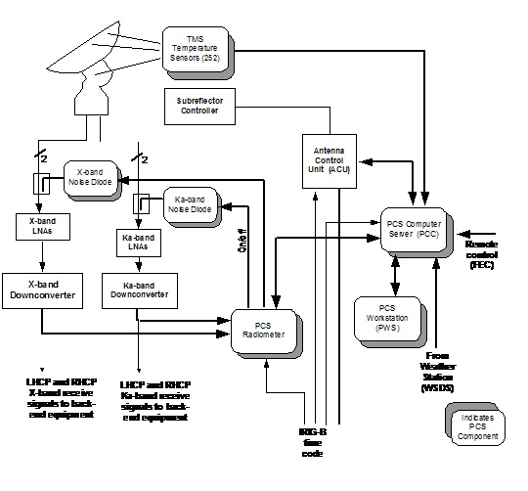
Pointing Calibration System

Slide 11
SPEM
Systemic Pointing Error Model
Due to imperfections in the antenna
Modelled in order to eliminate error

Slide 12
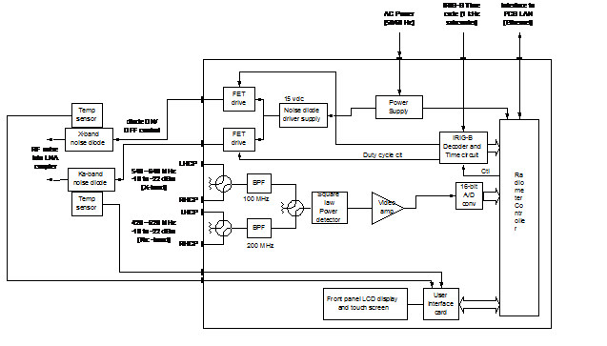
Radiometer
Specialized device used to calculate the noise temperature of the downlink

Slide 13
Calibration System
Done to calibrate the system, typically takes more than eight hours

Slide 14
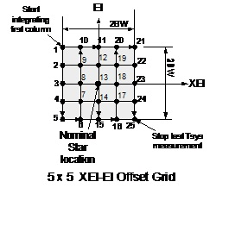
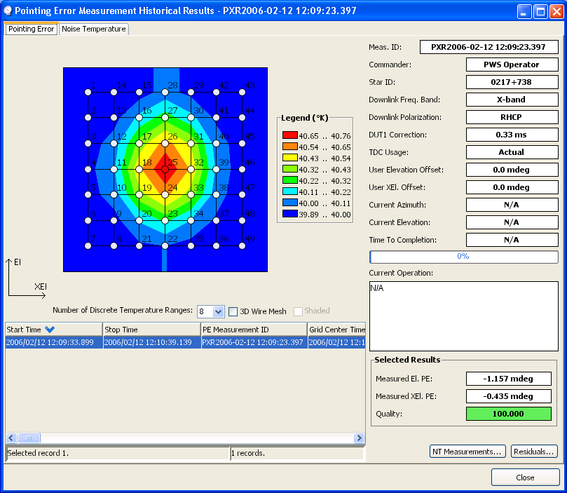
Measurement Grid
Results

Slide 15
Conclusion
Pointing Calibrations System ensures that an antenna is pointed where the operator wants it
Calibrated periodically to correct for SPEM
Constantly updated to correct for temperature changes in the dish, weather conditions, etc.
Result is a highly accurate antenna

Slide 16
References
Osterried, R., Droll, P., & Plemel, R. (2004). ESA Deep Space Antenna (DSA 2) Pointing Calibration System. Saskatoon, SK: SED Systems, Inc.
European Space Agency. (2010). European Space Agency . Retrieved October 20, 2010, from http://www.esa.int/esaCP/index.html

Slide 17
QUESTIONS?
?
?
?

