Slide 1

A friendly introduction
Presented to you by:
Nahim Nasser
Shah Warraich

Slide 2
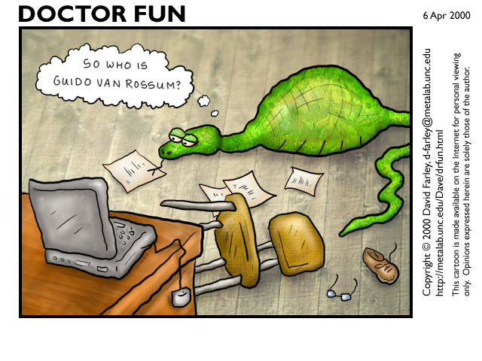
Conceived in the late 1980’s, implementation began in 1989
Brief Timeline of Python

Slide 3
Core features
An agile, interpreted high-level programming language
Based on the following programming paradigms:
Object-oriented
Imperative
Functional
Design philosophy emphasizes code readability.

Slide 4
Why Python? Because its Agile.
Excellent for beginners, yet superb for experts
Highly scalable, suitable for large projects as well as small ones
Rapid development
Portable, cross-platform
Embeddable

Slide 5
Easily extensible
Object-oriented
stable and mature
powerful standard libs
wealth of 3rd party packages

Slide 6
Why not to use Python?
Performance issues.
Not the best for memory intensive tasks.
Interpreted language & is slow compared to C/C++ or java.
Not good for high-graphic, 3d game programming that takes up a lot of CPU.
Its constantly evolving, with constant evolution there is little substantial documentation available for the language compared to PHP or Java.

Slide 7
Data Structures
Strings
a = “hello world”
b = ‘hello world’
c = ‘ ”hello world” ‘
d = “ %.4f”%5.3094538
e = “%s , %s” % (‘hello’, ‘world’)
“hello “ + “world”
a[:5] → “hello”
a[6:] → “world”

Slide 8
Integers
a = 123
b = int(“234”)
c = int(343.53)
Floats
a = 232.42
b= float(232)

Slide 9
Lists
L = [ item1 , item2 , item3, item4]
Lc = L1 + L2
L[1] → item2
L[:2] → [item1 , item2]
L[10:15] → []
L[-1] = item3
Functions:
append(x)
extend(L)
insert(i, x)
remove(x)
pop([i])
index(x)
count(x)
sort()
reverse()

Slide 10
Dictionaries
a = {‘a’:item1, ‘b’:item2,’c’:item3}
a[‘a’] → item1
a.keys() → [‘a’, ‘b’, ‘c’]
a.values() → [item1, item2, item3]
‘a’ in a – Indexed search.
Sets
a = set([1,1,1,3,4])
a → set([1,3,4])
Union, intersection

Slide 11
A comparative study
Python vs Non-scripting languages (Java, C#, C++)
Python will generally run slower
Much quicker to build
Python can be a ‘glue’ language. Develop components in java; combine them using python.
Can build binaries.

Slide 12
Python vs PHP
A world of commonalities
PHP has
Curly braces
Built-in function library has a wide variety of naming conventions.
Weak type system
Dictionary keys are iterated in the same order
Interfaces
Embeddable in html

Slide 13
Python has:
Indentation
Modules
Rules for capturing typos; reading an undefined variable.
Orthogonal syntax
Almost all objects are references, explicitly use deep copy
Structured exception handling. In PHP5 but most standard functions still don’t use exceptions.

Slide 14
Web development frameworks
Web development built into the core framework for php
Python as add-on libraries and hence flexibility.
Too many choices can be bewildering, quick to get started with php.

Slide 15
Python vs Ruby
High level, garbage collected, dynamic typing
Ruby has greater depth in OO
Fewer lines of code
Lambda and blocks
Rails
Python has a much bigger community – a universe of modules.

Slide 16
Sources
http://www.python.org/
http://en.wikipedia.org/wiki/Python_(programming_language)
http://pythoncard.sourceforge.net/what_is_python.html
http://page.mi.fu-berlin.de/prechelt/Biblio/jccpprtTR.pdf
http://www.python.org/doc/essays/comparisons.html
http://wiki.python.org/moin/PythonVsPhp
http://c2.com/cgi/wiki?PythonVsRuby
http://www.udemy.com/blog/modern-language-wars/

