Slide 1

A friendly introduction
Presented to you by:
Nahim Nasser
Shahjahan Warraich

Slide 2
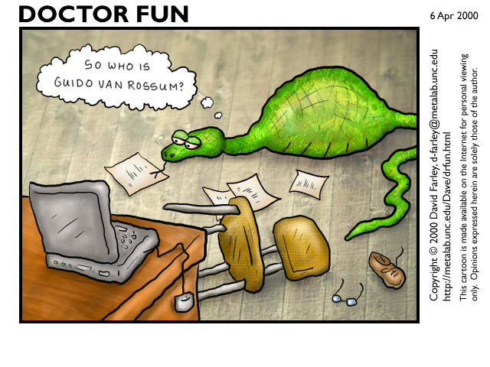
Conceived in the late 1980’s, implementation began in 1989
Brief Timeline of Python

Slide 3
Core features
An agile, interpreted high-level programming language
Based on the following programming paradigms:
Object-oriented
Imperative
Functional
Design philosophy emphasizes code readability.

Slide 4
Why Python? Because its Agile.
Excellent for beginners, yet superb for experts
Highly scalable, suitable for large projects as well as small ones
Rapid development
Portable, cross-platform
Embeddable

Slide 5
Easily extensible
Object-oriented
stable and mature
powerful standard libs
wealth of 3rd party packages

Slide 6
Why not to use Python?
Performance issues.
Not the best for memory intensive tasks.
Interpreted language & is slow compared to C/C++ or java.
Not good for high-graphic 3d game that takes up a lot of CPU.
Its constantly evolving, with constant evolution there is little substantial documentation available for the language compared to PHP or Java.

Slide 7
Data Structures
Strings
a = “hello world”
b = ‘hello world’
c = ‘ ”hello world” ‘
d = “ %.4f”%5.3094538
e = “%s , %s” % (‘hello’, ‘world’)
“hello “ + “world”
a[:5] → “hello”
a[6:] → “world”

Slide 8
Integers
a = 123
b = int(“234”)
c = int(343.53)
Floats
a = 232.42
b= float(232)

Slide 9
Lists
L = [ item1 , item2 , item3, item4]
Lc = L1 + L2
L[1] → item2
L[:2] → [item1 , item2]
L[10:15] → []
L[-1] = item3
Functions:
append(x)
extend(L)
insert(i, x)
remove(x)
pop([i])
index(x)
count(x)
sort()
reverse()

Slide 10
Dictionaries
a = {‘a’:item1, ‘b’:item2,’c’:item3}
a[‘a’] → item1
a.keys() → [‘a’, ‘b’, ‘c’]
a.values() → [item1, item2, item3]
‘a’ in a – Indexed search.
Sets
a = set([1,1,1,3,4])
a → set([1,3,4])
Union, intersection

