Slide 1
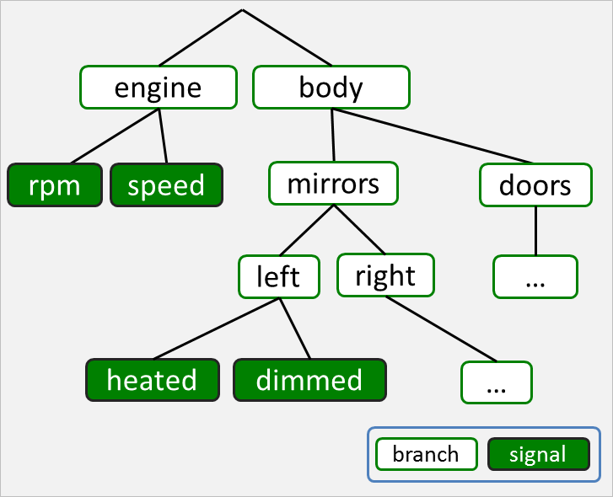
engine
body
rpm
speed
mirrors
doors
left
right
…
heated
dimmed
…
branch
signal

Slide 2
root.vspec
Markdown
generator
Markdown
Specification
engine.vspec
Pre-processor
FrancaIDL
generator
FrancaIDL
Specification
nav.vspec
JSON
generator
JSON
Specification
ivi.vspec

