Slide 1


INTERNATIONAL INSTITUTE OF PROFFESSIONAL STUDIES DAVV , INDORE
SAI’RA - A VIRTUAL ASSISTANT
PROJECT PRESENTATION
SESSION 2020-2021 (SEPT-FEB)
MCA 5TH YEAR (9TH SEM.)
UNDER GUIDANCE OF- SUBMITTED BY-
PROF. JUGENDRA DONGRE SIR ANUBHAV SINGH
IC-2K16-54
DATE-25-02-21

Slide 2
INTRODUCTION
SAI’RA means an Intelligent program that can
Speak
Ask
Recognize
Assist
A virtual assistant also called SAI’RA is an AI assistant or digital assistant is an application program that understands natural language voice commands and completes tasks for the user .

Slide 3
Why AI?
It enhances the speed, precision and effectiveness of human efforts.
In financial institutions, AI techniques can be used to identify which transactions are likely to be fraudulent, adopt fast and accurate credit scoring, as well as automate manually intense data management tasks.

Slide 4
Current System
In existing system, most of people use AI assistants proposed by
Google (Google assistant),
Amazon (Alexa),
Microsoft (Cortana) etc.
These assistances are Hi-tech yet you won’t be able to perform your system based tasks.

Slide 5
SOFTWARE REQUIREMENTS
Operating System : Windows 10 pro
Programming Language : Python
IDE/Workbench : PyCharm
Language distribution : Anaconda
Libraries : pyttsx3
SpeechRecognition
Ecapture
Wolframalpha etc.

Slide 6
HARDWARE REQUIREMENTS
Processor : Pentium i3
Hard Disk : 40 GB or more
RAM : 4 GB or more
System Type : 32 Bit OS
WIFI enabled system

Slide 7
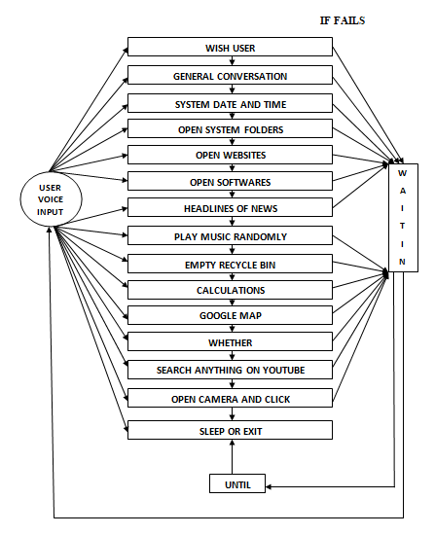
CONTROL FLOW OF SAIRA

Slide 8
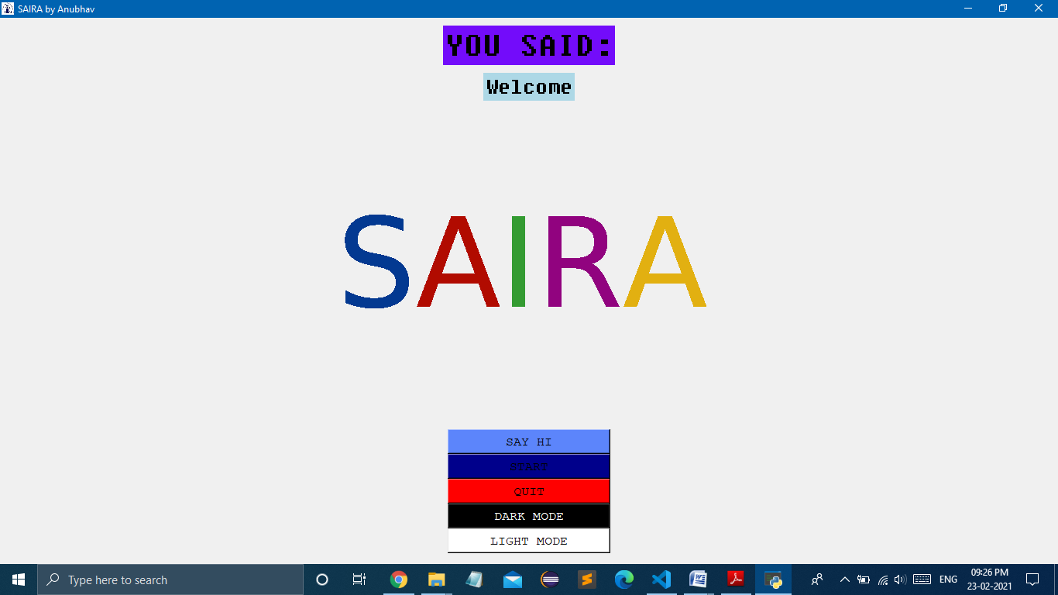
USER INTERFACE

Slide 9
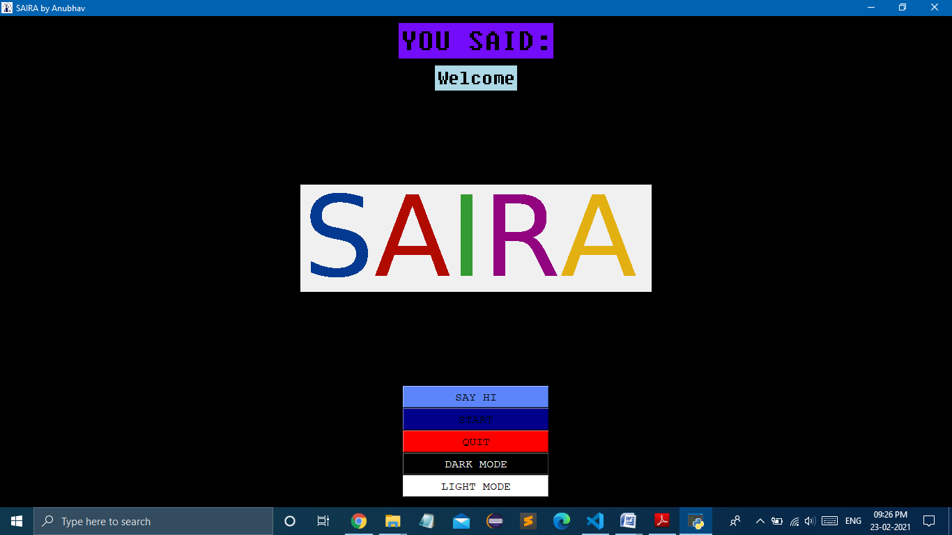
USER INTERFACE IN DARK MODE

Slide 10
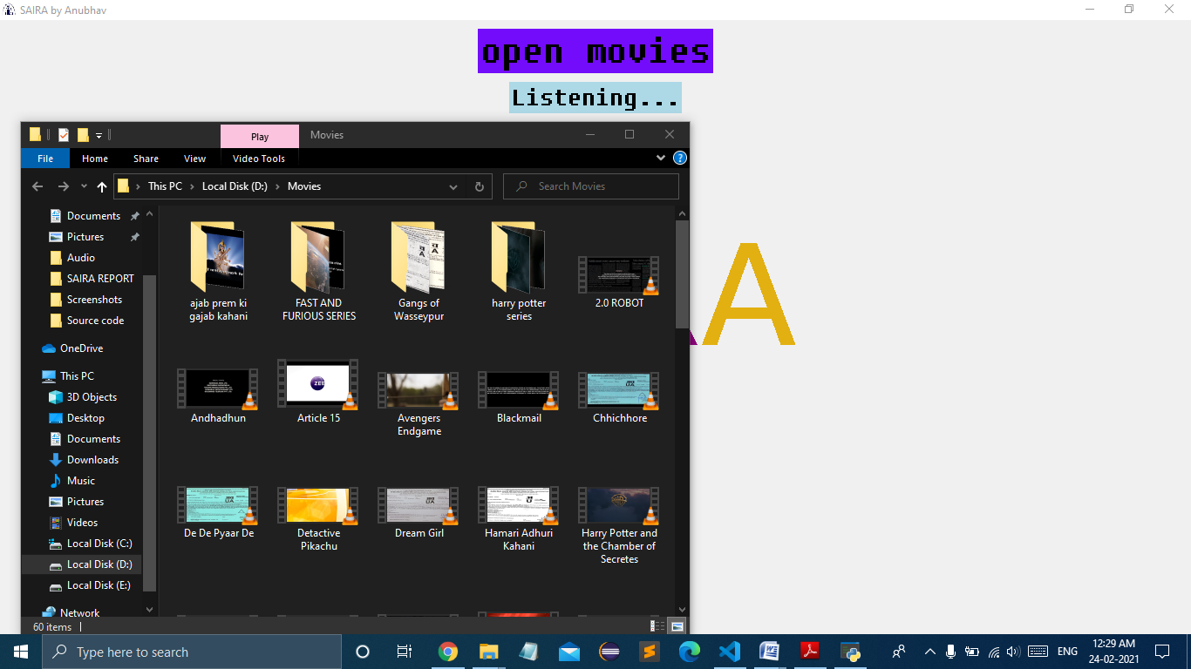
SEARCHING FOR MOVIES

Slide 11
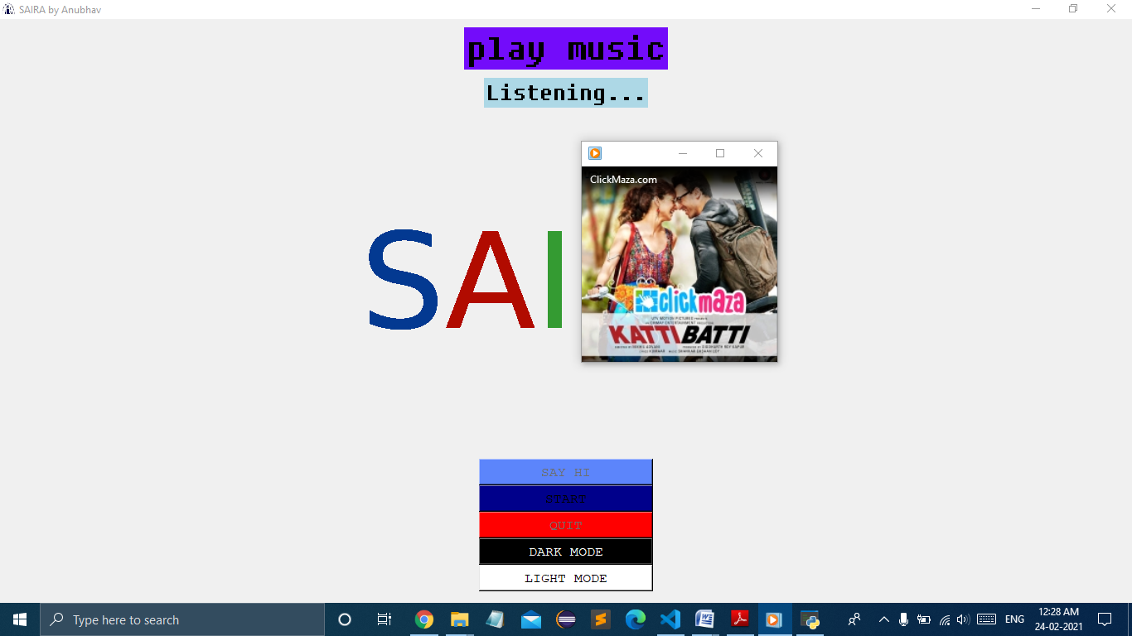
OPENING MUSIC

Slide 12
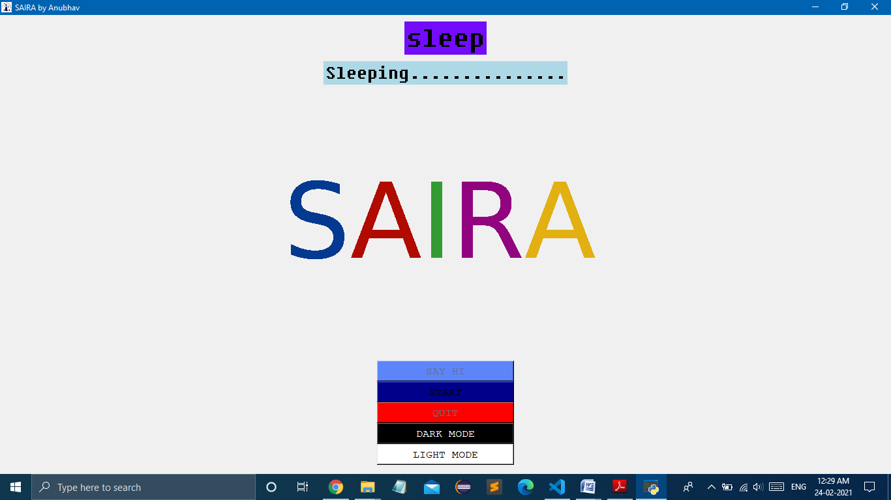
SLEEP OR EXIT

Slide 13
LIMITATIONS
Internet connectivity is must for better performance.
A good processor is needed. It can be choppy on older processors.
No authentication for user is available.
Can throw error if you change the path associated with a task.

Slide 14
FUTURE ENHANCEMENTS
Processing speed
En co-operate with LINUX based system
Try to cross platform this and make it a google chrome extension.
Take direct ideas of users and merge their ideas from open source.

Slide 15
CONCLUSION
Optimum utilization of resources.
Efficient management of records.
Simplification of the operations.
Less processing time and getting required information.
User friendly.
Portable and flexible for future enhancement.

Slide 16
BIBLIOGRAPHY
Automate the Boring Stuff with Python : By Al Sweigar
Python Courses : Google Python classes
The Python Standard Library : By Doug Hellmann
Online Resources : Geeks for Geeks
Python.org
Python community
Python libraries
youtube.com
google.com
towardsdatascience.com

Slide 17
THANKYOU
GITHUB ACCOUNT: https://github.com/anubhavv1998
PROJECT IS UPLOADED IN OPEN SOURCE:
https://github.com/anubhavv1998/SAIRA-Desktop-Assistant

