Slide 1
Dual Active Bridge Converter [DC/DC]
Arnav Pahuja
23085119
Under Supervision of Prof. S. K. Singh Sir

Slide 2
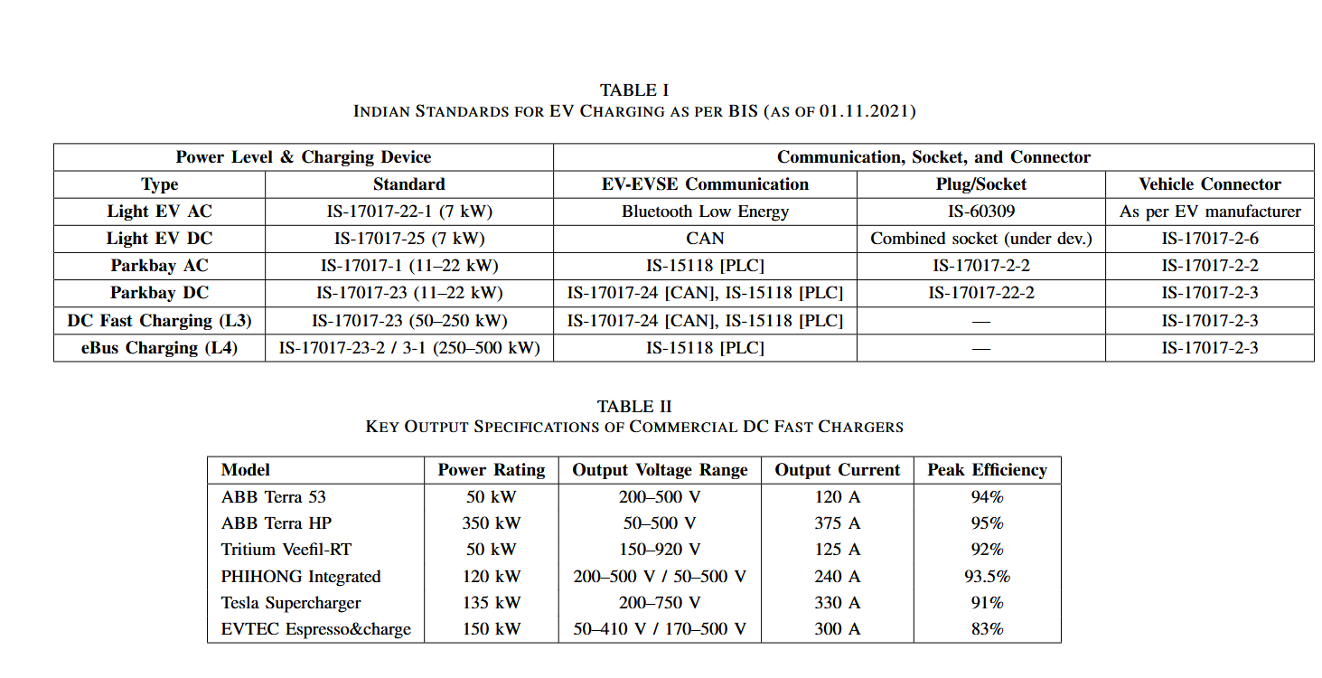
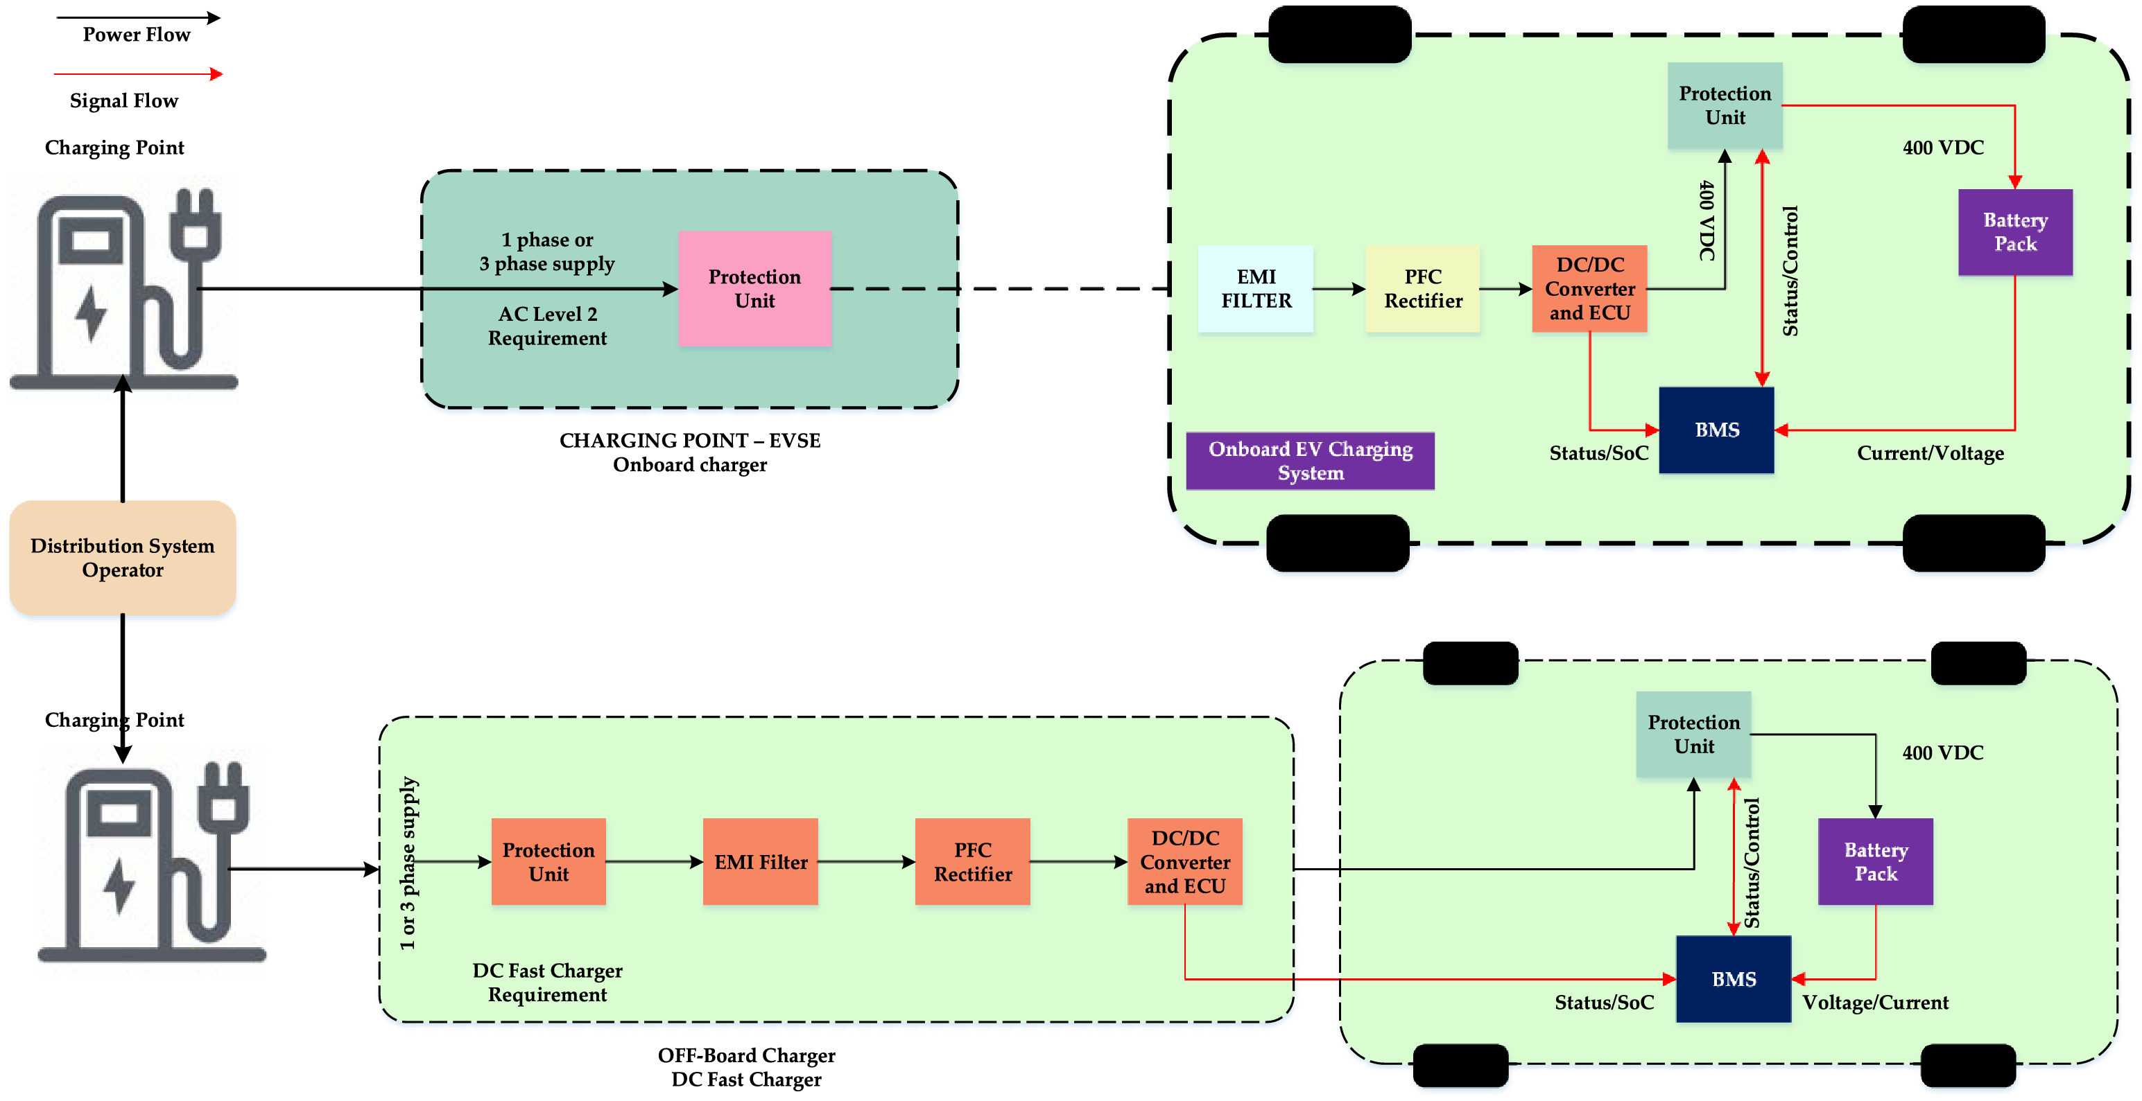
EV Charging Architecture
Levels of Charging Stations
On-Board vs Off-Board Charger

Slide 3
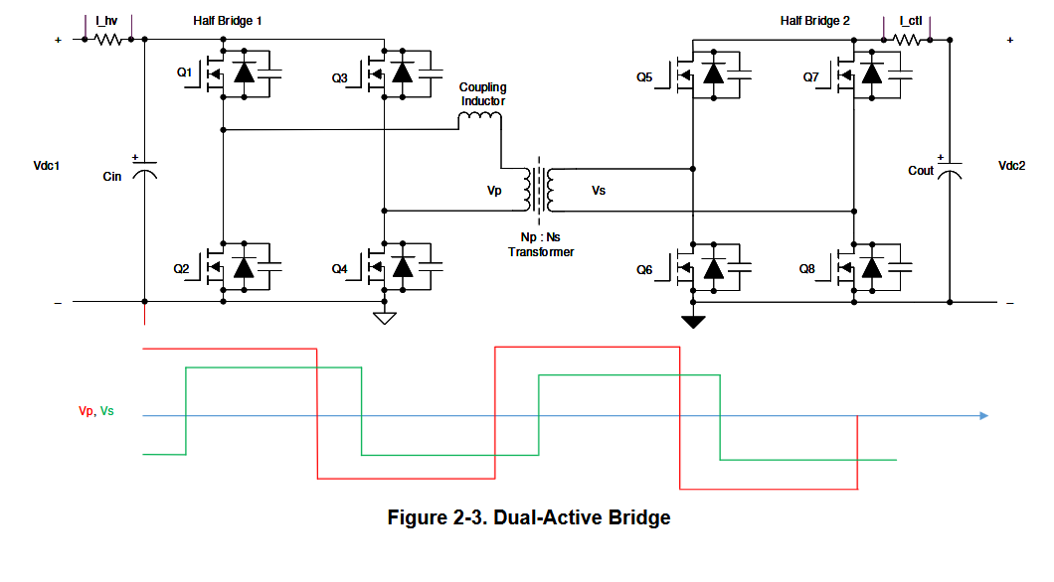
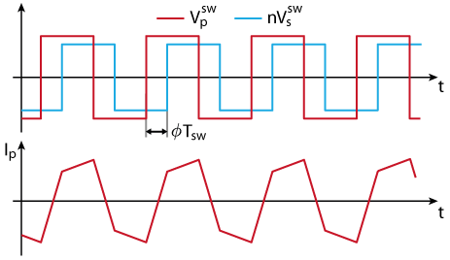
Dual Active Bridge Converter
Isolated operation
Power density (high frequency operation reduces the size of the isolation transformer)
Bidirectional power flow
Efficiency (Zero Voltage Switching)

Slide 4
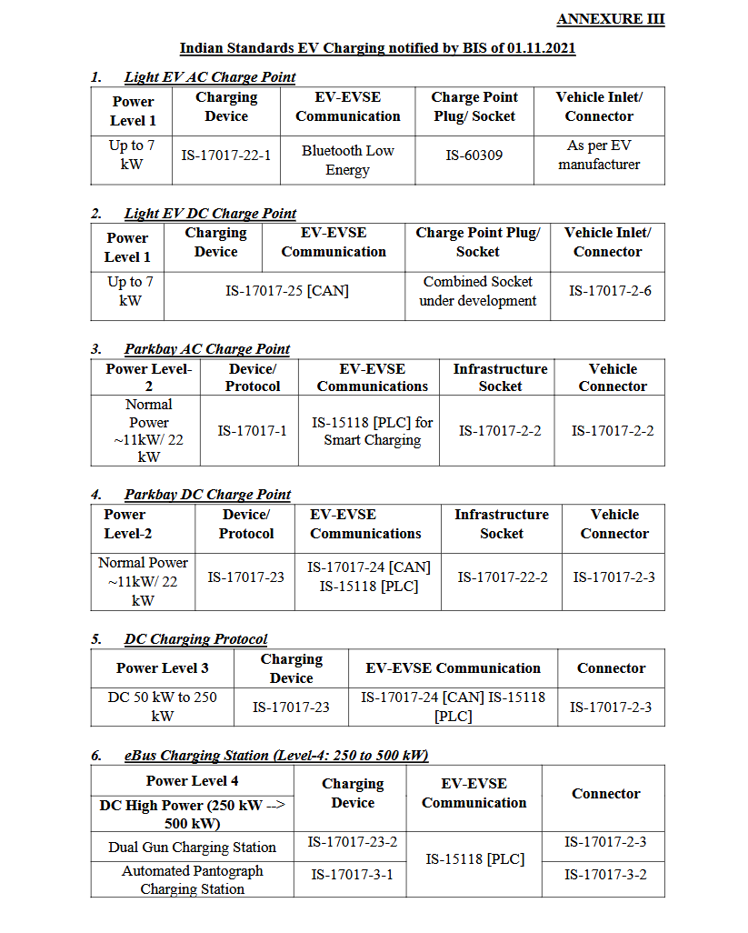
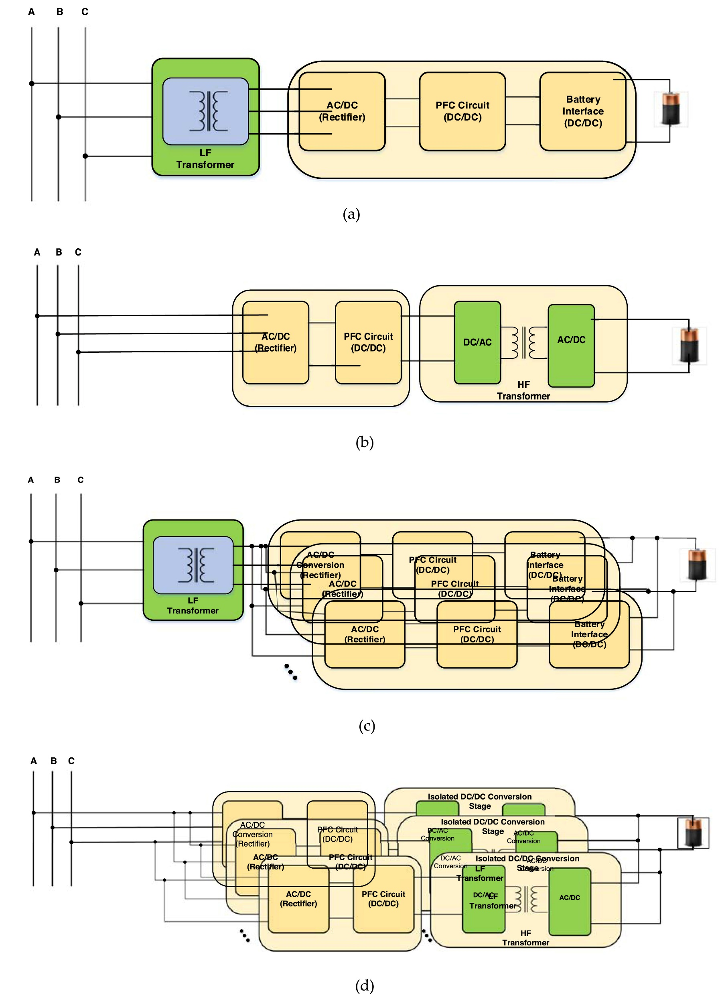
Level 3 DC Charger
BIS, Bureau of Indian Standards
Common High-Level DC chargers

Slide 5
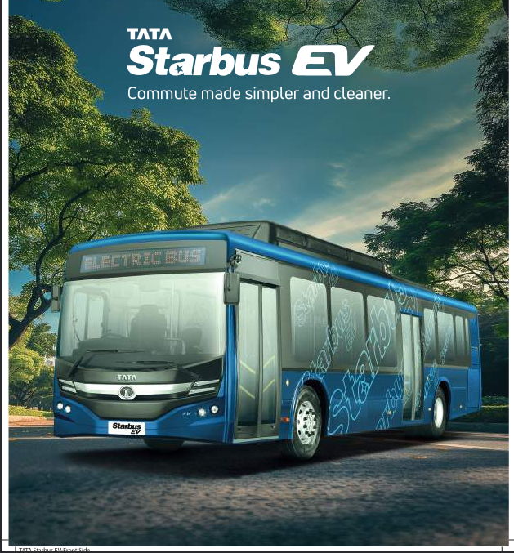
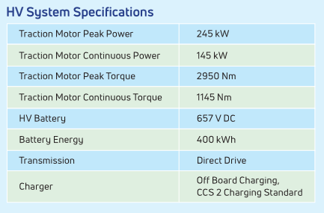
eBuses
Bi-Directional
Fast Charging

Slide 6
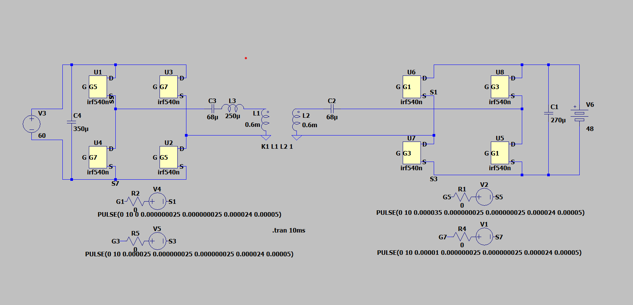
Simulation
Scaled-down => faster simulation

Slide 7
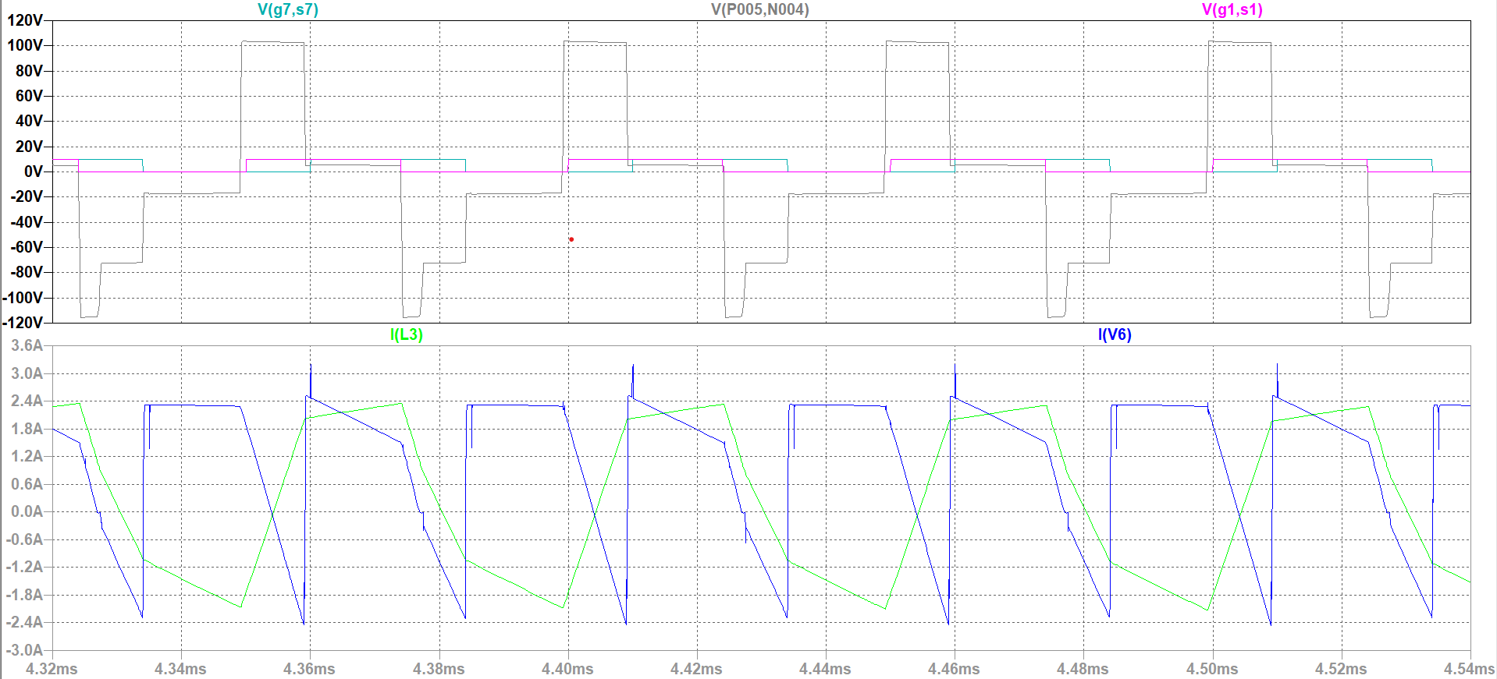
Results

Slide 8
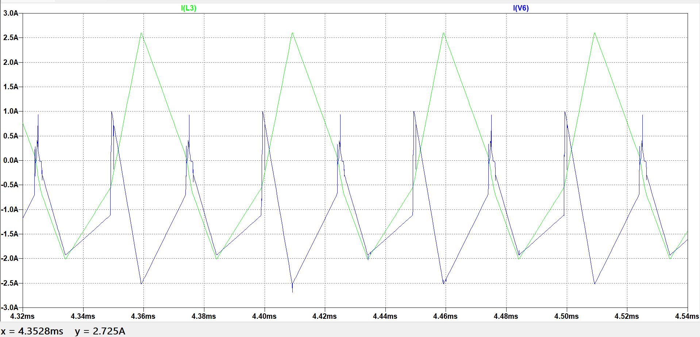
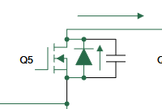
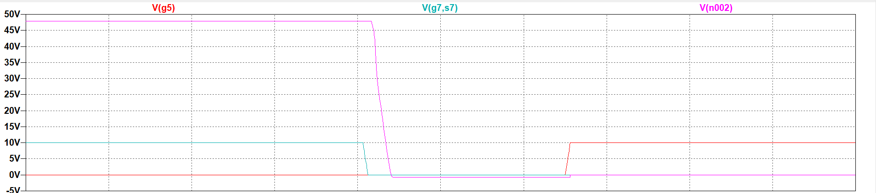
Results
Leading and Lagging Bridge Interchanged
Dead Time and Zero Volt Switching

Slide 9
Thank you
Problems faced . . .

