Slide 1
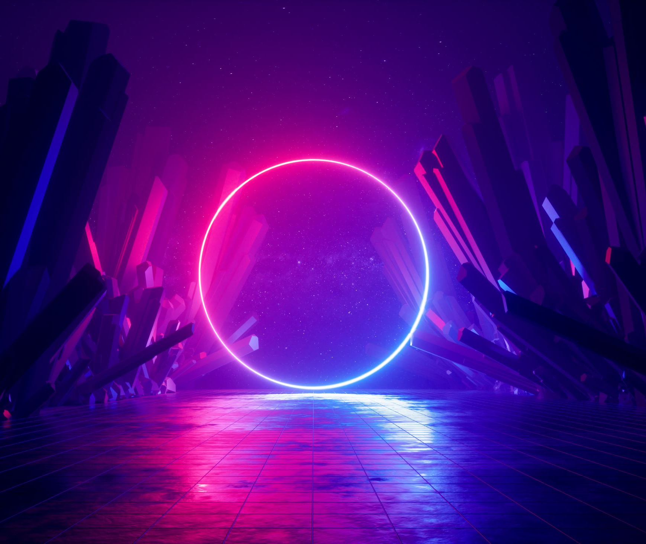
Let
= “Monedas”
esfera
= 1

Slide 2
= 29
Let Edad

