Slide 1

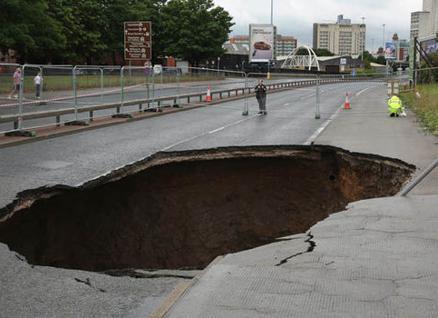
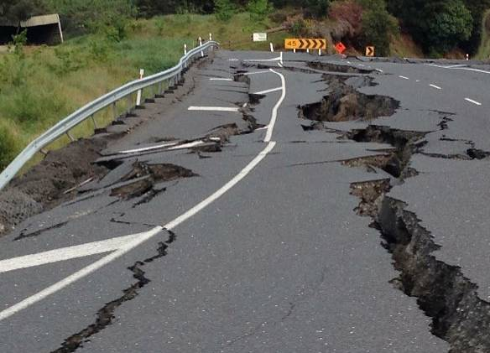
INDUSTRY :- Transportation Project :- ROAD TRASFORMER

Slide 2
Problem FROM bad roads
TYPES OF BAD ROADS
Potholes Due to wear and tear
Block due to tree fell down
Splits due to Earthquake
Ice patches due to rain and snow fall.
Accidents :- The Pacific Institute for Research and Evaluation examined information from the National Highway Traffic Safety Administration, Federal Motor Carrier Safety Administration and other government agencies and concluded that road problems like potholes and iced-over stretches of highway cause more than 42,000 deaths a year.
Vehicle Damage :- People have to spend more on the maintenance of vehicles which need frequent service after plying on bad roads.
Economy Loss :- Bad roads slows down the transportation network and have negative economy progress.
When and where :- No real time system available to monitor and detect/predict it.

Slide 3










APPROACH TO GET ROAD CONDITION REAL TIME
Natural calamities are not under our control.
Our solution is to get notified the road damages as real time as possible.
Getting the road images from CCTV camera or GPS.
Analyzing the road images using AWS Rekognition service.
Apply the Machine learning algorithm on the data to detect/predict damage on road.
Broadcast the message so that people traveling towards that area are cautious.
2
3
1
Amazon S3
Amazon EC2
Amazon Rekognition
4
b
5
Amazon RDS
a
6
c
Amazon Machine Learning
Amazon S3
Amazon
SES
Step 1 :- Images captured by CCTV or GPS are transferred and stored AWS S3 bucket or user can upload using UI.
Step 2 :- Server connects to S3 bucket to access the images.
Step 3 :- Using Rekognition service image is decoded into its labels.
Step 4 :- These labels are stored back into RDB MySQL.
Step 5a :- Email notification is send if the confidence of the road is lesser than the threshold.
Step 5b :- From UI data can be analyzed on the map.
Step 5c :- Data from RDS write back to the S3 in csv file.
Step 6 :- Amazon Machine learning service can be use for detail analysis.

Slide 4
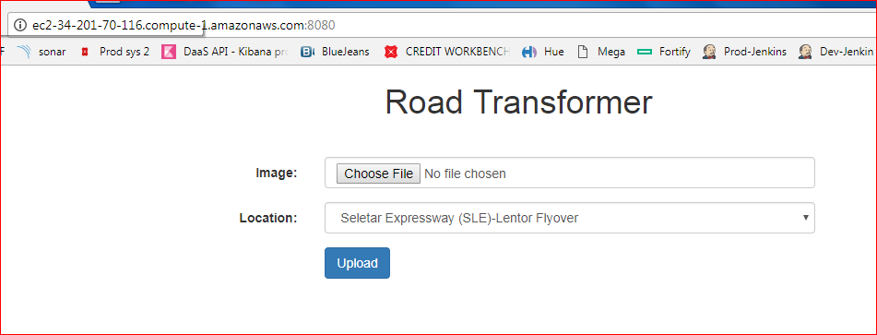
Demo:- Step 1
User to upload the road image from the UI.
Select the location from the drop down.

Slide 5
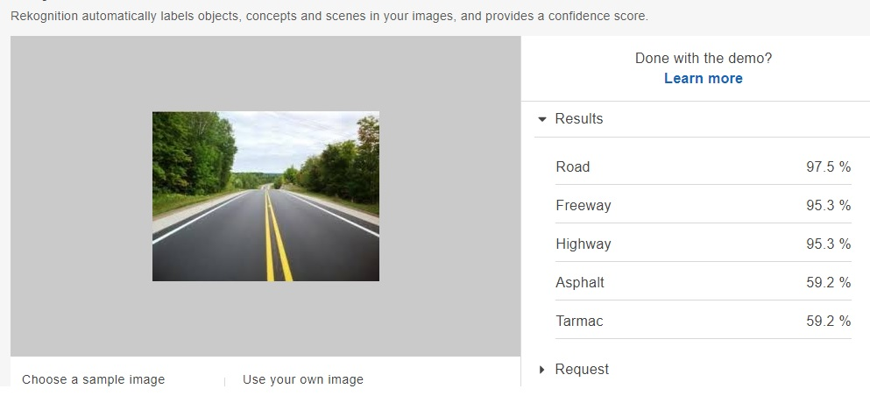
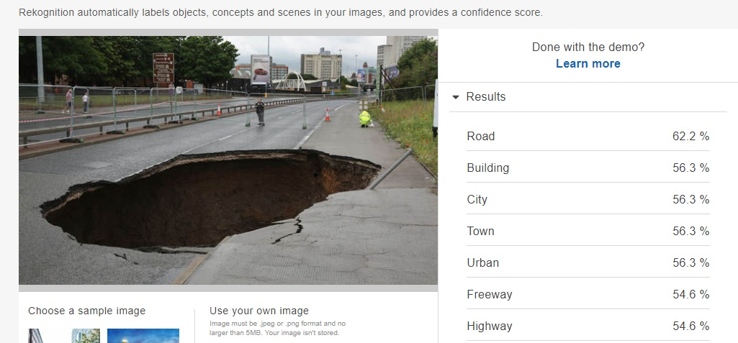
Demo :- Step 2 & 3
On AWS EC2 server , AWS Rekognision service is used to decode Step 1 images to get
confidence points on label name=road.
Road Confidence of the image
is 97.5%.
Road Confidence of the image is 62.2%

Slide 6
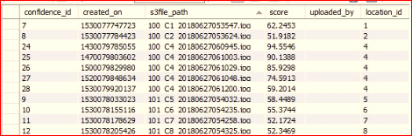
Demo:- Step 4
→ Table STREET_DETAIL will have static data will have details of the road , camera and latitude and longitude.
→ In this example we are taking SLE and KJE express.
LocationId | RoadId | CCTVId | Road_Name | Latitude | Longitude | Country
1 | 100 | C1 | Seletar Expressway (SLE)-Lentor Flyover | 1.3949603 | 103.8338768 | SINGAPORE
2 | 100 | C2 | Seletar Expressway (SLE)-Mandai Flyover | 1.4236993 | 103.7904469 | SINGAPORE
3 | 100 | C3 | Seletar Expressway (SLE)-Marsiling Flyover | 1.4264462 | 103.7826601 | SINGAPORE
4 | 100 | C4 | Seletar Expressway (SLE)-Upp Thomson Flyover | 1.3944496 | 103.8164205 | SINGAPORE
5 | 101 | C5 | Kranji Expressway (KJE)-Choa Chu Kang West Flyover | 1.3876229 | 103.7426103 | SINGAPORE
6 | 101 | C6 | Kranji Expressway (KJE)-Choa Chu Kang Dr | 1.3867514 | 103.7413845 | SINGAPORE
7 | 101 | C7 | Kranji Expressway (KJE)-Tengah Flyover | 1.3628371 | 103.7047132 | SINGAPORE
8 | 101 | C8 | Kranji Expressway (KJE)-Exit To BKE | 1.3691609 | 103.773865 | SINGAPORE
→ Table STREET_CONFIDENCE will be populated after each image is processed. This table will contain the road confidence of each image with the path location in S3.
→ In this example we are taking SLE and KJE express.

Slide 7
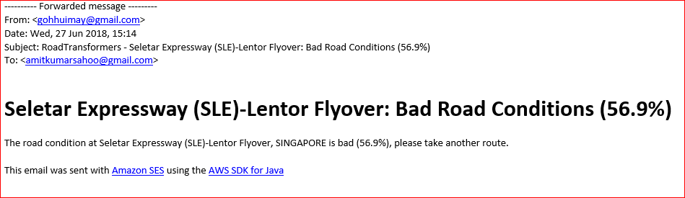
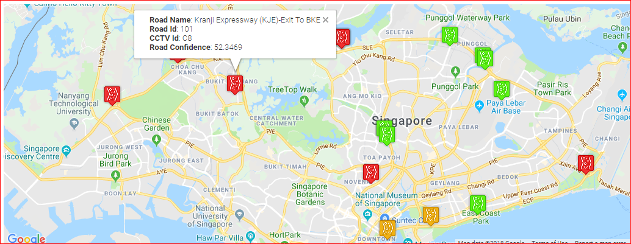
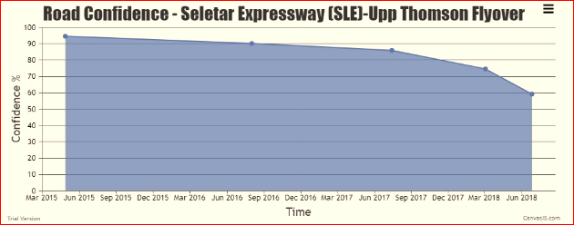
Demo :- Step 5
Image showing locations on the map.
red =< 70
orange between 76 to 85
green >85
b) Email notification once confidence is lesser than 70.
c) We can analyze lifespan of the road and predict when it to have 20% of wear and tear.

Slide 8
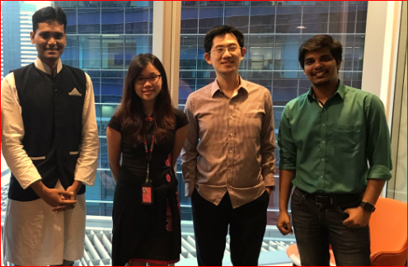
Road Transformer Team
Frans :- Team lead , Solution Architecture
Cloudera Spark Certified , java
Amit :- Business Analyst
AWS Developer Associate Certified
Oracle Certified Associate
Rohit :- Java developer , UI Developer
PCF Developer Certified
Hui May :- Python Developer, java Developer
Agile Coach

