Slide 1
Image Classification with ML
By: Vinay Venkatesh
Vinayven.com
GitHub.com/Simple2006
Linkedin.com/in/vinayven

Slide 2
About Me
Avid Programmer
AI/Robotics enthusiast
Computer Vision
Projects: ArmVision, Covid Tracker
Researcher at Aspiring Scholars Research Direct Program (ASDRP)

Slide 3
Existing Image Classification Solutions
Medical Image Analysis
Driverless Vehicles
Firearm Detection in Real-time Video
Reverse Image Search
Robotics

Slide 4
Making An Image Classification App
IDE's
Azure ML Notebooks
Google Colab
Jupyter Notebook
Libraries
PyTorch
Numpy
Matplotlib
Scikit-learn

Slide 5
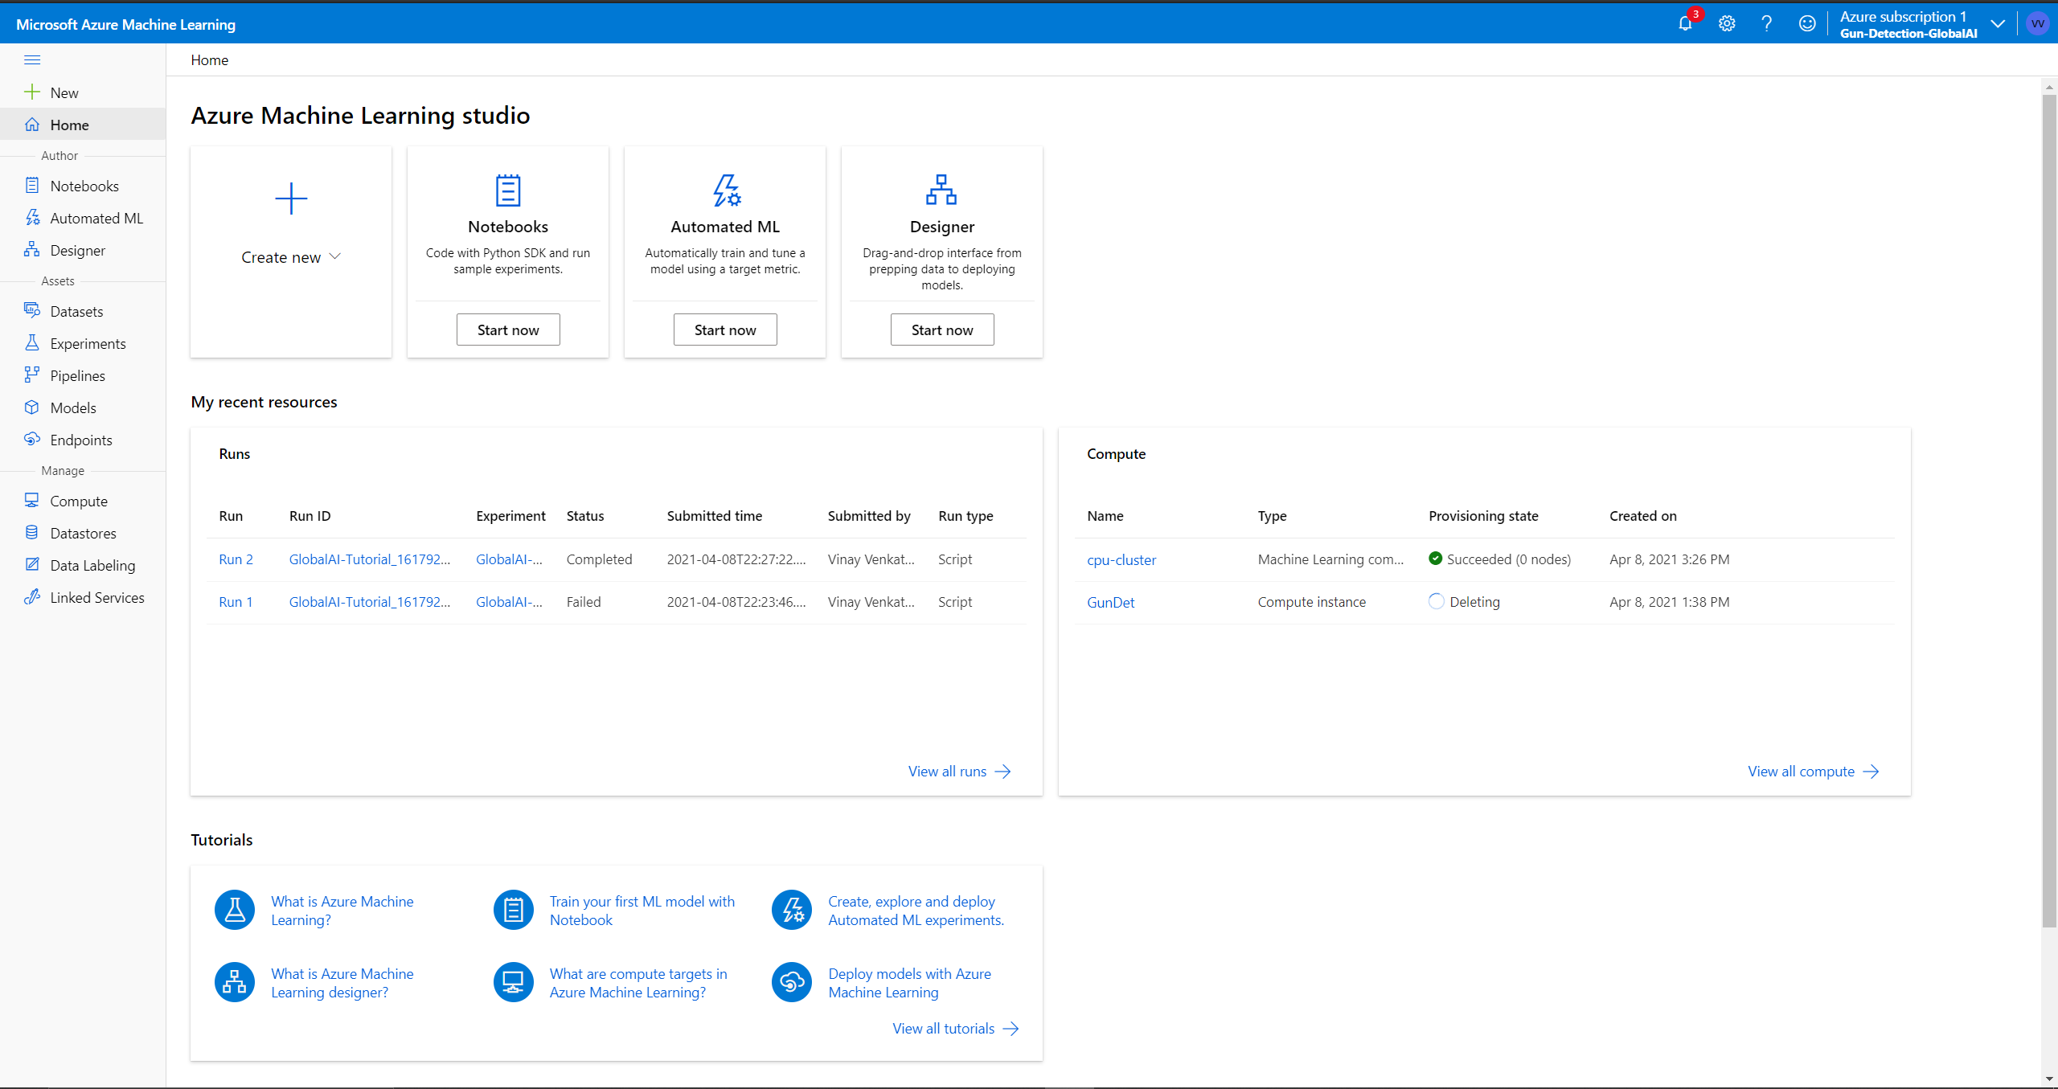
Microsoft Azure ML Platform
Azure M
Built in Jupyter Notebooks
Python
Matplotlib, numpy

Slide 6
Demo
Image Classification using Azure ML Platform.

Slide 7
Recap
What are some of the things we went over?
Why is Image Classification Important?
Examples of Existing Image Classification Solutions
How we can Make an Image Classification App
Image classification demo

Slide 8


Thank You!
vinayven.com
tinyurl.com/resources119
linkedin.com/in/vinayven

