Slide 1
Ruby!
Useful as a scripting language
script: A small program meant for one time use
Targeted towards small to medium size projects
Use by:
Amazon, Twitter, Yahoo!, White Pages, Reddit

Slide 2
Interpreted
C/C++
Compiled to assembly/Run directly on machine
Java
Compiled to bytecode/Interpreted by JVM
Ruby
Interpreted (no compilation)

Slide 3
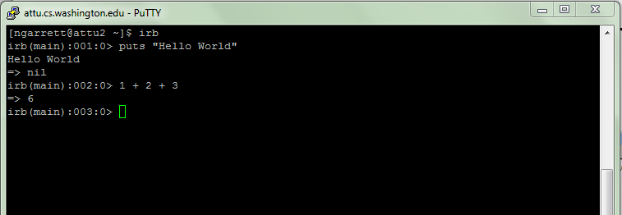
irb (Ruby interpreter)
Allows you to type commands one at a time and see results

Slide 4
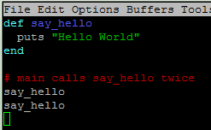
Our First Program
Ruby does not have a main method like Java
Just write your code directly in a file
Ruby statements do not end with semicolons
Method calls don’t need parenthesis

Slide 5

Expressions
Arithmetic is similar to Java
Operators similar to Java
+ - * / % (plus ** for exponentiation)
Precedence
() before ** before * / % before + -
Integers vs Real Numbers

Slide 6
Unlimited Precision
Java
There is a maximum value for integers
There is a maximum value for longs
Ruby
There is no maximum!
Fixnum
Bignum
Why the distinction?

Slide 7




Declaring Strings
“” allows escape sequences
‘’ does not allow escapes (excpet for \’)

Slide 8

Variables/Types
Don’t declare types
Ruby is looser about Types than Java
Type of variable can change throughout program

Slide 9

String Multiplication
Strings can be multiplied by integers
Concatenates string repeatedly

Slide 10
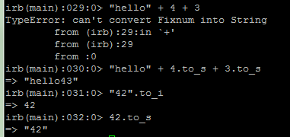
Strings and Ints
Integers and Strings cannot be concatenated in Ruby
to_s – converts to string
to_i – converts to integer

Slide 11


Loops
The for loop
Java
Ruby

Slide 12



Loops
The while loop
Java
Ruby

Slide 13

Constants
Ruby doesn’t really have constants
Instead declare a variable at the top of your code and it will be accessible everywhere
You will get a warning if you change a constant, but you can change it anyway (bad style)

Slide 14
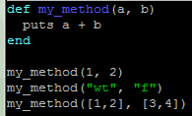
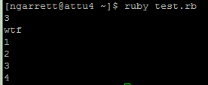
Parameters
Parameters are declared by writing their names (no types)
May seem odd that we can pass ints, strings, or arrays

Slide 15
Duck Typing
Actually, we can pass anything that has a + method
This is called Duck Typing
Why would we limit our method to only operating on objects of type Duck?
If it looks like a Duck and quacks like a Duck, then it’s a Duck
This allows us to write flexible, reusable code

Slide 16

Inspecting Objects
How do I know whether an object has a + method?
You can ask the object (with the “methods” method)
Everything is an object in Ruby (no primatives)

Slide 17
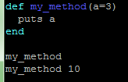

Default Parameter Values
You can give a default value to parameters
The caller doesn’t have to pass a value

Slide 18
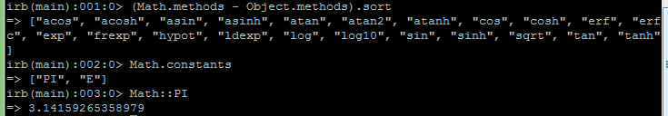
Math
The Math module has methods and constants that you can use
Has many of the same methods as Java

Slide 19
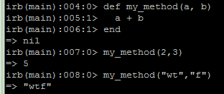

Returning Values
Methods in Ruby return the last value evaluated (only do this if you’re an expert)
You can also explicitly return values, and this is less error prone

Slide 20


Reading from the Console
Java
Ruby

Slide 21

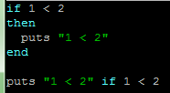
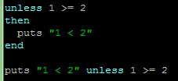
If Statements
Java
Ruby

Slide 22
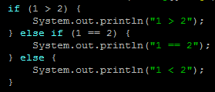
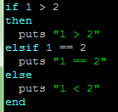
elsif
Java
Ruby

Slide 23

Logical Operators
== != >= <= < > (just like Java)
<=> (not in Java)
Remember, because of Duck Typing these are applicable to more than just numbers
What might <=> be useful for?
&& || ! (just like Java)

Slide 24

Arrays
Arrays
More flexible than Java, can mix types
Many useful methods
map, sort, delete, each, min, max, include?, select, shuffle, slice
Negative Indexing

Slide 25
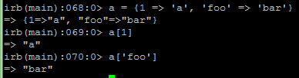
Hashes
In Java these are Maps
(you will learn about them in 143)
Ruby’s are more flexible; you can mix types
Kind of like Arrays, but instead of indexing by numbers, you index by whatever you want

Slide 26
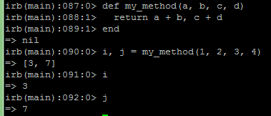
Multiple Assignment
Can assign to and return multiple items at a time (uses arrays under the covers)

Slide 27
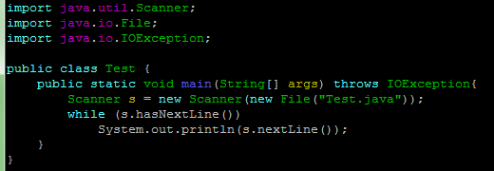

Reading Files
Java
Ruby

Slide 28
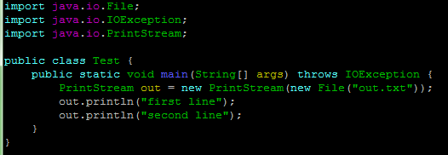
Writing Files
Java
Ruby

