Slide 1
Claude DB Connect
One assistant, four local databases
Claude Desktop wired to PostgreSQL, MySQL, MS SQL Server and SQLite over the Model Context Protocol — asking questions in plain English and getting answers from real SQL run against live local databases.
What it is · how it works · a full MS SQL Server walkthrough · what broke along the way
Claude DB Connect
1

Slide 2
THE PROJECT
What this is, and what you can do with it
A working integration, plus the debugging trail that made it work
Claude Desktop can normally only talk about your data. This project gives it a live connection to four different local databases, so it reads the actual schema, writes real SQL, runs it, and answers from the rows that come back — with the tool call visible every time.
Ask in plain English
Four databases, side by side
It generates working code
“What columns does the employees table have?” becomes a real schema query. No SQL written by hand, no connection string pasted into a chat.
PostgreSQL, MySQL, MS SQL Server and SQLite all connected at once — so a prompt can name which engine it should hit.
Ask for a Python script that charts the data and it pulls the live rows first, then writes code against the real schema.
Worth saying plainly: not one of the four worked by following the official guide as written. The integration is the deliverable; the debugging trail is the interesting part, and it is documented per database in the repo.
The project
2

Slide 3
HOW IT WORKS
The architecture, end to end
Every one of the four integrations is the same three-hop path
Claude Desktop
MCP server
Your database
the MCP client
translates tool calls to SQL
running locally
stdio
SQL
The middle hop is the whole story. Claude Desktop launches each MCP server as a local child process and talks to it over stdio — plain stdin/stdout, no network port, no HTTP. The server exposes database operations as callable tools, so Claude can list tables, read a schema, and run a query as discrete tool calls.
This single constraint is what invalidated the setup the original guide recommended: the image it named runs an HTTP server, which Claude Desktop's local MCP integration cannot speak to at all.
Nothing is hosted: the databases, the MCP servers and the client all run on one machine. No cloud database, no exposed port, no shared credentials.
How it works
3

Slide 4
HOW IT WORKS
The four integrations at a glance
Same architecture every time — what changes is how the server is packaged and where the data lives
Database | MCP server | Launched via | Where the data lives
PostgreSQL | postgres-mcp | uvx, with mcp<2.0.0 pinned | Docker container, port 5433
MySQL | mysql-mcp-server | uvx --from | Docker container, port 3306
MS SQL Server | sql-mcp-server | pip install + ODBC Driver 17 | Docker container, port 1433
SQLite | mcp-server-sqlite | uvx | A local .db file — no server
Full step-by-step for each: docs/setup/postgres.md · mysql.md · mssql.md · sqlite.md — every command, config block and gotcha, per database. This deck walks through MS SQL Server in full and points to the rest.
How it works
4

Slide 5
HOW IT WORKS
Why four, and what actually differs
One integration shows the pattern; four expose where the real friction is
Same transport, different packaging
Three of the four launch through uvx, which fetches and runs the Python server on demand. MS SQL Server needs a real pip install instead, because its server expects a system-level database driver to already be present.
One needs a host-level dependency
ODBC Driver 17 for SQL Server has to be installed on the machine itself, with admin elevation. Without it pyodbc cannot open a connection, and the MCP server fails at startup rather than at query time.
One has no server at all
SQLite is just a file on disk. No container to start, no port to bind, no password — the config simply points at a .db path, which makes it the shortest setup of the four by far.
The same upstream break hit two of them
postgres-mcp and sql-mcp-server both crashed on a breaking mcp 2.0.0 release. Same root cause, two different fixes: pin at invocation for uvx, pin at install for pip.
How it works
5
The takeaway: “connect an AI assistant to a database” is one sentence and four genuinely different problems.

Slide 6
THE WALKTHROUGH
Setting up MS SQL Server
Taking one of the four end to end — a host-level ODBC driver, a pip install instead of uvx, and a dependency pin to get past an upstream breaking change. Four steps, then what it can do.
The other three follow the same four-step shape — their full guides live in docs/setup/ in the repo.
MS SQL Server
6

Slide 7
STEP 1 OF 4 · MS SQL SERVER
Start the server, install the driver
Two things have to be in place before any MCP server can connect
The container is standard. The part that is easy to miss is the second command: ODBC Driver 17 is a host-level install, not a Python package, and it needs admin elevation. Without it the MCP server starts and then fails to connect, with an error that points at the driver rather than your password.
terminal
# 1 · start SQL Server 2022 in Docker
docker run -d --name local-mssql \
-e "ACCEPT_EULA=Y" \
-e "MSSQL_SA_PASSWORD=<YOUR_PASSWORD>" \
-p 1433:1433 \
mcr.microsoft.com/mssql/server:2022-latest
host dependency
# 2 · install ODBC Driver 17 for SQL Server on the host (needs admin / UAC)
learn.microsoft.com/en-us/sql/connect/odbc/download-odbc-driver-for-sql-server
Give it ~30 seconds: SQL Server finishes initialising well after the container reports as running. Connecting too early looks exactly like a wrong password.
The walkthrough · MS SQL Server
7

Slide 8
STEP 2 OF 4 · MS SQL SERVER
Seed a schema worth querying
A deliberately different dataset from the other three databases
MS SQL Server gets a books table rather than the employees table used elsewhere. That is intentional: with all four connections live at once, distinct schemas make it immediately obvious which database actually answered a prompt.
schema
-- sql/mssql/books_schema.sql
CREATE TABLE books (
id INT IDENTITY(1,1) PRIMARY KEY,
title VARCHAR(200) NOT NULL,
author VARCHAR(100) NOT NULL,
genre VARCHAR(50),
price DECIMAL(6,2)
);
Seeded with five rows — The Silent Orbit, Whispers of Kanto, Beneath the Ash, Letters to Aria, The Last Cartographer — spanning five genres and a $11.99–$18.00 price range, so aggregation and ranking queries both return something meaningful.
Small on purpose: five rows exercise the whole path end to end. What matters is that the query is real, not that the dataset is large.
The walkthrough · MS SQL Server
8

Slide 9
STEP 3 OF 4 · MS SQL SERVER
Install the MCP server, and pin the SDK
The one step where the obvious command leaves you with a broken server
Install it with pip, not uvx — the server needs to live in a real environment alongside the ODBC driver. Then immediately pin the SDK. The upstream mcp package shipped a breaking 2.0.0 that renamed FastMCP and moved the module entirely, but sql-mcp-server declares no upper bound — so a clean install silently pulls the version that cannot run it.
terminal
pip install sql-mcp-server
pip install "mcp<2.0.0" --force-reinstall
# second line is not optional — without it the server crashes on startup
What you see if you skip the pin
ModuleNotFoundError: No module named 'mcp.server.fastmcp'
Same bug, second time: PostgreSQL hit this identical breaking change. There it is pinned at invocation time inside the uvx command; here it has to be pinned at install time. Recognising it as one upstream problem rather than two saved a second round of debugging.
The walkthrough · MS SQL Server
9

Slide 10
STEP 4 OF 4 · MS SQL SERVER
Register it with Claude Desktop
The config block, and the two things that quietly go wrong here
claude_desktop_config.json
Two traps in this step
{
"mcpServers": {
"sql-assistant": {
"command": "sql-mcp-server",
"args": [],
"env": {
"DB_SERVER": "localhost",
"DB_NAME": "testdb",
"DB_DRIVER": "ODBC Driver 17 for SQL Server",
"DB_USER": "sa",
"DB_PASSWORD": "<YOUR_PASSWORD>"
} } } }
Find the config the right way
Use Settings → Developer → Edit Config. On Windows, packaged installs of Claude Desktop do not use %APPDATA%\Claude — the real file sits under AppData\Local\Packages\<id>\LocalCache\Roaming\Claude\. Editing the wrong copy looks like the config being ignored.
Quit properly, not just close
Closing the window leaves it running in the tray, and MCP servers are only launched on a cold start. Quit from the system tray, reopen, then confirm sql-assistant reads running under Settings → Developer.
Add, don't replace: all four servers coexist under the same mcpServers key — keep the existing entries and append this one.
The walkthrough · MS SQL Server
10

Slide 11
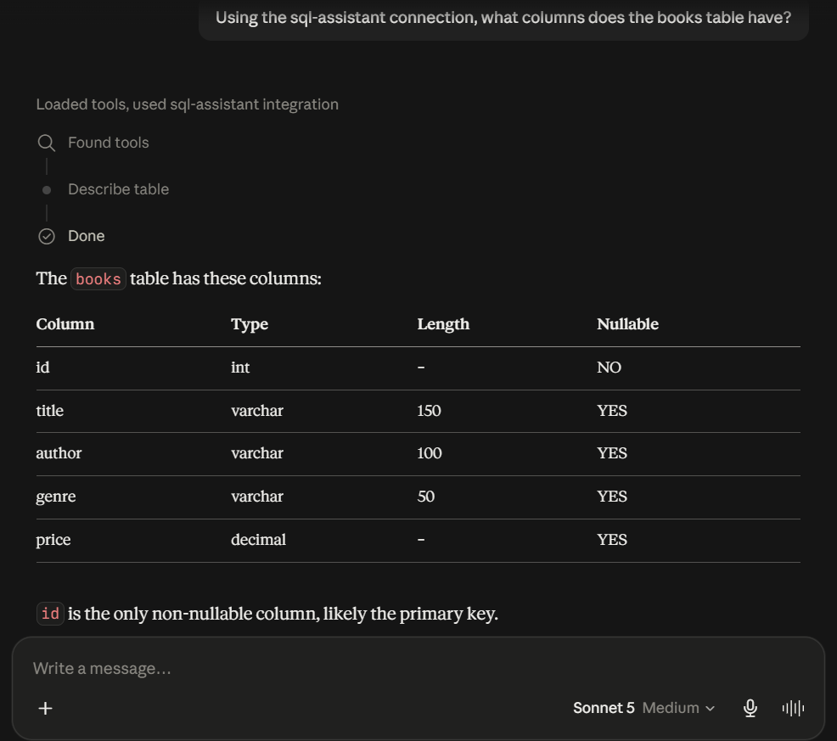
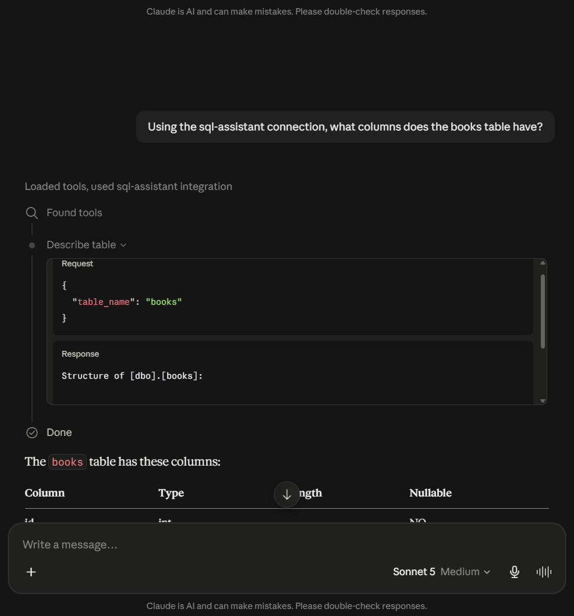
MS SQL SERVER · SCHEMA DISCOVERY
ASKED IN CLAUDE DESKTOP
Reading the schema
“What columns does the books table have?”
No schema is supplied in the prompt — the column names, types and identity key all come back from a live metadata query.
MS SQL Server
11

Slide 12
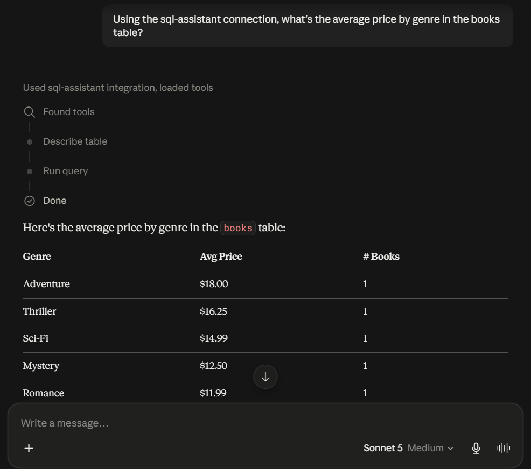
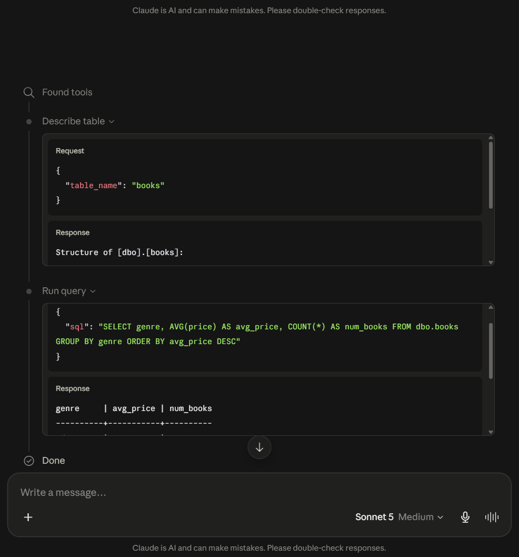
MS SQL SERVER · AGGREGATION
ASKED IN CLAUDE DESKTOP
Aggregating across the table
“What's the average price by genre in the books table?”
Picks the grouping and the measure itself, composes the GROUP BY, and returns per-genre averages computed from the actual rows.
MS SQL Server
12

Slide 13
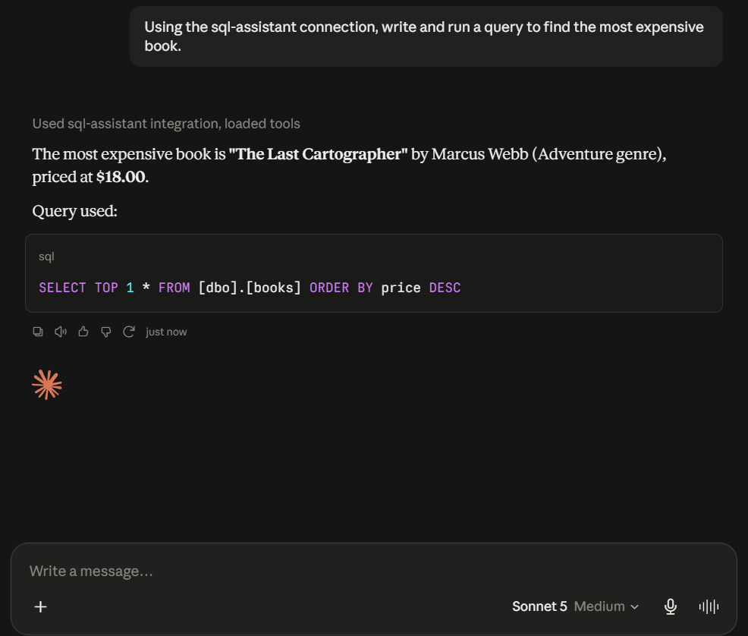
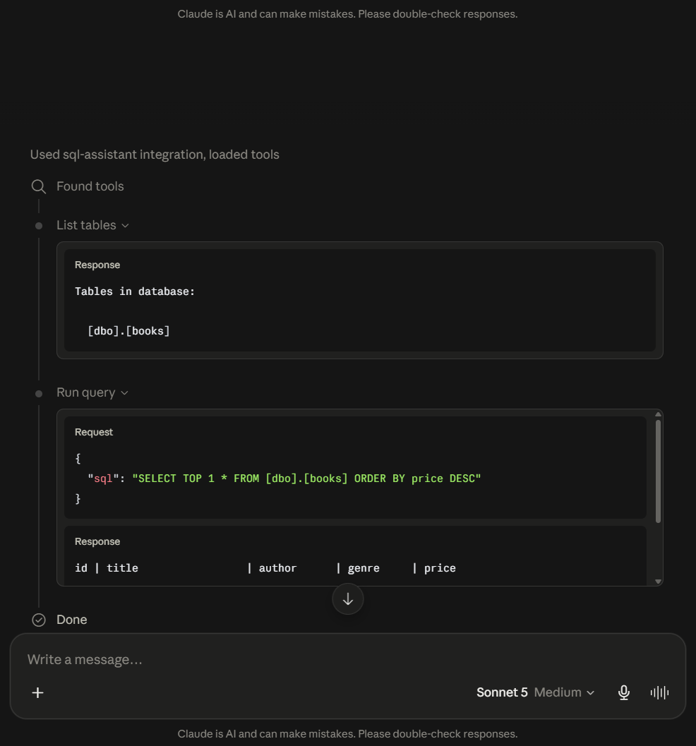
MS SQL SERVER · QUERY GENERATION
ASKED IN CLAUDE DESKTOP
Writing dialect-specific T-SQL
“Write and run a query to find the most expensive book.”
Uses TOP rather than the LIMIT syntax the other three engines expect — the same prompt produces different, correct SQL per database.
MS SQL Server
13

Slide 14
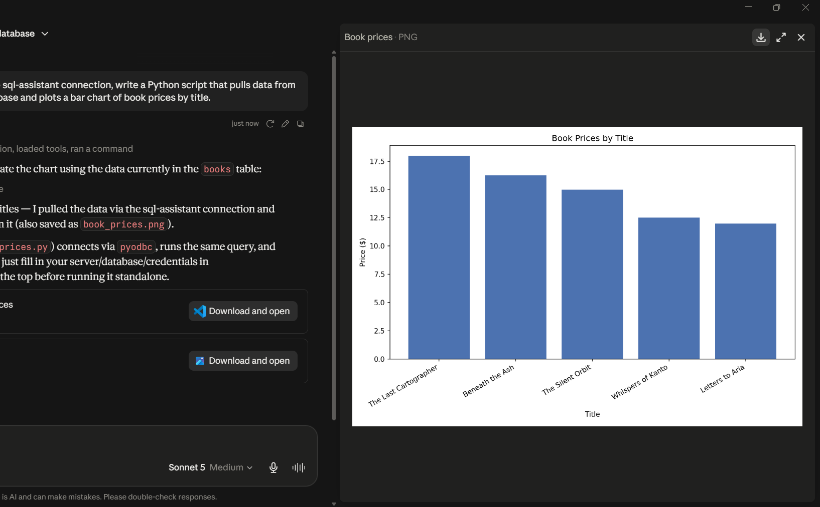
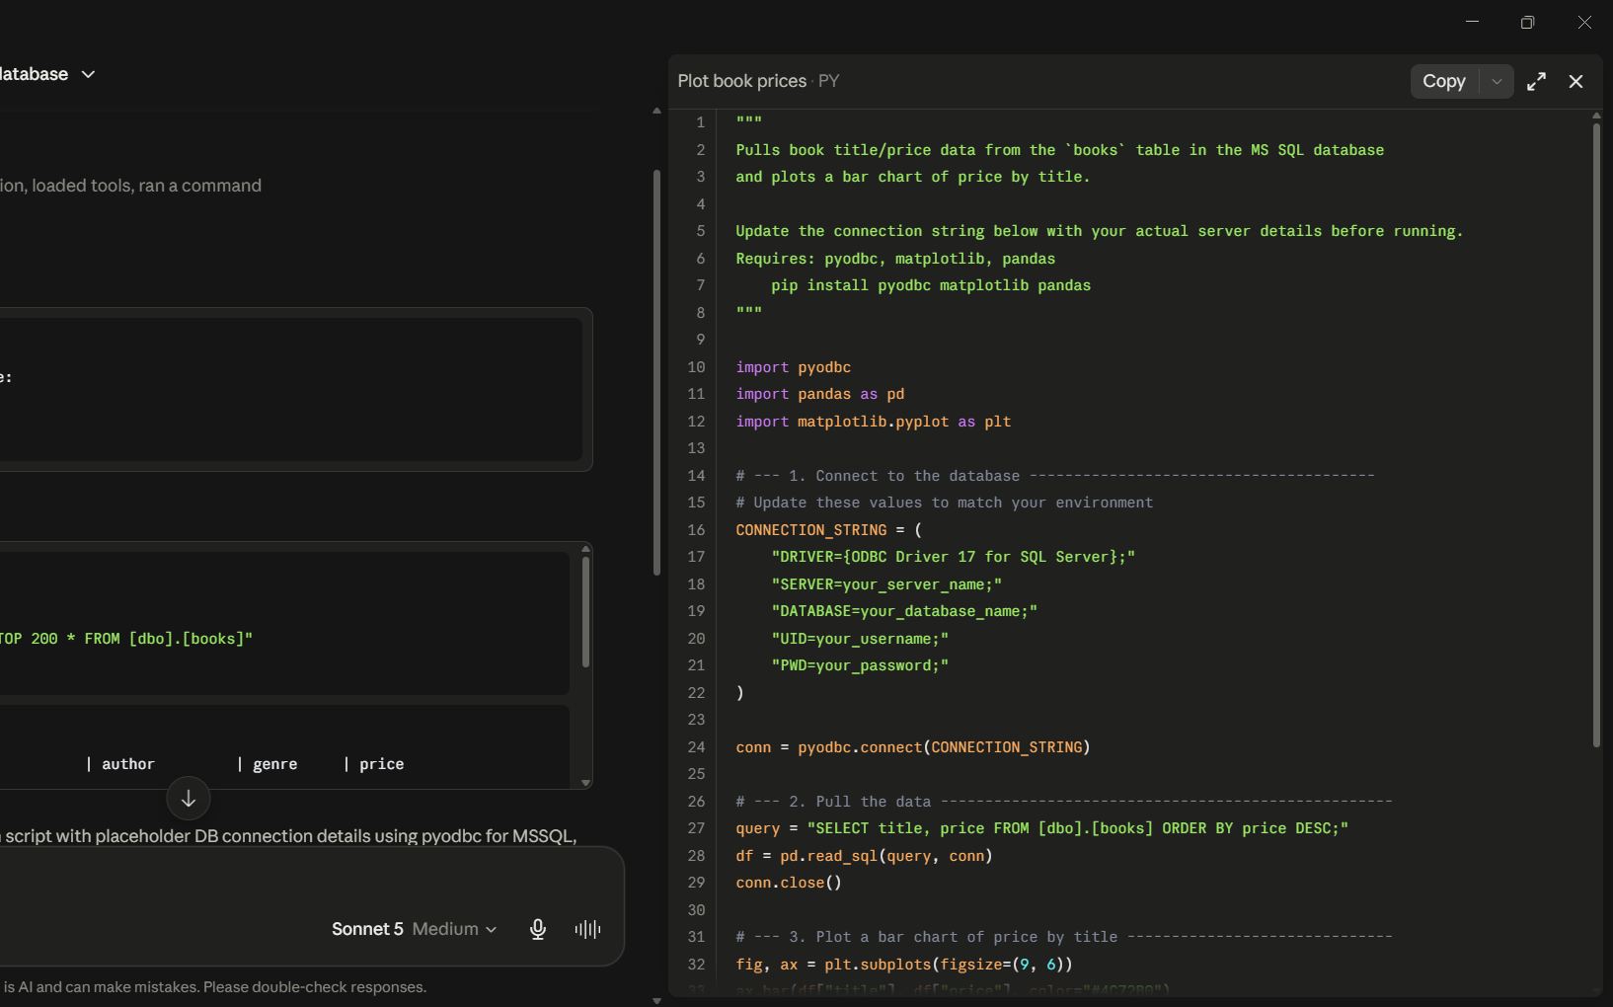
MS SQL SERVER · CODE GENERATION
ASKED IN CLAUDE DESKTOP
Writing code from live data
“Write a Python script that pulls this data and charts it.”
Queries the table first, then writes a script shaped around the schema it just read — real column names and types, no placeholders to fix afterwards.
MS SQL Server
14

Slide 15
LESSONS
What broke, and how it was found
None of this was in the original guide — each layer had to be diagnosed independently
The recommended image spoke the wrong protocol
The officially recommended package was deprecated
openmcpserver/mcp-postgres:latest runs an HTTP server under Uvicorn. Claude Desktop's local MCP servers communicate over stdio, so this image cannot work here at all — confirmed by running it manually and watching it bind an HTTP port instead of starting a stdio process.
@modelcontextprotocol/server-postgres was retired mid-2026. Its suggested replacement, @crystaldba/postgres-mcp, does not exist on npm at all — it is a PyPI package meant to be run with uvx, not npx, which is why every npx attempt failed.
An upstream SDK shipped a breaking change mid-build
A native Windows service was hijacking the port
mcp 2.0.0 renamed FastMCP and moved the module. Neither postgres-mcp nor sql-mcp-server declares an upper bound, so both resolved the version that breaks them. Pinning mcp<2.0.0 fixed both — at invocation for uvx, at install for pip.
Postgres auth kept failing with a provably correct password. netstat -ano | findstr :5432 showed two listening PIDs; tasklist identified one as postgres.exe running as a Windows service, intercepting connections before Docker ever saw them. The container moved to 5433.
The pattern: every failure surfaced far from its cause — a driver problem read as a bad password, a port conflict read as bad credentials, a dependency break read as a broken package.
Lessons
15

Slide 16
LESSONS
Being straight about the limits
What this setup does not do, stated plainly
Read-only is a wrapper flag, not a database rule
POSTGRES_READ_ONLY is enforced by the MCP wrapper — the underlying user is still a superuser. Anything bypassing the wrapper could write. A rigorous setup would create a dedicated read-only role and GRANT SELECT instead of relying on the flag.
Nothing persists across a reboot
Docker containers do not auto-start, and Claude Desktop only launches MCP servers on a cold start. Bringing everything back up is a documented five-minute sequence, not an always-on service.
The datasets are deliberately tiny
A handful of rows per database. The aim was a working protocol path end to end, not a benchmark of query performance or data volume.
No real credentials are committed
Config files ship with placeholders, secrets live in a gitignored .env alongside a checked-in .env.example, and the real Claude Desktop config is gitignored too.
Why list these at all: knowing the limits of a control is more useful than claiming it is airtight — and every one of these is written up in the repo rather than left implied.
Lessons
16

Slide 17
EXPLORE IT
Everything is in the repo
Each database has its own guide with every command, config block and gotcha for that engine — this deck walked through one of the four.
github.com/4reeb-5yed/claude-db-connect
Also in the repo
README.md
docs/setup/postgres.md
overview, architecture and a screenshot per database
PLAN.md
docs/setup/mysql.md
the full build log and design decisions
docs/setup/mssql.md
scripts/
a helper to bring the Postgres container up
docs/setup/sqlite.md
sql/ · config/
schemas and Claude Desktop config examples
Four databases, four different failure modes, one working protocol path — all documented.
Claude DB Connect
17

