Slide 1

Database development with pl/sql final project
PROJECT: SMART INVENTORY OPTIMISATION SYSTEM
BY: RUREBWAYIRE AMPOZE ARIELLA
(27640)
GITHUB LINK: https://github.com/4ri3ll4/PLSQL_FINAL

Slide 2


Problem Statement
Manual tracking leads to costly errors, stockouts, and overstocking. Delayed restocking results in lost sales and poor supplier perception. Lack of governance and audit trail creates security risks.
Solution: Automated tracking and intelligence for optimized reorder decisions.

Slide 3
Project Objectives & Scope
Maintain accurate real-time stock levels.
Auto-generate optimized reorder requests.
Enforce critical business rules (weekday/holiday restriction).
Provide Business Intelligence (BI) for decision support.
Scope: Procurement, Sales Logging, Stock Control, and Auditing.

Slide 4
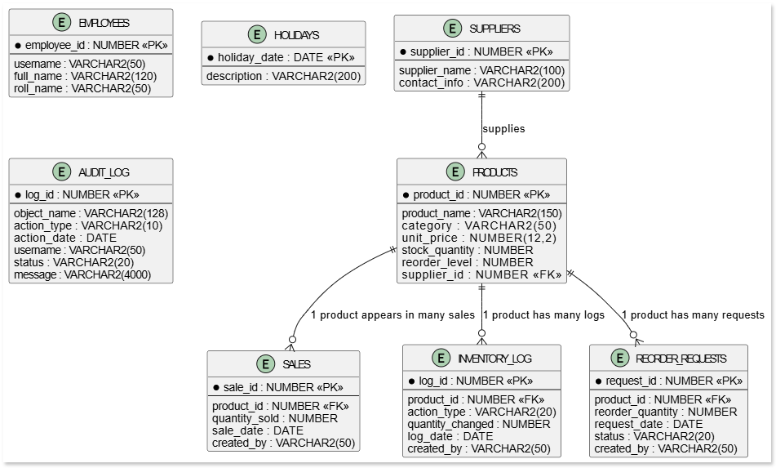
Logical Database Design (Phase III)
Design is normalized to Third Normal Form (3NF) for data integrity.
Key Dimension Tables: PRODUCTS, SUPPLIERS, EMPLOYEES.
Key Fact Tables: INVENTORY_LOG (for all stock movements), AUDIT_LOG (for governance).
Rule Support: HOLIDAYS table drives the security restriction.

Slide 5
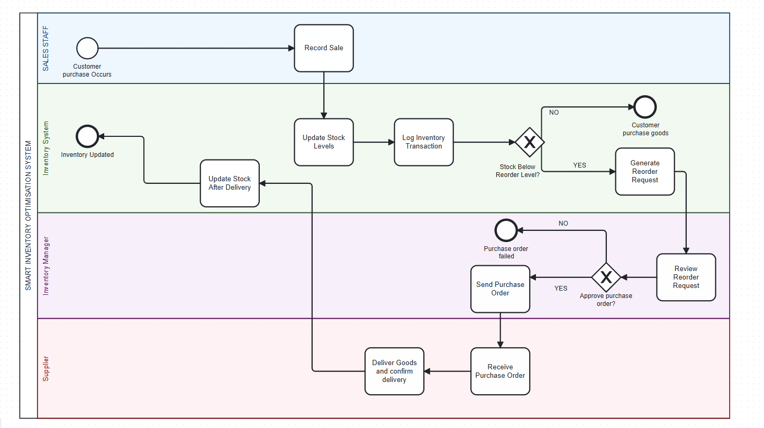
Business Process Flow (Phase II)
The business process flow is demonstrated by this BPMN diagram:

Slide 6
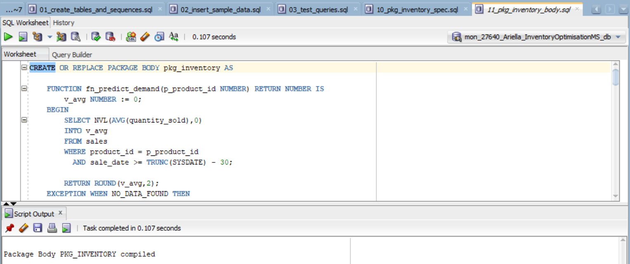
Core PL/SQL Development (Phase VI)
Functionality grouped into the PKG_INVENTORY Package (10_pkg_inventory_spec.sql,
11_pkg_inventory_body.sql).
Key Function: F_REORDER_CHECK (or similar) determines if stock_quantity is below
reorder_level.
Technique: Utilizes Explicit Cursors for efficient multi-rowprocessing and custom
exception handling.

Slide 7
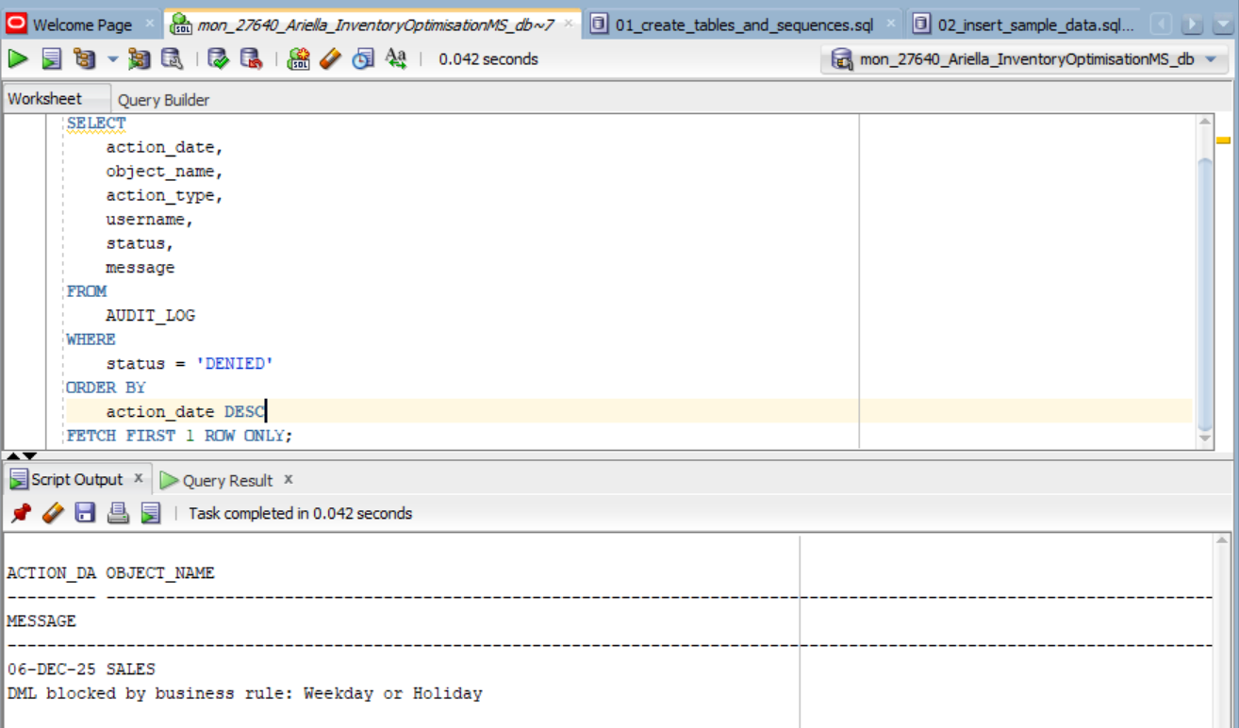
RESTRICTIONS & Auditing (Phase VII)
Business Rule enforced via a Trigger on DML operations. *
Rule: Employees CANNOT INSERT/UPDATE/DELETE on WEEKDAYS or PUBLIC HOLIDAYS.
Proof: The trigger calls a restriction function and logs the attempt in AUDIT_LOG with STATUS='DENIED'.
This fulfills the security and auditing requirement.

Slide 8

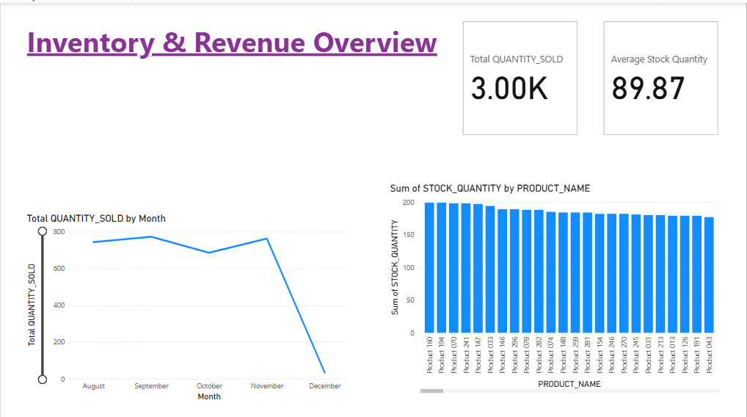
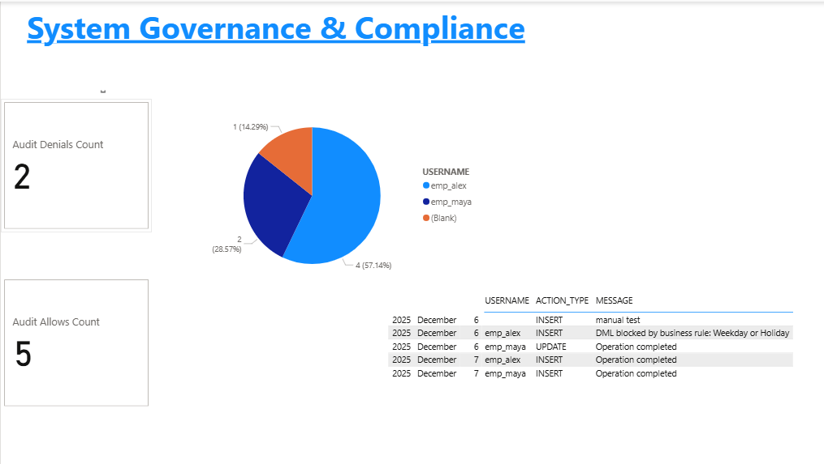
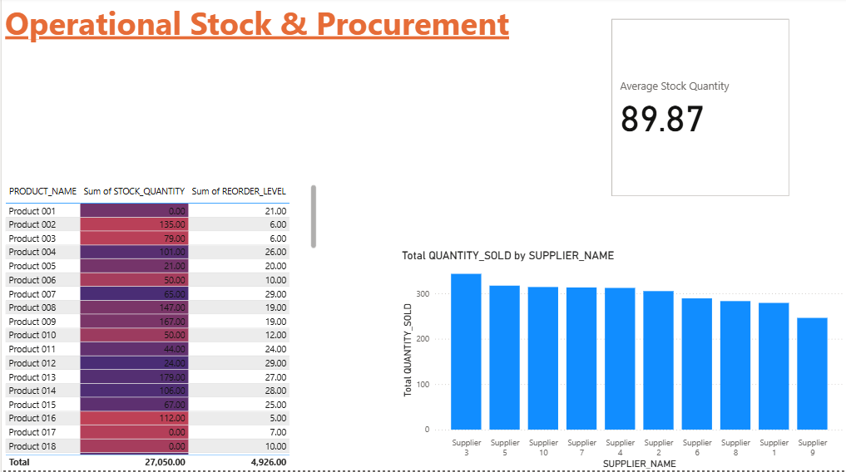
BI & Analytics
KPIs Defined: Inventory Turnover, Stockout Rate, Supplier Performance, Audit Violations.
Dashboards: Executive Summary, Audit Monitoring, and Performance Dashboard (Show Mockups).
Technique: 12_analytics_examples.sql uses Window Functions (e.g., LAG()) to analyze sales trends and ranking.

Slide 9
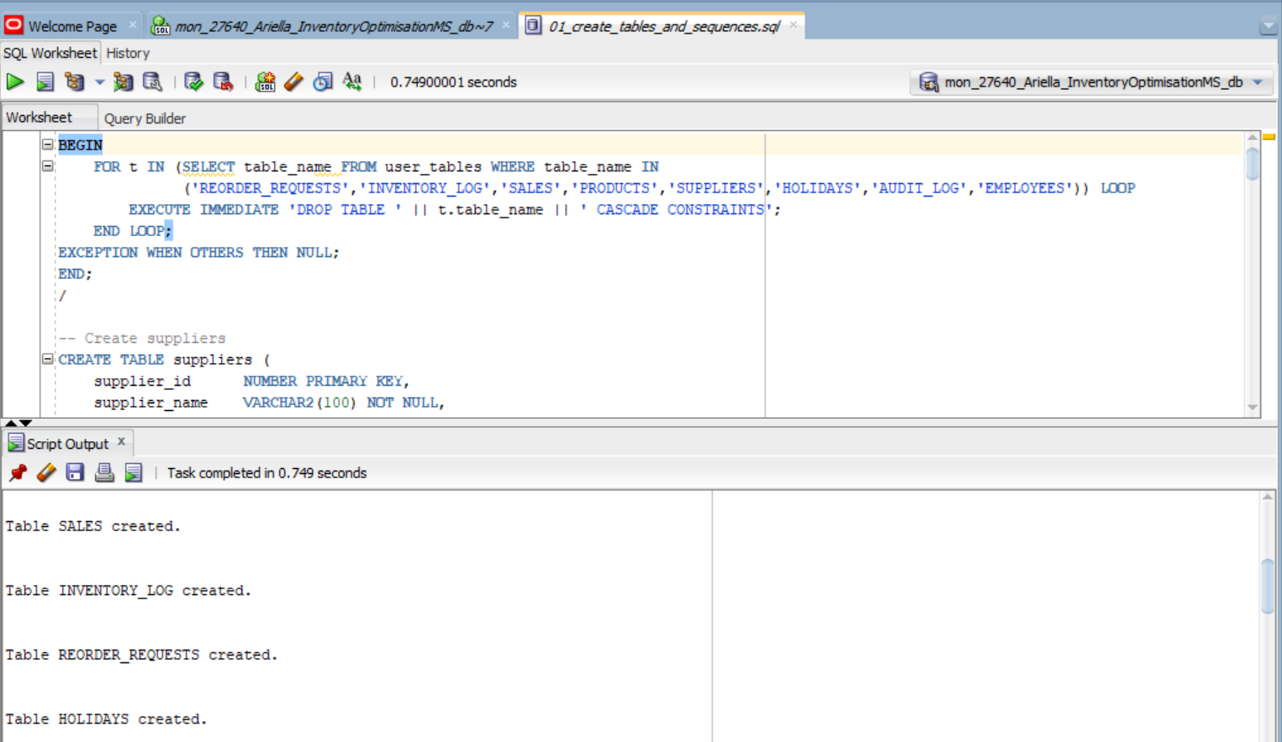
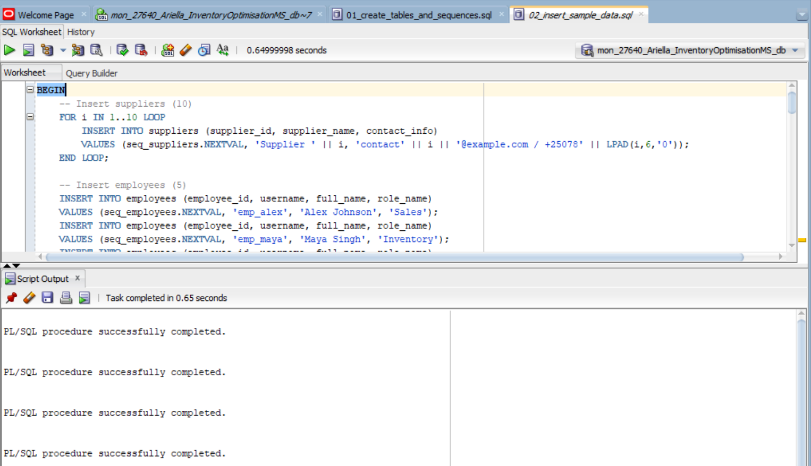
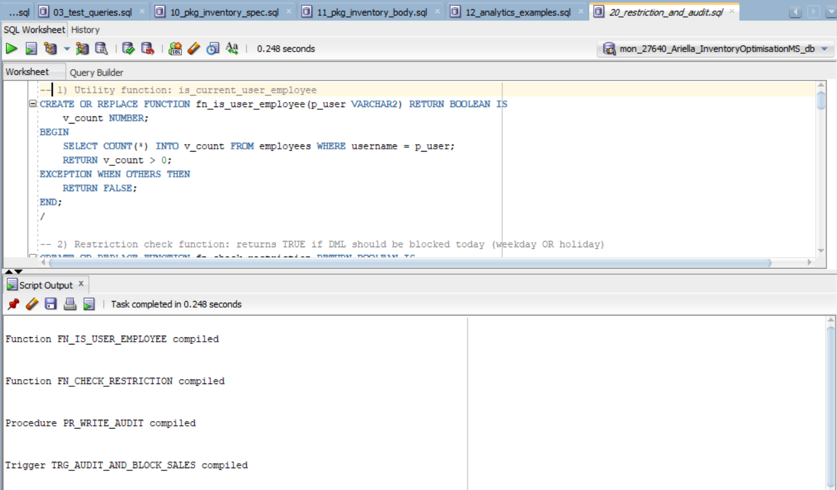
TESTING & VERIFICATION
All scripts tested and error-free (03_test_queries.sql).
Data Validation: Over 100 rows inserted into main tables for realistic testing.
Critical Test Result: Show a successful log entry in the AUDIT_LOG where a DML action was DENIED due to the holiday rule.
Proof of Concept: Display table data (5-10 rows).

Slide 10

Thank You!
CONCLUSION
Achievements: System is functional, automated, and compliant with all project phases.
Future Work: Integration with a front-end system or adding a forecasting model.
Final Thought: This project demonstrates mastery of Oracle DDL, DML, PL/SQL, Triggers, and BI principles.

