Slide 1
MQTT
Message Queuing Telemetry Transport

Slide 2
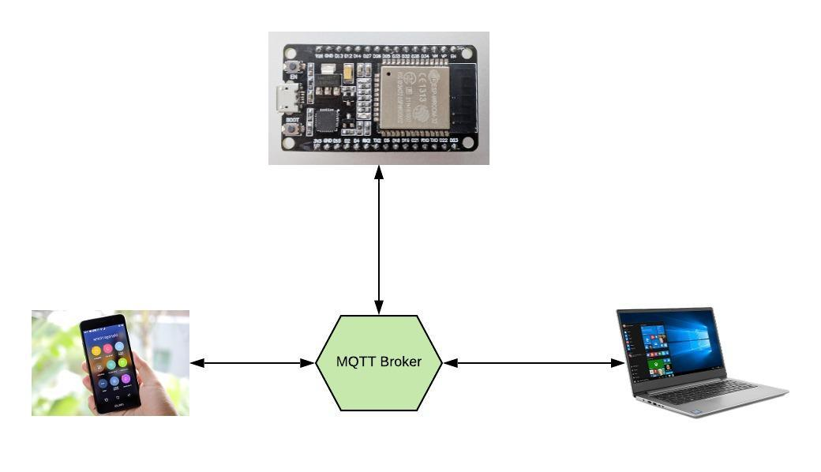
Broker and clients
A broker is required for MQTT to work
Multiple clients can connect to a broker

Slide 3
Establishing a broker
Most cloud providers (AWS, AZURE, etc.) offer an MQTT service
Eclipse Mosquito is a very popular MQTT broker software. It’s free, open source, secure and well maintained. You can host it on your own server or in the cloud
Free sandboxes are available to play around.

Slide 4
MQTT Client
The ESP32 will act as a client
Several MQTT client applications are available from very simple (MQTTBox) to highly sophisticated (Node-Red)
MQTT box http://workswithweb.com/mqttbox.html

Slide 5
MQTT Topics
Topic:
A string that identifies a resource it looks like a relative URI
Topics can follow a tree structure using a “/”
E.g. Earth/Australia/Vic/Melbourne/temperature/device1234
identifies temperature from device1234 in Melbourne
Wild cards are used with a #
Earth/Australia/Vic/Melbourne/#
This identifies all Melbourne devices
A device can have as many topics as it likes

Slide 6
Publish and subscribe
A device can publish any data it wishes, to any topic
A device can subscribe to any topic and receive published information
* Naturally, Security will also play a role but that largely depends on how the broker is setup and the certificates on the clients

Slide 7
QOS (Quality of service)
There are 3 levels of QOS
0. Almost Once (Fire and forget)
1. At least Once (Fire and get ack)
2. Exactly Once (Fire get and ack and ack the ack)

Slide 8
Retain
The broker can retain a message and wait for a device to connect and then immediately push a notification.
This is super useful to notify devices of an action after they wake up from sleep

Slide 9
Last will
If a device ungracefully disconnects. (The connection is killed without a proper disconnect [dropped connection, the device runs out of power, crashes etc.]) The broker can publish a last will
The last will is a normal message that is published to clients that have subscribed / interested in the fact that the device ungracefully diconnected

