Slide 1
SPI

Slide 2
SPI = Serial Peripheral interface
Requires 4 data lines
Each device on the bus required an additional GPIO pin
Faster than I2C
4 I2C busses 1 one of which is dedicated to flash

Slide 3
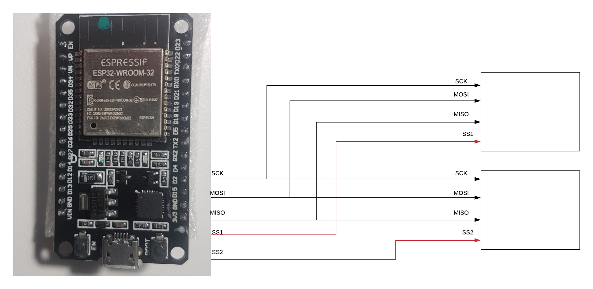
Spi bus

Slide 4
