Slide 1
Welcome
Composition over Inheritance

Slide 2
Introduction
My name is Adam ☺
I’m an exchange student from Denmark
How shifting from Inheritance to Composition revolutionized a core system of my project
Thank you Sungwoo!

Slide 3
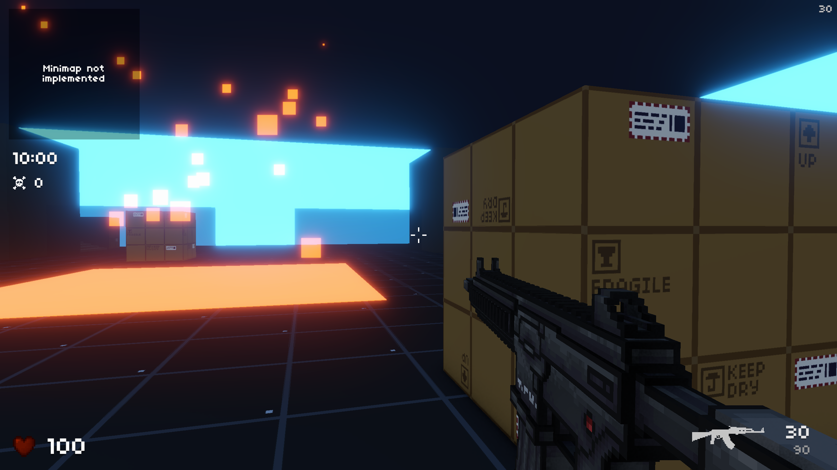
For context
Voxel-based first person shooter (FPS) for Windows
Unity game engine
Originally began as a fun hobby project in my free-time
But as it grew, I became more serious about the scope of the project
Planning a Steam release!

Slide 4
One of the Key features
Weapon System: (Defines gun behaviour)
Must be highly intricate!
Appeal to skilled players invested in competitive games
Complex systems require thoughtful planning and smart coding practices!

Slide 5
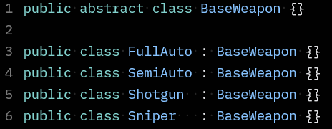
The original Weapon System
Used inheritance
One abstract super-class with standard behaviour
Sub-classes would inherit and modify them
This approach made intuitive sense in the beginning
Example: AK47 → instance of FullAuto
But as the game grew in complexity, I ran into problems associated with inheritance...

Slide 6
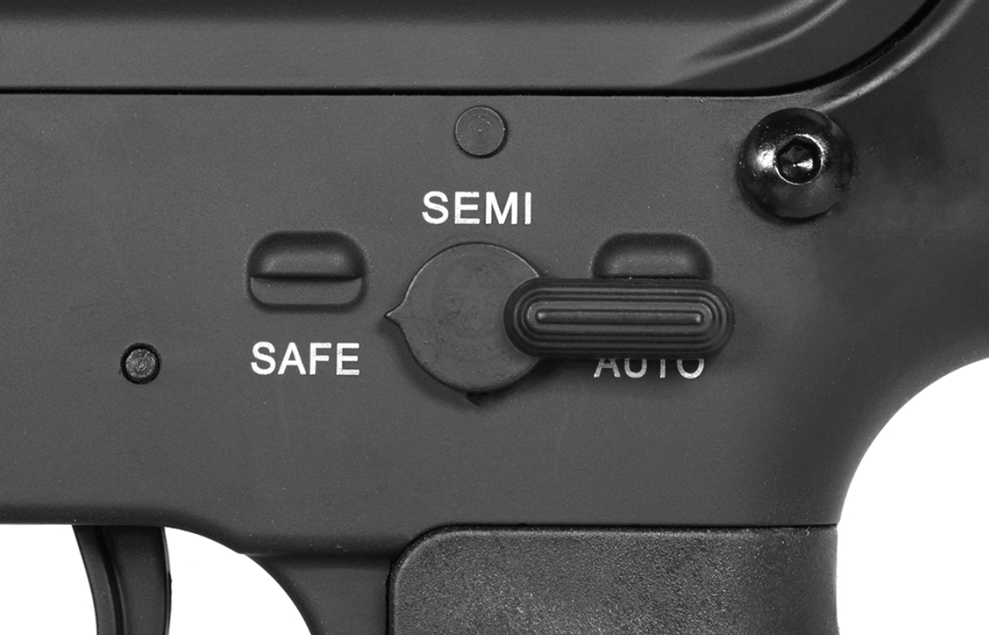

Limitations of inheritance
Inheritance is not very flexible because of it’s statically nature
Unsuitable for a weapon system that prioritises flexibility
Weapons need to shift between full- and semi-auto
Adding that was impossible with my implementation
AK47 is an object of FullAuto, cannot be easily converted to SemiAuto object

Slide 7
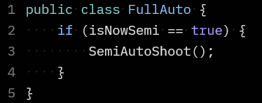
Limitations of inheritance
Could technically be solved with if-statements but...
Would introduce:
Code duplication and overlapping behaviour
Awkward to read
If bugs occur, I would have to fix them in both scripts

Slide 8

More duplicated code...
Had an instance where I had to differentiate between full- and semi-auto shotguns
But I already had two classes for that (FullAuto and SemiAuto) so I now had duplicate code
Now, Shotgun class served as a blueprint another blueprint
Multilayered inheritance is messy to work with
Ambiguity

Slide 9
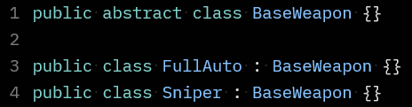
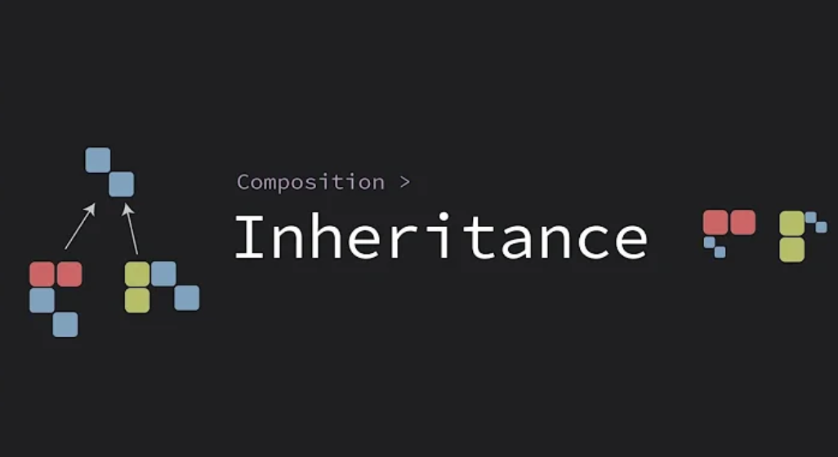
Ambiguous naming conventions
Both FullAuto and Sniper inherit from BaseWeapon but:
Full-auto describes a mode of fire
Sniper describes a weapon classification
Made me question what even a sub-class was
Increasingly difficult to maintain, not sustainable
Architectural nightmare
Change was necessary, began exploring different solutions
“The Flaws of Inheritance”

Slide 10
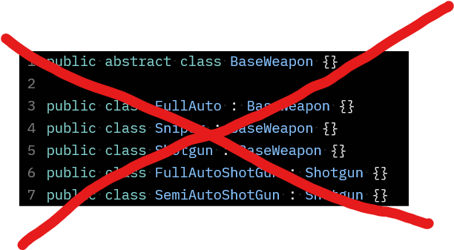
The shift (inheritance → composition)
Instead of using one abstract super-class and many sub-classes...
We can have one class that represents every weapon in the game
To modify it’s behaviour, we give it components (pieces of data: classes, interfaces, structs, etc...)

Slide 11
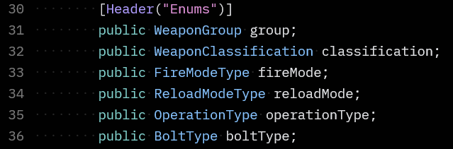
Example
Only one BaseWeapon class (an empty vessel)
Whenever we create a weapon, we only make an instance of BaseWeapon which can morph into anything
To modify the behaviour each weapon instance, I use enums

Slide 12
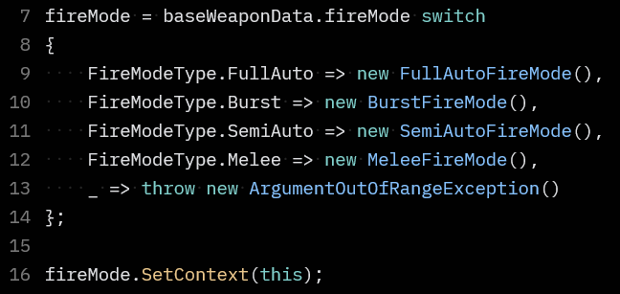
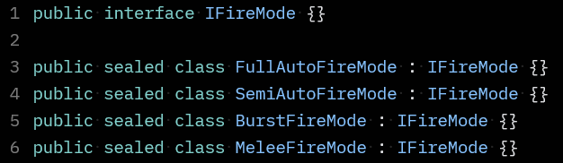
Example
In the BaseWeapon class
I would use switch expressions to determine the behaviour of the weapon based on those enums
If the weapons FireMode enum == FullAuto, then give it FullAuto properties
These properties are interfaces that are implemented dynamically
It can be changed and configured in run-time (toggle)
Now Shotguns, Snipers, Assault Rifles can fully utilize the same mechanics without duplicating code across scripts

Slide 13
The impact: What has changed
Results were game changing
I now have code that’s extremely easy to maintain
But also easy to add on to (new features)
Games need new features with updates, so flexibility and scalability is an absolute must!
Very similar to assembling Lego bricks
Bugs are easy to fix since they’re now isolated

Slide 14
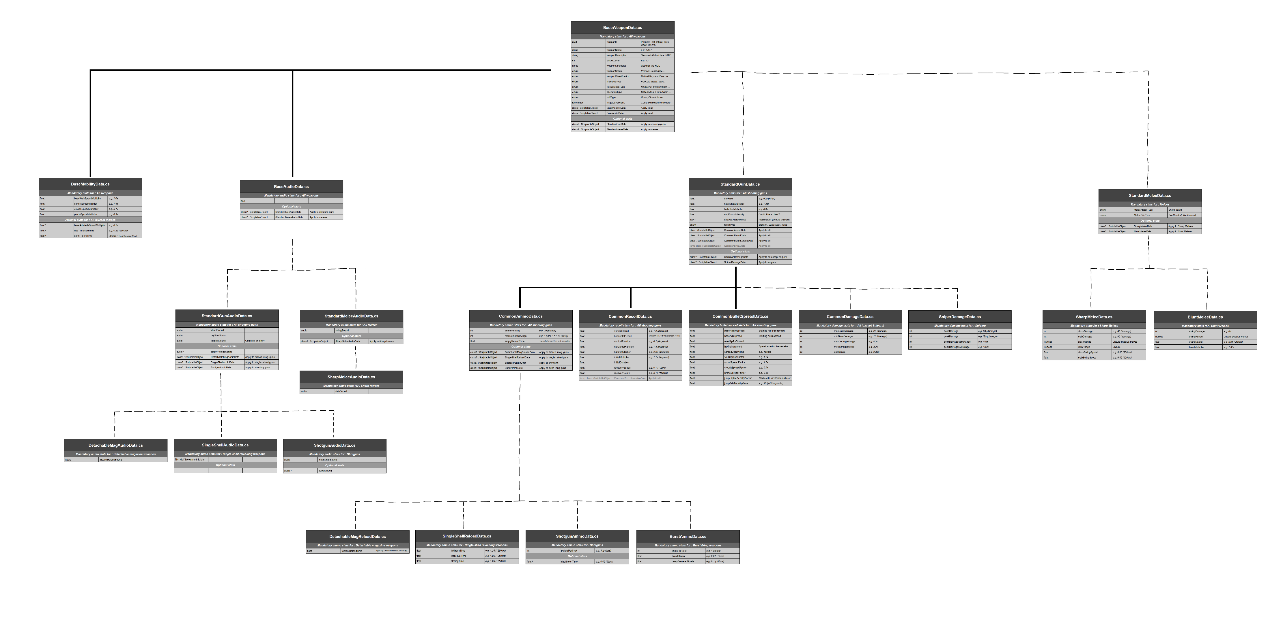
X
X

Slide 15
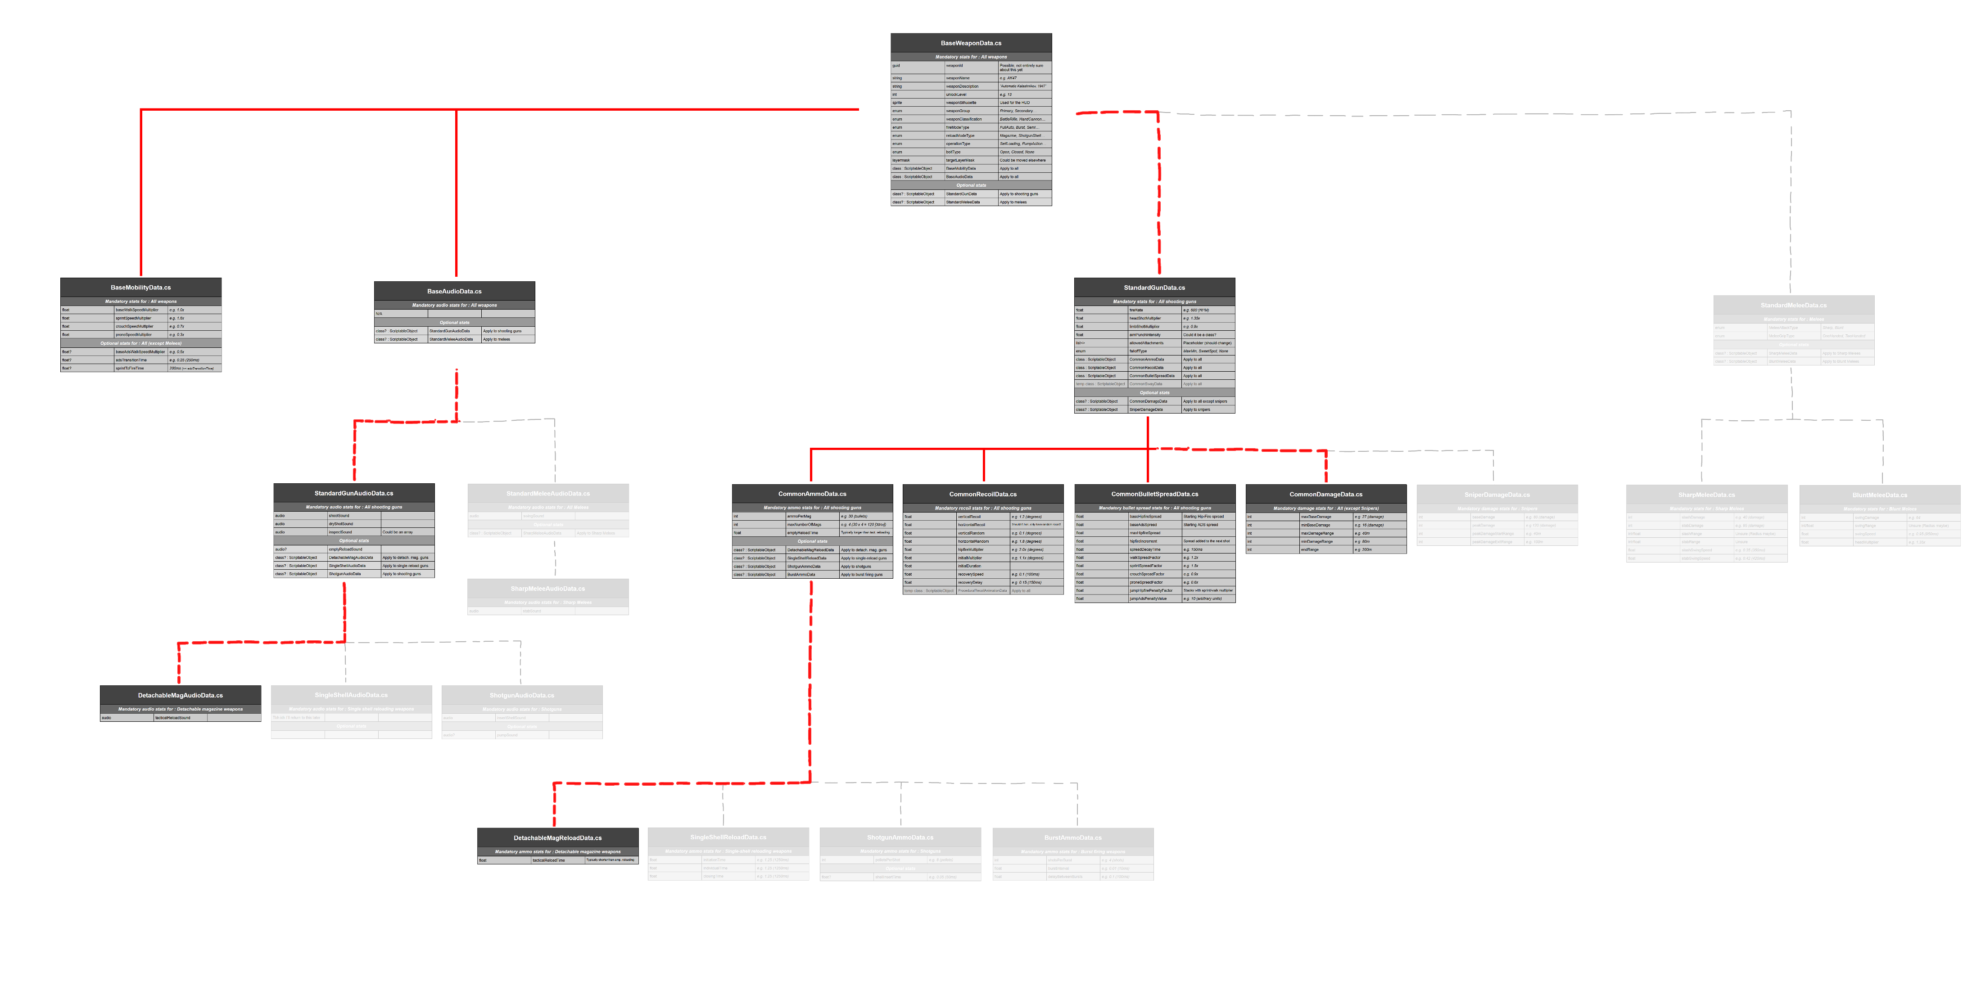
X
X

Slide 16
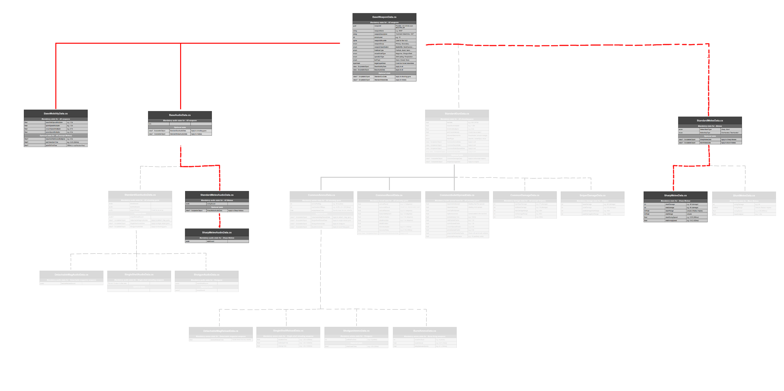
X
X

Slide 17
What i have learned
This shift taught me more than a design pattern
It fundamentally changed the way that I think about software architecture, in terms of...
How I should strategize
Importance of diagrams, like UML, and documentation
If you neglect these, then you might find it hard to maintain your code
Or worse, not being able to understand your code!
Programmers should design with maintainability and readability in mind
Can you use a hybrid solution? (Both In

Slide 18

Thank you

