Slide 1


NEPAL PUBLIC GRIEVANCE MANAGEMENT SYSTEM
STREAMLINING GRIEVANCE REPORTING AND RESOLUTION
BY SHREYAS SINGH AND JYOTENDRA SINGH

Slide 2

Problem: Inefficient Grievance Management in Nepal
Delays: The existing grievance management system in Nepal often results in significant delays in addressing citizen complaints and concerns. This delay can be frustrating for citizens who seek timely resolution.
Lack of Transparency: Transparency in the grievance resolution process is lacking. Citizens often have limited visibility into the status of their complaints, leading to uncertainty and dissatisfaction.
User Frustration: Due to delays and a lack of transparency, citizens may become frustrated with the grievance management system. This frustration can lead to a breakdown in trust between the public and government institutions.

Slide 3

Objectives:
Streamline Grievance Submission and Tracking:
Efficient Submission: The system aims to provide citizens with an easy and efficient way to submit their grievances. This includes user-friendly online forms and submission portals.
Real-time Tracking: Citizens will have the ability to track the progress of their complaints in real-time. This transparency ensures that they are informed about the status of their grievances at all stages of resolution.
2. Improve Accountability in Grievance Resolution:
Accountability Mechanisms: The system will incorporate mechanisms to hold responsible authorities and administrators accountable for addressing grievances promptly and effectively.

Slide 4



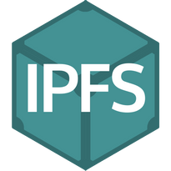

Technology Stack
1. React Vite - Frontend Framework
React Vite: A lightning-fast frontend development framework that ensures seamless user experiences.
Tailwind CSS: A utility-first CSS framework for rapid and responsive UI development, enhancing the system's user interface.
2. SmartPy - Smart Contract Development
SmartPy: A high-level smart contract development platform for creating secure and efficient blockchain contracts.
Taquito: A TypeScript library for interacting with Tezos smart contracts, ensuring reliable blockchain integration.
3. IPFS - Decentralized File Storage
IPFS (InterPlanetary File System): A distributed file system for storing and sharing data in a decentralized manner.
Pinata: A Pinata integration for robust IPFS file management and content pinning.

Slide 5
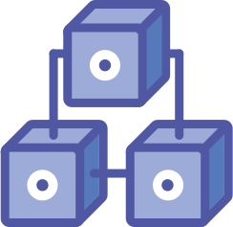
Blockchain-Powered Efficiency
Blockchain Integration
Integral to our system, blockchain technology offers several key advantages:
Transparency: Every grievance submission and resolution action is recorded on the blockchain, providing a transparent and publicly accessible ledger.
Security: Immutable records ensure that once data is added, it cannot be altered or deleted, safeguarding the integrity of grievance information.
Trust: Citizens and administrators can trust that the grievance process is tamper-proof and free from manipulation.
Smart Contracts
Smart Contracts: Self-executing contracts with predefined rules and conditions.
In our system, smart contracts automate grievance resolution processes, ensuring fairness and adherence to established rules.
Users can track the status of their grievances in real-time, enhancing accountability.
Benefits of Blockchain
Decentralization: No single entity has control over the system, reducing the risk of bias or corruption.
Data Integrity: Records are cryptographically secured, preventing unauthorized access or modification.
Auditability: Administrators and citizens can audit the entire grievance history at any time, promoting trust.

Slide 6
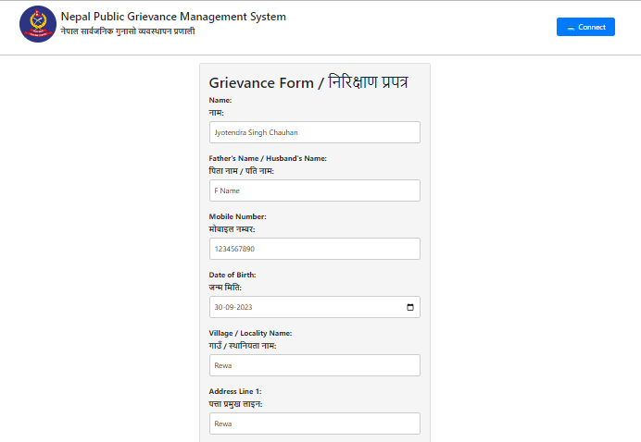
Project Glimpse

Slide 7
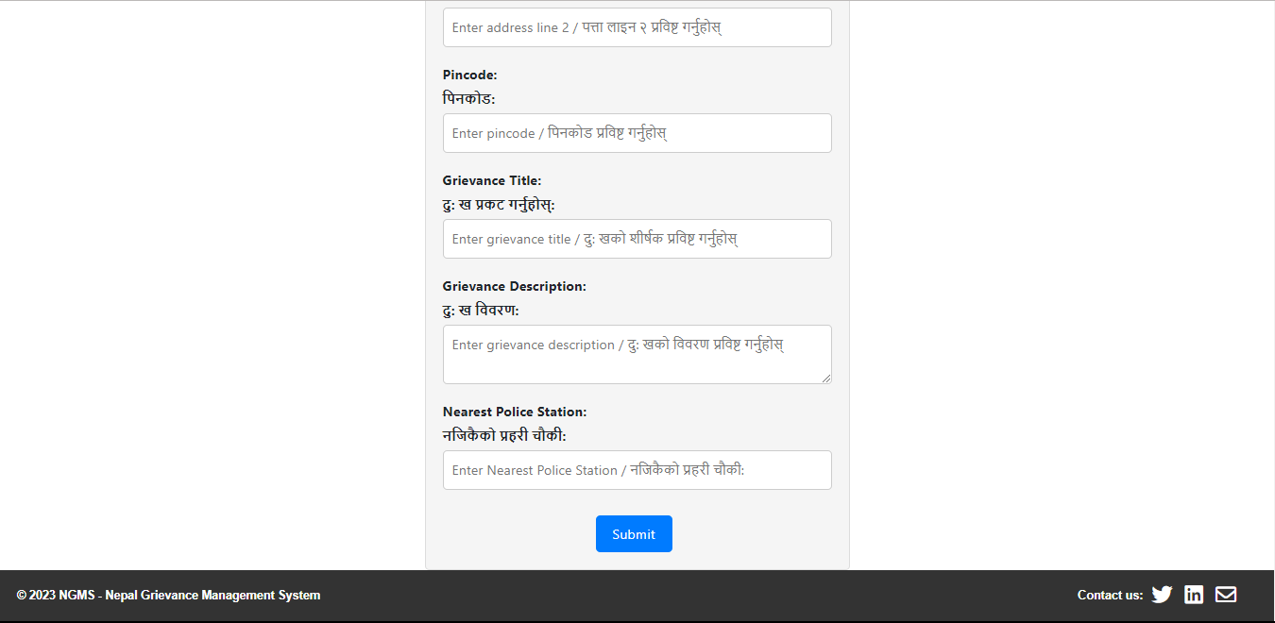
Project Glimpse

Slide 8
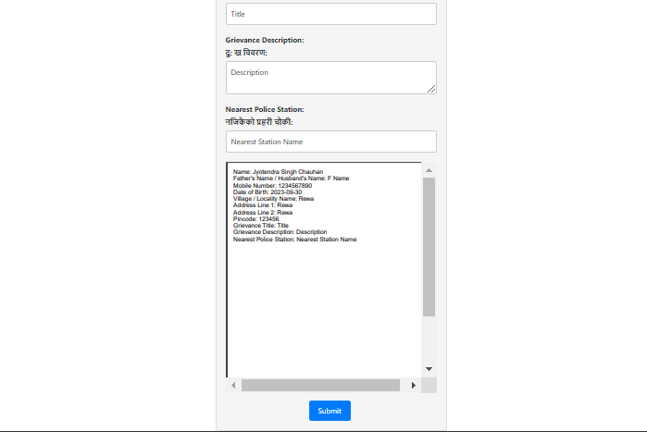
Project Glimpse

Slide 9

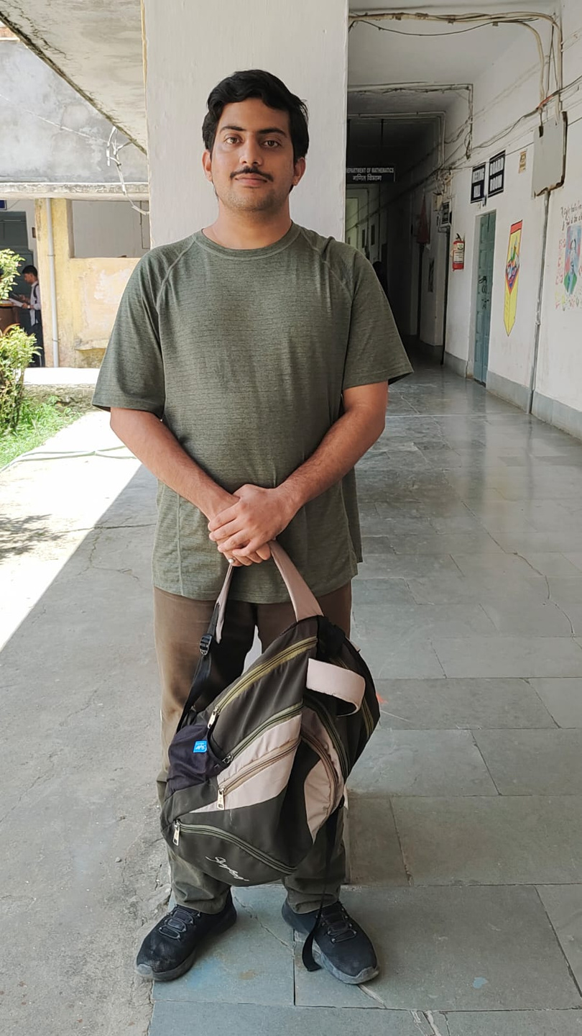
Team Members
Jyotendra Singh Chauan,
B.tech. CSE 3rd Year
Shreyas Singh Gaharwar,
B.Sc. CSE 3rd Year
shreyassingh621@gmail.com
jyotendrachandan02@gmail.com

Slide 10


