Slide 1
Elevate Your WordPress Plugin Development with TDD
Sudip Limbu Full-Stack Developer

Slide 2
What is TDD?
Write a Test, Watch it Fail
Red
Write just enough
code to make it pass
Improve the code
REPEAT
Refactor
Green
Notes:
Grocery List

Slide 3
Unit Test
Dependency 1
Mocked
Unit of Code to Test
Test Runner
Pass
Mocked
Dependency 2

Slide 4
Integration Test
Dependency 1
Code to Test
Test Runner
Pass
Dependency 2

Slide 5
E2E Test
Whole App or Feature
Test Runner
Pass

Slide 6
Testing Pyramid
Unreliable
Slow
Manual
E2E
Automated
Fast
More Reliable
Integration
Unit
Notes:
Story of Grocery List

Slide 7
Setup Environment for plugin testing
Plugin Scaffolding (using WP-CLI)

Slide 8
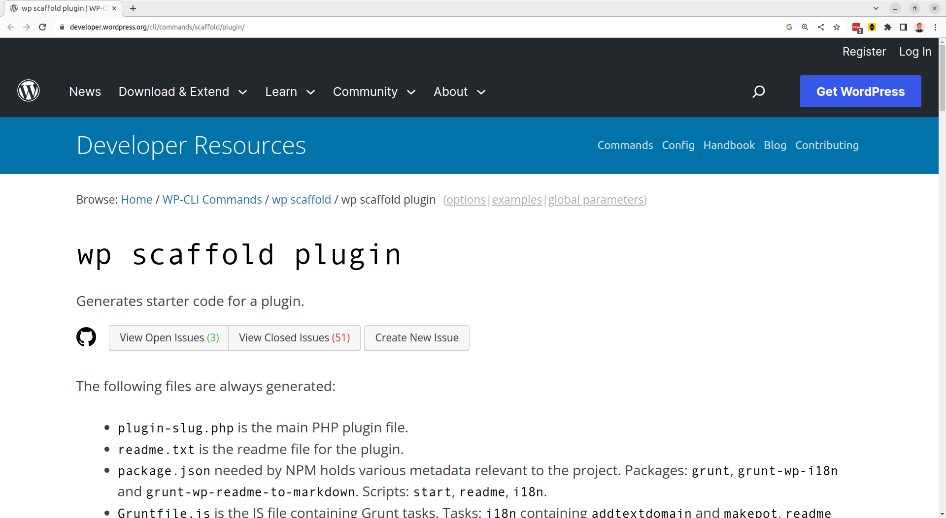

Slide 9
Setup Environment for plugin testing
Plugin Scaffolding (using WP-CLI)
WP-ENV

Slide 10
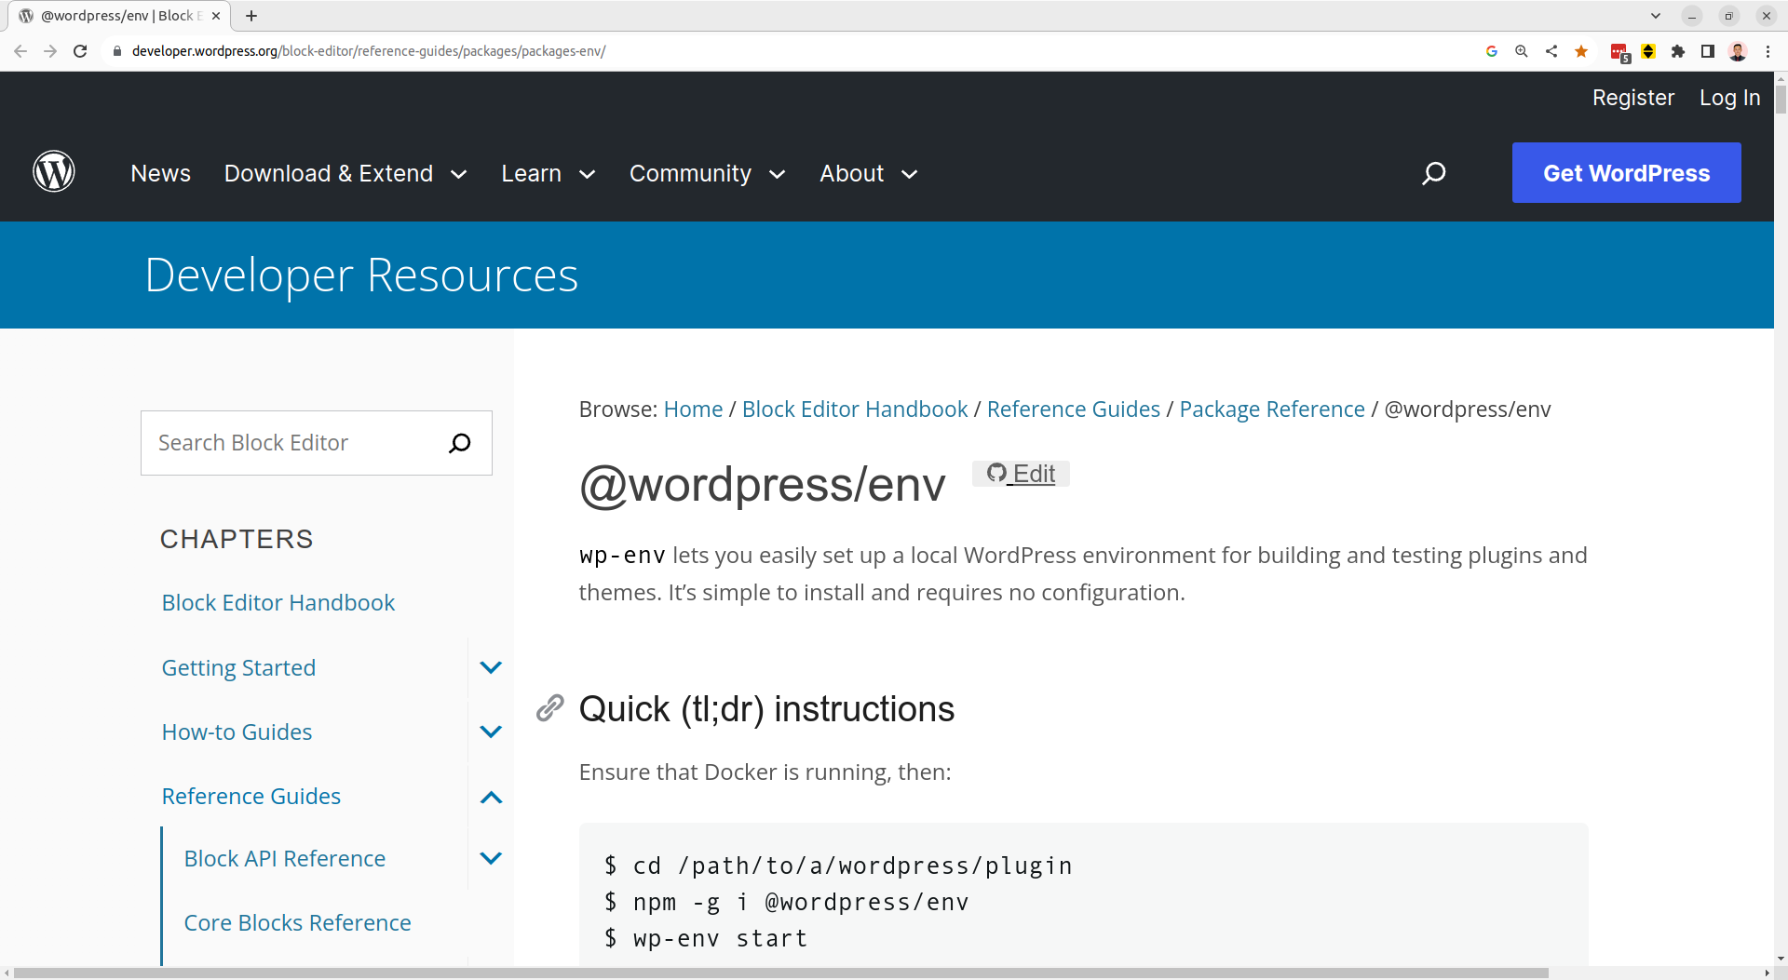

Slide 11
WP-ENV
Plugin Scaffold (Partially)
Local Test Setup
Apache/Nginx
PHP MySQL
Plugin
Dependencies
Test Configurations
WordPress Testing Library
Local Setup
Apache/Nginx
PHP MySQL
NPM/Composer
@wordpress/env (docker)

Slide 12
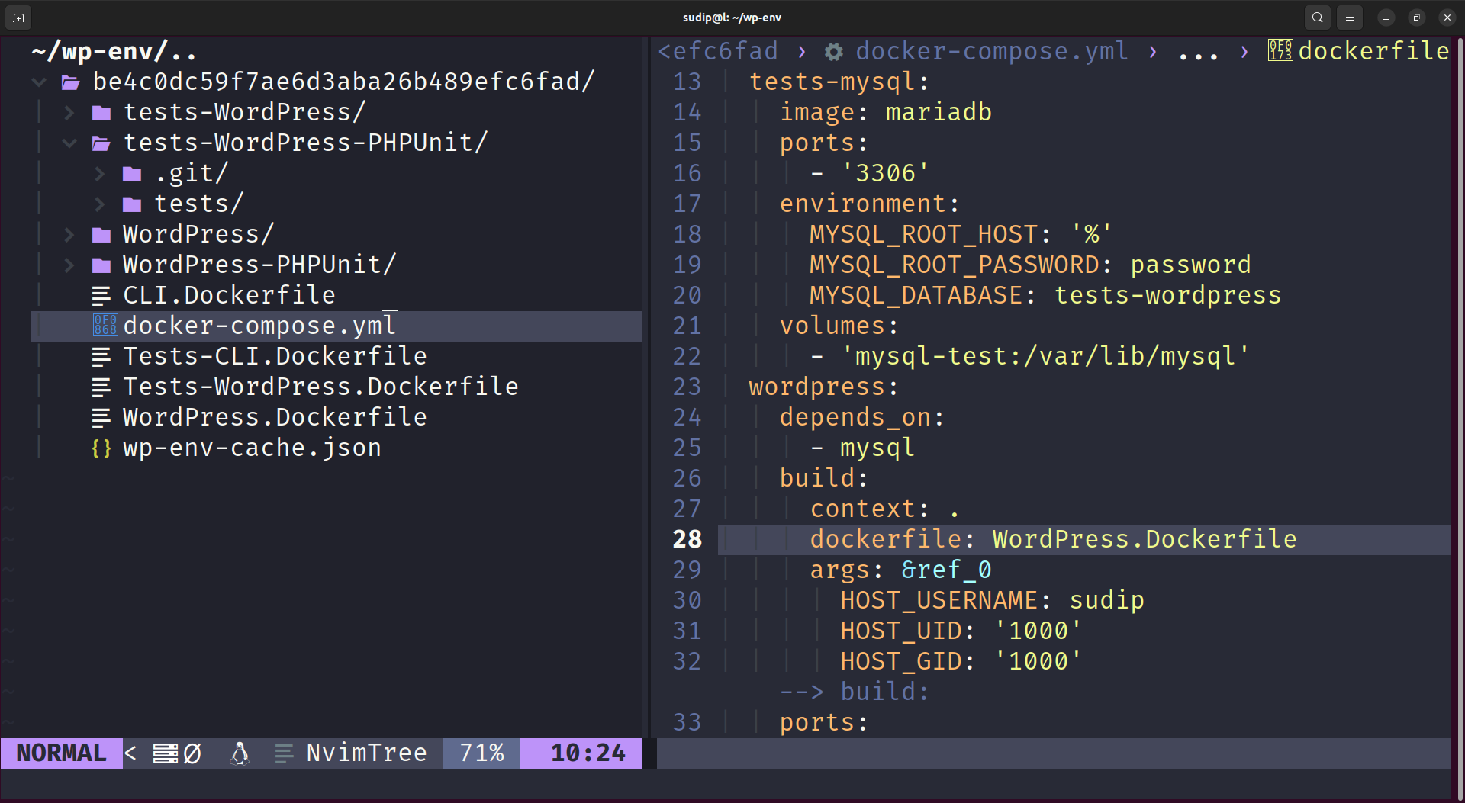

Slide 13
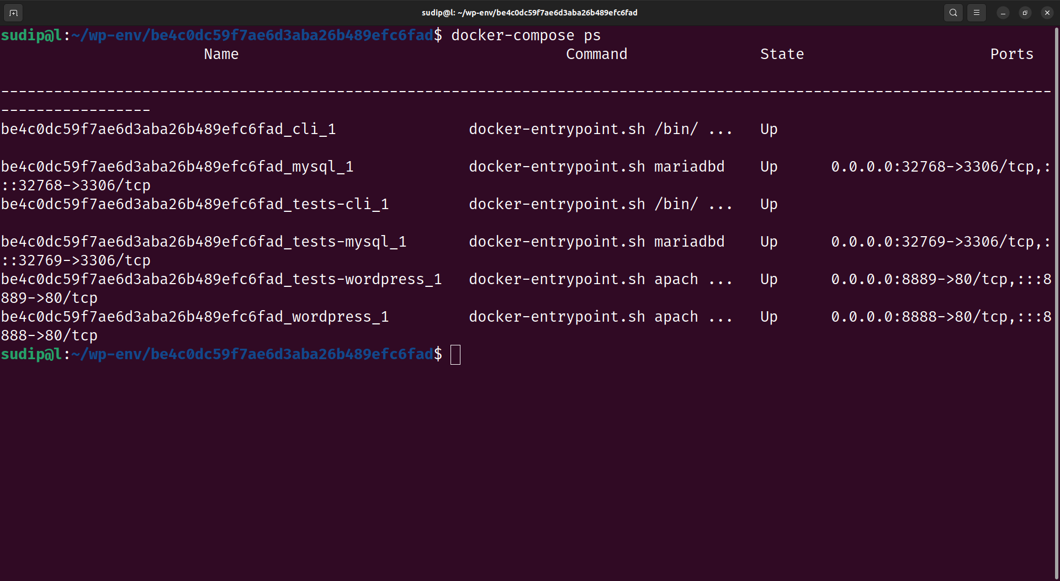

Slide 14
Unit Test/Integration Requirements
phpunit/phpunit
yoast/phpunit-polyfills

Slide 15
Unit/Integration Tests
wp-env creates isolated enviroments
wp-env installs WordPress testing library along with the required packages
use phpunit.xml for configuration
use .wp-env.json manages WordPress and PHP versions
use composer.json manages dependencies
run phpunit

Slide 16
E2E test Requirements
@playwright/test
@wordpress/e2e-test-utils-playwright

Slide 17
E2E tests
wp-env creates isolated enviroments
wp-env serves app at localhost:8888/8889
use playwright.config.ts for configuration
use .wp-env.json manages WordPress and PHP versions
package.json manages dependencies
install testing browsers (chromium/firefox/webkit)
run playwright

Slide 18
Test in multiple WordPress and PHP Versions
use .github/workflows/main.yml to configure
push your changes to github

Slide 19
Resources
https://github.com/WordPress/wordpress-develop
https://github.com/WordPress/gutenberg
https://github.com/woocommerce/woocommerce
https://github.com/elementor/elementor

Slide 20
Why TDD?
Improves Code Quality
Self Documentation
Decreases Technical Debt
Improves Developer Confidence
Agile Methodology (CI/CD)
Happy Customer

Slide 21

Sudip Limbu
Full-Stack Developer WordPress/PHP/JavaScript
@4slimbu

