Slide 1
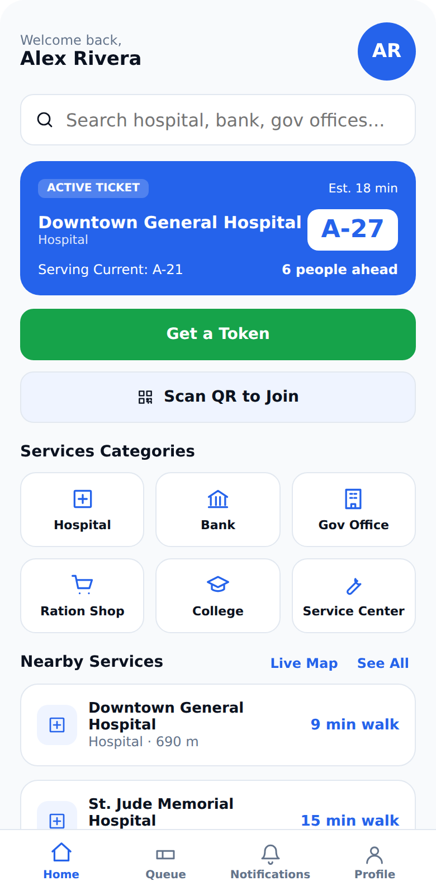
Smart Q
Skip the Wait. Smart Q Knows Your Turn.
Smart queue management for shops, clinics and offices
TechTrack Line | Founder: Srisudhan S
Notes:
Smart Q is a smart queue management platform. Customers join a queue from their phone and arrive when it is their turn. Shops run the queue from a simple dashboard.

Slide 2



Waiting in line wastes time and gives no answers
No visibility
Time stuck on site
Shops lack control
People do not know how long the wait will be, or whether it is worth staying.
Customers stand in line instead of using that time for something else.
Walk-ins pile up, and there is no easy way to call people in order or share a live status.
Notes:
Three problems: no visibility of the wait, customers lose time standing in line, and shops have no simple tool to manage the flow.

Slide 3
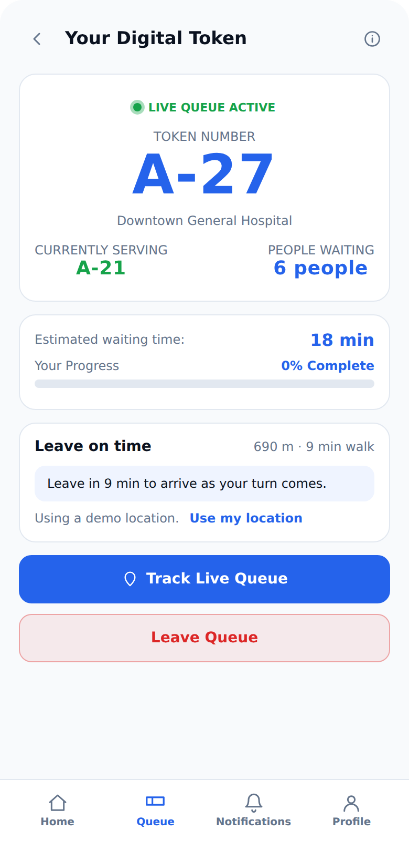




Join from anywhere. Arrive when it is your turn
Digital token
Pick a service or scan the shop QR code to get a token.
Live place in line
See people ahead, estimated wait and alerts when your turn is near.
Leave on time
Distance and travel time from your location tell you when to leave.
Shop QR code
Shops show one QR code, and customers join in seconds.
Notes:
The core flow: get a digital token, follow your place in line, and leave at the right time based on your distance to the shop.

Slide 4
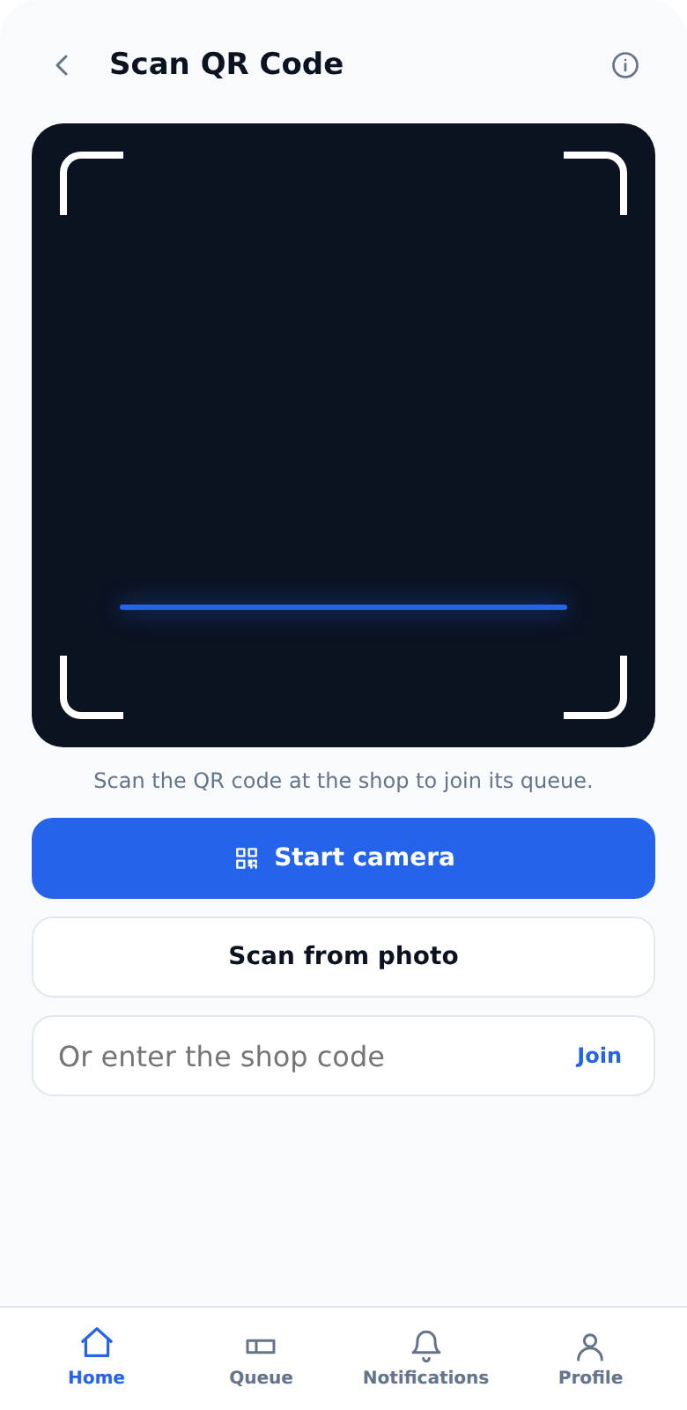
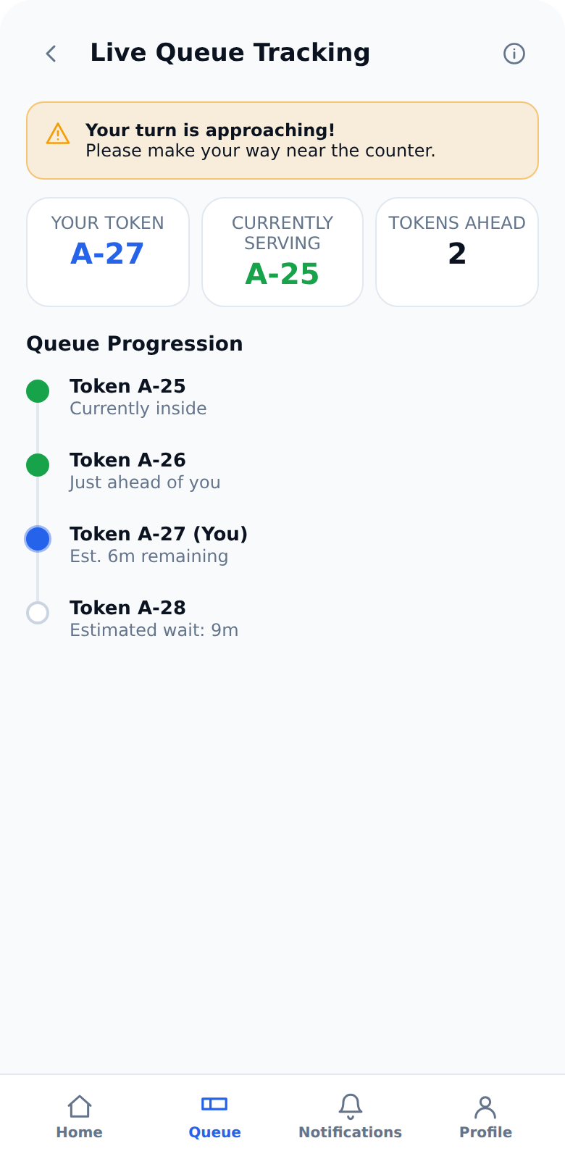
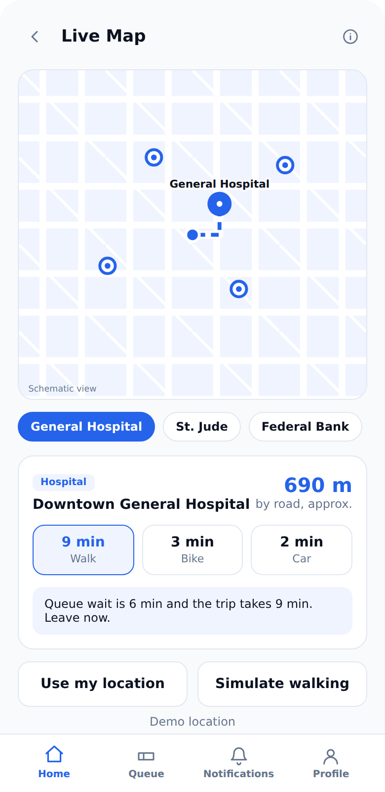
How it works
1
Join
2
Track
3
Arrive on time
Scan the shop QR code or pick a service. You get a token right away.
Watch your place in line and the estimated wait update live.
Get the leave time for your travel mode and an alert as your turn nears.
Notes:
Three steps. Join with a QR code, track the queue live, then arrive on time using the travel time estimate.

Slide 5
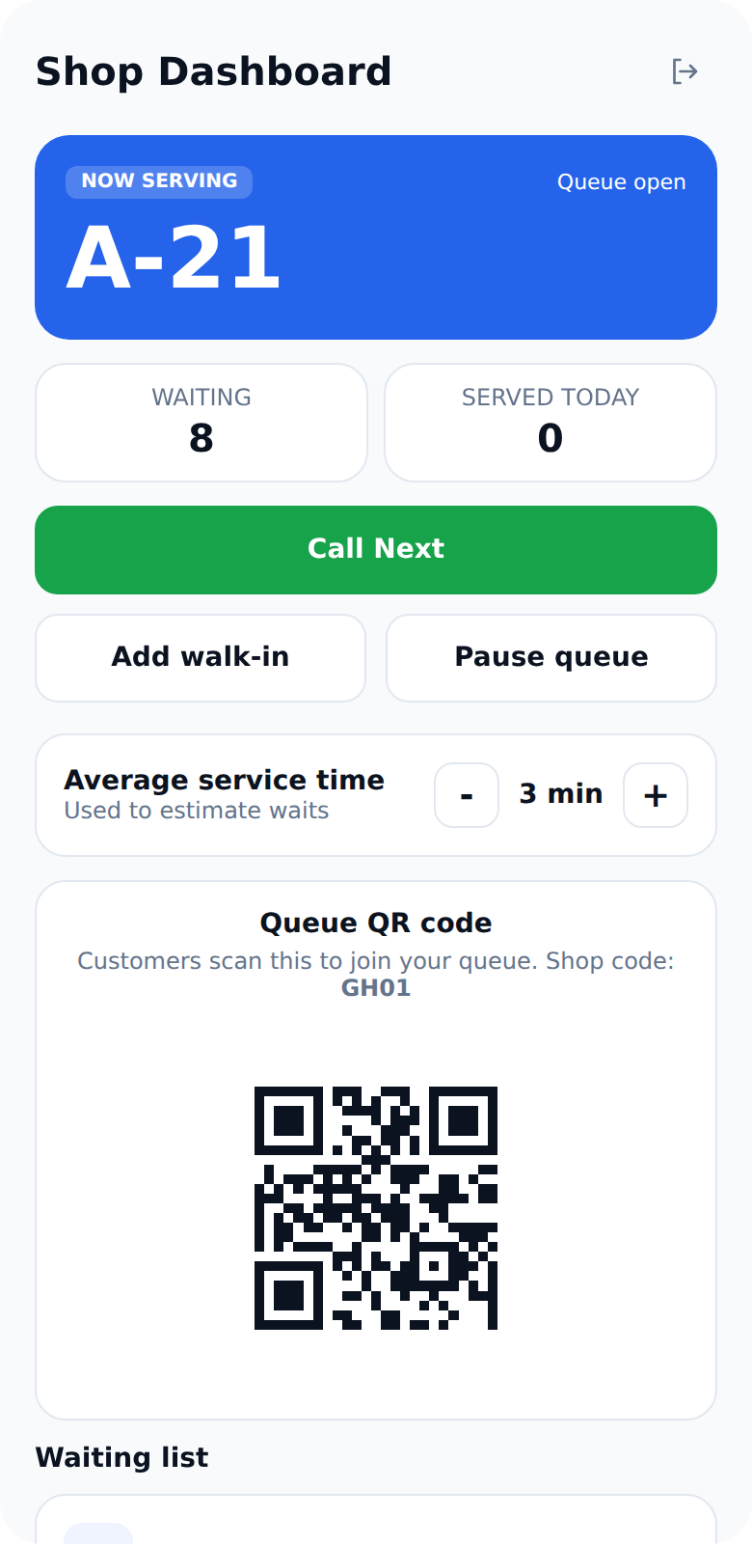
A simple dashboard for shopkeepers
Call the next token with one tap
Add walk-ins to the same queue
Pause the queue when you need a break
Set the average service time to tune wait estimates
Show a QR code customers scan to join
Customers see the new place and get alerts as the shop calls tokens.
Notes:
Shopkeepers log in separately. The dashboard shows who is being served, lets them call the next token, add walk-ins, pause the queue and set the average service time.

Slide 6
Simple pricing: 3 days free, then ₹25 per month
Free
Premium
₹0
₹25 / month
Always available
First 3 days free, cancel any time
Join queues with digital tokens
Scan a shop QR code
Queue history and saved services
Live map with distance and travel time
Leave on time reminders
Alerts when your turn is near
Notes:
Customers start with a 3 day free trial of Premium. After that Premium is 25 rupees per month. Shop plans are still to be decided.

Slide 7
Where we are and what comes next
Now
Next
Later
Working prototype
Make it real
Grow
Customer and shopkeeper flows
QR join, live place in line, alerts
Map timing and Premium trial
Supabase login and database
Shared live queue across devices
UPI payments with Razorpay
Push notifications
Real map and routing provider
SMS and WhatsApp alerts
Shop analytics
Appointments and multi-counter queues
Tamil and Hindi support
Notes:
Today there is a working prototype. Next we connect Supabase for real accounts and a shared live queue, add UPI payments, and use a real map provider.

Slide 8



Skip the Wait.
Smart Q Knows Your Turn.
Founder: Srisudhan S
techtrackline@gmail.com
techtrackline.lovable.app
Notes:
Close with the tagline and contact details. Offer a live demo: scan the QR code on the shop dashboard with a phone.

