Slide 1


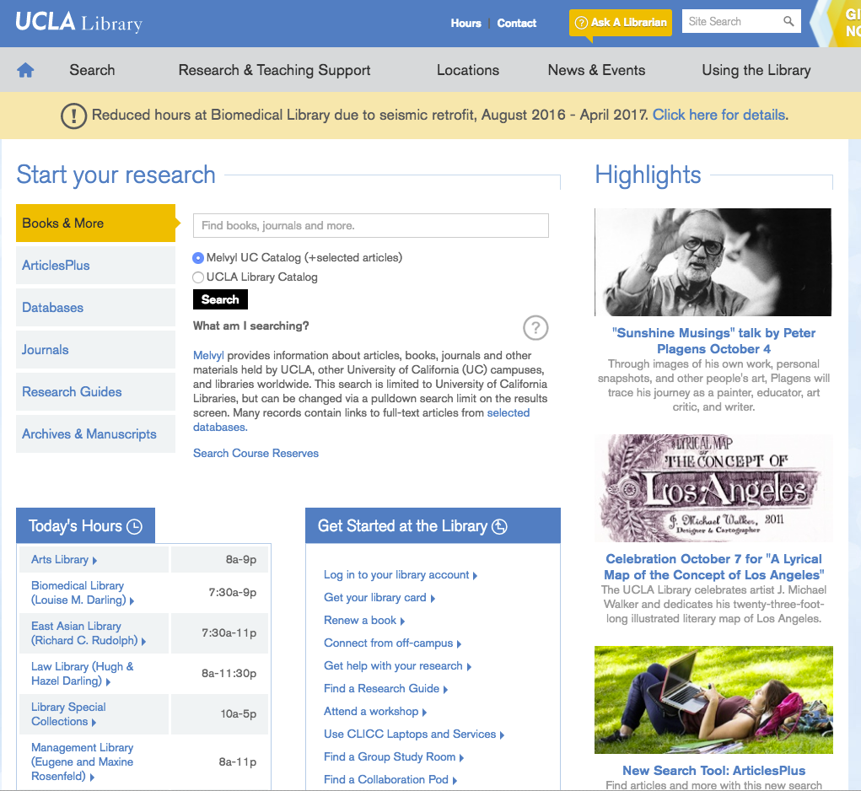



Online Guides & Tutorials +
Free one-on-one research consultations
Lots of support for student researchers!
24/7 Chat
Super search tools
Science Libraries:
Biomedical
Science & Engineering
Connect from off-campus
We’re here to help - http://library.ucla.edu

