Slide 1


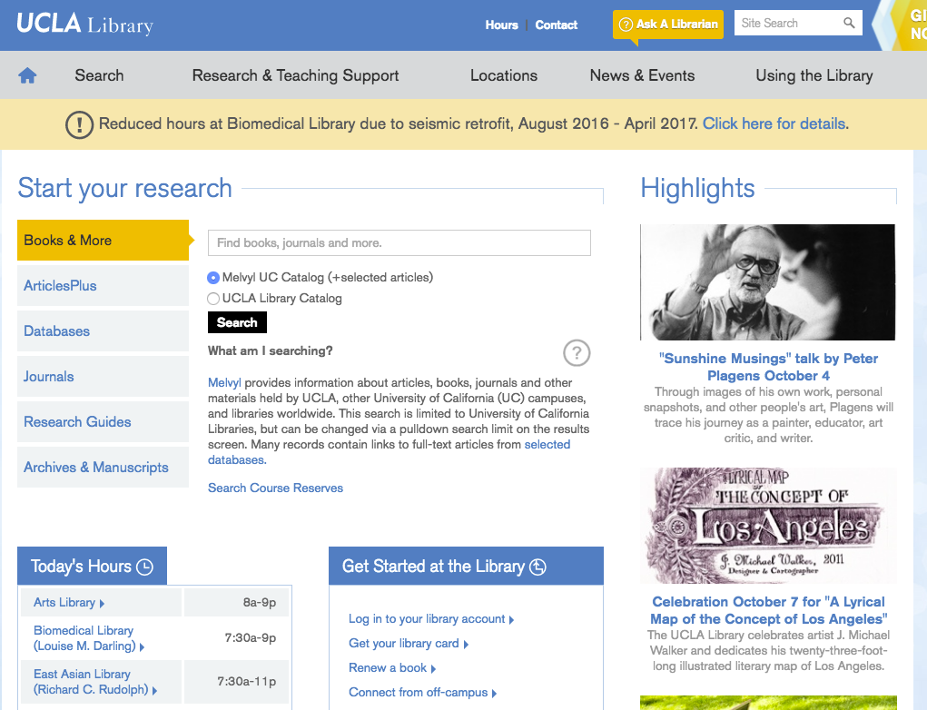



Online Guides & Tutorials
Free one-on-one research consultations
24/7 Chat!
Super search tools
Lots of Libraries.
Find your favorites!
Connect from off-campus
UCLA Library is here to help! library.ucla.edu

