Slide 1
Pre trained models in deep learning
CSE 705 – SEMINAR ON RECENT ADVANCES ON REINFORCEMENT LEARNING.
By:
Sudheer Anugoju and
Gaddipati Lohit
Submission Date: 29-June-2022

Slide 2
Pre trained models
Dense Net
YAMNet
BERT
VGG 16
Inception V3
T5

Slide 3
Description
The main aim of this project is to explore the different pre trained model that exist in Deep Learning and to learn how to implement them and execute them on your own inputs. In this project we have used different kinds of datasets, which includes audio, Images and text. Each of these models, as the name suggest, are pre-trained with similar datasets.

Slide 4
DENSE NET 121

Slide 5
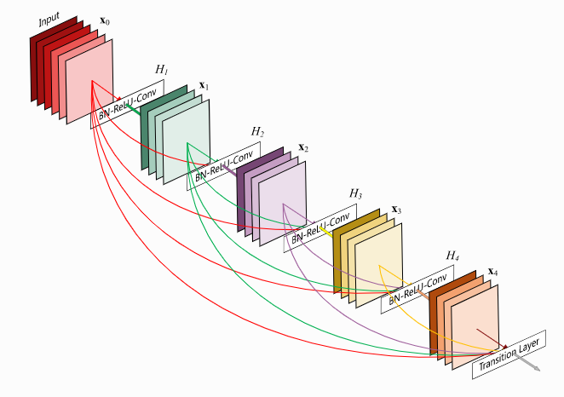
Background
Dense Net uses residual connections to reuse features across the layers, as the convolutions depend on all the previous inputs but only a small number of filters.
The last layer, which is known as Transition Layer, help to reduce the dimensionality.
It has 1 7x7 Convolution, 58 3x3 Convolution and 61 1x1 Convolution along with 4x4 Average pooling filter and a 1 Fully Connected Layer
Notes:
As DenseNets require fewer parameters and allow feature reuse, they result in more compact models and have achieved state-of-the-art performances and better results across competitive datasets, as compared to their standard CNN or ResNet counterparts.

Slide 6
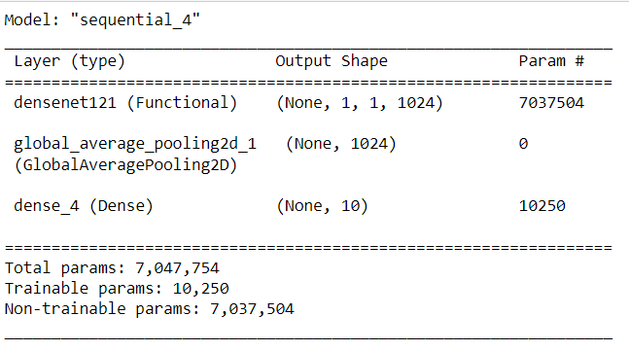
Implementation
PRETRAINED DATASET = ImageNet
DATASET: Cifar10
ADDITIONAL LAYERS: Average Pooling and Dense.
ACCURACY: 62.64
TYPE OF DATA: Images
Here the model is supposed to predict the name of the images based of its training.

Slide 7
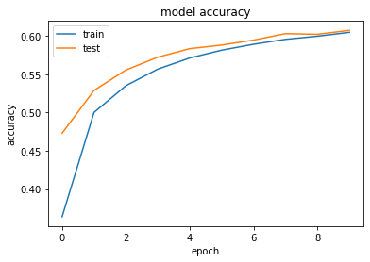
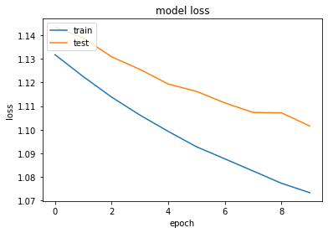
Results

Slide 8
YAMNet

Slide 9
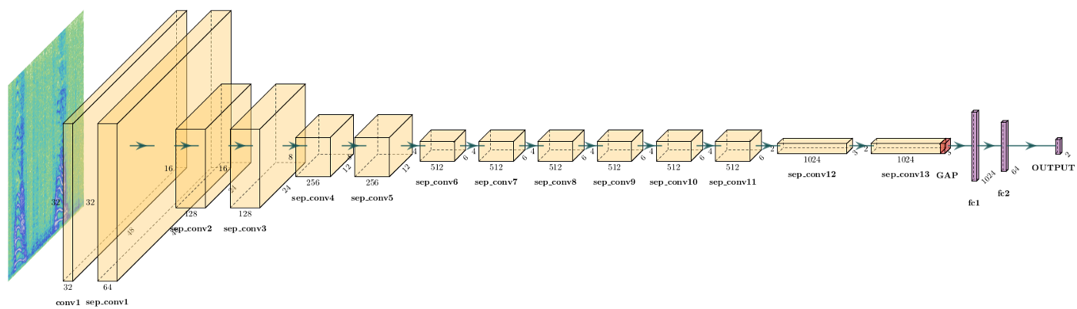
Background
YAMNet, Yet Another Mobile Network is a pre-trained model, which makes use of MobileNetV1 depth wise- separable convolution architecture, takes audio as an input and edicts its classes.
Internally, the model extracts "frames" from the audio signal and processes batches of these frames. This version of the model uses frames that are 0.96 second long and extracts one frame every 0.48 seconds .
Notes:
Yes, that is the full form, is a pretrained acoustic detection model trained by Dan Ellis on the AudioSet dataset which contains labelled data from more than 2 million Youtube videos

Slide 10
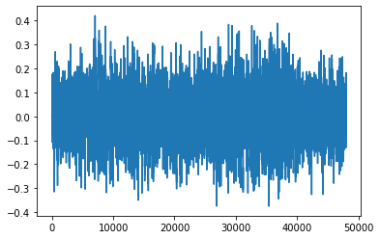
Implementation
PRETRAINED DATASET = AudioSet(2 M YT videos)
DATASET: MS-coco dataset
ADDITIONAL LAYERS: just a couple of dense layers
ACCURACY: 91.15 %
TYPE OF DATA: Audio
The following image show a test sample from the dataset that was used.

Slide 11
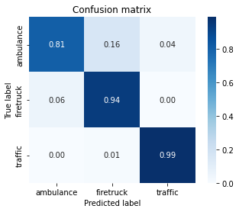
Results
The following confusion matrix show the probability of the input belonging to each class.

Slide 12
T5 TRANSFORMER

Slide 13
Background
Text –to- Text Transfer Transformer, also known as T5, is an NLP pre-trained model that is can perform translation, question answering, classification and summarization and much more.
The T5 is essentially an encoder-decoder pre-trained on different mixtures of Unsupervised and supervised task.

Slide 14
Implementation
PRETRAINED DATASET = Multiple datasets mixture of supervised and Unsupervised.
DATASET: Multiple articles dataset.
TYPE OF DATA: Text Summarization or Title.
Unlike the rest, this model an NLP based model that converts Text to text.
Initially we install hugging face transformers and then we import T5 tokenizer and T5 model from hugging face.
Then we move on to tokenizing and data preprocessing and Finally, we generate summaries.
Notes:
pretraining on C4 large wiki data set.
2. With T5, we propose reframing all NLP tasks into a unified text-to-text-format where the input and output are always text strings, in contrast to BERT-style models that can only output either a class label or a span of the input.
3. Hugging face an open-source NLP library that made our life easy to deal with State of the art transformers just like sci-kit learn for machine learning algorithms

Slide 15
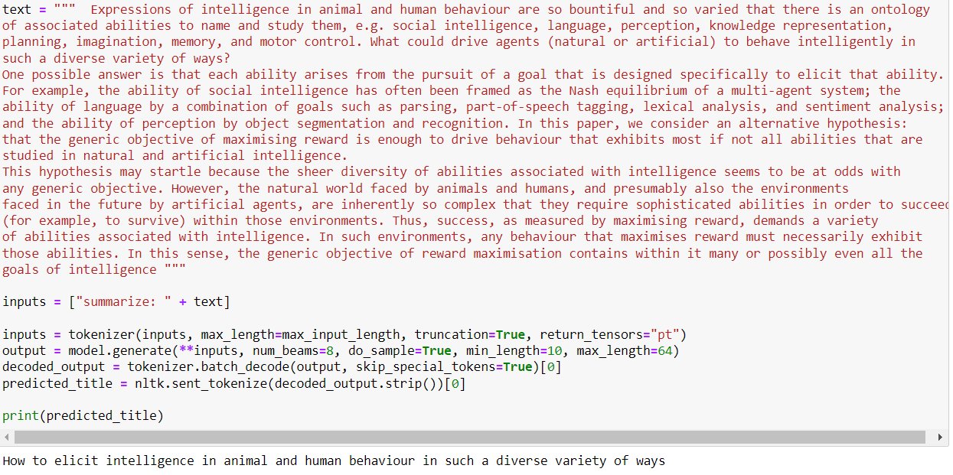
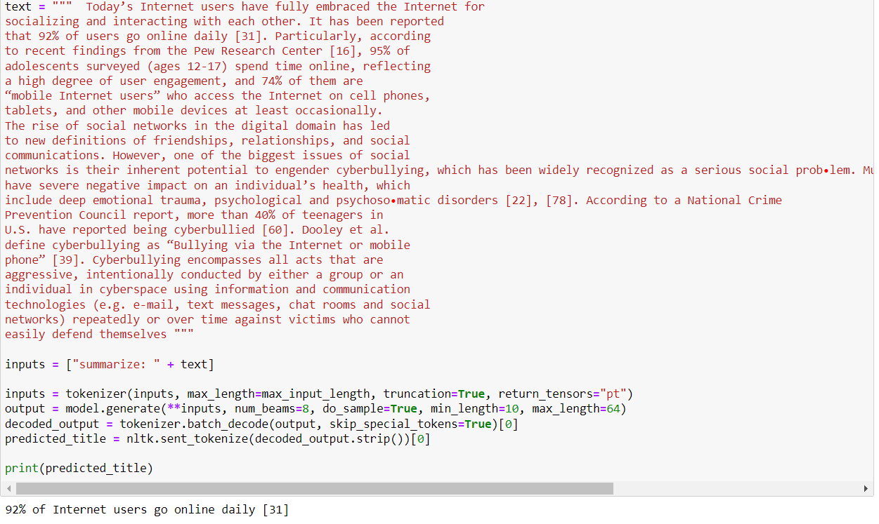
Results

Slide 16
Results
The First paragraph was taken from the research paper REWARD IS ENOUGH and as you can see the summarization How to elicit intelligence in humans and animal behavior in such diverse variety of ways is an apt summarization of the paragraph that was given to the model
Similarly, In the second picture, was taken from another research paper on CYBERBULLING AND SECURITY and the summarization of the model 92% of users go online daily suits with the theme of the paragraph and the paper, as was the case with the first paragraph.
Although, the above examples are successfully summarized there are instance where the model wasn’t accurately able to summarize or title the given input.

Slide 17
BERT

Slide 18
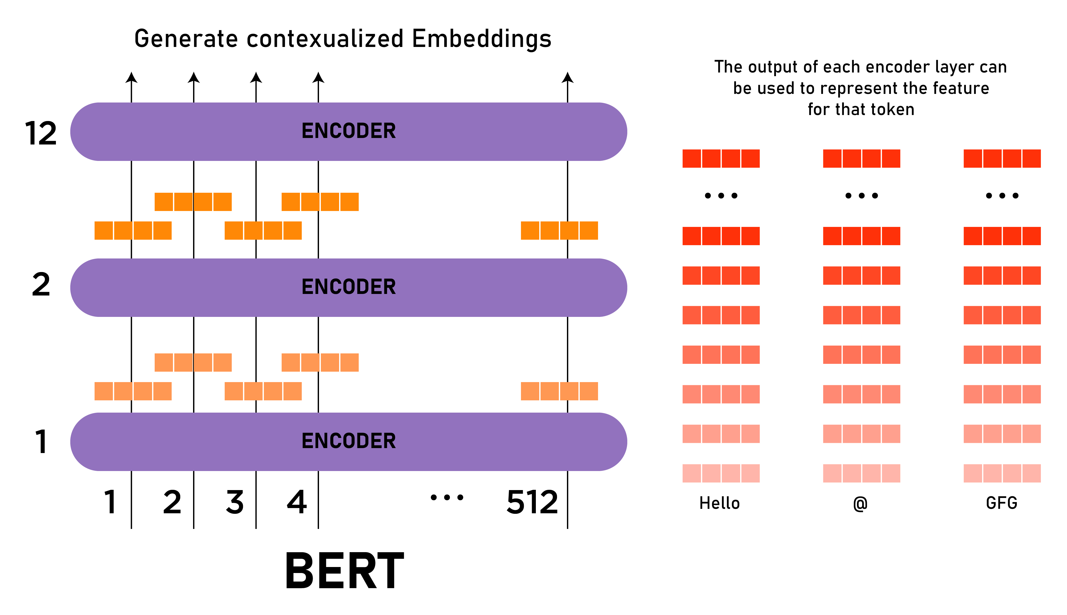
Background
The BERT, uses a Transformer encoder architecture, processes each token of input in full context of all the token that comes before and after.
BERT is designed to help the computer better understand the ambiguous language in the text with the help of the texts that are surrounding the target.

Slide 19
Implementation
PRETRAINED DATASET = corpora BookCorpus + English Wikipedia
DATASET: SPAM dataset.
ACCURACY: 92.59
TYPE OF DATA: Texts
This model is used to detect the spam messages which was pre trained on a concatenation of two datasets and achieves high accuracies in NLP tasks.

Slide 20
INCEPTION-V3

Slide 21
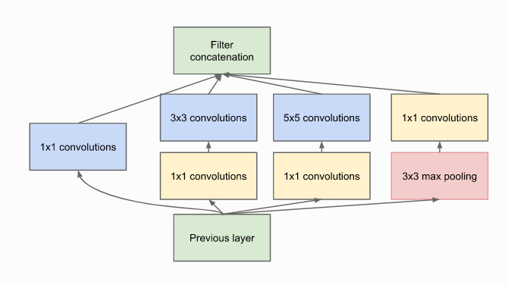
Background
Inception V3 is built upon Inception, also known as Google Net. Which is 22 layers deep. Inception V3 is 48 layers deep but its just as fast as its previous versions.
Inception V3 uses less computational power and is more efficient.
Inception layer is made up of 1×1 Convolutional layer, 3×3 Convolutional layer, 5×5 Convolutional layer and an output filter along with 1×1 Convolutional layer for dimensionality reduction before the next layer and a Max pooling layer.

Slide 22
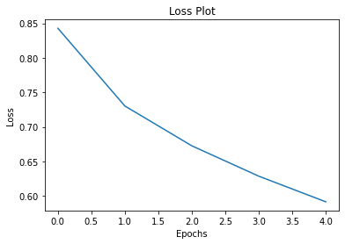
Implementation
PRETRAINED DATASET = ImageNet
DATASET: ms-coco dataset
ADDITIONAL LAYERS: just a couple of dense layers
LOSS: Constant decrease as the number of epochs increases.
TYPE OF DATA: Images
Here, unlike above, the model gives a brief description of the input based of the training.

Slide 23
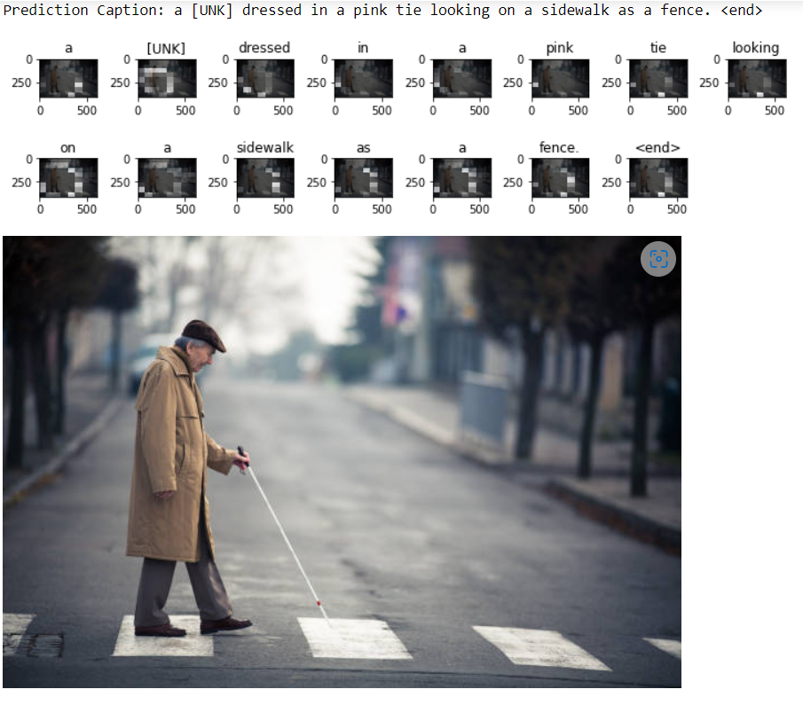
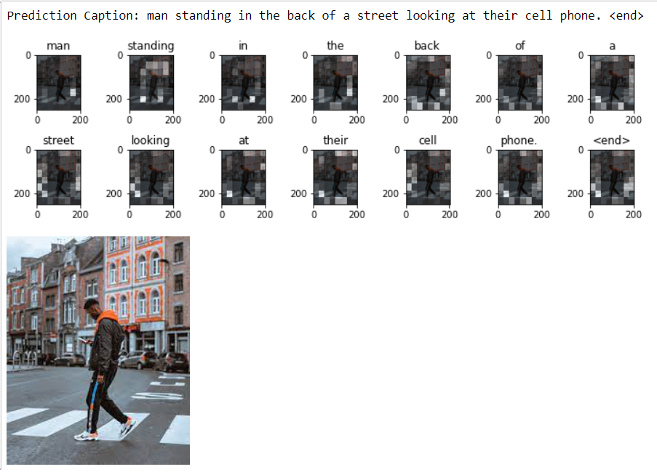
Results

Slide 24
VGG

Slide 25
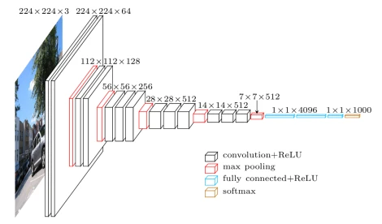
Background
Visual Geometry Group, also known as VGG is developed by researches at oxford.
The VGG is made up of blocks and each block consists of a two-dimensional Convolution and max pooling layers.
Depending on the number of convolutional layers used there are VGG 16 and 19.
Notes:
Won the Image net(ILSVR) competition

Slide 26
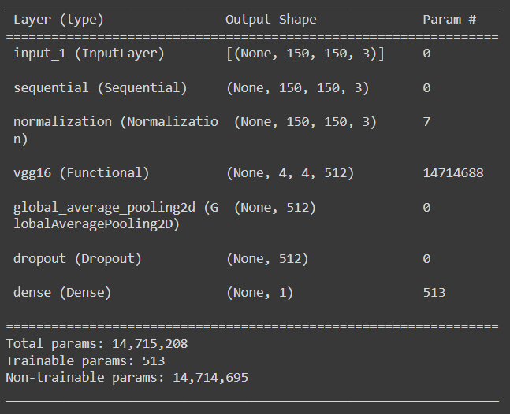
Implementation
PRETRAINED DATASET = subset of ImageNet
DATASET: cats and dogs' dataset
ADDITIONAL LAYERS: a normalization layer, pooling layer, dense and a dropout layer
LOSS: Constant decrease as the number of epochs increases.
TYPE OF DATA: Binary classification of Images
Here, the model is trained to classify the given images into only two categories either a dog or a cat.
Notes:
Basically, the VGG replace the kernals in ALexNet with a 3x3 kernals

Slide 27
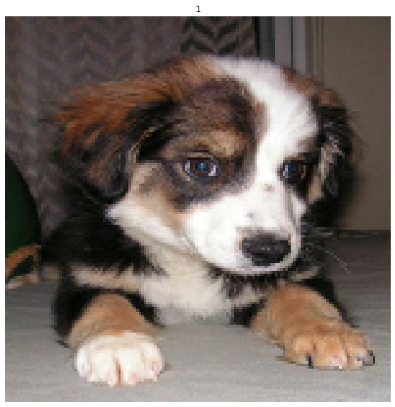
Results

Slide 28
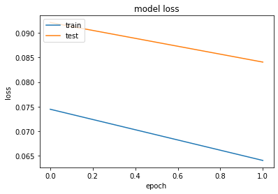
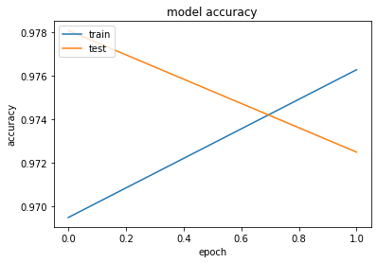
Results

Slide 29
Key Observations
Despite using large datasets our models perform their respective tasks very quickly.
The accuracy we got requires the model to highly trained on different kinds of data, which we didn’t do due to lack of resources.
Instead, we used the models that we trained on similar data to solve our problem, which is the definition of Transfer Learning
Despite having less resources and computational power we were able to keep the losses to a very minimum.
Notes:
Basically, the VGG replace the kernals in ALexNet with a 3x3 kernals

Slide 30
Conclusion
To summarize, pre-trained models are the most efficient way of performing task like image classification tasks or NLP task with minimum resources.
Pre-Trained models are already trained on their respective datasets and based on these we can determine which pre-trained model to use for your task at hand
Inception can be used for image classification with input size of 224x 224 and DenseNet is also used for visible object classification and has an input size of 32x32. YAMNet is used for dividing the audio into classes. VGG is also an object recognition model.
BERT is an NLP model i.e., it’s a text classification model. It can be used in sentiment analysis or spam detection and much more. T5 is also an NLP model , unlike BERT, that can be used for text translation or summarization and such tasks.
Notes:
Basically, the VGG replace the kernals in ALexNet with a 3x3 kernals

Slide 31
THANK YOU

