Slide 1
Storage in Azure Microsoft Intelligent App Workshop
<Name of Trainer>
<Title of Trainer>

Slide 2
NoSQL vs. SQL
Data stored in columns and tables
Relationships represented by data
Data Manipulation Language
Data Definition Language
Transactions
Abstraction from physical layer
Non-relational
Distributed
Open-source
Horizontally scalable
Often schema-free
Often with easy replication support
Eventually consistent
BASE (not ACID)

Slide 3
Azure SQL Database

Slide 4


SQL Options in Azure
SQL Server
SQL Server in Azure VM
Azure
SQL Database
Azure SQL Data Warehouse
SQL
DW
Cloud-first but not cloud only
Docker Container Support
Windows and Linux

Slide 5
Azure SQL Database
Fully managed SQL database service that lets you focus on your business
Azure
SQL Database
Database provisioning on-demand
Predictable performance for enterprise workloads
Elastic database pools for unpredictable SaaS workloads
99.99% availability SLA
Geo-replication and restore services for data protection
Secure and compliant to protect sensitive data
SQL

Slide 6
SQL Database Service Tiers
Basic
Standard
Premium
Intended Use
Light transactional workloads
Go-to option for most business applications
High throughput and business-critical databases
Workload Elasticity
Isolated databases and elastic database pools
Performance
•
••
•••
Business Continuity
•
••
•••
Programming Surface
Compatible with SQL Server databases
Availability
99.99%*

Slide 7
Database performance and throughput
Compute
DTU database transaction unit
Writes
Reads
Memory

Slide 8
Predictable performance
Isolated databases are allocated isolated resources
Basic, Standard, and Premium tiers provide increasing performance levels
Scale up/down in response to actual or predicted change in workload
Databases remain online while scaling
Hourly billing at highest rate that hour
P11
P6
P4
P2
P1
S3
S2
S0
S1
B
5
10
20
50
100
125
250
500
1000
1750
DTUs

Slide 9
Elastic database pools
Share resources dynamically among databases on the same server
Customer-managed over-provisioning makes pools cost-effective for unpredictable, sporadic workloads
Well-matched to many database-per-tenant SaaS workloads
Basic, Standard, and Premium tiers
Databases can burst to the same level as isolated DBs in the same tier
Pool size is scaled to support aggregate workload
Hourly billing for the pool based on pool size and DB count
Max per-database burst level
eDTUs
200
400
800
1200

Slide 10
Azure Cosmos DB

Slide 11
Developing planet-scale apps comes with planet-scale challenges
Write accurate, globally distributed apps
Managing and versioning complex schemas
Scaling both throughput and storage based on global demand
Balancing the needs for strong and eventual consistency
Delivering highly-responsive experiences
Ensuring an always-on system

Slide 12

Put your data where your users are

Slide 13
Introducing Azure Cosmos DB A globally distributed, massively scalable, multi-model database service
Global Business
Save money
Global distribution
Become more productive
Become more flexible
Elastic scale-out
Become more responsive
Guaranteed single-digit latency
Become more innovative
Choice of consistency
Supplier
Enterprise-level SLAs
Store
Multi-model + multi API
Partner

Slide 14




Introducing Azure Cosmos DB A globally distributed, massively scalable, multi-model database service
Table API
Table API
Column-family
Document
Key-value
Graph
Elastic scale out
of storage & throughput
Guaranteed low latency at the 99th percentile
Five well-defined consistency models
Turnkey global distribution
Comprehensive SLAs

Slide 15
Azure Storage (HOL)
Demo Accelerated Network

Slide 16
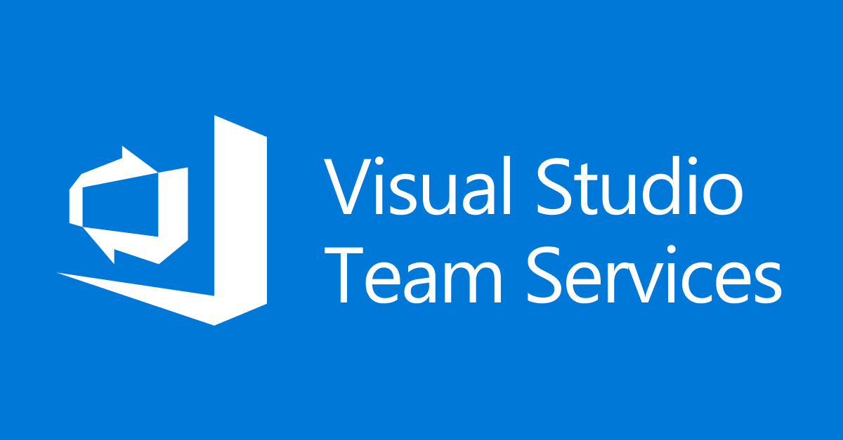

Questions?
Azure

