Slide 1
DevOps in Azure Microsoft Intelligent App Workshop
<Name of Trainer>
<Title of Trainer>

Slide 2


The converged DevOps lifecycle
Plan + Track
Release
Developers
IT Ops
Develop + Test
Monitor + Learn

Slide 3
Shift to DevOps
Old World
Focus on planning
Compete, not collaborate
Static hierarchies
Individual productivity
Efficiency of process
Assumptions, not data
New World
Focus on delivering
Collaborate to win
Fluent and flexible teams
Collective value creation
Effectiveness of outcomes
Experiment, learn and respond

Slide 4
DevOps habits and practices
PRACTICES
Application Performance Management
Infrastructure as Code
Continuous Deployment
Release Management
Configuration Management
Automated Recovery
PRACTICES
Automated Testing
Continuous Integration
Continuous Deployment
Release Management
PRACTICES
Usage Monitoring
Telemetry Collection Testing in Production
Stakeholder Feedback
PRACTICES
Code Reviews
Automated Testing
Continuous Measurement
FLOW OF CUSTOMER VALUE
TEAM AUTONOMY & ENTERPRISE ALIGNMENT
BACKLOG refined with LEARNING
EVIDENCE gathered in PRODUCTION
MANAGED TECHNICAL DEBT
PRODUCTION FIRST MINDSET
INFRASTRUCTURE is a FLEXIBLE RESOURCE
PRACTICES
Testing in Production
Usage Monitoring
User Telemetry
Stakeholder feedback
Feature flags
PRACTICES
Application Performance Management
Infrastructure as Code
Continuous Delivery
Release Management
Configuration Management
Automated Recovery
PRACTICES
Enterprise Agile
Continuous Integration
Continuous Deployment
Release Management

Slide 5

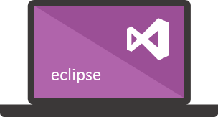






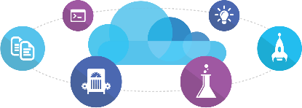

Microsoft Tooling
People | Process | Tools
Developer IDE
Build/CI
Release/CD
Develop
Build + Test
Monitor
Deploy
Team Collaboration
Release Management for Visual Studio
Test
Monitor + Learn
Automation Service
PowerShell | WAML
Azure Resource Management
Application Insights
Microsoft Test Manager
xPlat Command Line
On-Premises | Hybrid | Cloud

Slide 6








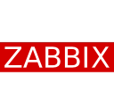





OSS Tooling
People | Process | Tools
Developer IDE
Build/CI
Configuration
Develop
Build + Test
Monitor
Deploy
Team Collaboration
Release
Monitor + Learn
Test
On-Premises | Hybrid | Cloud

Slide 7
In the Early Days…
Azure Service Management API was the version 1 that provided programmatic access for functionality in the Azure platform
Very limited functionality
Examples: ASM can be used to configure Cloud Services, Storage accounts, Virtual Networks
No way to target multi-region or multi-service in a single script
No consistency in the API exposed by services
XML, some used JSON
Limited access control
Subscription co-administrator for providing user access
Limited auditing available from the portal
Hard to organize lots of resources across the organization

Slide 8
Consistent Management Layer
Azure Resource Manager API

Slide 9
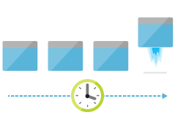
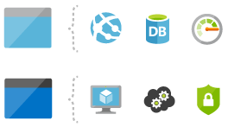

Areas of Focus
Deploy
Organize
Control

Slide 10
Deploying with ARM
template-driven
declarative
idempotent
multi-service
multi-region
extensible

Slide 11
Support for IaaS and PaaS
Support for IaaS
Incl. Networking
Support for PaaS
Mixed environments
E.g. web app in IaaS, SQL DB in PaaS

Slide 12
Advanced Concepts, Resources
Template functions
E.g. string functions, numeric functions, array functions, deployment values, etc.
https://azure.microsoft.com/en-us/documentation/articles/resource-group-template-functions/
Template linking
https://azure.microsoft.com/en-us/documentation/articles/resource-group-linked-templates/
Creating multiple instances
https://azure.microsoft.com/en-us/documentation/articles/resource-group-create-multiple/
Best Practices
https://azure.microsoft.com/en-us/documentation/articles/best-practices-resource-manager-design-templates/

Slide 13
Azure DevOps (HOL)
Demo Accelerated Network

Slide 14
Summary
Infrastructure is code
ARM makes Azure ready for large-scale
Number of resources, regions, etc.
ARM makes management easier
E.g. idempotency, tags, access control
ARM is cross-platform
PowerShell, Azure CLI, or REST
Create Linux and Windows resources

Slide 15
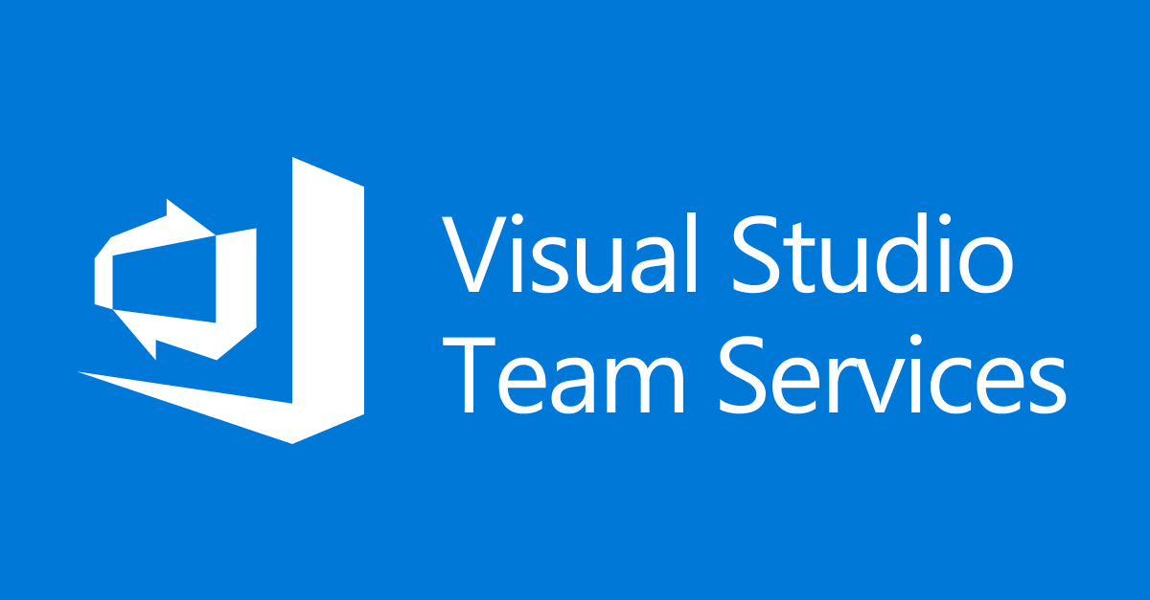

Questions?
Azure

