Slide 1
Microservices Microsoft Intelligent App Workshop
<Name of Trainer>
<Title of Trainer>

Slide 2
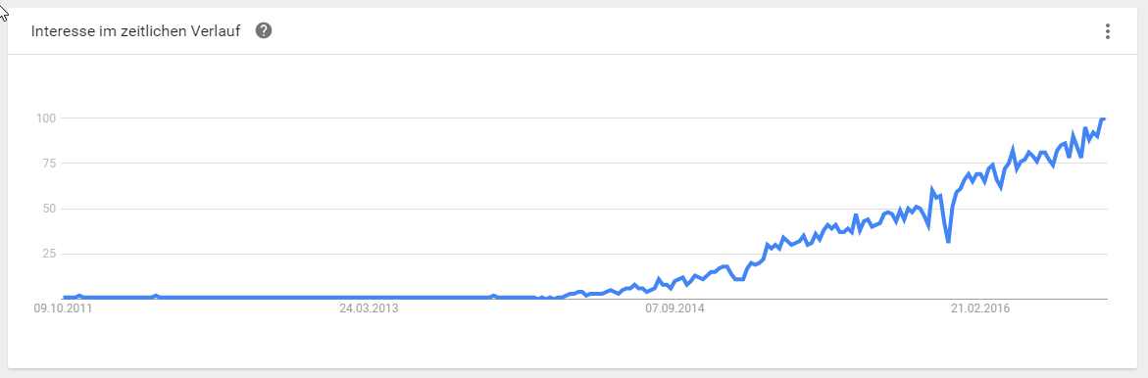
Microservices are currently hot!
Source: https://www.google.com/trends/explore?q=Microservices, 2016-10-03

Slide 3
What are Microservices?
Small, autonomous services working together
Single responsibility principle applied to SOA
See also concept of Bounded Context
Best used with DevOps and continuous deployment
Enhance cohesion, decrease coupling, enable incremental evolvement
How small are Microservices?
It depends (e.g. team structure, DevOps maturity, etc.)
“… one agile team can build and run it”, “… can be rebuilt by a small team in two weeks”
Find an individual balance
Autonomous = deploy changes without affecting others
Technology- and platform-agnostic APIs
See also https://en.wikipedia.org/wiki/Microservices

Slide 4
Loose Coupling
Tight Coupling
A change in one module usually forces a ripple effect of changes in other modules
See also Disadvantages of Tight Coupling
Loose Coupling
Components have little or no knowledge of the definitions of other components
Coupling is reduced by e.g. standards, queues, etc.
Microservices = loose coupling wanted
Single change → single deployment
No timing issues (if system A is deployed, system B needs update at the same time)

Slide 5
Cohesion
Highly cohesive systems
Functionality is strongly related
Modules belong together
Microservices = high cohesion wanted
Functions grouped in a services because all contribute to a single well-defined task
Reduce risk that a requirement concerns many different system components

Slide 6
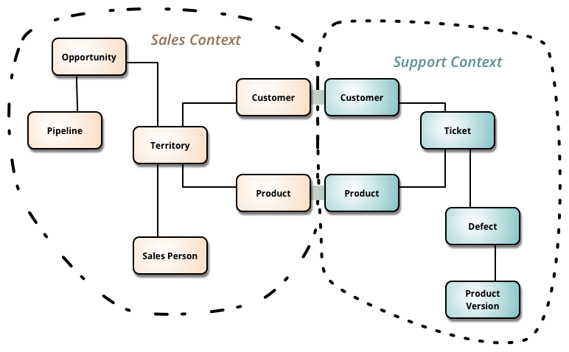
Bounded Context
Microservices often represent bounded contexts
Business-focused design
Less technical-focused design based on technical layers
Source: http://martinfowler.com/bliki/BoundedContext.html

Slide 7
Microservices
Microservices
Modeled around business concepts
Culture of Automation
Hide implementation details
Decentralized
Independently deployed
Isolate failures
Highly observable
Fundamental ideas
Work alongside many state-of-the-art approaches for software development
Agile development techniques
Continuous Integration/Delivery
DevOps
Cloud Computing
Containers

Slide 8
Why? Why not?

Slide 9
Why Microservices?
Work well in heterogeneous environments
Right tool for the job
Available skills of team members
Grown environment (e.g. M&A, changing policies, changing overall designs)
Easier to test/adopt new technologies
Reduce risk and cost of failure
New platforms (e.g. Node.js instead of .NET), new versions (e.g. .NET Core),
Resilience
Reduce single point of failures
Support different SLAs for difference modules (costs, agility)
Separation of services add complexity (e.g. network) → criticism of Micrservices

Slide 10
Why Microservices?
Let people take responsibility
Teams “own” their services
You build it, you run it
Scaling
Fine-grained scaling is possible
Simplify deployment of services
Overall, deployment of many Microservices might be more complex → criticism
Deployment patterns: https://www.nginx.com/blog/deploying-microservices/

Slide 11
Why Microservices?
Composability
Hexagonal architecture
Ability to replace system components
Outdated technology
Changed business requirements

Slide 12
Why Not? (Examples)
Harder to debug and troubleshoot
Distributed system
Possible mitigation: Mature logging and telemetry system
Performance penalty
Network calls are relatively slow
Possible mitigation: Remote calls for larger units of work instead of chatty protocols
No strong consistency
We are going to miss transactions!
Possible mitigation: Idempotent retries

Slide 13
Why Not? (Examples)
Harder to manage
You have to manage lots of services which are redeployed regularly
Possible mitigation: DevOps, Automation
System is too small
For small systems, monolithic approach is often more productive
Cannot manage a monolith (e.g. deployment)? You will have troubles with Microservices!
Environment with lots of restrictions
Microservices need a high level of autonomy

Slide 14
Team Organization

Slide 15
Conway‘s Law
„Any organization that designs a system will inevitably produce a design whose structure is a copy of the organization’s communication structure”
Organizational hurdles for Microservices
Tightly-coupled organizations
Geographically distributed teams
Missing tools (e.g. self-service cloud infrastructure, CI/CD tools)
Unstable or immature service that frequently changes
Missing culture of taking ownership (need someone to blame)
Cope with many different and new technologies
Source: Conway, How Do Committees Invent, Datamation magazine, April 1968

Slide 16
Organisational Helpers
Co-locate teams
One team responsible for a single service should be co-located
Embrace open source development style
Works internally, too
Internal consultants, custodians and trusted committers
Quality gateways
Servant leaders
Step-by-step approach
Be clear in communication
E.g. responsibilities, long-term goals, changing roles

Slide 17
Microservices Architects…
…don‘t create perfect end products
…help creating “a framework in which the right systems can emerge, and continue to grow”
…understand the consequences of their decisions
…code with the team (“architects should code”, “coding architect”)
…aims for a balance between standardization and freedom
Build skills for a certain technology vs. right tool for the right job
…create guiding principals and practices
Example for principals (largely technology-independent): https://12factor.net/
Example for practices (often technology-dependent): .NET Core Coding Guildelines
Recommended reading: Newman, Sam. Building Microservices, O'Reilly Media

Slide 18
Guidance, Governance
Samples
Small code samples vs. perfect examples from real world
Templates, code generators
Examples: Visual Studio Templates, .NET Core CLI, Angular CLI
Shared libraries
Be careful about tight coupling!
Example: Cross-platform libraries based on .NET Standard Library for cross-cutting concerns
Handle and track exceptions from principals and practices
Remember goal of Microservices: Optimize autonomy
→ Exceptions should be allowed

Slide 19
Technical Aspects

Slide 20
Microservice Interfaces

Slide 21
Monolith to Microservices
ERP
HR
Notification
REST API
ERP
HR
EDI
Apps
Accounting
Payments
PLM
Accounting
Web UI
CRM
Doc. Mgmt.
Web UI
Apps
SCM
CRM
Ext. Partners
SCM
Rating
PLM
…

Slide 22
Interfaces
Small number of communication standards
Examples: HTTP/REST, OData, GraphQL, OpenID Connect
Goals: Interoperability, productivity (economy of scope), detect malfunctions
Practices and principles for typical use-cases needed
Status Codes
Data encoding
Paging
Dynamic filtering
Sorting
Long-running operations
…
See also https://speakerdeck.com/rstropek/restful-web-api-design

Slide 23
Interface Technology
Tolerant against changes
See also Breaking Change in Microsoft’s REST API Guidelines
Technology-agnostic
Simple to use and provide
Availability of tools, libraries, frameworks, knowledge
Hide implementation details
Shared Database anti-pattern

Slide 24
Interface Design
Synchronous communication
Request/response pattern
Bidirectional communication
Example: RESTful Web API, WebSockets
Asynchronous communication
Event-driven
Examples: Service Bus, RabbitMQ, Apache Kafka, Webhooks
Central orchestration or autonomy?
Example: Business Process Modelling and Execution
Further reading: https://www.nginx.com/blog/event-driven-data-management-microservices/

Slide 25
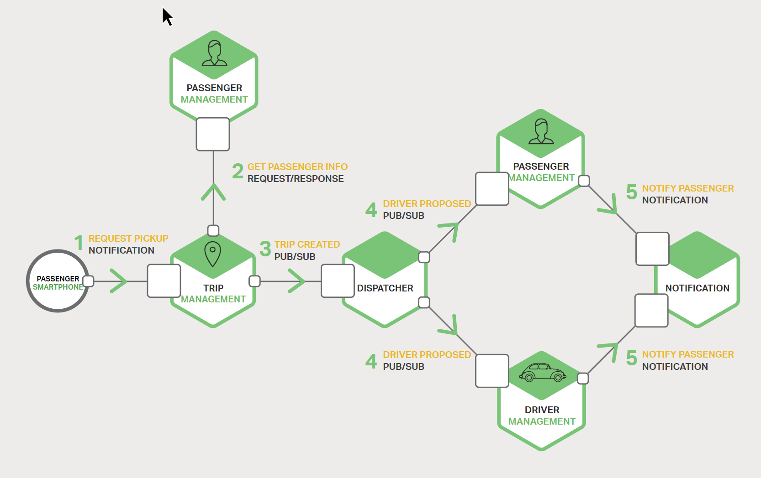
Interface Mechanisms
Image Source: Chris Richardson, Microservices – From Design to Deployment, NGINX, 2016

Slide 26
Handling Failures
Partial failures
Single service must not kill entire system
Outage vs. degradation
Performance degradation
Single dependent service not available
Circuit breaker pattern
Track success of requests
Stop trying if error rate/performance exceeds threshold
Regular health check or retry

Slide 27
Versioning
Semantic Versioning (SemVer)
Raise awareness for breaking changes
Definition of a breaking change is necessary
Avoid breaking changes
Discussion point: JSON vs. XAML deserializer in C#
Offer multiple versions in parallel
Give consumers time to move
Use telemetry to identify slow movers

Slide 28
Libraries vs. Microservices
Goal: Don‘t Repeat Yourself (DRY)
Contraction to Microservices architecture?
Good for…
…cross-cutting concerns (use existing, wide-spread libraries)
…sharing code inside a service boundary
Client libraries
Hide complexity of communication protocol
Implement best practices (e.g. retry policy)
Example: Azure Active Directory Authentication Libraries
UI components
Service provides UI fragments (e.g. WebComponents)

Slide 29
Automation
Continuous Integration and Deployment, Tests

Slide 30

Mobile app CI and CD
Code Repository
Build + Deploy
Automated Testing
User Testing
Backlog
Monitor and improve
Image Source: Microsoft

Slide 31
CI/CD
One code repository and CI/CD build per service
Possible: Common infrastructure for economy of scope and scale
Build and deployment pipeline
Compile and fast tests (unit tests)
Slow tests
UAT (manual tests, explorative tests)
Performance testing (e.g. cloud load testing)
Separate deployment from release
E.g. Azure App Service stages with swapping
Canary releasing
Direct portion of your traffic against new release and monitor stability

Slide 32
Monitoring
System-wide view of our system‘s health
Contains data from all services
Logging
Telemetry (e.g. CPU and memory usage, response times, dependent requests, etc.)
Microsoft‘s solutions
Visual Studio Application Insights
Hockeyapp
3rd party solutions
Log analysis with Elastic Stack
Dynatrace (leader in Gartner Magic Quadrant)

Slide 33
Manual Testing
Manual testing: try the program and see if it works!
Tester plays the role of a user
Checks to see if there is any unexpected or undesirable behavior
Test plans with specified test cases
Drawbacks
Slow
Requires lots of resources → expensive
Cannot be performed frequently
Heavy manual testing is a showstopper for Microservices

Slide 34
Testing Level
Unit Test
Test single function or class
Service Tests
Bypass UI and test service directly
Stubs or mockups for dependent services/resources (e.g. Mountbank)
End-to-End Tests
Hard in a Microservice environment (e.g. which versions to test?)
Tend to be flaky and brittle
Good approach: Test a few customer-driven “journeys”

Slide 35
Deployment

Slide 36
Deployment Strategies
Single service instance per host
Inefficient
Multiple service instances per host
Efficient in terms of resource usage
No isolation → no resource limitation, no isolated environments, no sandboxes
Service instance per VM
Based on a common image
Complete isolation
Uses resources less efficient → expensive
Requires mature virtualization environment

Slide 37
Deployment Strategies
Service instance per container
Based on a common image (automatically created)
High level of isolation (like VMs if you use e.g. Windows Hyper-V Container)
Requires running container environment (e.g. Docker Cloud, Azure Container Services)
Serverless deployments
E.g. Azure App Service, Azure Functions
Reduce operations to a minimum

Slide 38
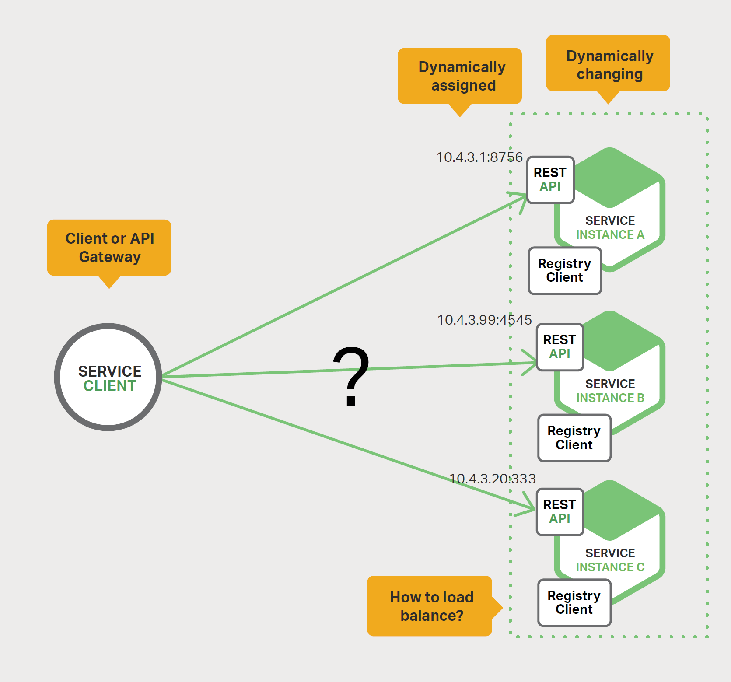
Service Discovery
Dynamically assigned addresses
Changing environment
Failures
Scaling
New versions
Tools
DNS (e.g. Azure DNS)
Load Balancer (e.g. Azure LB)
Discovery and config tools (e.g. Consul)
Image Source: Chris Richardson, Microservices – From Design to Deployment, NGINX, 2016

Slide 39
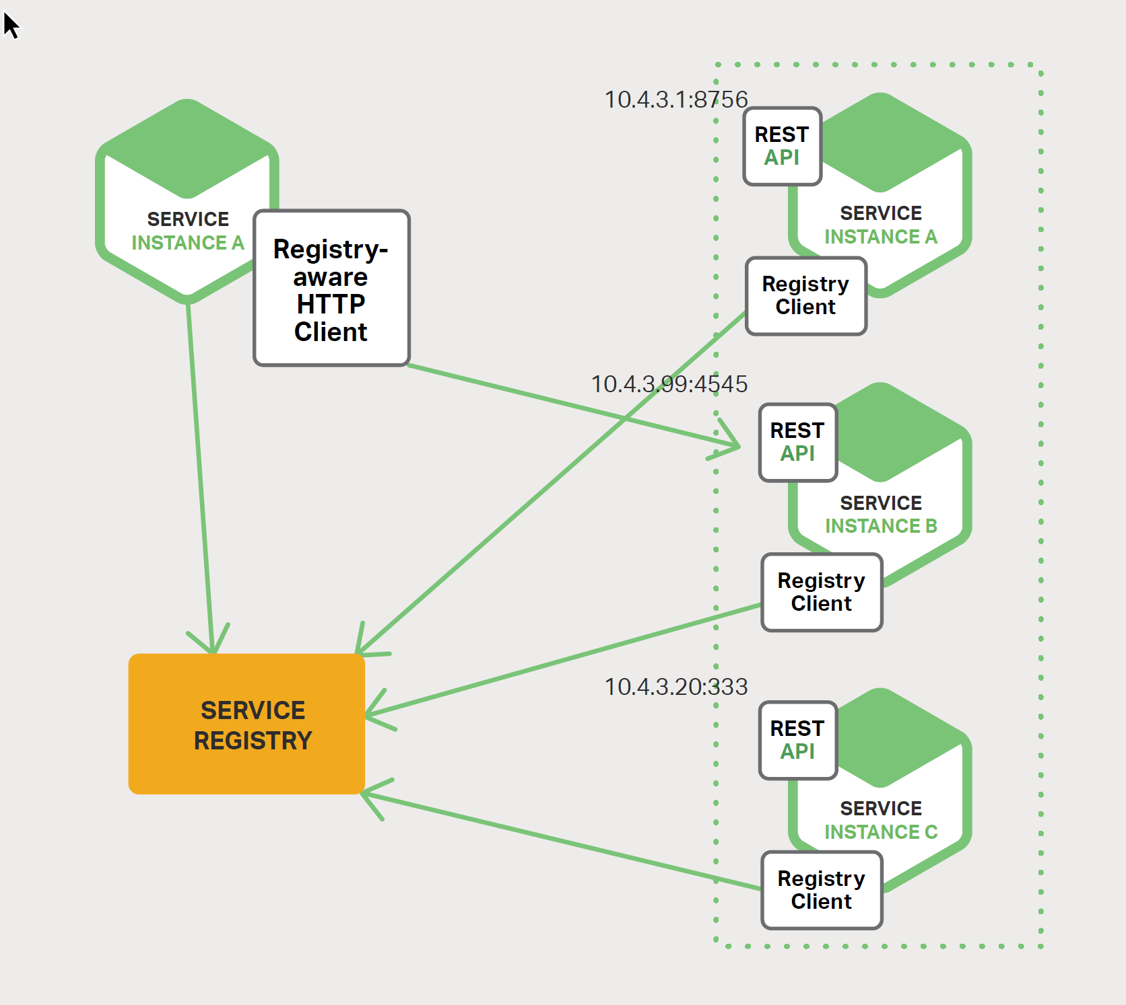
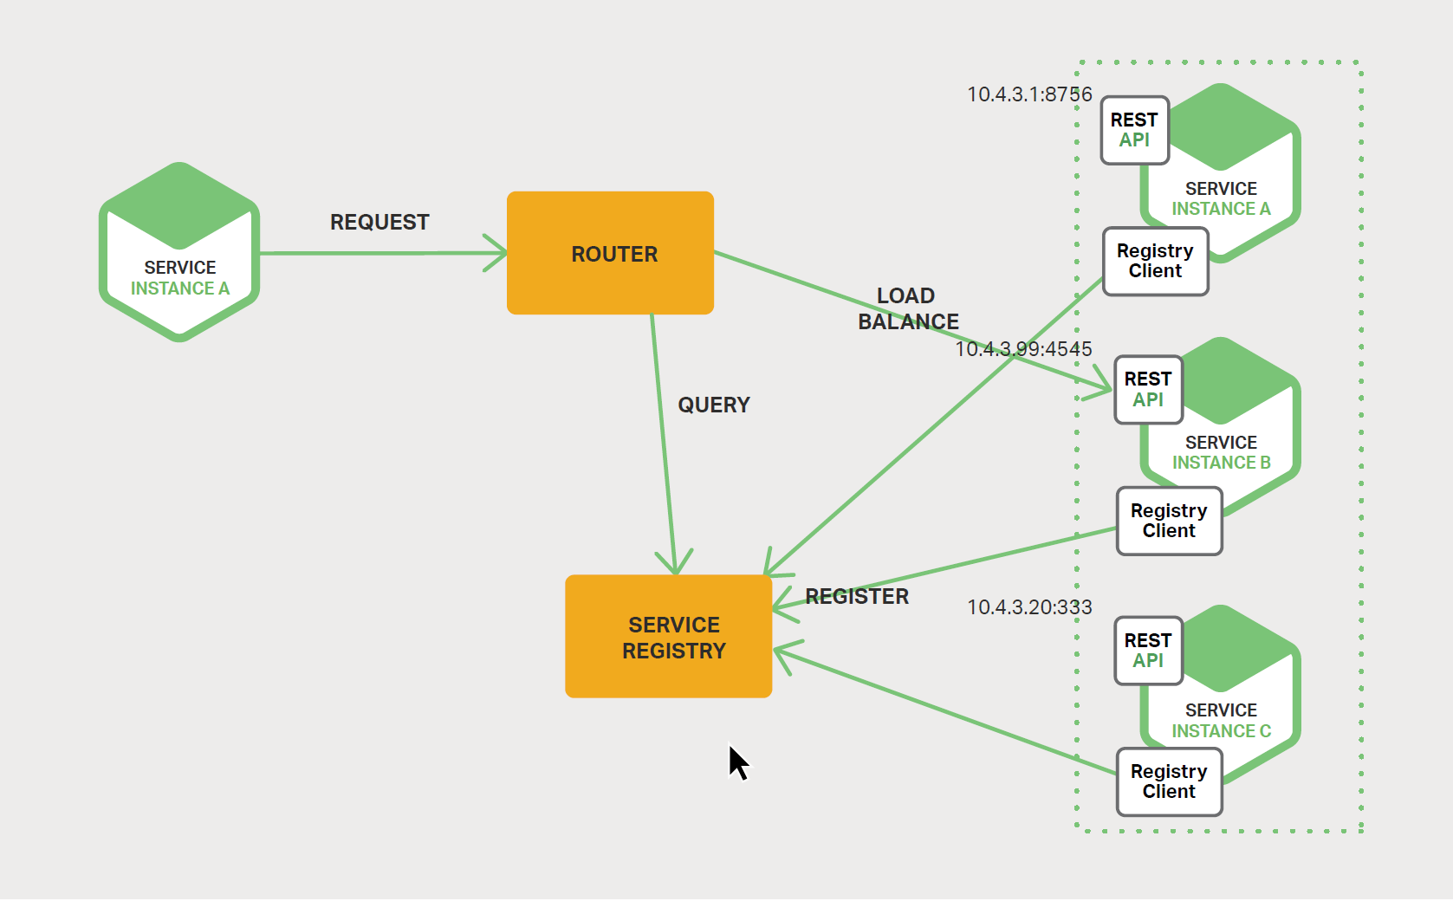
Client vs. server-side discovery
Image Source: Chris Richardson, Microservices – From Design to Deployment, NGINX, 2016

Slide 40
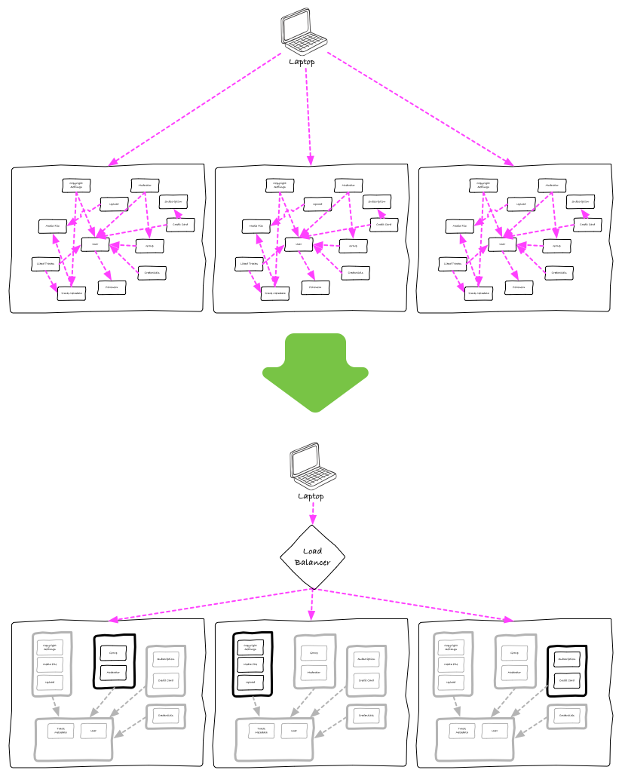
Deployment
Architecture
Old: Each node contains entire system
New: Unrelated modules behind load balancer/reverse proxy
API Gateways
Marshal backend calls
Aggregate content
Example: Azure API Management
Source: How we ended up with microservices

Slide 41
Data Management

Slide 42
Data Management
Each Microservice has its own data
No transactions
No distributed queries
Duplicated data to a certain extent
Event-driven architecture
Requires service bus or message broker (e.g. Service Bus, RabbitMQ, Apache Kafka)
Option: Use DB transaction log
Event sourcing and CQRS
Read more in MSDN, Martin Fowler

Slide 43
Transactions
Question and avoid ACID transactions across services
Perfectly fine inside service boundaries
Has consequences on API design (e.g. Azure Storage Entity Group Transactions)
Idempotent retry
Gather data, try again later
Use compensating transactions

Slide 44
Microservices (HOL)
Demo Accelerated Network

Slide 45
Further Readings
Martin Fowler on Microservices
Newman, Sam. Building Microservices, O'Reilly Media
NGINX
Tech Blog
Microservices: From Design to Deployment

Slide 46


Questions?
Azure

