Slide 1
Monitoring Microsoft Intelligent App Workshop
<Name of Trainer>
<Title of Trainer>

Slide 2
What is Application Insights?
Application Performance Management (APM)
PaaS offering provided by Microsoft
Primarily for DevOps teams building web solutions
Data collection, storage, and analytics
Collection done by components provided by Microsoft
Data stored in servers operated by Microsoft
Analytics in Azure Portal, AI Analytics, Power BI, etc.
Ready-made solution
Add AI instrumentation module (e.g. NuGet package)
Add config file or code
No need to write a lot of code or run your own servers

Slide 3
Covered Telemetry
HTTP request rates, response times, success rates
Dependency (HTTP & SQL) call rates, response times, success rates
Exception traces from both server and client
Diagnostic log traces
Usage data like page view counts, user and session counts, etc.
AJAX call rates, response times and success rates
Server performance counters
Custom client and server telemetry

Slide 4
Data Analytics
Alerts
Smart and manual alerts on failure rates and other metrics, and on availability
Charts over time of aggregated metrics
Diagnostic search
Instances of requests, exceptions, custom events, log traces, page views, dependency and AJAX calls
Analytics
Query language over your telemetry
Dashboards will drill-down capabilities
Visual Studio
Code lenses and diagnostic data for debug sessions
Segmentation
By e.g. client location, browser version, OS version, server instance, custom dimensions, and more.

Slide 5
Adding Application Insights
At runtime
No code changes
Available for IIS, Azure Web Apps, Azure Functions, Azure VMs, and J2EE
At development time
Add instrumentation modules and configuration to your code, write custom telemetry
For backend and desktop apps
Native support for .NET, Java, Node.js, JavaScript, Python, Ruby, etc. (details)
Can be integrated in existing logging frameworks like Log4Net, Log4J, LogStash, etc.
Plugins available for commonly used CMS
Availability Tests

Slide 6
Analytics
Search feature of AI
Analytics query language
Details

Slide 7
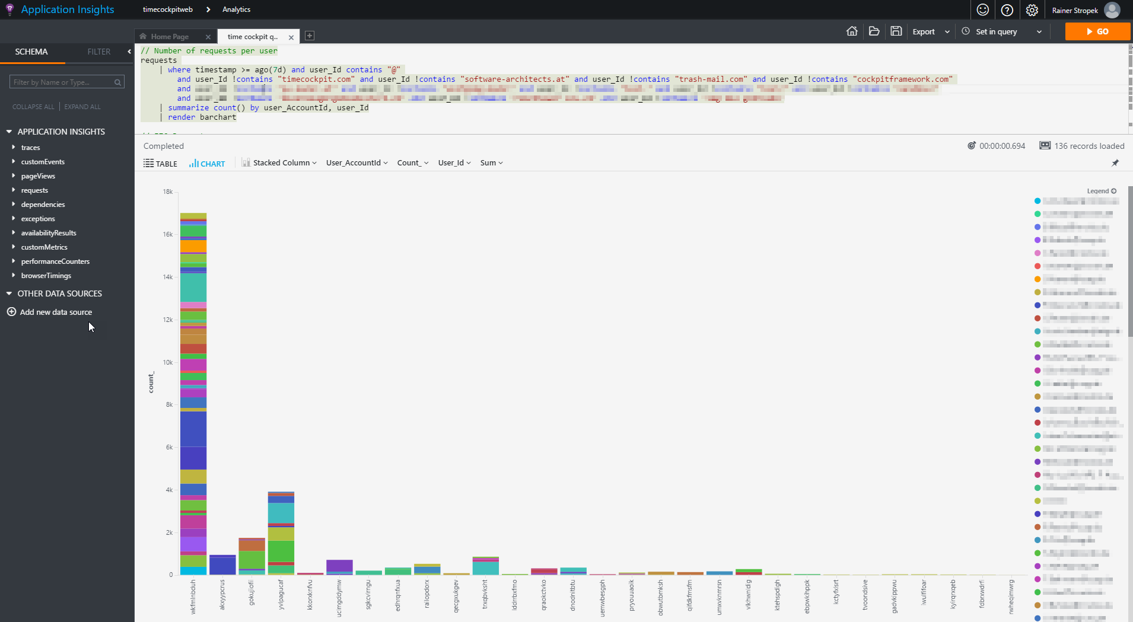
Requests per Tenant

Slide 8
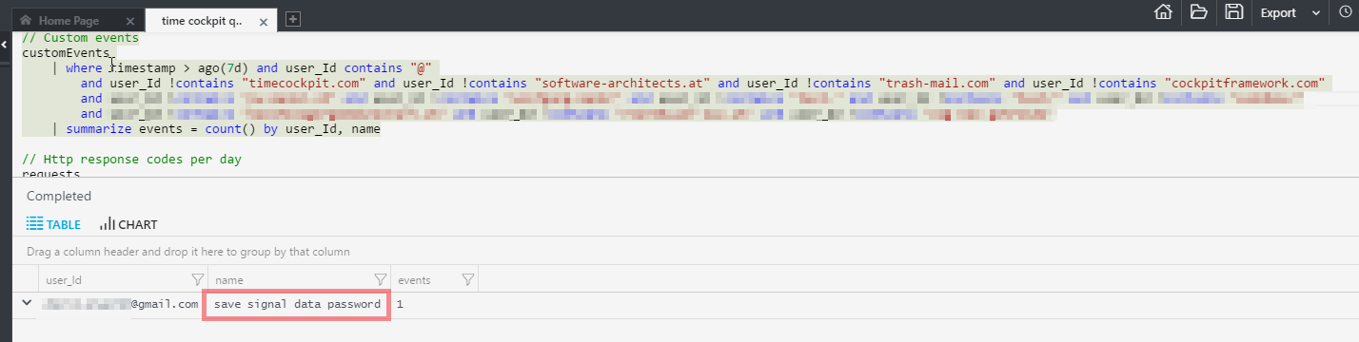
Custom Events

Slide 9
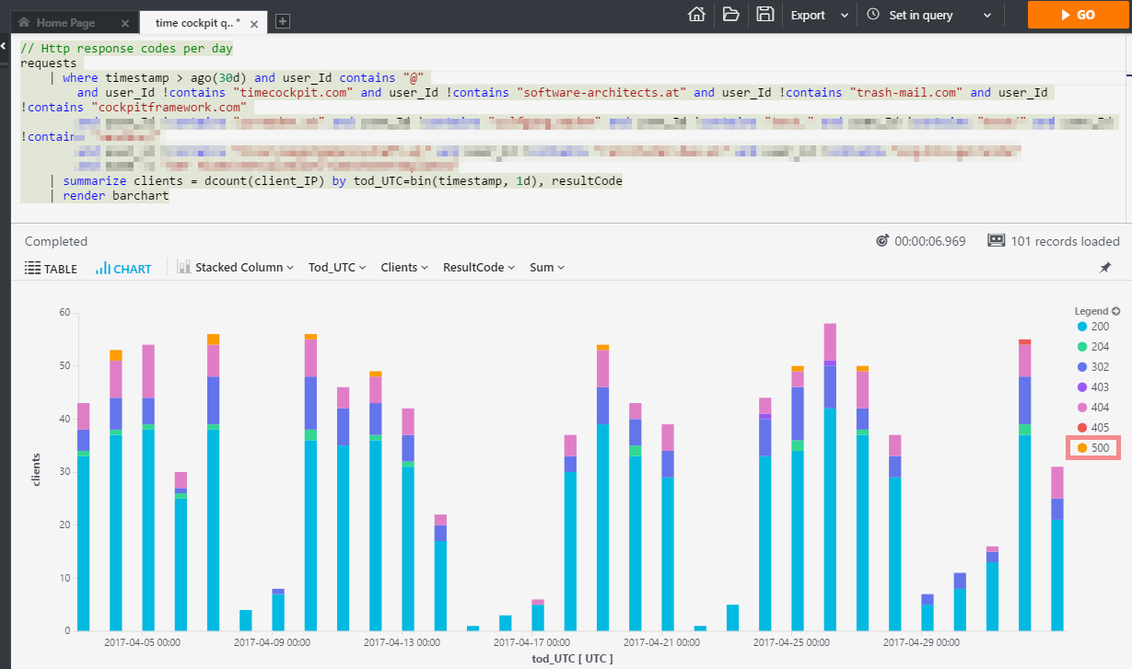
Find Failed Requests

Slide 10
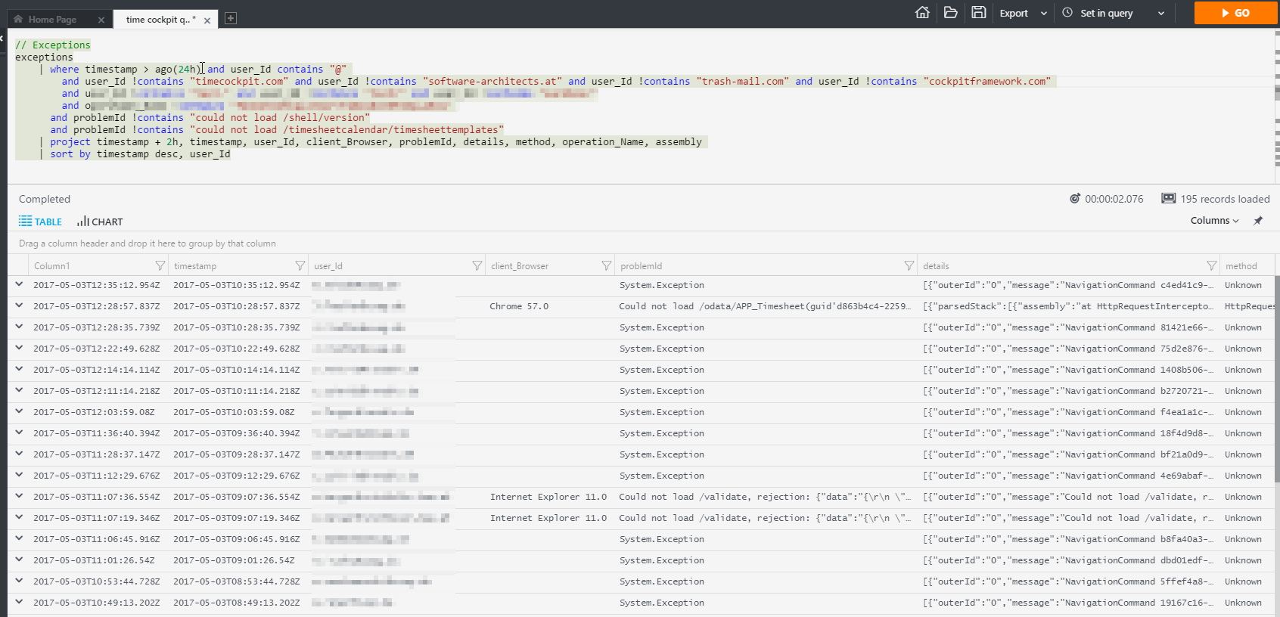
Analyze Exceptions
Client and Server Side

Slide 11
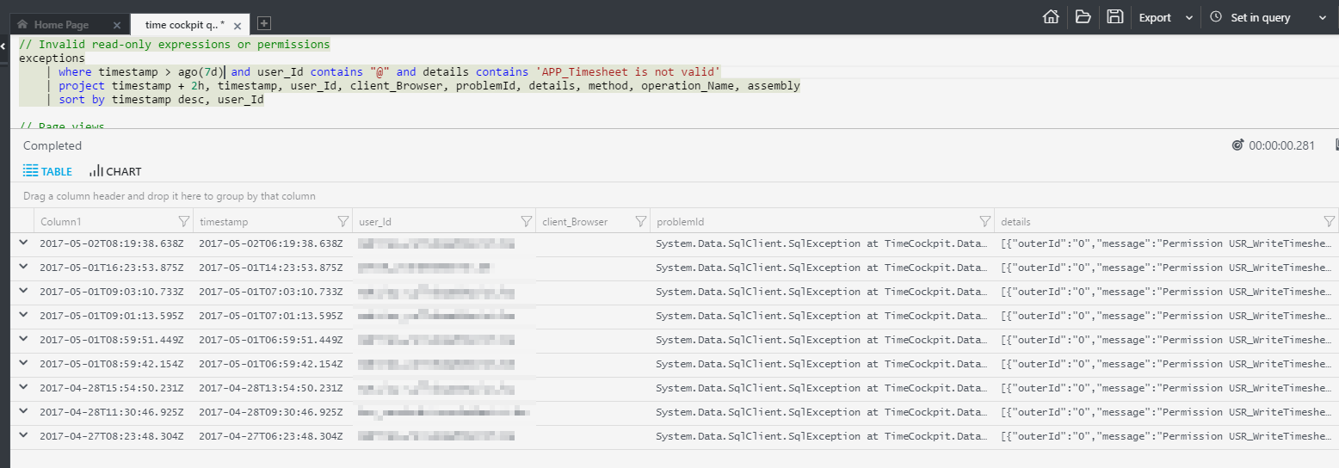
Analyze Specific Failures
Analyze consequences of a breaking change

Slide 12
Application Insights (HOL)
Demo Accelerated Network

Slide 13
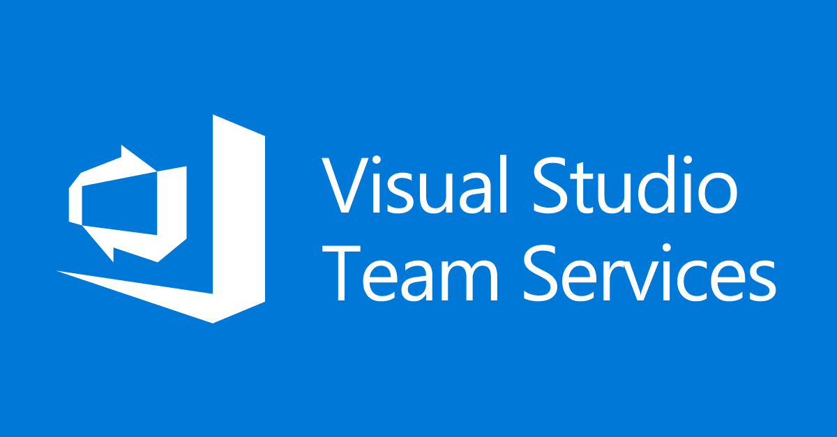

Questions?
Azure

