Slide 1
Future of App Development Microsoft Intelligent App Workshop
<Name of Trainer>
<Title of Trainer>

Slide 2
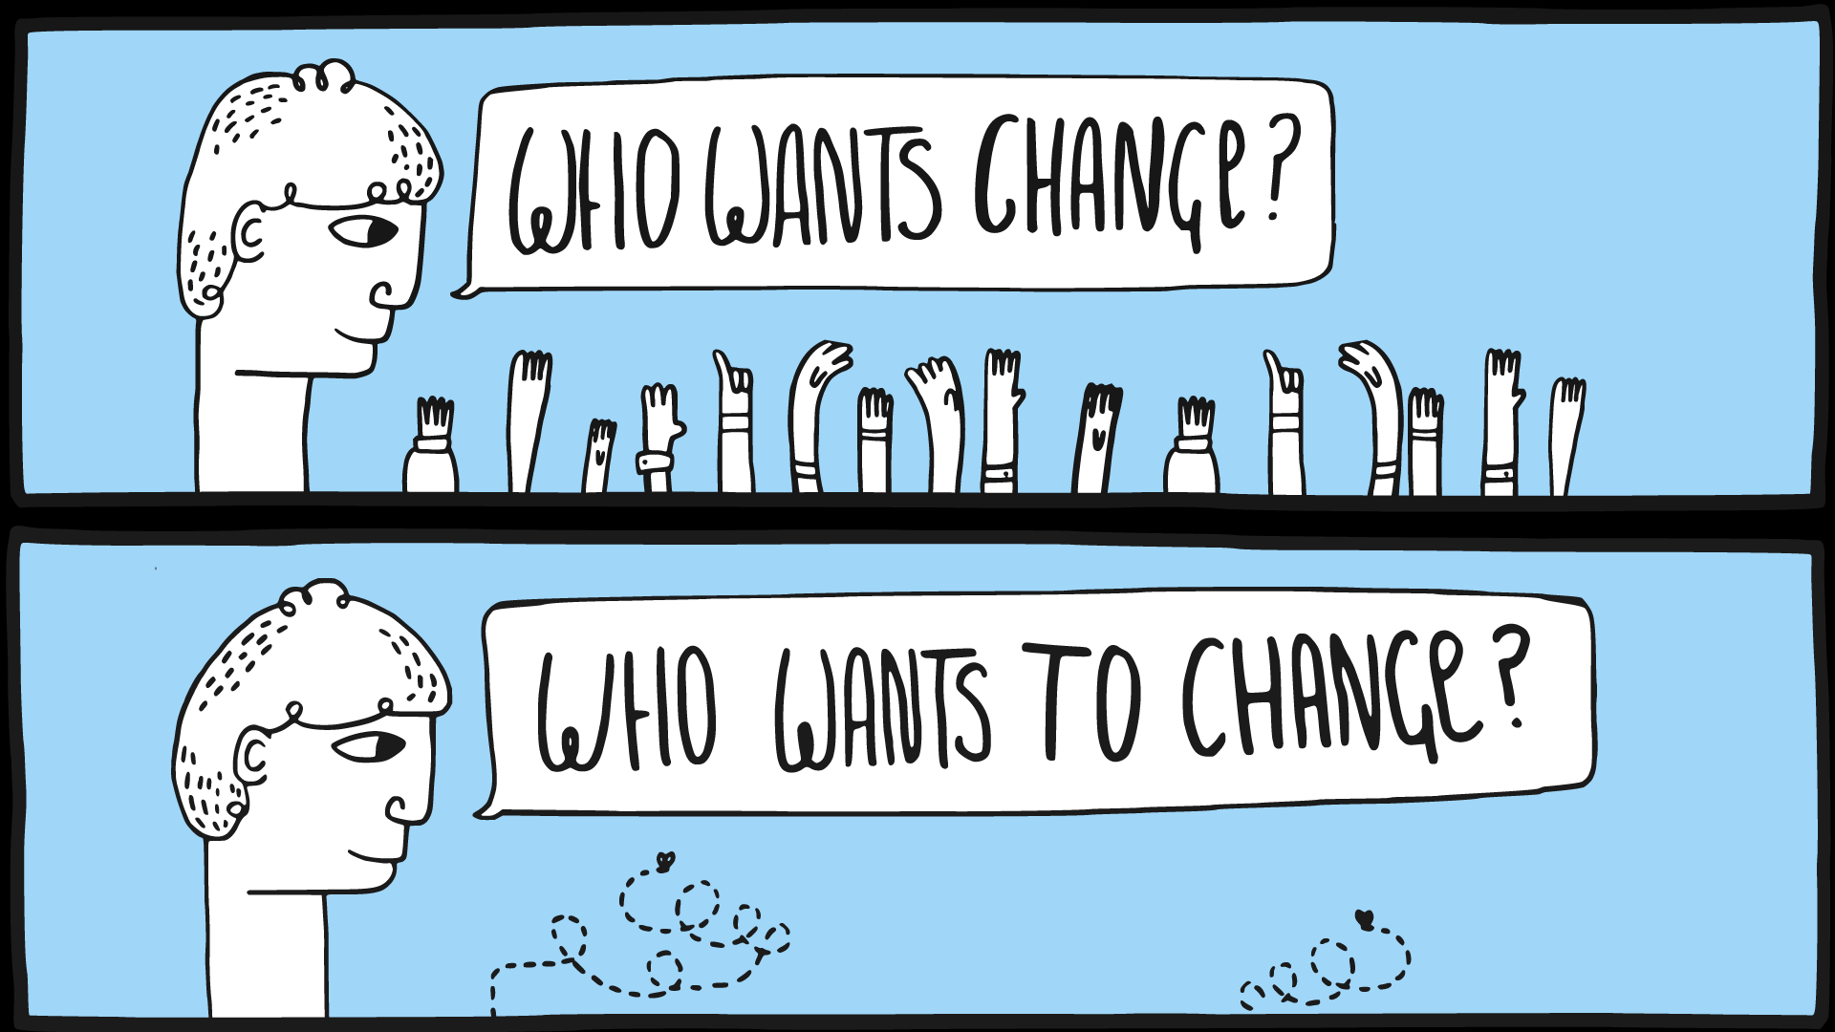
Creative Commons, Source: Alan O'Rourke, https://flic.kr/p/ykLoWK

Slide 3
Microsoft is Changing – Three Examples
Windows Subsystem for Linux
Running native Linux binaries in Windows without VM or Container
https://msdn.microsoft.com/en-us/commandline/wsl/about
Open Source PowerShell on Linux
https://github.com/PowerShell/PowerShell
Containers, Participating in Docker Ecosystem
E.g. microsoft/dotnet, microsoft/powershell
Docker on Windows
Notes:
Speak about how Microsoft is changing towards Open Source and Cross Platform

Slide 4
Microsoft and Cross Platform
Demo Accelerated Network
Notes:
If you have time, show quick demos for the areas of change mentioned on the previous slide

Slide 5
Demo
# Start Bash on Windows
cd /mnt/c/…
vim some-js.js
node some-js.js
# Run Powershell on Linux
Docker: microsoft/powershell
$something = "asdf"
Write-Host $something
Get-Item tmp
# Run Docker on Windows
docker run -it –rm microsoft/windowsservercore cmd
docker run –d –p 8080:80 microsoft/iis
Microsoft is changing

Slide 6
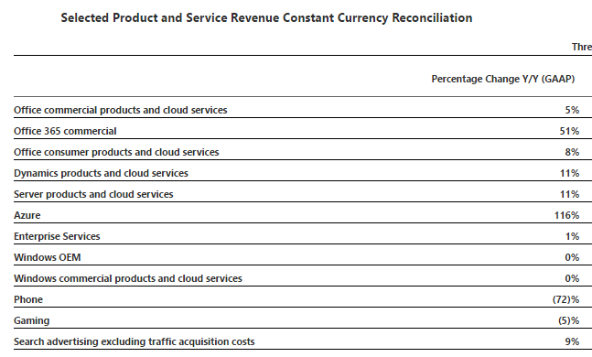
Microsoft’s Change
Earnings Release FY17 Q1
Source: Microsoft Investor Relations

Slide 7
Enterprises are Changing
Digital Interdependence
Digital ecosystem readiness
“79% of […] top performers […] participate in a digital ecosystem”
Interoperability
External mindset
Focus on managing interdependence
BI/Analytics and Cloud Services
Top two investment areas of top performers
Source: 2017 CIO Agenda, Gartner Inc.; available at http://www.gartner.com/imagesrv/cio/pdf/Gartner_CIO_Agenda_2017.pdf

Slide 8
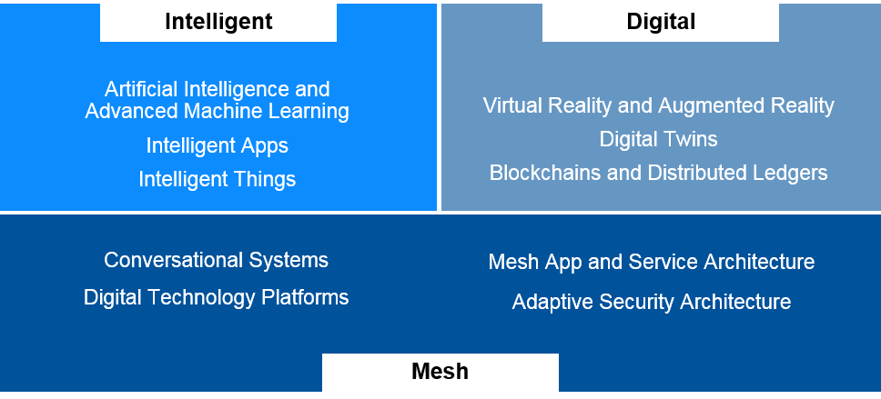
Environment is Changing
Azure Machine Learning, R, Cognitive Services, IoT Hub
Hololens, Windows Holographic, Azure BaaS
Bot Framework, Azure Platform
Xamarin, Web Technologies, DevOps, APIs
Source: Gartner, Oct. 2016, available via http://www.gartner.com/smarterwithgartner/gartners-top-10-technology-trends-2017/

Slide 9

What does that mean for me as an enterprise developer?

Slide 10
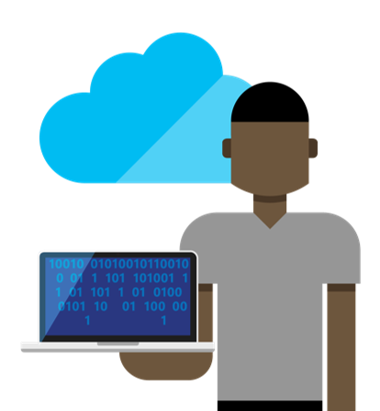

The Converged DevOps lifecycle
Plan + Track
Release
Developers
IT Ops
Develop + Test
Monitor + Learn

Slide 11
Microservices
Microservices
Modeled around business concepts
Culture of Automation
Hide implementation details
Decentralized
Independently deployed
Isolate failures
Highly observable

Slide 12
Artificial Intelligence (AI)
Versatility, Control
Elastic infrastructure for analytics and learning
Manage massive data sets in the cloud
Enhance apps with ready-made AI services
Deep Learning Toolkits (e.g. MS Cognitive Toolkit, TensorFlow, etc.)
High-Level APIs (e.g. Keras, etc.)
Cognitive Services
Development Effort

Slide 13
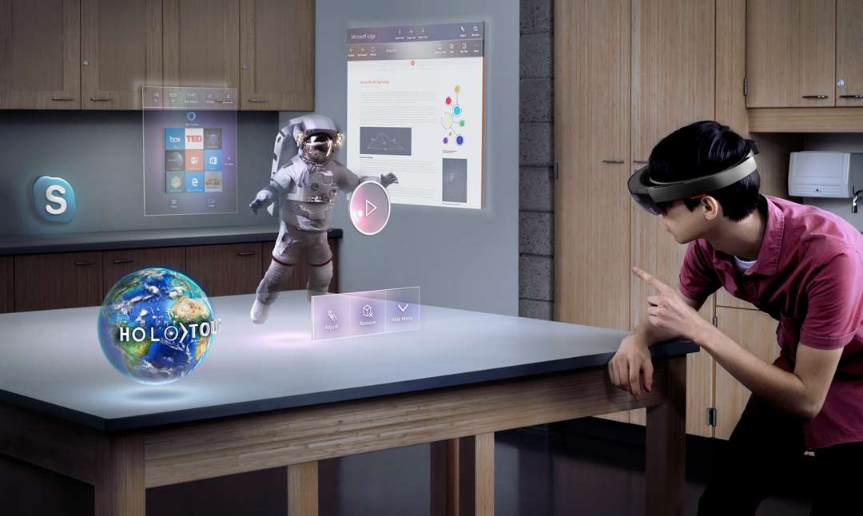
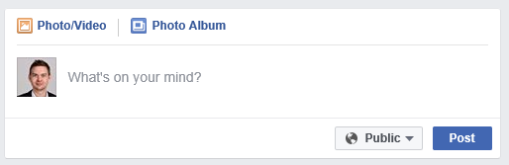
New User Interfaces

Slide 14
Conway‘s Law
„Any organization that designs a system will inevitably produce a design whose structure is a copy of the organization’s communication structure”
Organizational hurdles for Microservices
Tightly-coupled organizations
Geographically distributed teams
Missing tools (e.g. self-service cloud infrastructure, CI/CD tools)
Inappropriate security policies
Unstable or immature service that frequently changes
Missing culture of taking ownership (need someone to blame)
Cope with many different and new technologies
Source: Conway, How Do Committees Invent, Datamation magazine, April 1968

Slide 15
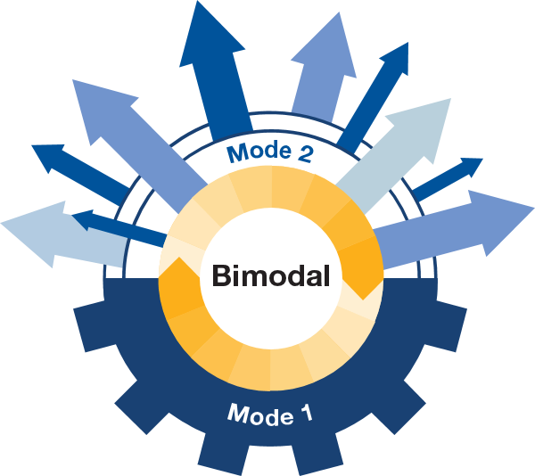
Bimodal Enterprise
Mode 1: Predictability and Stability
Mode 2: Exploratory
We have to deliver in mode 1 to get trusted for mode 2
Source: Gartner, Deliver on the Promise of Bimodal, Feb. 2016, available via http://www.gartner.com/it-glossary/bimodal/

Slide 16
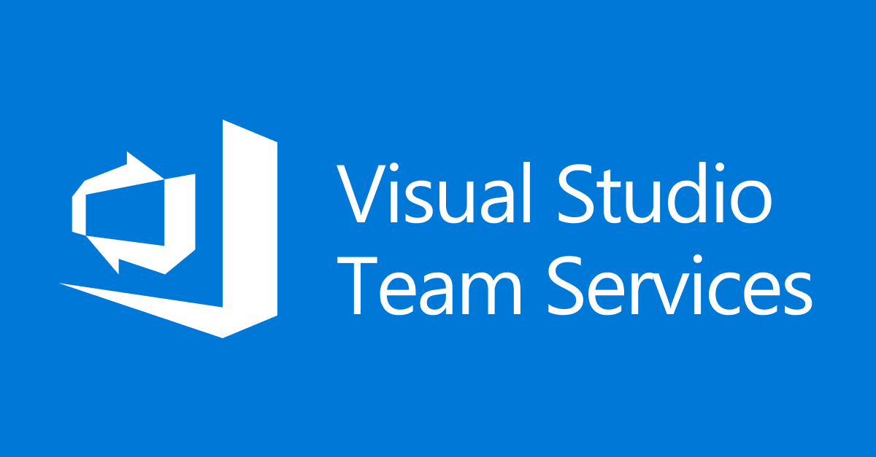

Questions?
Azure

