Slide 1
Projection
Introduction

Slide 2
Projection
Is a type of Transformation
Transforming points in a coordinate of dimension n into a coordinate system of dimension m where m < n
Planar Geometric Projection: Projecting an object on to a flat plane
Turning 3D shapes to its 2D plane (this chapter)
From 2D to 1D also possible

Slide 3
Projection (Terminologies)
Object/Target Point (P): A single point on an object/geometry we're trying to project (calculate projection of)
Projected Point (P'): The projected point after a projection transformation is applied for a given point P'. Projected points together constitutes the projected image
Projectors: The "rays" responsible for projection. They'll intersect the projection plane.
Projection Plane (PP): The plane where the projected image of the object will appear on. This plane holds all of the P' points. Also known as view plane.
Center Of Projection (COP): The singular point where all the projectors/projection rays converge (only applicable to perspective projection).
Direction Of Projection (DOP): The direction towards which the parallel projection rays go towards (only applicable to parallel projection).

Slide 4
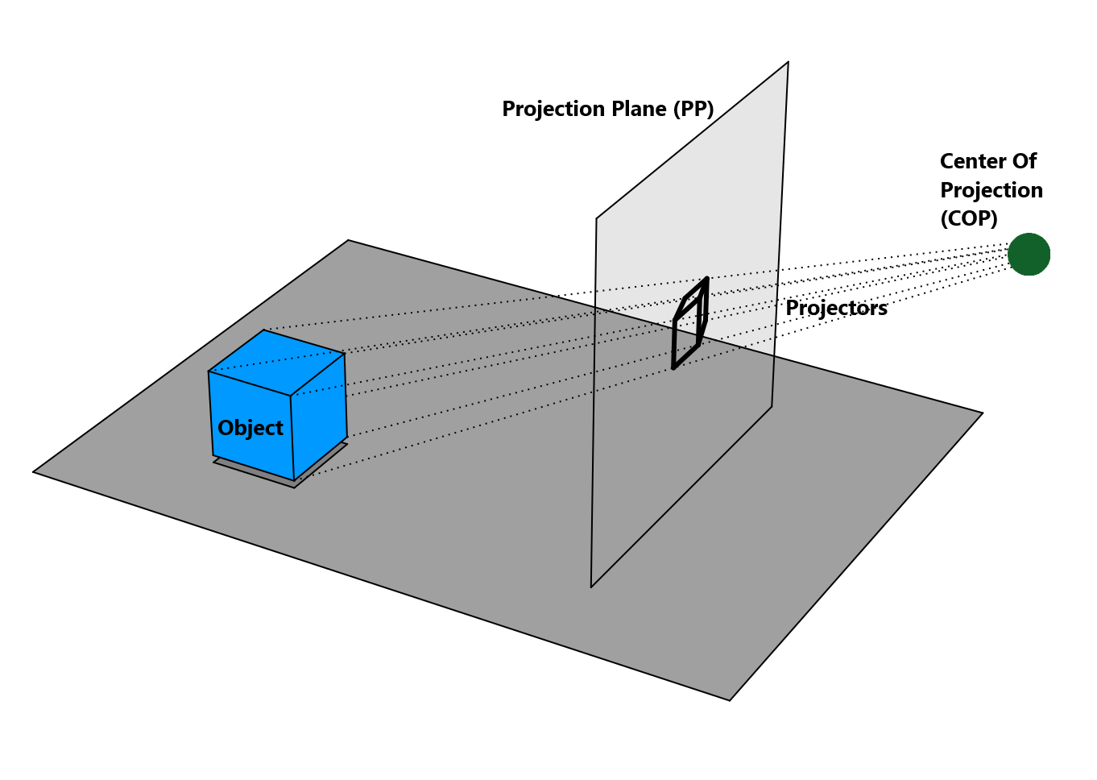
Projection (Anatomy)

Slide 5
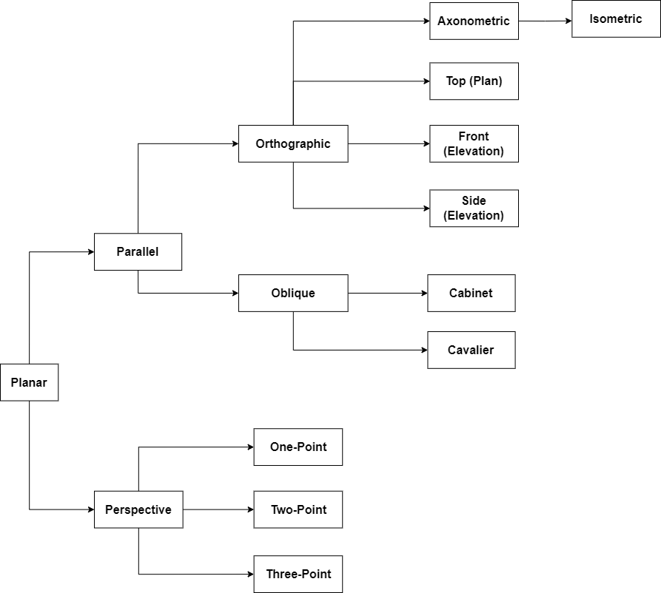
Projection
(Types)

Slide 6
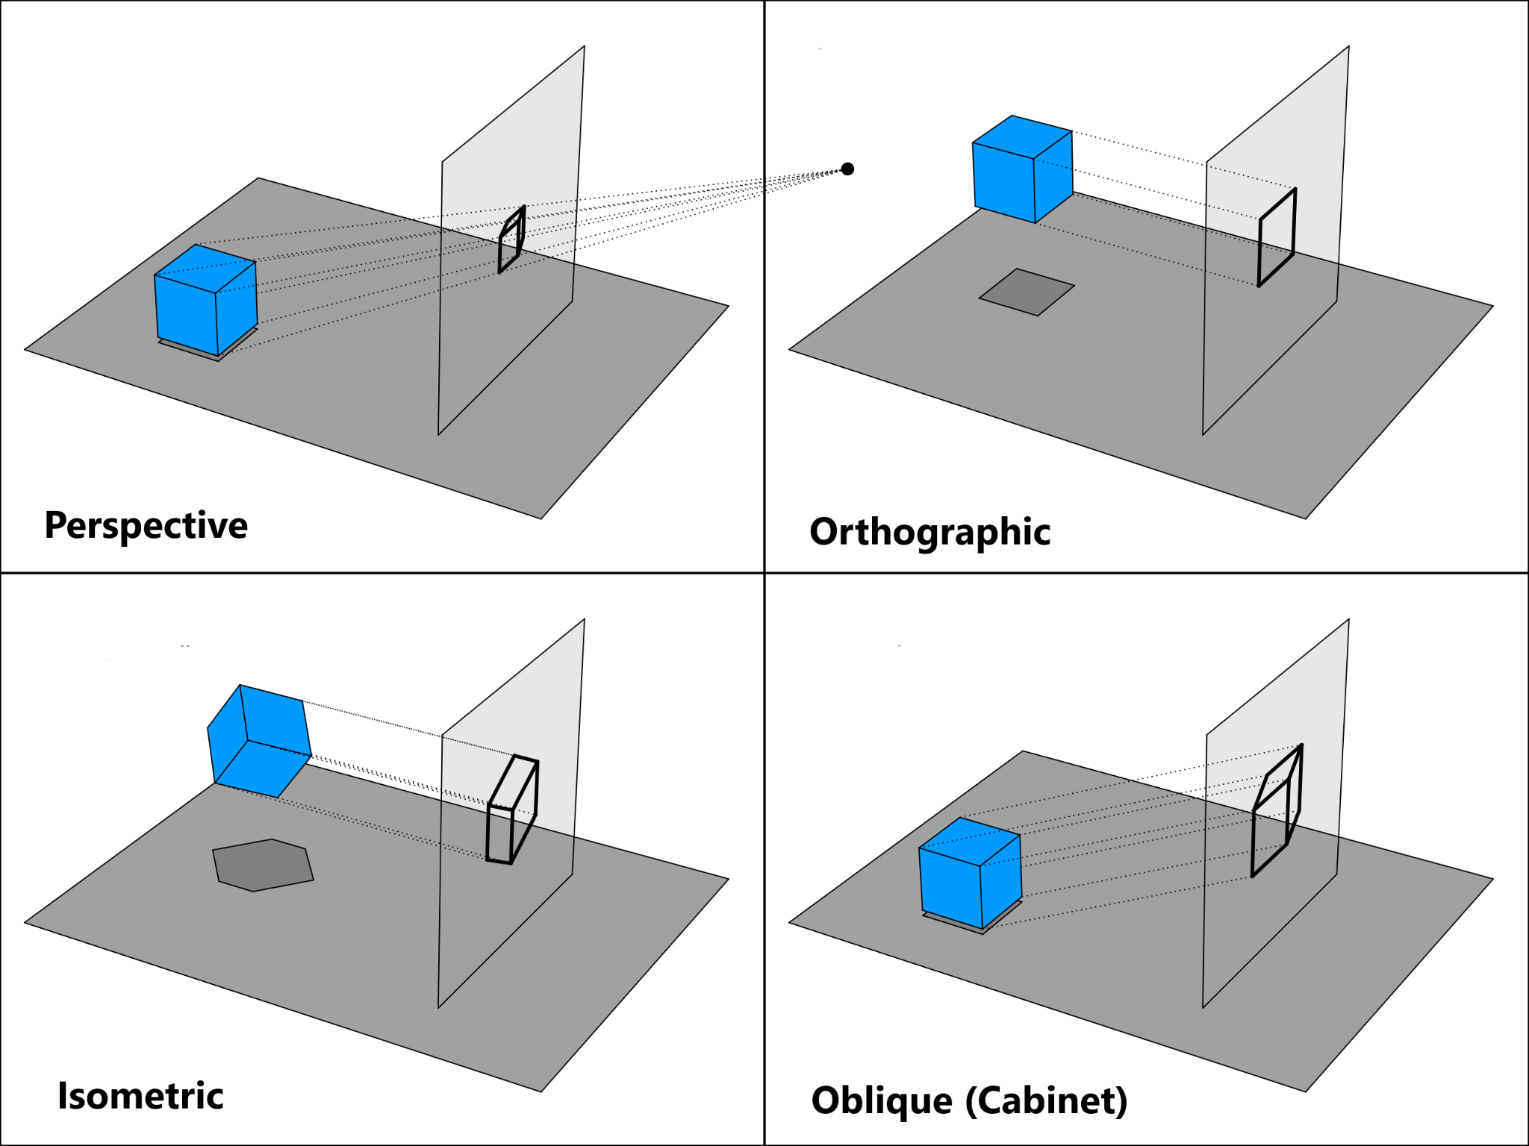

Slide 7
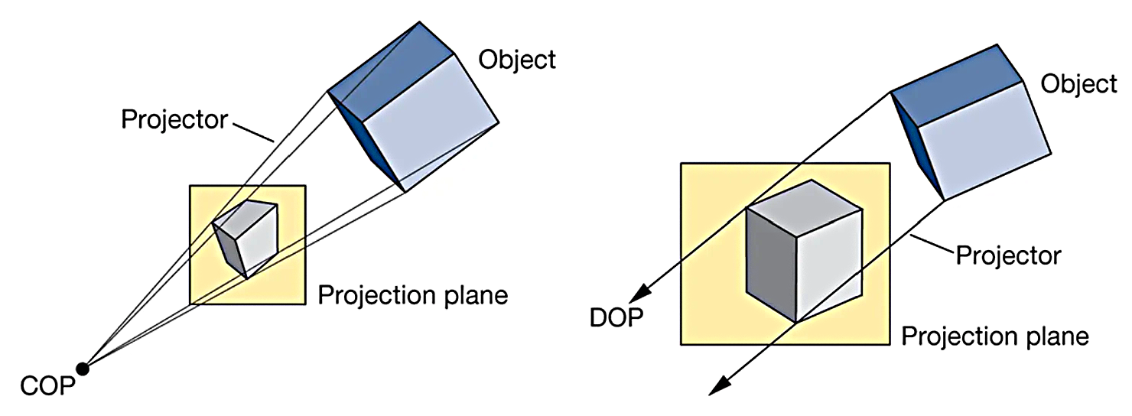
Perspective
vs
Parallel
 | Perspective | Parallel
Nature of Projectors | Projectors aren't parallel, and will converge at a point called COP. | The projectors are always parallel, will never converge.
Configured By | The Center of Projection (COP) and the distance between COP and the projection plane (PP) | The angles those eventually control the Direction of Projection (DOP)
Foreshortening | Yes, so more familiar to human eye | No, appears less realistic
Examples | 1-point, 2-point, 3-point | Cabinet, Cavalier, Orthographic

Slide 8
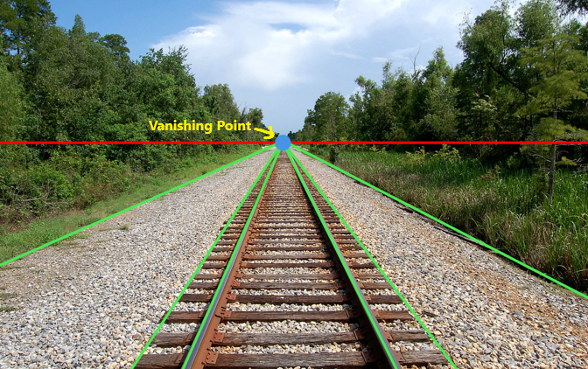
Perspective Projection

Slide 9
Perspective Projection (Attributes)
Vanishing Point: All lines that are parallel to each other (in 3D space)
appear to converge into a single point (in projected space)
One-point Perspective Projection: 1 vanishing point
Two-point Perspective Projection: 2 vanishing points
Three-point Perspective Projection: 3 vanishing points
In reality, there are infinite number of vanishing points.
Foreshortening: Basically the phenomenon of far-away objects appearing smaller than the closer ones (despite having equal size).
More realistic since resembles human vision. Used in video games, animation, VR

Slide 10
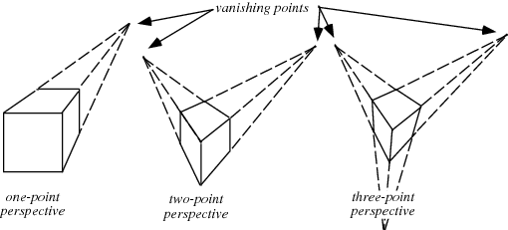
Perspective Projection (Types)

Slide 11
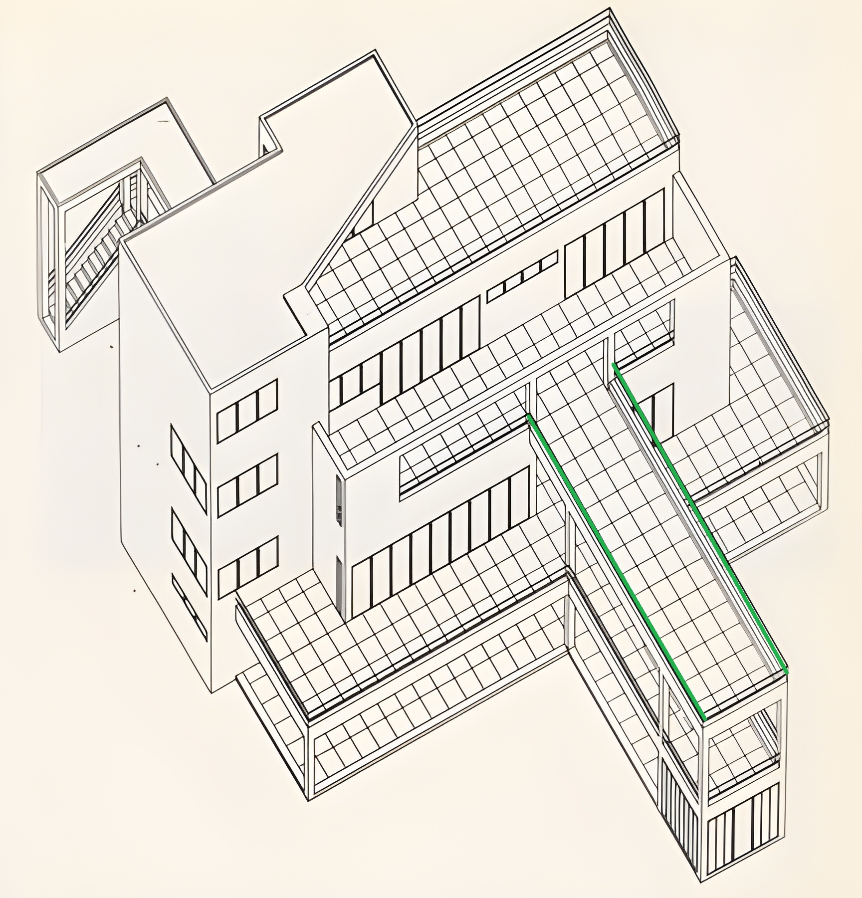
Parallel
Projection

Slide 12
Parallel Projection (Attributes)
Parallel Lines: Lines that are parallel to each other (in 3D space) even still appear parallel to each other (in projected space)
No Convergence: Since the lines remain parallel there are no single point the projectors converge into (in other words, they converge at infinity). So there are no COP, but there is a Direction Of Projection (DOP).
No Foreshortening: Objects that are far-away appear the same size as the closer ones.
For Orthographic the DOP is equal to the normal vector of the plane, whereas they are not equal in case of Oblique.
Parallel Projected Images are less realistic, but they are good for architectural planning and design.
(Some video games use isometric projection which is a type of parallel projection)

Slide 13
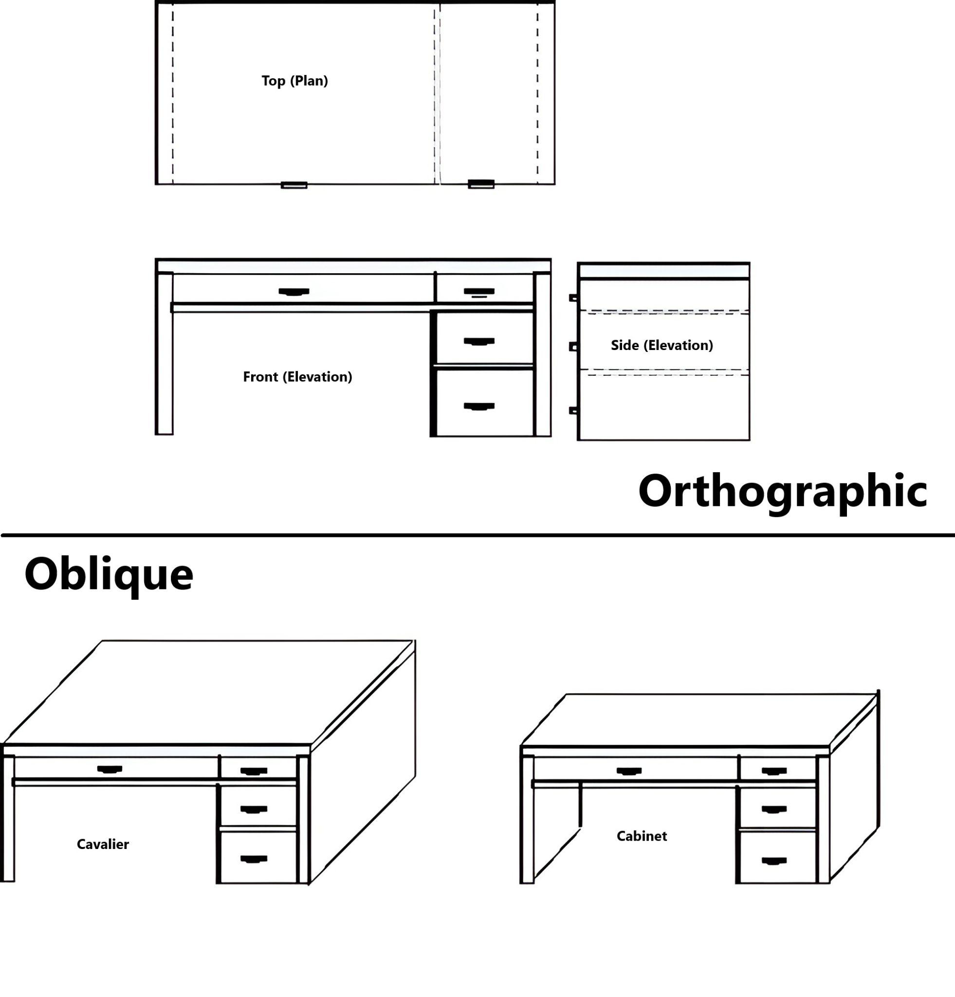
Parallel
Projection
(Types)

Slide 14
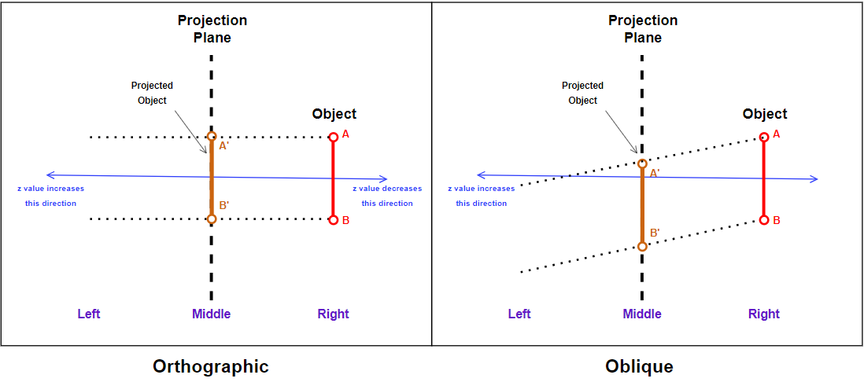
Parallel Projection (Geometric Setup)

Slide 15
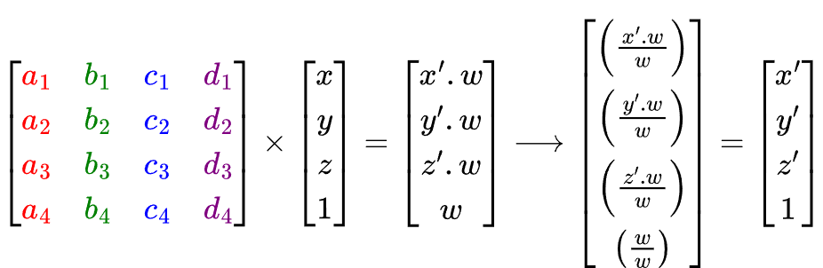
Performing Projection Math
Depending on the scenario, we need to use a specific projection matrix. A 4x4 homogeneous coordinate matrix since we're in 3D.
The point to be projected P(x,y,z) will need to be converted into a 4x1 column-matrix, the w/last value will be 1.
Multiplying the projection matrix and the point column-matrix will give a 4x1 result containing the transformation point.
The w/last value of result won't necessarily be 1. In this case, we need to divide all values in the result by w to get the actual result called P'(x',y',z').

Slide 16
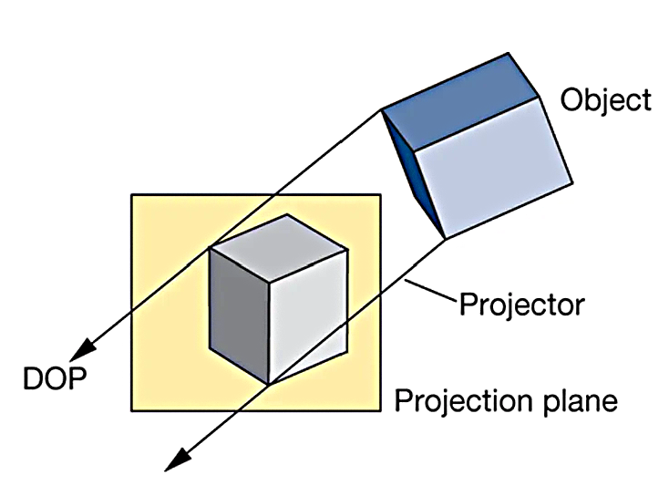
Deriving Parallel Projection Matrix for XY Plane
The projection rays don't converge, so there are no Center Of Projection (COP)
There is however, a Direction Of Projection (DOP)
This DOP is steered by some angles/scaling factors, which control the ultimate projection transformation
Different angle/scaling factor configuration for Cabinet, Cavalier, Orthographic

Slide 17
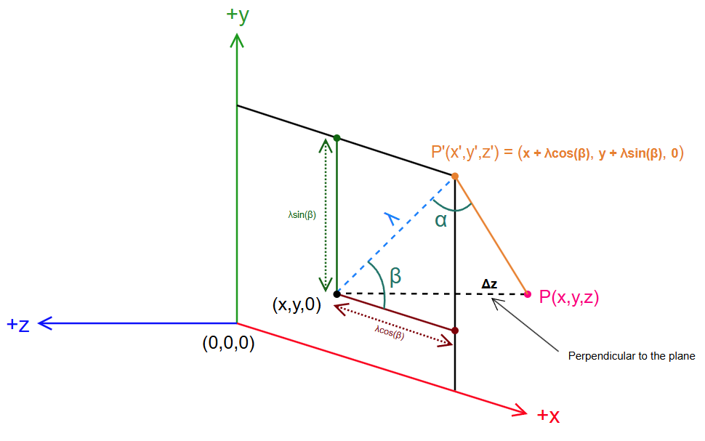
P' is the projected point on plane for P
The distance between the plane and P is Δz
(x, y, 0) is an equivalent point for P(x, y, z) put on the projection plane
β is inclination angle
x' = x + λ cos(β) ….1(a)
y' = y + λ sin(β) ….1(b)
Oblique
Orthographic
This is 90º
Notes:
The inclination angle in projection refers to the angle that a particular axis (or plane) of the object makes with the plane of projection.

Slide 18
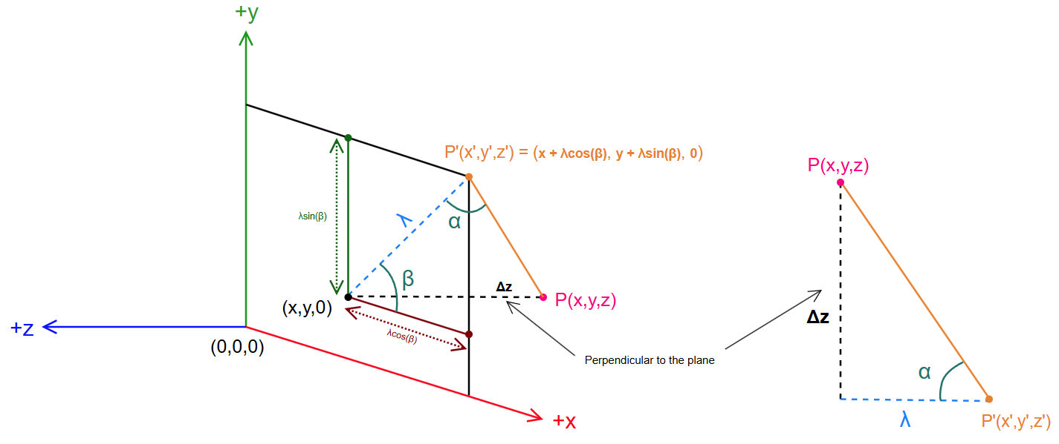
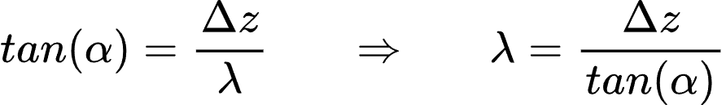
α is the angle between the projection plane and projection ray, this is the angle of skewness.
This is 90º
We will address Δz as just z since:
Δz = (z - 0) = z
Notes:
The angle of skewness in a projection refers to the angle by which the axes of the object are inclined relative to the plane of projection.

Slide 19
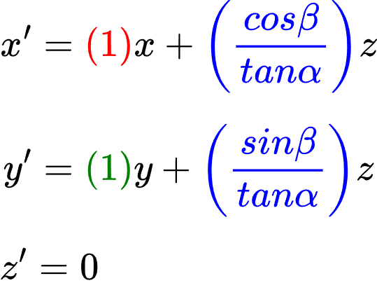
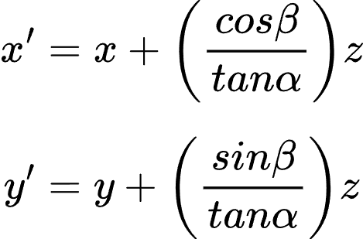

From equations 1(a) and 1(b), we can write
Rewriting with color coded coefficients
Since on the projection plane, all z values are 0 (for this particular scenario)
Coefficients Color Coding:
(x = red, y = green, z = blue, leftover = purple)

Slide 20
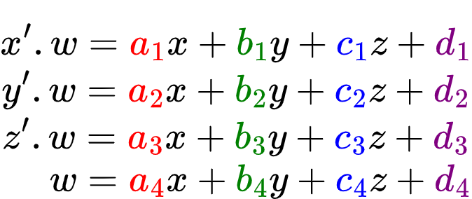
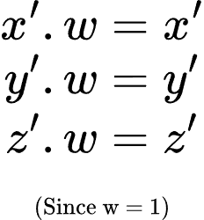
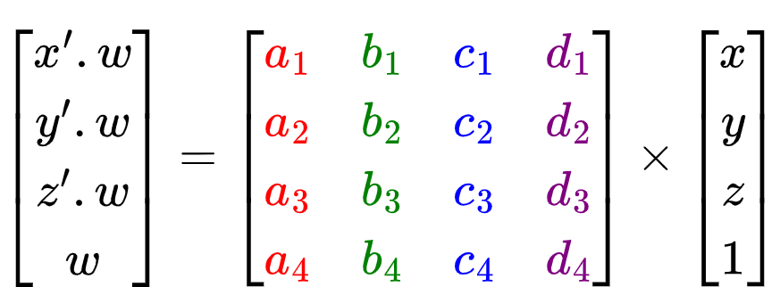
Strategy: Converting x', y', z' equations to a 4x4 matrix
We don't have any w equation.
We will consider w = 1
(since parallel projection)

Slide 21
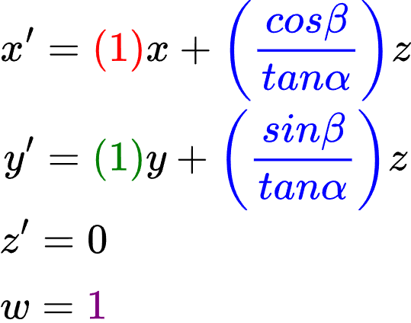
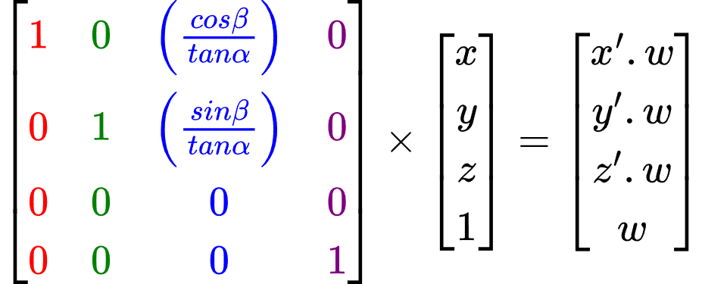
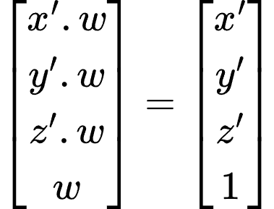
Since, w = 1 (only for this scenario)

Slide 22
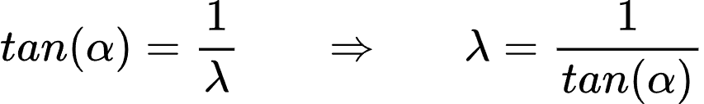
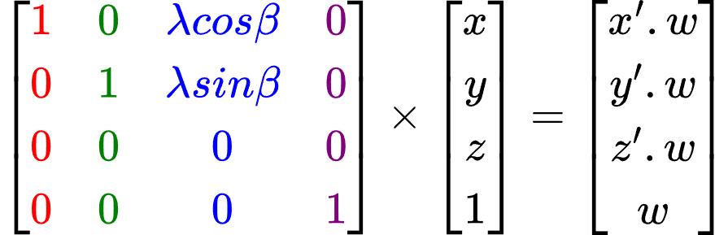
Considering Δz = z as 1, we can get this relation:
For the math,
We can either build the matrix using
(α, β) or (λ, β)
By which, we can get an alternate matrix:

Slide 23
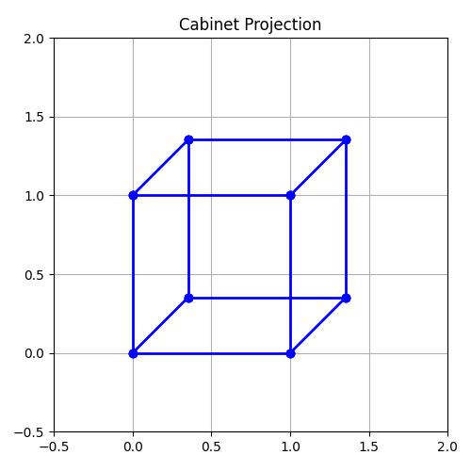
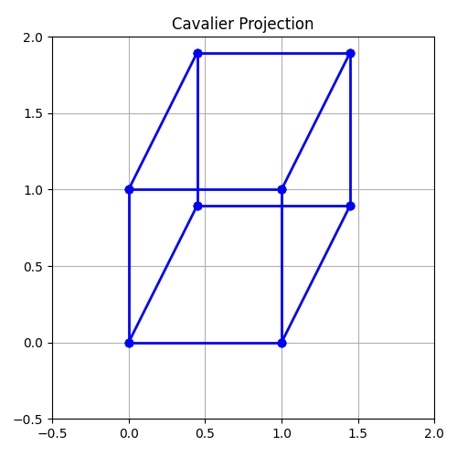
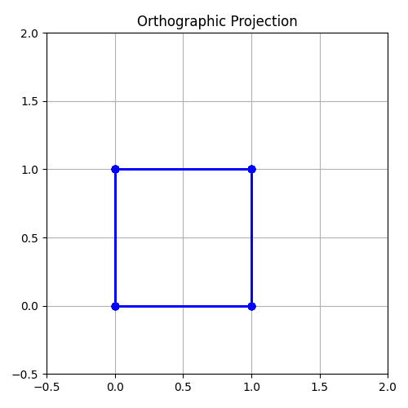
Configurations for different types of parallel projections
Type | Oblique? | λ (depth) | α (deg) | β (deg) | Preview
Cabinet | Yes | 0.5 | 63.4 | 0-360
Cavalier | Yes | 1 | 45 | 0-360
Orthographic | No | 0 | 90 | 0-360

Slide 24
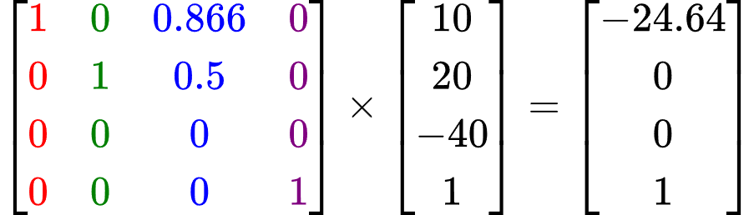
Example: For a point P (10, 20, -40), calculate the projected point P' using Cavalier Projection, orientation angle is 30° for projection plane of XY.
For Cavalier, α = 45°. And it is given that, β = 30°
The whole calculated matrix with the point multiplied is:
We don't need to divide values by w since w is already 1
P' is (-24.64, 0)

Slide 25
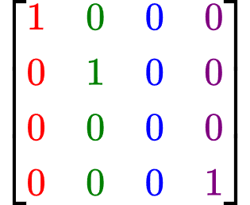
Example: Derive the matrix for orthographic projection
Here, the projection rays will be perpendicular to the projection plane, α will be 90 degrees, making λ as 0, so the value of β won't even be considered.
Putting these values into the formula matrix gives:

Slide 26
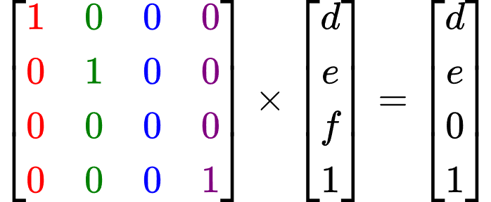
Example: Calculate Orthographic Projection on XY Plane for the point P (d, e, f)
We don't need to know any other value since the orthographic projection matrix is constant, we simply multiply our provided point P (as a homogenous column-matrix) with the matrix.
In fact, applying orthographic projection on XY Plane to a point is equivalent to copying the point's x and y values, while setting its z value to 0. [(x, y, z) becomes (x, y, 0)]

Slide 27
But how can we find the Parallel projection matrix for different projection plane other than XY?
Same way
Rotate the coordinate system clockwise to get to YZ plane.
Rotate the coordinate system counterclockwise to get to ZX plane.
Modify the matrix accordingly.

Slide 28
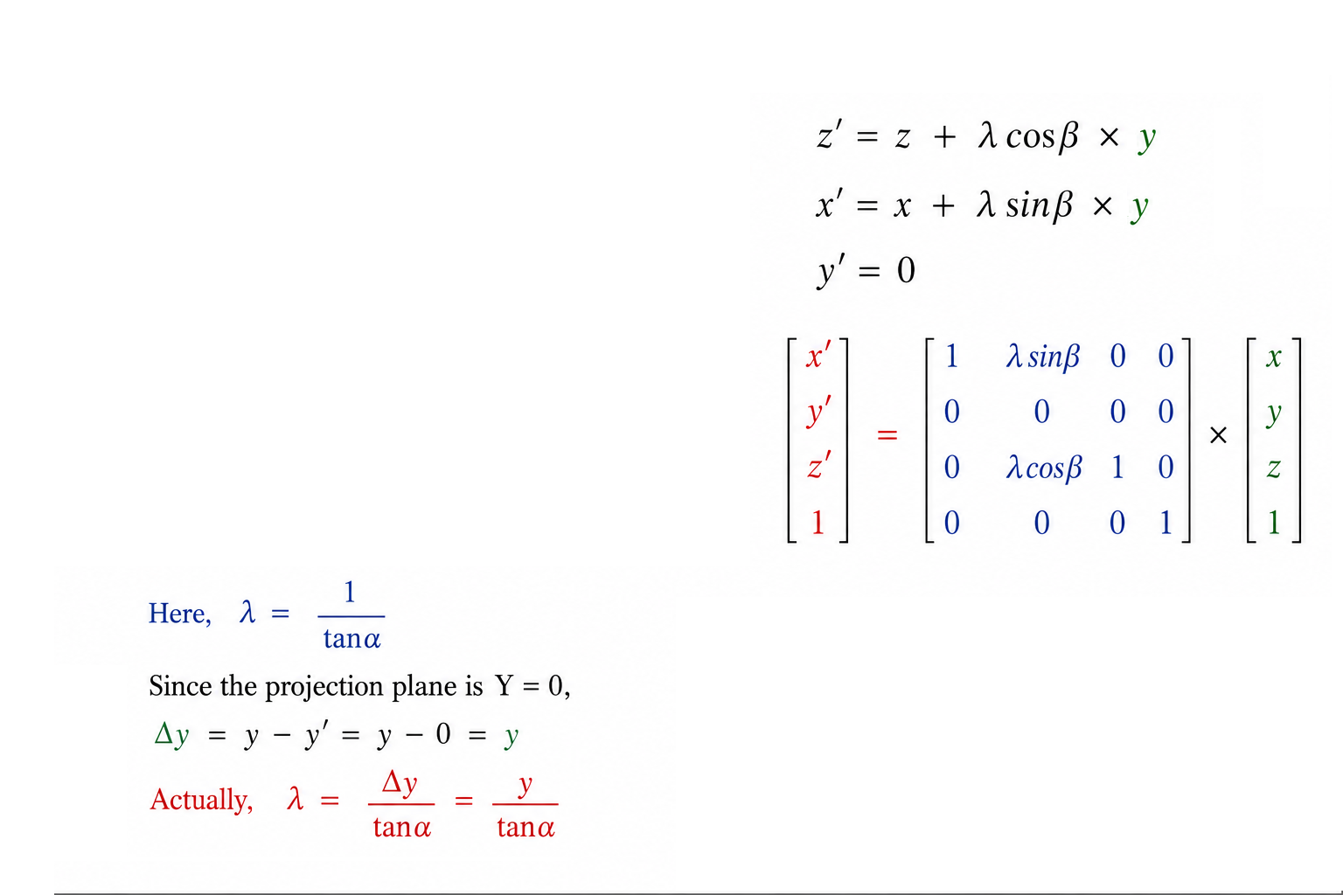
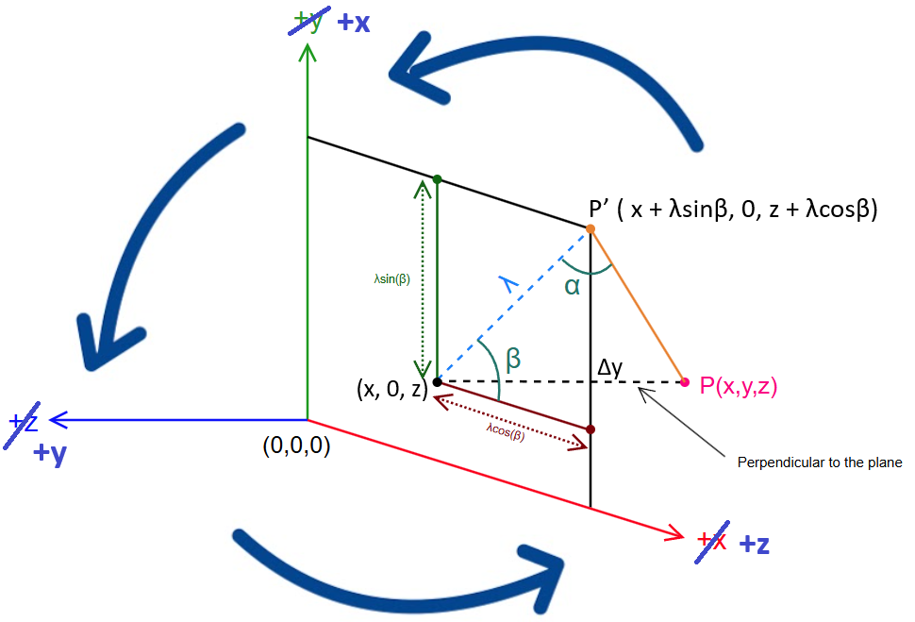
Projection Plane: ZX / Y =0

Slide 29
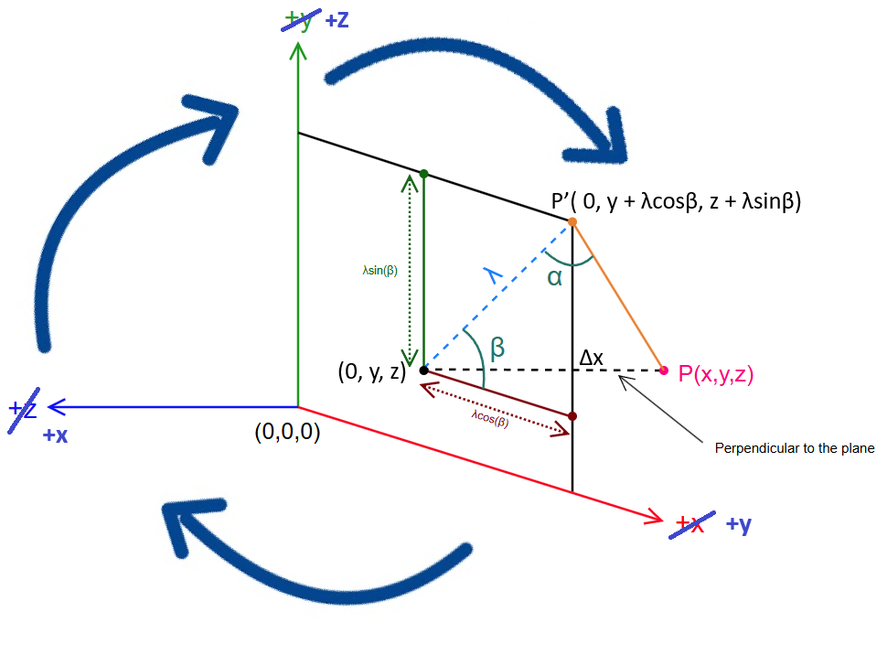
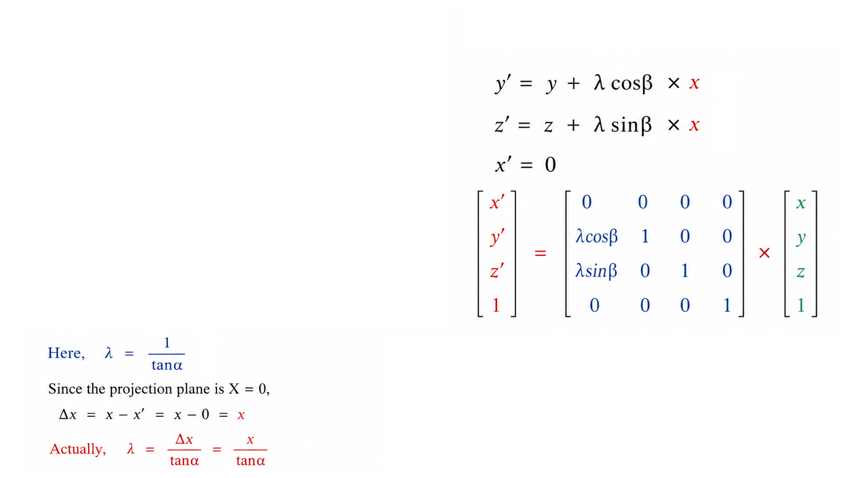
Projection Plane: YZ / X =0

Slide 30
Perspective Projection
(General Purpose)

Slide 31
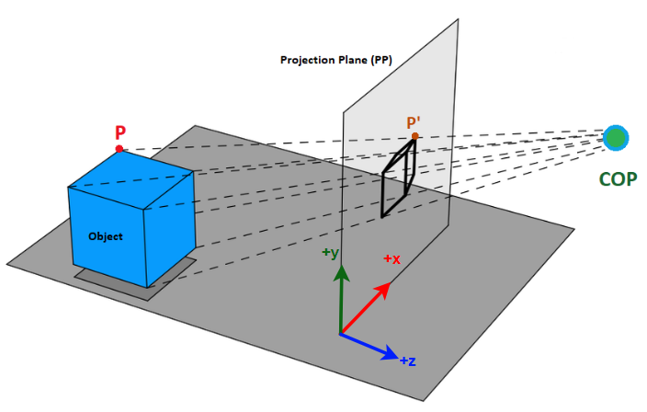
Perspective Projection Overview
In case of General Purpose Perspective Projection, the COP is not necessarily on the z-axis

Slide 32
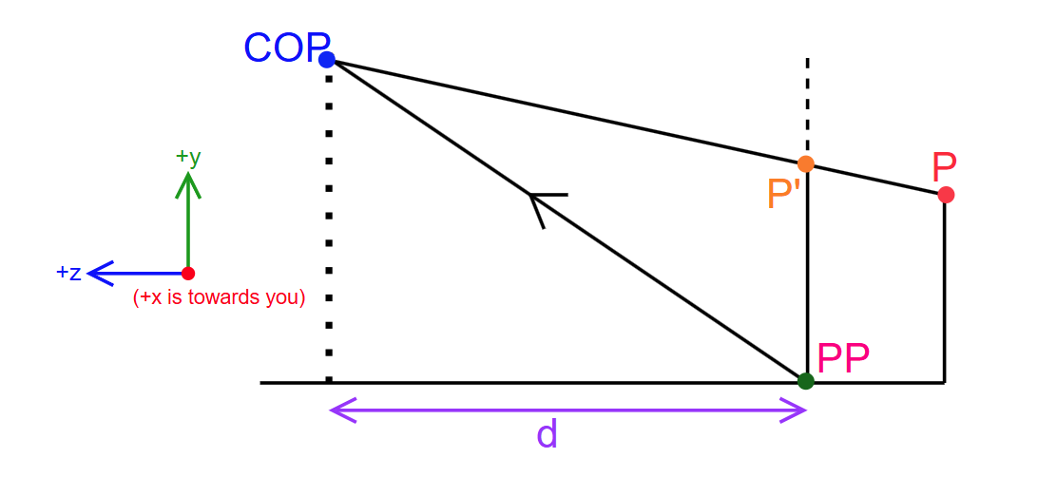
Scenario
COP is at an arbitrary point, not necessarily on the z-axis
We don't care if COP or PP is at origin or not.
The distance between COP and PP (expressed as d) is the z-distance between them.

Slide 33
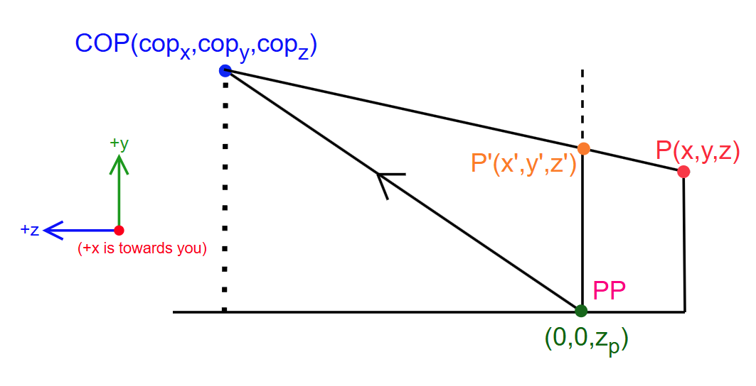
Scenario
COP is expressed component-wise as (cop_{x}, cop_{y}, cop_{z})
The z-axis pierces through the PP, the piercing point is (0, 0, z_{p})
The difference between cop_{z} and z_{p} is equals to d

Slide 34
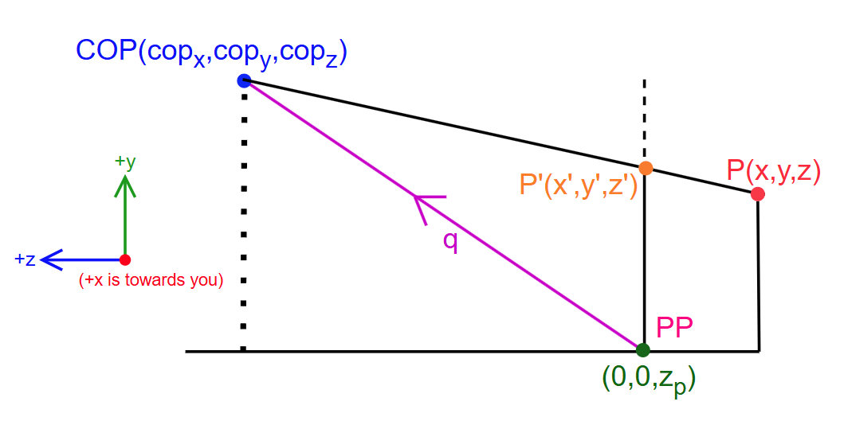
Scenario
We consider a vector called q that goes from (0, 0, z_{p}) to COP
So, q = (qx, qy, qz) = (cop_{x}, cop_{y}, cop_{z}) - (0, 0, z_{p}) = (cop_{x}, cop_{y}, cop_{z}-z_{p})
(qx, qy, qz) is sometimes expressed as (Qdx, Qdy, Qdz)

Slide 35
Scenario
q_{x} = cop_{x}
q_{y} = cop_{y}
q_{z} = cop_{z} - z_{p}
cop_{x} = q_{x}
cop_{y} = q_{y}
cop_{z} = z_{p}+ q_{z}
……..1(a)
……..1(b)
……..1(c)

Slide 36
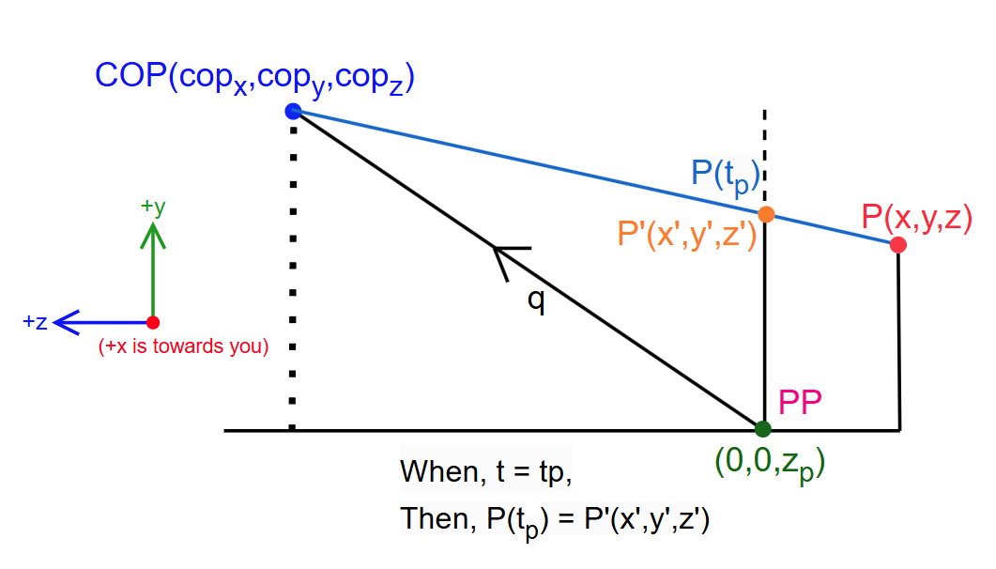
Scenario
We consider a parametric line segment that goes between COP and P
This line segment is basically our projection ray

Slide 37
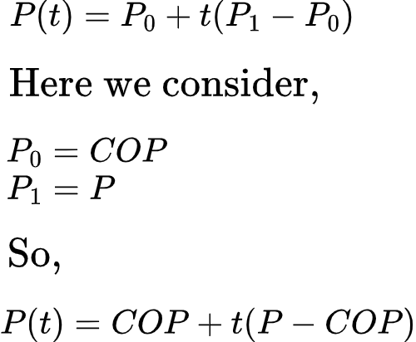
Scenario
At some point, for a certain value of t, P(t) will be the same as P'
We call that t value t_{p}
……..(2)

Slide 38
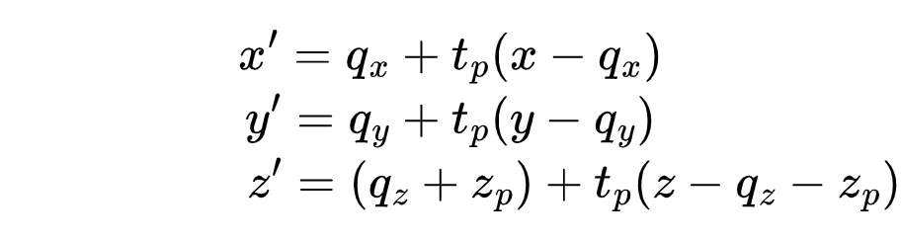
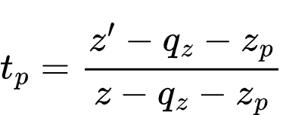
Breaking the equation the last equation into x, y, z components
……..3(a)
……..3(b)
……..3(c)
We need to remove t_{p} from these equations, since we don't know the value of t_{p}
Using the equation of z' we can write:

Slide 39
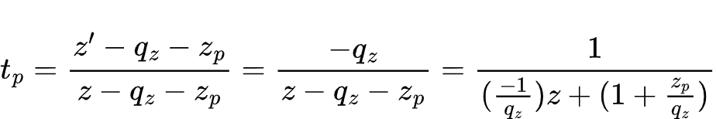
Since P'(x',y',z') and (0,0,z_{p}) both reside on the same plane (the PP), their z value are the same.
which means:
z' = z_{p} ……..(4)
(Remember this equation)
Now we substitute the value of t_{p} in the equations of x' and y' from before

Slide 40
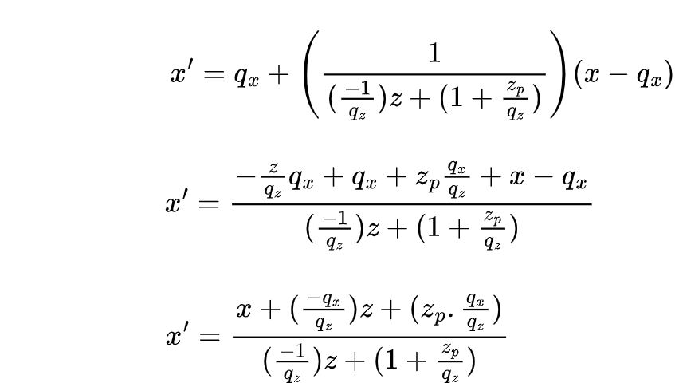
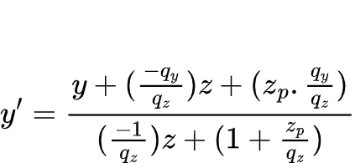
For x'
……..5(a)
For y', following the same way
……..5(b)

Slide 41
For x'
Notice how they have the same denominator
(Remember this)
……..5(a)
For y', following the same way
……..5(b)

Slide 42
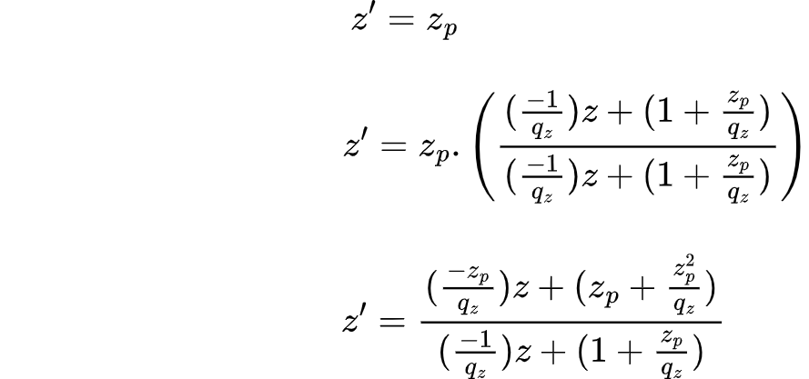
For z'
[Ok, but it lacks the common denominator]
[multiply by denominator/denominator]
[multiply the above part with z_{p}]
[keep the bottom part intact]
We've brought the common denominator present in x' and y'
(Remember this)
……..5(c)

Slide 43
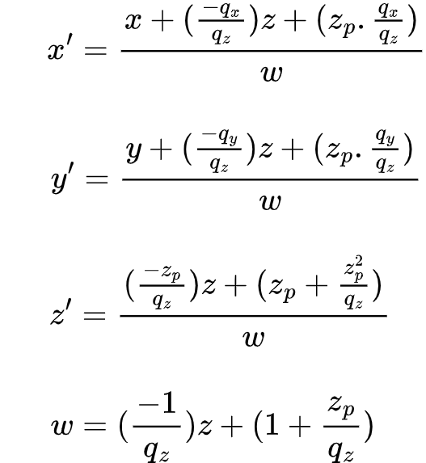
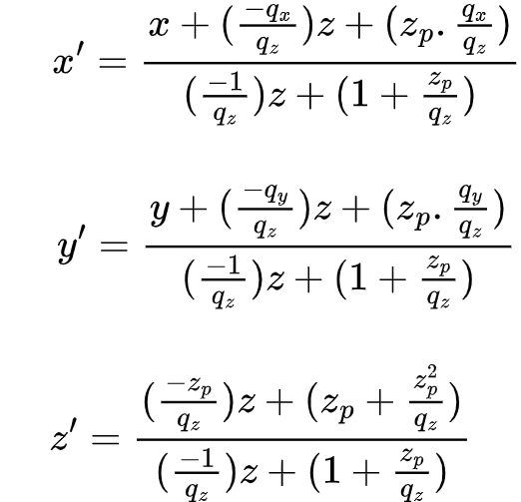
All in one place
We can call the common denominator "w"

Slide 44
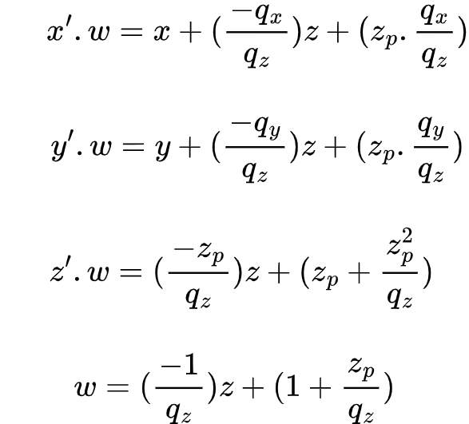
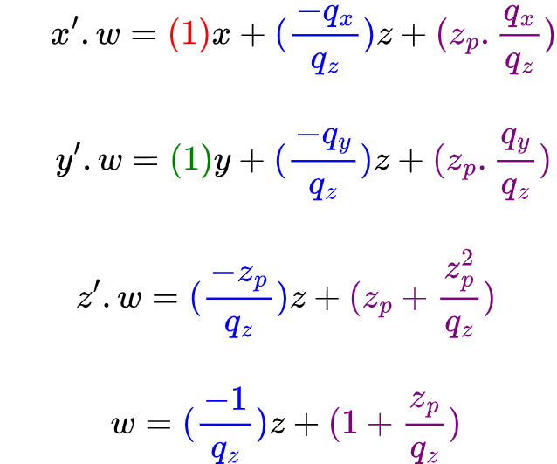
Moving "w" to the L.H.S
Same thing, but with color coded coefficients
Coefficients Color Coding:
(x = red, y = green, z = blue, leftover = purple)

Slide 45
Check Again: Performing Projection Math
Depending on the scenario, we need to use a specific projection matrix. A 4x4 homogeneous coordinate matrix since we're in 3D.
The point to be projected P(x,y,z) will need to be converted into a 4x1 column-matrix, the w/last value will be 1.
Multiplying the projection matrix and the point column-matrix will give a 4x1 result containing the transformation point.
The w/last value of result won't necessarily be 1. In this case, we need to divide all values in the result by w to get the actual result called P'(x',y',z').

Slide 46
Strategy: Converting x', y', z' equations to a 4x4 matrix

Slide 47

Ultimate Matrix System
We only need to know the constants q_{x}, q_{y}, q_{z}, z_{p} to build the matrix

Slide 48

Getting Simple Perspective Projection Matrix from the General One (COP at Origin)
COP = A = (0, 0, 0)
(0, 0, z_{p}) = B = (0, 0, d)
So, z_{p} = d
Vector q(qx, qy, qz) = COP - (0, 0, z_{p}) = (0, 0, 0) - (0, 0, d) = (0, 0, -d)
So, q_{x} = 0 and q_{y} = 0 and q_{z} = -d

Slide 49

Getting Simple Perspective Projection Matrix from the General One (COP at Origin)
COP = A = (0, 0, 0)
(0, 0, z_{p}) = B = (0, 0, d)
So, z_{p} = d
Vector q(qx, qy, qz) = COP - (0, 0, z_{p}) = (0, 0, 0) - (0, 0, d) = (0, 0, -d)
So, q_{x} = 0 and q_{y} = 0 and q_{z} = -d

Slide 50

Getting Simple Perspective Projection Matrix from the General One (PP at Origin)
COP = A = (0, 0, d)
(0, 0, z_{p}) = B = (0, 0, 0)
So, z_{p} = 0
Vector q(qx, qy, qz) = COP - (0, 0, z_{p}) = (0, 0, d) - (0, 0, 0) = (0, 0, d)
So, q_{x} = 0 and q_{y} = 0 and q_{z} = d

Slide 51

Getting Simple Perspective Projection Matrix from the General One (PP at Origin)
COP = A = (0, 0, d)
(0, 0, z_{p}) = B = (0, 0, 0)
So, z_{p} = 0
Vector q(qx, qy, qz) = COP - (0, 0, z_{p}) = (0, 0, d) - (0, 0, 0) = (0, 0, d)
So, q_{x} = 0 and q_{y} = 0 and q_{z} = d

Slide 52

Example: For COP at (100, 90, 0), calculate the projected point P' for a point P(30, 50, -250) where the Projection Plane parallel to XY is 200 units away from COP
The z level of COP is 0, while the z level of P is -250.
Since there's a projection on the plane, the plane is likely to be between these two points.
The plane itself will have a z value that's between 0 and -250 (which is a negative value).
It's already said the distance between COP and PP is 200 units. This distance is across z-axis.
Thus, the z value of PP is (0-200) = -200. This is the z_{p} value.
So, z_{p} = -200

Slide 53


Example: Continued…
Since we've got the z_{p}, we can now calculate the q vector.
q = COP - (0,0,z_{p}) = (100,90,0) - (0,0,-200) = (100,90,200)
So, q_{x} = 100 and q_{y} = 90 and q_{z} = 200 (and z_{p} = -200 from previously)
We now but these values into the general purpose perspective projection matrix, we will get the matrix from the upper-right.

Slide 54


Example: Continued…
Now, simply multiply the point P as a column vector.
Almost done, all we need to do is divide each value in the result by "w" which is 1.25

Slide 55

Example: For COP at origin, calculate the projected point P' for a given point P(50, 60, -300), if the plane is 200 units in Z axis away from the COP.
{ d = z value of PP }
Since the Projection Plane (PP) lies on the negative side of the z-axis, all points on that plane will have a negative z value, which is why d is negative

Slide 56


Now' using our matrix for "COP at Origin", we place the d value there, and multiply it by our point P (as a column vector)
Now, divide all the values by w = 3/2 to get the final answer
P' = (33.33, 40, -200)

Slide 57

Example: For PP at origin, calculate the projected point P' for a given point P(50, 60, -100), if the plane is 200 units in Z axis away from the COP.
{ d = z value of COP }
Since the COP lies on the positive side of the z-axis, its z values will be positive, which makes the value of d positive

Slide 58


Now' using our matrix for "PP at Origin", we place the d value there, and multiply it by our point P (as a column vector)
Now, divide all the values by w = 3/2 to get the final answer
P' = (33.33, 40)

Slide 59
The END

