Slide 1
Bash: THE Bourne-again shell
https://www.gnu.org/software/bash/
By: Asa Jenkins

Slide 2
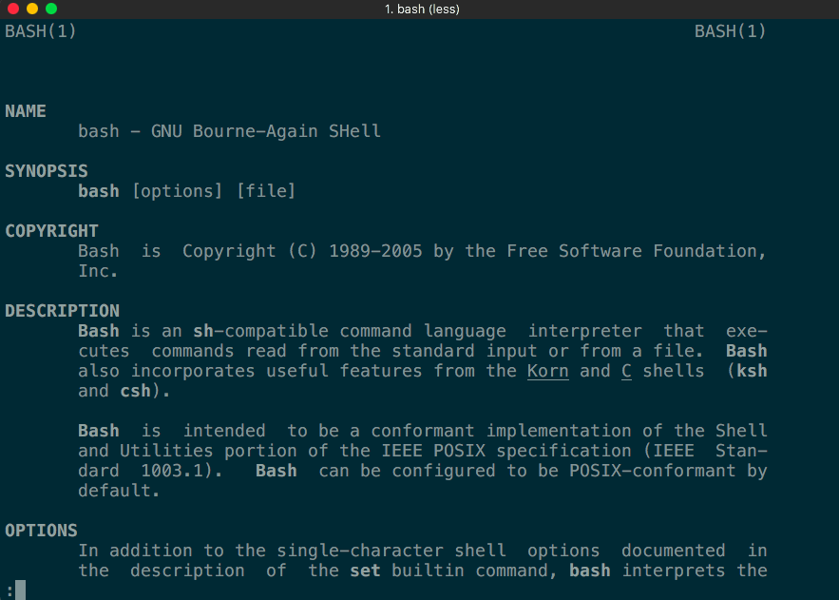
What is bash?
Bash stands for “Bourne-Again Shell”, which is based on the Bourne shell and mostly compatible with its features.
A Unix Shell (or Bourne shell) is both a command interpreter, and programming language.
Bash is the de facto shell on most GNU/Linux distributions.
Think of Bash as a way to speak to your system. It allows you to perform basic operations like math, run applications, or tests.
“man bash”

Slide 3
History
Bash initial release was in June 8, 1989.
Brian J. Fox is the original author of the GNU Bash Shell.
Written for the GNU Project as a replacement for the Bourne Shell.
The GNU Project is a free software, mass-collaboration project that aims to develop software for users to control the way they use their computing devices.

Slide 4
Programming language or scripting language?
Bash not only is an excellent command line shell, but also a scripting language.
Shell Scripting allows the use of the shell’s abilities and to automate a lot of the tasks that would otherwise require a lot of commands.
The difference between a scripting language and programming language Is programming languages are more powerful and a lot faster, and generally programming languages start off a source code and compiled down into an executable.
Scripting languages on the other hand, also starts from source code, but is not compiled down to an executable. Rather an interpreter reads the instructions in the source file and executes the instructions.

Slide 5
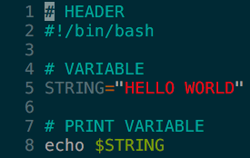


Design
Bash implements Simple Commands separated by spaces.
chmod u=rwx test1.txt
Sets test1.txt to readable/writeable/executable.
You can pipe commands together using the (|) symbol.
ls -l | grep "\.docx$”
Pipes the output of “ls –l” to “grep “\.docx$”” which finds the occurrences with “.docx”.
You can redirect output into files or redirect input from a file into a command/program/file.
Command > output_file
Redirects command into a file.
Command < input_file
Redirects input into a command/program/file
Command < input_file > output_file
Redirects input into a command/program/file, and redirects the output of that into a file.
You can automate tasks using scripts.

Slide 6
Simple commands

Slide 7
syntax

Slide 8
Arithmetic expressions

Slide 9
variables

Slide 10
arrays

Slide 11
Conditionals

Slide 12
loops

Slide 13
functions

Slide 14
List constructs

Slide 15
Scripting it together

Slide 16
Conclusion

