Slide 1
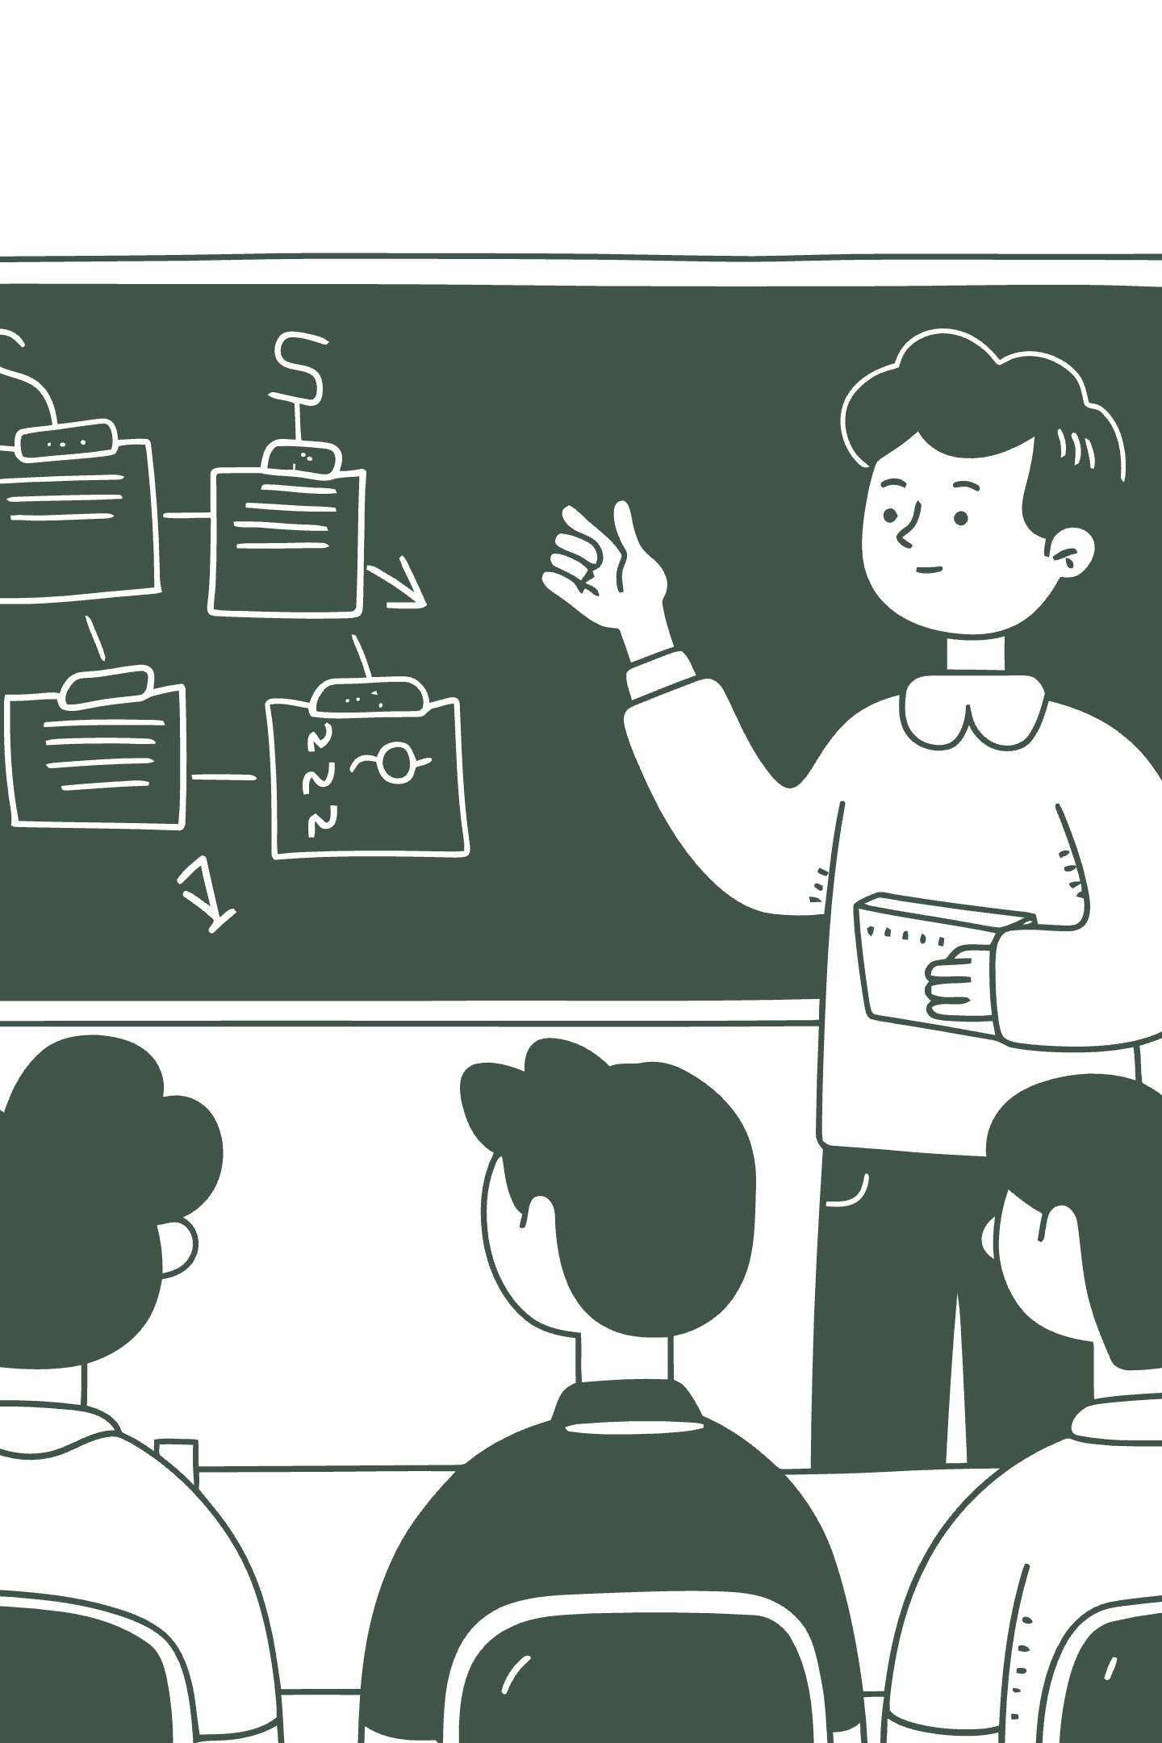
Student Feedback & Teaching Improvement Analyzer
AI-Driven Teaching Excellence Analyzer: Transforming student feedback into actionable insights for continuous educational improvement.

Slide 2
Challenges in Current Feedback Systems
Lack of Multilingual Feedback Processing
Lack of Standardized Metrics
The existing system does not support feedback submitted in regional or native languages, leading to the exclusion of a significant portion of student responses. This results in a representation bias and limits the inclusivity and comprehensiveness of the analysis.
No uniform framework for faculty evaluation makes comparative analysis difficult and subjective judgments more likely.
Lack of Personalized Faculty Improvement Roadmaps
Absence of Longitudinal Performance Tracking
The system identifies strengths and weaknesses but lacks personalized recommendations and development plans, limiting its effectiveness in improving teaching quality..
The current design lacks long-term tracking of faculty performance across semesters, making it difficult to identify trends, improvements, or declines and limiting effective academic planning.
No Continuous Tracking
Missing Real-Time Intervention
Faculty performance isn't monitored over time, preventing longitudinal improvement measurement and personalized development plans.
Without immediate feedback loops, opportunities for timely course correction and student support are lost during the semester.

Slide 3
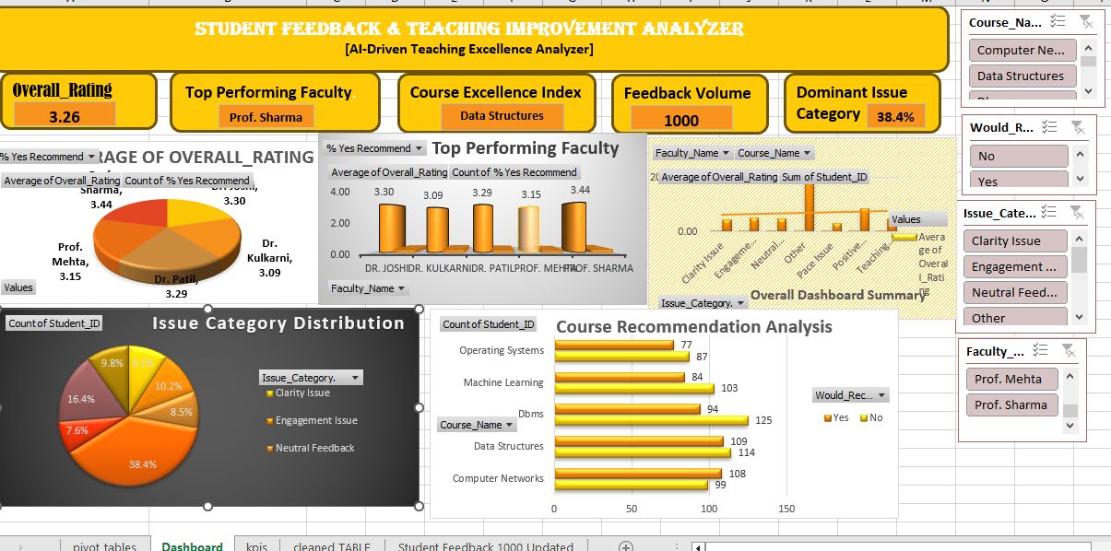
Dashboard

Slide 4
Centralized Dashboard Interface
An integrated analytics platform provides administrators and faculty with real-time visibility into teaching performance, student sentiment, and course effectiveness through intuitive visualizations and actionable metrics.

Slide 5
Dashboard Snapshot
3.26
1000
Overall Rating
Feedback Responses
Mean score across all courses and faculty
Total student responses analyzed
38.4%
1
Clarity Issues
Top Faculty
Most frequently reported problem area
Prof. Sharma leads performance rankings
Course Excellence Index: Data Structures course achieves highest ratings, demonstrating effective pedagogy and clear communication.

Slide 6
Faculty Performance Analysis
Comparative analysis reveals performance variations across teaching staff, enabling targeted professional development and recognition of excellence. The visualization identifies top performers while highlighting faculty requiring additional support or training resources.

Slide 7
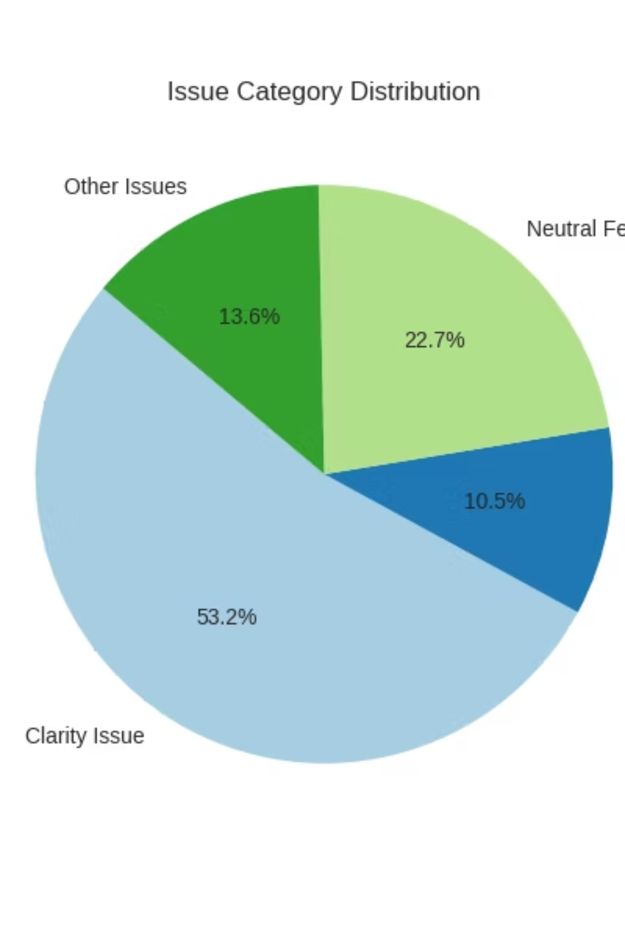
Issue Category Distribution
Primary Issue: Clarity (38.4%)
Secondary Concerns
Engagement, pacing, and assessment methods represent additional improvement opportunities.
Students most frequently report difficulty understanding course material and explanations.

Slide 8
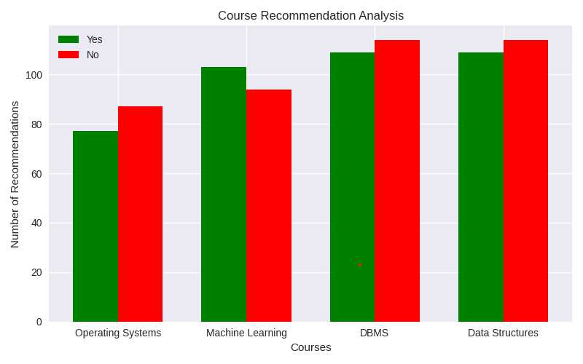
Course Recommendation Analysis
Student willingness to recommend courses varies significantly, indicating mixed satisfaction levels. Data Structures shows strongest endorsement, while other courses reveal improvement areas requiring faculty attention and curriculum refinement.

Slide 9





Additional Enhancement Requirements
Multilingual NLP Processing
Longitudinal Performance Tracking
Bias Detection Algorithms
Identify and correct bias patterns in anonymous feedback to ensure fair and accurate evaluations.
Expand feedback analysis to regional languages, ensuring inclusive access for diverse student populations.
Monitor faculty development across semesters to measure improvement and identify persistent challenges.
Personalized Improvement Plans
Real-Time Feedback Systems
Generate customized professional development recommendations based on individual performance data.
Enable mid-semester interventions through continuous feedback collection and immediate alerts.

Slide 10




Key Insights & Findings
Excellence Recognition
Communication Priority
Prof. Sharma demonstrates outstanding teaching performance, setting benchmark for faculty development programs.
Clarity issues dominate feedback, requiring focused faculty training on explanation techniques and accessibility.
Course Model
Improvement Opportunity
Data Structures course represents best practice example for curriculum design and instructional delivery.
Mixed course recommendations signal need for systematic quality enhancement initiatives.

Slide 11


