Slide 1
IIIT DHARWAD
Human Activity Recognition
Using Pose Estimation
PoseLab
Mini Project II / Seventh semester
August to November 2026
01
Notes:
Add the actual student names, roll numbers and supervisor before submission. The deck describes a working implementation and an evaluation plan. Real participant results remain pending.

Slide 2
Project scope
Six activities from an ordinary camera
Standing
Sitting
Marching in place
Squats
Jumping jacks
Waving
Single person. Fixed camera. Full body in view.
02
Notes:
Pose estimation locates joints. Activity recognition assigns a label to movement. Our scope is deliberately restricted to six controlled activities and one fully visible person.

Slide 3
Research foundation
01
BlazePose and MediaPipe
A pretrained detector estimates 33 body landmarks.
02
Landmark sequence classification
Prior work motivates recognizing exercise from keypoint time series.
03
Our study
Compare mean pose features with pose and motion features on unseen people.
03
Notes:
[1] Bazarevsky et al., BlazePose: On-device Real-time Body Pose Tracking, 2020. https://arxiv.org/abs/2006.10204
[2] Arrowsmith et al., Physiotherapy Exercise Classification with Single-Camera Pose Detection and Machine Learning, Sensors 23(1), 363, 2023 issue. https://doi.org/10.3390/s23010363
[3] Google AI Edge Pose Landmarker web guide. https://ai.google.dev/edge/mediapipe/solutions/vision/pose_landmarker/web_js
The project reuses a pretrained pose detector and studies simpler motion features. It does not claim either paper’s results.

Slide 4
Processing pipeline
01
Capture
Webcam or local video
02
Estimate pose
33 landmarks from MediaPipe
03
Extract features
Geometry over two seconds
04
Classify
Rule baseline or Random Forest
05
Display
Confirmed activity and full-cycle counts
04
Notes:
The browser owns capture, MediaPipe inference and display. Python computes features, predicts and trains models. Video stays in the browser. After asset setup, inference does not require an internet service. The browser detector is synchronous and targets approximately 10 samples per second.

Slide 5
Feature comparison
18
72
Mean pose features
Pose and motion features
Joint angles and normalized
body measurements
Mean, standard deviation,
range and absolute speed
Research question: do motion statistics improve macro F1?
05
Notes:
Both models see the same participant split and accepted windows. Static means window-mean pose geometry, not a single frame. The 18 features include eight joint angles and ten position/trunk measurements. Normalization corrects image aspect ratio, centers on the hips and divides by torso length.

Slide 6
Tracking quality and label confirmation
01
Quality checks
Reject cropped limbs, low visibility, degenerate geometry and tracking gaps.
02
Model abstention
A validation-selected threshold can reject low forest vote scores.
03
Consecutive labels
Three matching predictions confirm an activity. Unknown clears the state.
06
Notes:
An accepted two-second window needs at least 12 valid frames, 85 percent valid coverage, at least 1.8 seconds of valid span and gaps no larger than 0.35 seconds. Core joint visibility must be at least 0.5. The forest vote score is uncalibrated. Unknown is an output state, not a trained class. Three consecutive predictions add roughly one second of confirmation delay.

Slide 7
Repetition counting
Squats
1 Upright pose arms the counter
2 Both knees bend
3 Return upright completes a rep
Jumping jacks
Closed stance, open stance, then closed again
Tracking loss discards a partial cycle.
07
Notes:
Counters use live geometry only when the activity is confirmed. Squats require upright, bent and upright states. Jumping jacks require closed, open and closed arms and legs. Threshold hysteresis and a 0.6-second minimum count interval suppress noise. Tracking loss resets partial cycles. Repetition accuracy needs annotated continuous clips and is not included in window classification metrics.

Slide 8
Planned participant dataset
180 planned clips
6 participants × 6 activities × 5 clips
Training: P01–P04
Validation: P05
Testing: P06
Permission before recording
One activity per clip
Stable participant IDs
08
Notes:
This slide describes a collection target, not data already collected. Six participants, six activities and five eight-second clips produce 180 clips and 24 minutes of activity excluding setup. Use the same participant ID across all sessions. All sessions and views from one person stay in one split. More independent test participants would strengthen the study.

Slide 9
Evaluation design
Variant | Features | Activity rejection
Mean pose | 18 | Quality only
Pose and motion | 72 | Quality only
Mean pose with threshold | 18 | Quality and model votes
Pose and motion with threshold | 72 | Quality and model votes
Accuracy, macro F1, confusion matrix, coverage and accepted accuracy
09
Notes:
Random Forest settings: 200 trees, max depth 12, min_samples_leaf 2, balanced class weighting and seed 42. Validation selects a threshold from 0, .45, .55, .65, .75 by macro F1, preferring coverage of at least .7 when available. Test metrics include unknown errors. Always show coverage with accepted-only accuracy. Adjacent windows are correlated. No real participant experiment has been run yet.

Slide 10
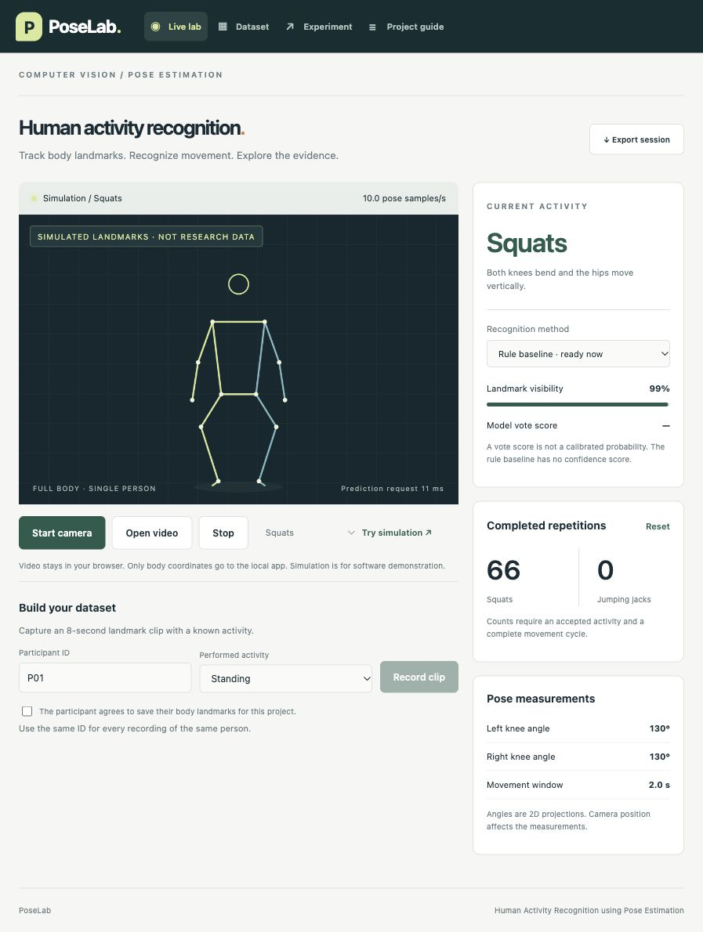
Working demonstration
Live lab
Dataset collection
Model comparison
Session export
Simulation is labeled.
Real participant results
remain pending.
10
Notes:
Screenshot from the local PoseLab implementation. Procedural skeletons are labeled simulation and are not empirical activity-recognition evidence. Use the live webcam or a consented local video for the final presentation. Do not present simulated counts as measured human performance.

Slide 11
Implementation verification
01
22 automated checks
Geometry, timing, quality rejection, participant splits, training and state logic.
02
Actual pose inference
The official Lite model detected 33 landmarks in a public test image.
03
Empirical evaluation pending
Real recordings are needed for activity accuracy, count error and laptop speed.
11
Notes:
Actual implementation checks: 18 Python tests and four JavaScript tests passed. Procedural fixtures verify software mechanics only. A separate browser smoke test loaded the official local Lite bundle and detected 33 landmarks in Google’s public example image at https://storage.googleapis.com/mediapipe-assets/pose.jpg. The dashboard demonstrated synthetic recognition and repetition counting. Webcam accuracy on people has not been measured.

Slide 12
Limitations and next steps
Single person and camera-view sensitivity
Occlusion and two-second motion-window delay
Small dataset and uncalibrated classifier scores
Next: collect participants and complete the fixed comparison
12
Notes:
Be explicit that the software is implemented while participant evaluation remains. Camera perspective distorts projected angles. Small local data limits generalization. Unknown rejection cannot guarantee unfamiliar-action detection. The model is not a clinical assessor. Collect the planned data, freeze splits, run the experiment and report results before final submission.

Slide 13
Research references
Bazarevsky et al. 2020
BlazePose: On-device Real-time Body Pose Tracking
arxiv.org/abs/2006.10204
Arrowsmith et al. 2023
Physiotherapy Exercise Classification with Single-Camera
Pose Detection and Machine Learning
doi.org/10.3390/s23010363
Implementation references: Google AI Edge and scikit-learn documentation
13
Notes:
Sources accessed 6 October 2026. The project’s results must be supplied by real measurements. Do not copy research-paper accuracy into the report. Institutional submission deadline: at least three working days before each presentation according to the supplied guidelines; official Table I was not supplied.

