Slide 1

Media Files
SoftUni Team
Technical Trainers
Software University
https://softuni.org

Slide 2
Table of Contents
What are media files?
The pillow library
Static Files
Media Files in Django
Uploading images
Uploading documents
2
Notes:
2

Slide 3
Have a Question?
sli.do
#python-web
Notes:
3

Slide 4

What are Media Files?

Slide 5
What are Media Files?
Media files are pictures, music, audios, videos, and documents
Computer programs or applications can read and work with a digital file after it is encoded during the saving process
For instance, document formats can be read and edited in word-processing programs like Microsoft Word

Slide 6
Most Common Media Files
Photo file formats: JPEG, GIF, TIFF, BMP
Music file formats: AAC, MP3, WAV, WMA, DOLBY DIGITAL, DTS
Other available music file formats: AIFF, ASF, FLAC, ADPCM, DSD, LPCM, OGG
Video file formats: MPEG-1, MPEG-2, MPEG-4, AVI, MOV, AVCHD, H.264, H.265
Other available video formats: DivX and DivX HD, Xvid HD, MKV, RMVB, WMV9, TS/TP/M2T, WMV

Slide 7

Pillow
Python Imaging Library

Slide 8
What is Pillow?
Python Imaging Library (abbreviated as PIL) (in newer versions known as Pillow) is a free library
It adds support for opening, manipulating, and saving many different image file formats
It is available for Windows, Mac OS X and Linux
Some of the file formats supported are PPM, PNG, JPEG, GIF, TIFF, and BMP

Slide 9
Installing Pillow
To install pillow, we can use the python package manager (pip)
Warnings
Pillow and PIL cannot co-exist in the same environment
Before installing Pillow, please uninstall PIL
pip install pillow

Slide 10
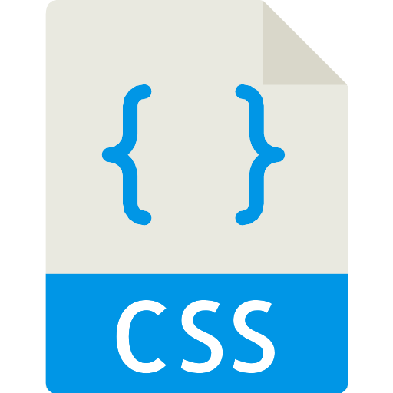
Static Files in Django
Managing Static Files

Slide 11
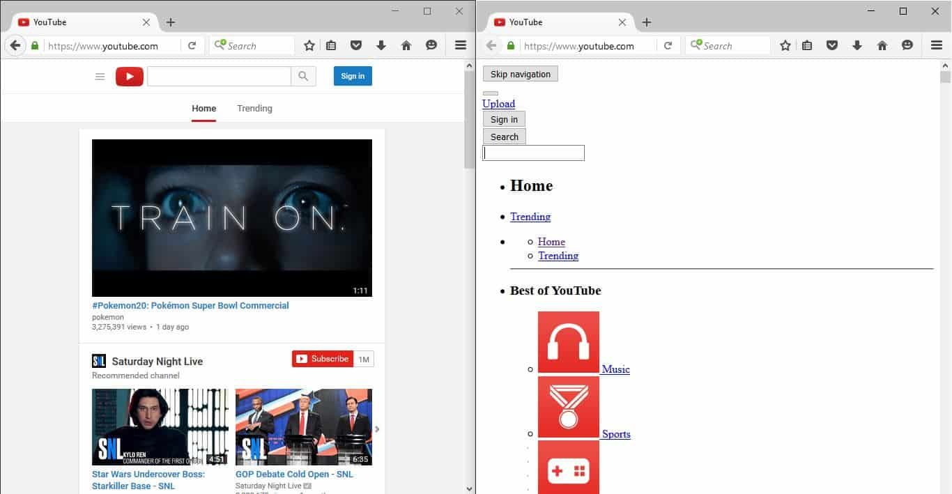
A Word About Static Files
Most of the times, your application would need to serve external files such as JavaScript, CSS, etc.
This type of files are called "static files"
Youtube with and without CSS

Slide 12
Configuring Static Files in Django
First, make sure that your application is in INSTALLED_APPS
Make sure you have STATIC_URL variable
Make sure you have STATICFILES_DIRS variable
STATIC_URL = '/static/'
STATICFILES_DIRS = [
os.path.join(BASE_DIR, 'static'),
]

Slide 13
Using Static Files
To include your CSS for example you will need the following code
To include images, we use the same approach
Path to the CSS file
{% load static %}
<link rel="stylesheet" href="{% static './css/style.css' %}"/>
Path to the image
{% load static %}
<img src="{% static './my_image.png' %}" alt="My image">

Slide 14

Demo
Configuring and Using Static Files

Slide 15


Media Files in Django
Django
Images

Slide 16
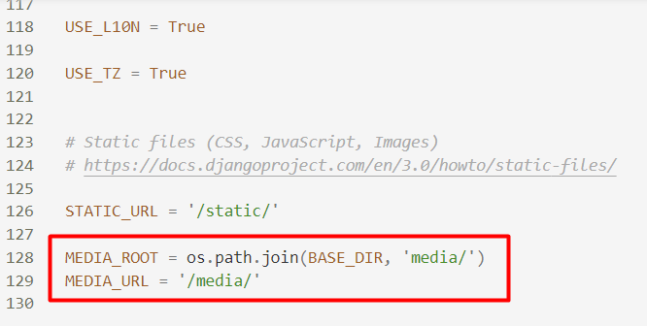
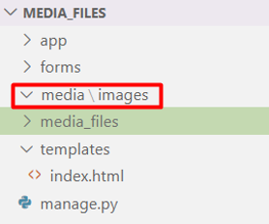
Configure Media Folder
Create a media folder and configure it in the settings.py file

Slide 17
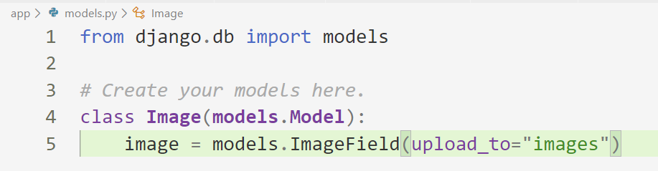
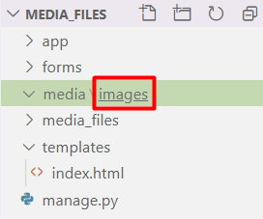
Create Image Field in a Model
Name of the folder where the images will be stored

Slide 18
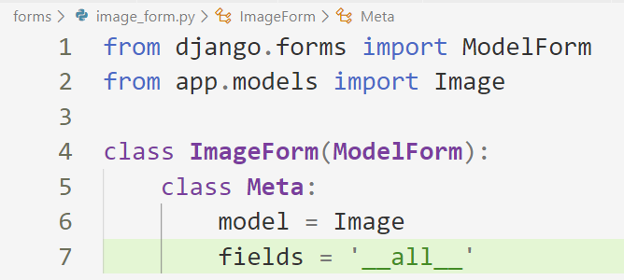
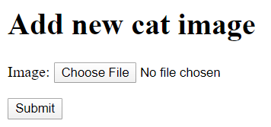
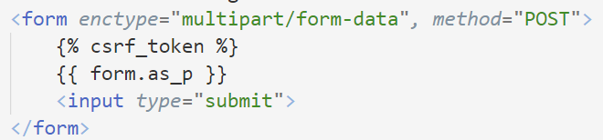
Create a Model Form

Slide 19
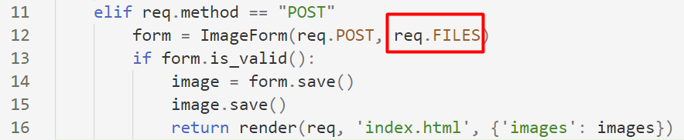
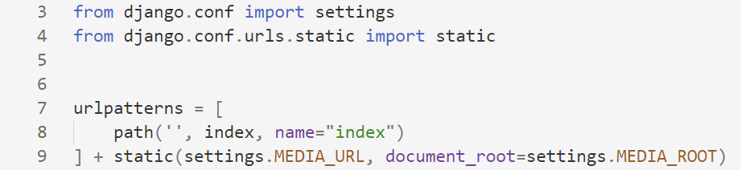
Handling the POST Request
Configure the URLs for media

Slide 20
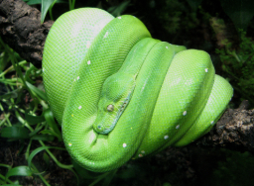
Displaying the Image

Slide 21
Demo
Live Exercise in Class

Slide 22

Media Files in Django
Django
Documents

Slide 23
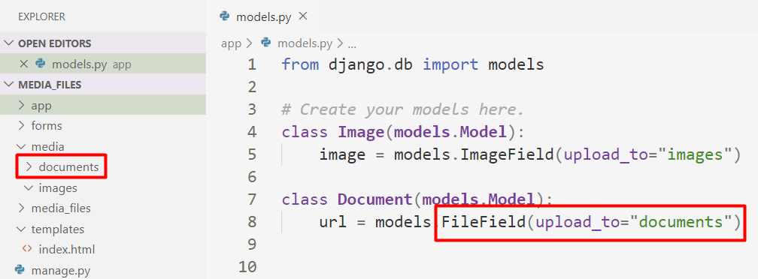
Create Documents Folder

Slide 24
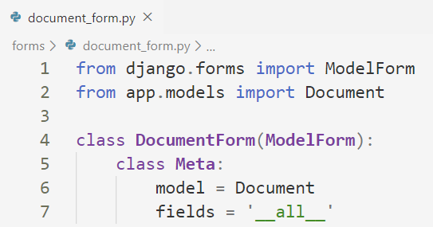
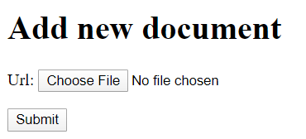
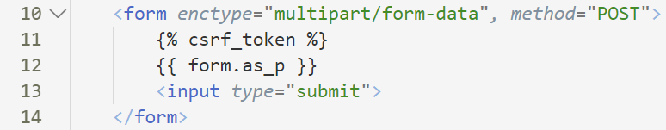
Create Model Form

Slide 25
Demo
Live Exercise in Class

Slide 26

Summary
Media files are pictures, music, audios, videos, and documents
We use the pillow library for opening, manipulating, and saving many different image file formats
Notes:
26

Slide 27
Questions?
Notes:
27

Slide 28

License
This course (slides, examples, demos, exercises, homework, documents, videos and other assets) is copyrighted content
Unauthorized copy, reproduction or use is illegal
© SoftUni – https://softuni.org
© Software University – https://softuni.bg
Notes:
28

Slide 29
Trainings @ Software University (SoftUni)
Software University – High-Quality Education, Profession and Job for Software Developers
softuni.bg, softuni.org
Software University Foundation
softuni.foundation
Software University @ Facebook
facebook.com/SoftwareUniversity
Software University Forums
forum.softuni.bg
Notes:
29

