Slide 1

Login and Register
SoftUni Team
Technical Trainers
Software University
https://softuni.org

Slide 2
Table of Contents
Registration
Login/Logout
Django Signals
2
Notes:
2

Slide 3
Have a Question?
sli.do
#python-web
Notes:
3

Slide 4

Registration
Notes:
4

Slide 5
Registration
A lot of the coding for working with Users and Authorization happens in the views.py file.
We check if there is a "POST" request and then perform an action based off of that information.

Slide 6
Registration (2)
Sometimes we will want to save that information directly to the database
Other times, we set commit=False so we can manipulate the data before saving it to the database
This prevents collision errors
user.save()
user.save(commit=False)

Slide 7
Example of a User registration
def register(request):
registered = False
if request.method == 'POST':
user_form = UserForm(data=request.POST)
profile_form = UserProfileInfoForm(data=request.POST)
if user_form.is_valid() and profile_form.is_valid():
user = user_form.save()
user.set_password(user.password)
user.save()
profile = profile_form.save(commit=False)
profile.user = user
pic = 'profile_pic'
# Continues on the next slide

Slide 8
Example of a User registration (2)
if pic in request.FILES:
profile.profile_pic = request.FILES[pic]
profile.save()
registered = True
else:
print(user_form.errors, profile_form.errors)
else:
user_form = UserForm()
profile_form = UserProfileInfoForm()
return render(request, 'basic_app/registration.html',
{'user_form': user_form,
'profile_form': profile_form,
'registered': registered})

Slide 9
Example of a User registration (3)
We should edit the urls.py file in our application, now that we have a view for registering
from .views import register
urlpatterns = [
path('register/', register, name='register'),
]

Slide 10
Example of a User registration (4)
and our urls.py file in our project
urlpatterns = [
path('', views.index, name='index'),
path('admin/', admin.site.urls),
path('app/', include('basic_app.urls')),
]

Slide 11
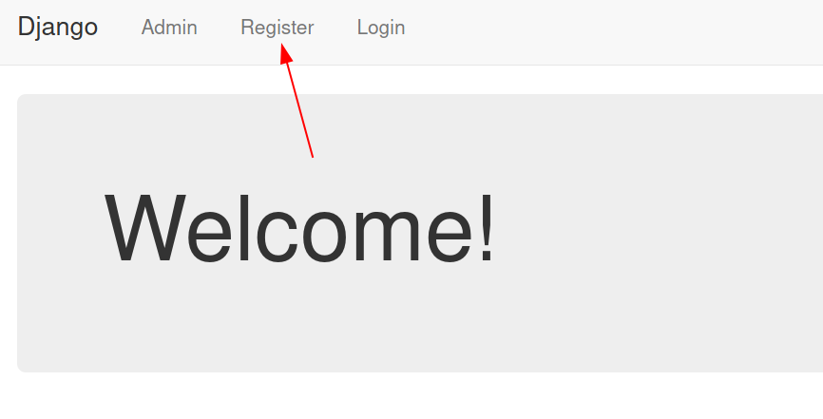
Example of a User registration (5)
We can now start the project, including our templates folder

Slide 12
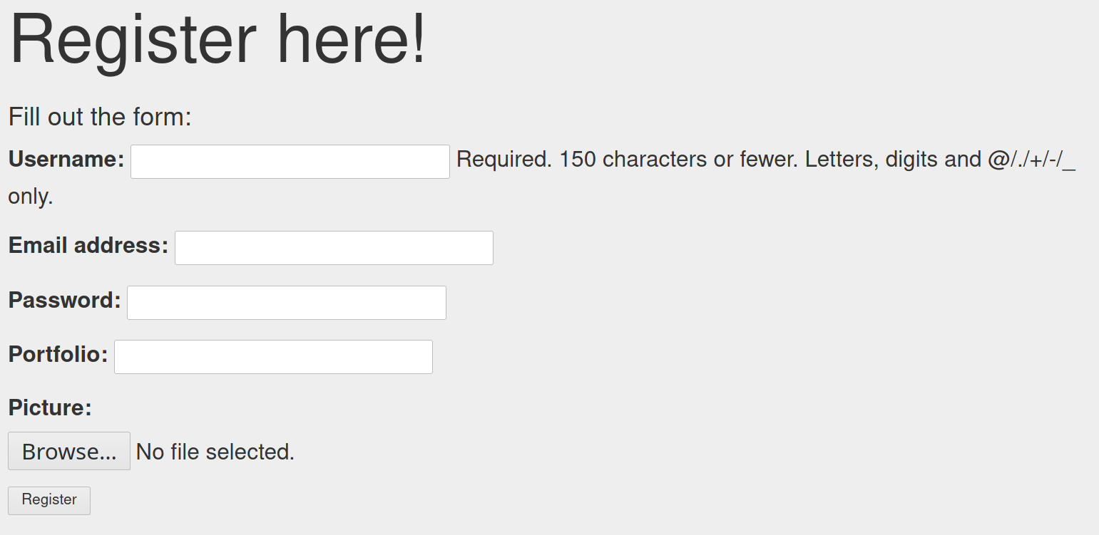
Example of a User registration (6)

Slide 13
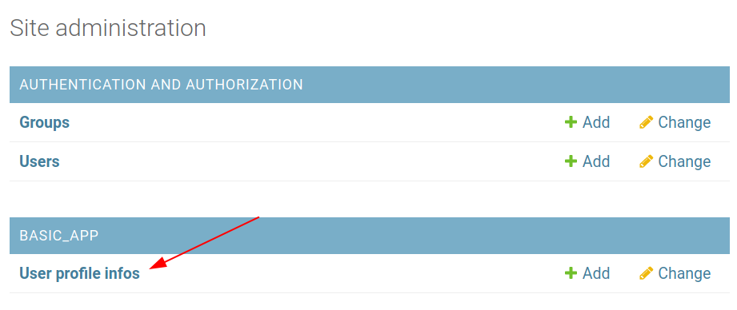
Admin page
We can view our registered users in the admin page

Slide 14

Login/Logout
Notes:
14

Slide 15
Login
Once a user is registered, we want to make sure that they can log in and out of the site
This process involves
Setting up the login views
Using built-in decorators for access
Adding the LOGIN_URL in settings
Creating the login.html
Editing the urls.py files

Slide 16
Example of a User login
from django.contrib.auth import authenticate, login, logout
def user_login(request):
if request.method == 'POST':
username = request.POST.get('username')
password = request.POST.get('password')

Slide 17
Example of a User login (2)
user = authenticate(username=username, password=password)
if user:
if user.is_active:
login(request, user)
return HttpResponseRedirect(reverse('index'))
else: return HttpResponse("Account not Active")
else: return HttpResponse('Invalid login details')
else: return render(request, 'basic_app/login.html', {})

Slide 18
Example of a User login (3)
We can make views for the users logging out and a special page for logged in users
@login_required
def special(request):
return HttpResponse("Logged in")
@login_required
def user_logout(request):
logout(request)
return HttpResponseRedirect(reverse('index'))

Slide 19
Example of a User login (4)
We need to update our urls.py in our application
from .views import register, user_login
urlpatterns = [
path('register/', register, name='register'),
path('login/', user_login, name='user_login')
]

Slide 20
Example of a User login (5)
and our urls.py file in our project
urlpatterns = [
path('', views.index, name='index'),
path('admin/', admin.site.urls),
path('app/', include('basic_app.urls')),
path('logout/', views.user_logout, name='logout'),
path('special/', views.special, name='special'),
]

Slide 21

Django Signals

Slide 22
What are Signals?
The Django Signals is a strategy to allow decoupled applications to get notified when certain events occur
A common use case is when you extend the Custom Django User by using the Profile strategy through a one-to-one relationship
We use a "signal dispatcher" to listen for the User's post_save event to also update the Profile instance as well

Slide 23
When to Use Signals
When many pieces of code may be interested in the same events
When you need to interact with a decoupled application, e.g.
A Django core model
A model defined by a third-party app

Slide 24
Extending the User Model
We often need to extend the Custom Django User in our applications
We will be creating a new Django Model to store extra information that relates to the User Model
from django.db import models
from django.contrib.auth.models import User
class Profile(models.Model):
user = models.OneToOneField(User, on_delete=models.CASCADE)
bio = models.TextField(max_length=500, blank=True)
location = models.CharField(max_length=30, blank=True)
birth_date = models.DateField(null=True, blank=True)

Slide 25
Extending the User Model
We will now define signals so our Profile model will be automatically created/updated when we create/update User instances
Hooking the create_user_profile and save_user_profile methods to the User model whenever a save event occurs
# Code continues from previous slide
@receiver(post_save, sender=User)
def create_user_profile(sender, instance, created, **kwargs):
if created:
Profile.objects.create(user=instance)
@receiver(post_save, sender=User)
def save_user_profile(sender, instance, **kwargs):
instance.profile.save()

Slide 26
Updating with Django Forms
forms.py
class UserForm(forms.ModelForm):
class Meta:
model = User
fields = ('first_name', 'last_name', 'email')
class ProfileForm(forms.ModelForm):
class Meta:
model = Profile
fields = ('url', 'location', 'company')

Slide 27
Updating with Django Forms
views.py
@login_required
@transaction.atomic
def update_profile(request):
if request.method == 'POST':
user_form = UserForm(request.POST, instance=request.user)
profile_form = ProfileForm(request.POST, instance=request.user.profile)
if user_form.is_valid() and profile_form.is_valid():
user_form.save()
profile_form.save()
messages.success(request, _('Your profile was successfully updated!'))
return redirect('settings:profile')
else:
messages.error(request, _('Please correct the error below.'))
else:
user_form = UserForm(instance=request.user)
profile_form = ProfileForm(instance=request.user.profile)
return render(request, 'profiles/profile.html', {
'user_form': user_form,
'profile_form': profile_form
})

Slide 28
Updating with Django Forms
profile.html
<form method="post">
{% csrf_token %}
{{ user_form.as_p }}
{{ profile_form.as_p }}
<button type="submit">Save changes</button>
</form>

Slide 29

Exercise
Practicing Login, Register and Signals

Slide 30

Summary
Registration
Logging in
Logging out
Django Signals
Notes:
30

Slide 31
Questions?
Notes:
31

Slide 32

License
This course (slides, examples, demos, exercises, homework, documents, videos and other assets) is copyrighted content
Unauthorized copy, reproduction or use is illegal
© SoftUni – https://softuni.org
© Software University – https://softuni.bg
Notes:
32

Slide 33
Trainings @ Software University (SoftUni)
Software University – High-Quality Education, Profession and Job for Software Developers
softuni.bg, softuni.org
Software University Foundation
softuni.foundation
Software University @ Facebook
facebook.com/SoftwareUniversity
Software University Forums
forum.softuni.bg
Notes:
33

