Slide 1
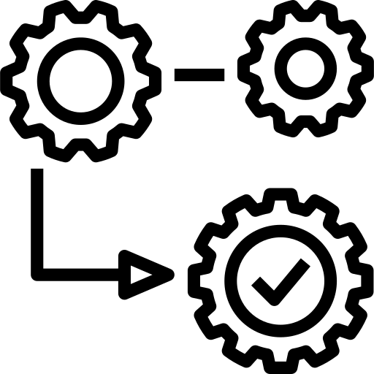
Functions Advanced
SoftUni Team
Technical Trainers
Software University
https://softuni.bg

Slide 2
Table of Contents
Packing Arguments
*args and **kwargs
Unpacking Arguments
Unpacking Lists and Tuples
Unpacking Dictionaries
Recursion
2
Notes:
2

Slide 3
Have a Question?
sli.do
#python-advanced

Slide 4
Packing Arguments
*args
**kwargs
*args and **kwargs

Slide 5
What is Packing?
This operation is called packing
We pack all the arguments into one single variable
We use packing when we don't know how many arguments need to be passed to a function
def some_func(*args, **kwargs):
pass
5

Slide 6
Packing Arguments into Tuple
We use *args to pack arguments into tuple
def some_func(*args):
print(args)
some_func(1, 2, 3) # (1, 2, 3)
some_func("peter", "george") # ("peter", "george")
some_func(True, False) # (True, False)
some_func() # ()
6

Slide 7
Packing Arguments into Dictionary
**kwargs allows you to pass keyworded variable length of arguments to a function
def greet_me(**kwargs):
for key, value in kwargs.items():
print(f"{value}, {key}")
greet_me(Peter="Hello", George="Bye")
# Hello Peter
# Bye George
7

Slide 8
Formal Args, *args and **kwargs
You can also use keyword arguments and *args
So, if you want to use all three of these in argument types then the order is
def some_func (arg1, *rest_args):
print(arg1 + sum(rest_args))
some_func(5, 5, 10) # 20
some_func() # Error
The function requires at least 1 argument
some_func(fargs, *args, **kwargs)
8

Slide 9
Problem: Multiplication Function
Write a function called multiply() that can receive any number of numbers (integers) as different parameters
The function should return the result of the multiplication of all of them
Submit only your function in judge
print(multiply(1, 4, 5))
print(multiply(4, 5, 6, 1, 3))
print(multiply(2, 0, 1000, 5000))
20
360
0

Slide 10

Solution: Multiplication Function
def multiply(*args):
result = 1
for num in args:
result *= num
return result
10

Slide 11
Unpacking Arguments
*
**
Unpack Lists, Tuples and Dictionaries

Slide 12
What is Unpacking?
We can use * to unpack the list so that all elements of it can be passed as different parameters
And we can use ** to unpack a dictionary, so all of its elements are passed as keyworded arguments
12

Slide 13
Unpacking Lists
Note that the length of the list, that you unpack, must be the same as the number of parameters in the function
def print_nums(a, b, c):
print(a, b, c)
nums = [1, 2, 3]
print_nums(*nums) # 1 2 3
13

Slide 14
Unpacking Dictionaries
Note that the keys of the dictionary must match the names of the parameters of the function
The order of the keys in the dictionary does not matter
def some_func(name, age):
print(f"{name} is {age} years old")
person = {'age': 20, 'name': "Peter"}
some_func(**person) # Peter is 20 years old
14

Slide 15
Problem: Person Info
Write a function called get_info that receives a name, age and town, and returns a string in the format: "This is {name} from {town} and he is {age} years old"
Use dictionary unpacking when testing your function
kwargs = {"name": "John", "town": "Sofia", "age": 20}
print(get_info(**kwargs))
This is John from Sofia and he is 20 years old

Slide 16

Solution: Person Info
def get_info(name, age, town):
return f"This is {name} from {town} and he is {age} years old"
# TEST CODE
print(get_info(**{"name": "George", "town": "Sofia", "age": 20}))
16

Slide 17

Recursion
Function Calling Itself

Slide 18
What is Recursion?
The process in which a function calls itself is called recursion
The function that is calling itself is called a recursive function
A recursive function has the following structure
A base case
A recursive case
18

Slide 19
Base Case and Recursive Case
The base case in a recursion returns a value without making any other recursive calls
It is the condition for the recursion to stop
The recursive case is the central part of the recursive function
It is the solution to the bigger problem expressed in terms of smaller problems
19

Slide 20
Example
Factorial recursive representation
def fact(n):
if n == 1:
return 1
return n * fact(n - 1)
Base Case
Recursive Case
20

Slide 21
Problem: Character Combinations
Write a program that reads a single string and prints all the possible combinations of the characters in that string
Submit your solution in judge
abc
acb
bac
bca
cba
cab
abc

Slide 22
Solution: Character Combinations
def print_comb(text, idx):
if idx >= len(text):
print("".join(text))
return
print_comb(text, idx + 1)
for i in range(idx + 1, len(text)):
text[idx], text[i] = text[i], text[idx]
print_comb(text, idx + 1)
text[idx], text[i] = text[i], text[idx]
text = list(input())
print_comb(text, 0)
Using swapping algorithm
22

Slide 23
Explanation: Character Combinations
A
B
C
Swap A with A
Swap A with B
Swap A with C
A
B
C
B
A
C
C
B
A
Swap B with B
Swap B with C
Swap A with A
Swap A with C
Swap B with B
Swap B with A
A
B
C
A
C
B
B
A
C
B
C
A
C
B
A
C
A
B
23

Slide 24
Problem: Chairs
Write a program that receives names on the first line and number of chairs on the second line
Find all the ways to fit whose people on the chairs
Print each combination on a separate line
Peter, George
Peter, Amy
George, Amy
Peter, George, Amy
2

Slide 25

Practice
Live Exercise in Class (Lab)

Slide 26

Summary
Packing arguments into:
Tuple
Dictionary
Unpacking arguments into:
Tuple
Dictionary
…
…
…

Slide 27
Questions?
Notes:
27

Slide 28










SoftUni Diamond Partners

Slide 29



Educational Partners

Slide 30
Trainings @ Software University (SoftUni)
Software University – High-Quality Education, Profession and Job for Software Developers
softuni.bg, softuni.org
Software University Foundation
softuni.foundation
Software University @ Facebook
facebook.com/SoftwareUniversity
Software University Forums
forum.softuni.bg
30
Notes:
30

Slide 31

License
This course (slides, examples, demos, exercises, homework, documents, videos and other assets) is copyrighted content
Unauthorized copy, reproduction or use is illegal
© SoftUni – https://about.softuni.bg
© Software University – https://softuni.bg
Notes:
31

