Slide 1

Authentication
SoftUni Team
Technical Trainers
Software University
https://softuni.org

Slide 2
Table of Contents
What is Authentication?
What is Authorization?
Authentication in Django
Permissions and Authorization in Django
2
Notes:
2

Slide 3
Have a Question?
sli.do
#python-web
Notes:
3

Slide 4

What is Authentication?

Slide 5
What is Authentication?
Authentication is the act of proving an assertion, such as the identity of a computer system user
In contrast with identification, authentication is the process of verifying that identity
It might involve validating personal identity documents, verifying the authenticity of a website with a digital certificate, etc.

Slide 6
How Authentication Works
During authentication, credentials provided by the user are compared to those in a database of authorized users' information
If the credentials match, the process is completed, and the user is granted access
Authenticating a user with a user ID and a password is the most basic type of authentication, but there are more authentication factors

Slide 7
Authentication Factors
An authentication factor represents some piece of data or attribute that can be used to authenticate a user requesting access to a system
Since authenticating a user with a user ID and a password relies on just one authentication factor, it is a type of single-factor authentication
Two-factor authentication usually depends on the knowledge factor combined with either a biometric factor or a possession factor like a security token

Slide 8
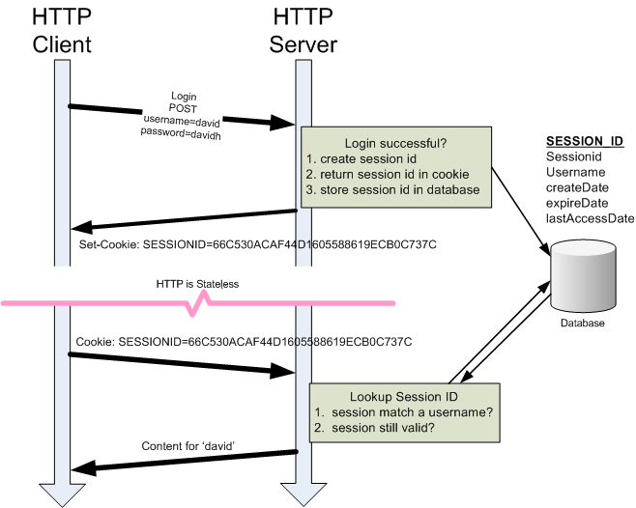
Sessions and Cookies
Cookies and Sessions are used to store information
Cookies are only stored on the client-side machine
A session creates a file on the server where registered session variables are stored
Cookies are text files stored on the client computer

Slide 9

What is Authorization?

Slide 10
What is Authorization?
Authorization includes the process through which an administrator grants rights to authenticated users
The privileges and preferences granted for the authorized account depend on the user's permissions
The settings defined for all these environment variables are set by an administrator

Slide 11
Authentication in Django
Django

Slide 12
Authentication in Django
Django comes with a user authentication system
It handles user accounts, groups, permissions and cookie-based user sessions
The Django authentication system handles both authentication and authorization

Slide 13
The User Model
User objects are the core of the authentication system
They interact with your site and are used to restrict access, register user profiles, associate content with creators etc.
The primary attributes of the default user are:
username
password
email
first_name
last_name

Slide 14
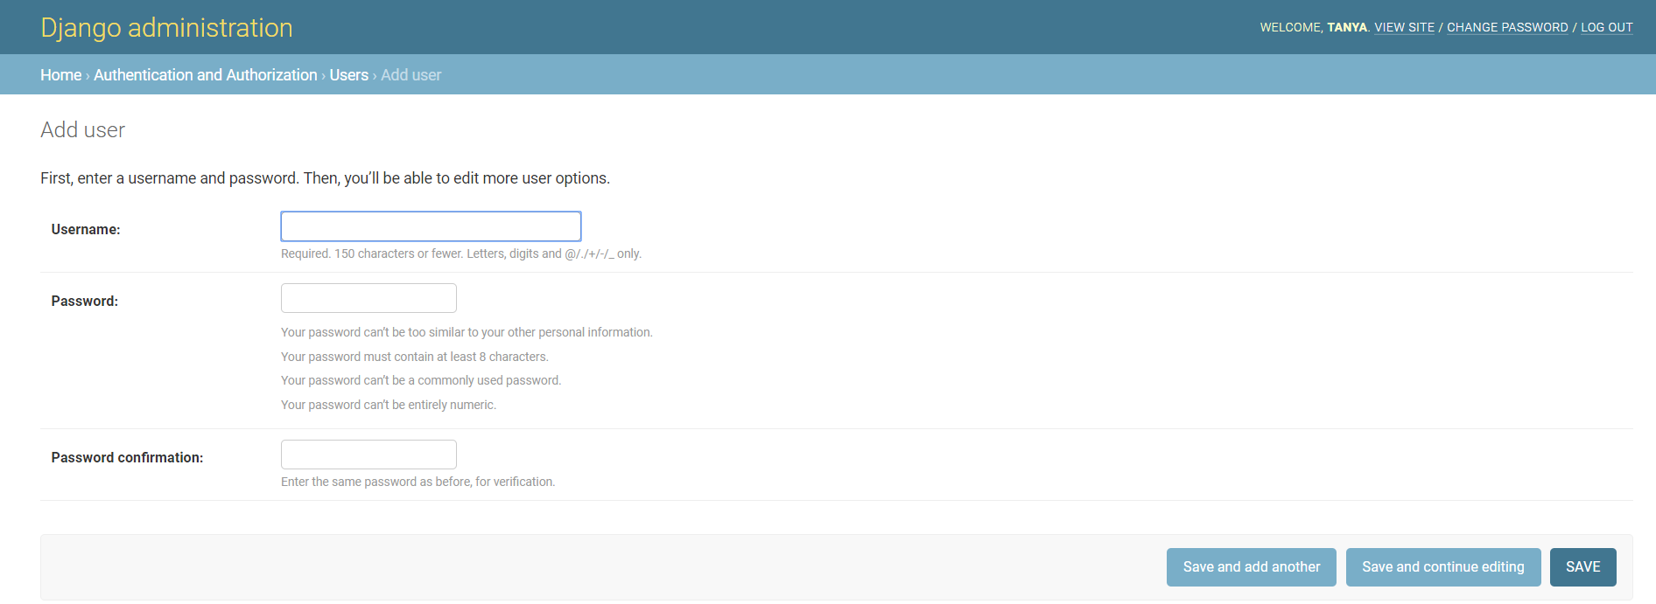
Create User
To create a new User, we can use the built-in helper function create_user()
Or using the Django Admin
from django.contrib.auth.models import User
user = User.objects.create_user('peter', 'peter@gmail.com', 'peterpass')

Slide 15
Authenticating Users
We can use the authenticate() function to verify credentials (for login)
If the credentials are not valid, None is returned
from django.contrib.auth import authenticate
user = authenticate(username='peter', password='peterpass')
if user:
# Credentials are valid
else:
# Credentials are not valid

Slide 16
Logout a User
from django.contrib.auth import logout
def logout_view(request):
logout(request)
redirect('index')

Slide 17

Permissions and Authorization

Slide 18
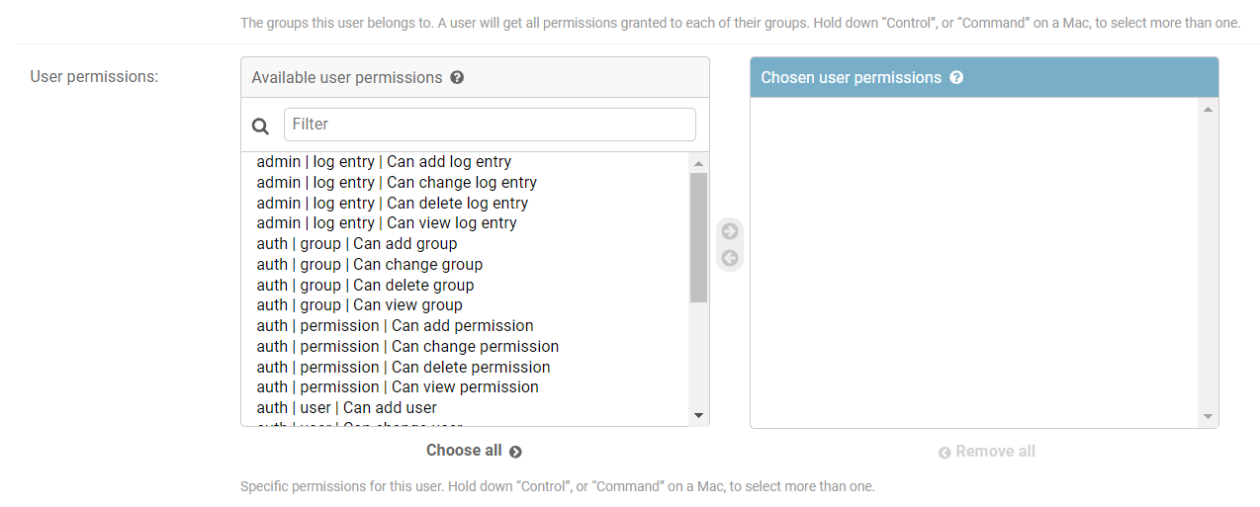
Django Permissions in Users
In Django we have some built-in permissions
We can manage those permissions using the Django Admin

Slide 19
Django Permissions in Groups
Instead of managing the permissions of each User, we can use Groups
For example, we can create a group User, and each new User will belong to that group
Then, we can add permissions to that Group, so it applies to each member of the Group

Slide 20
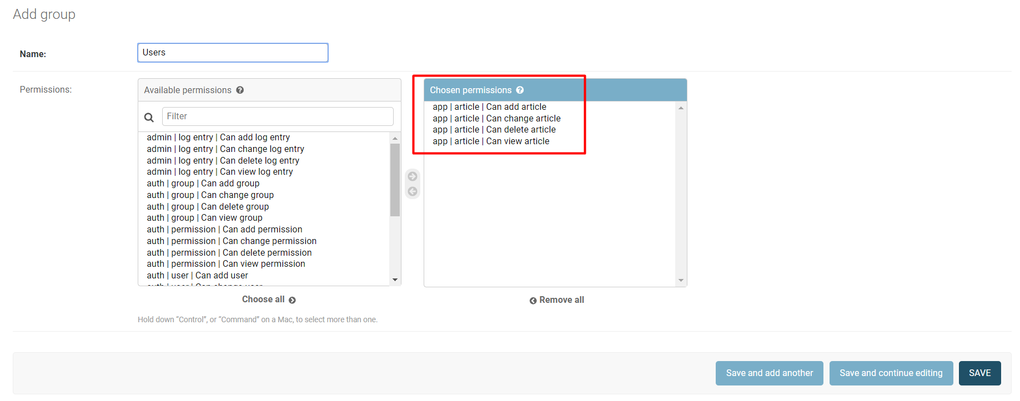
Example: Permissions in Groups

Slide 21
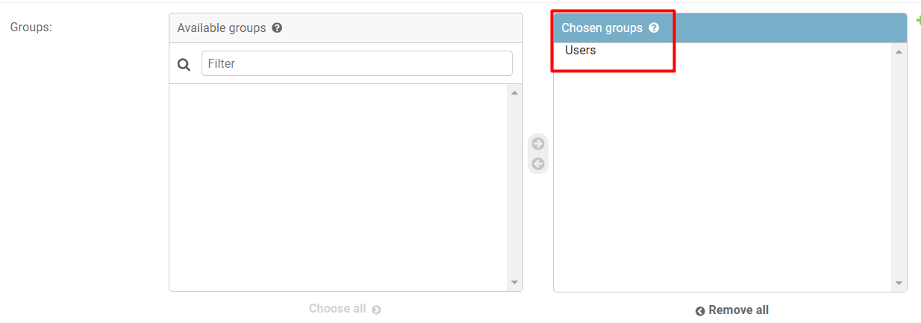
Example: User in Users Group
The user now belongs to the group

Slide 22
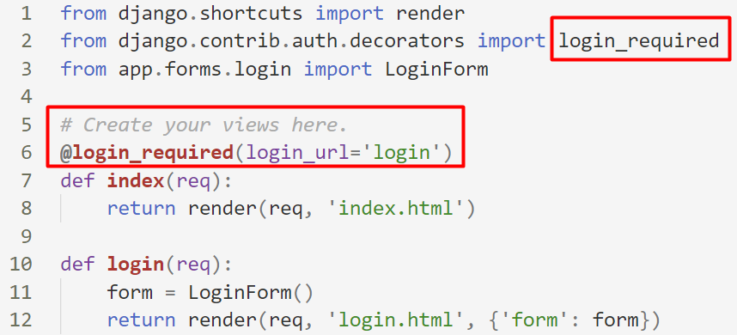
Using Built-In Decorators
There are some built-in decorators in Django, which allow us to add permission control
The decorator checks whether there is a logged in user

Slide 23
Creating Custom Decorators
We can make our custom decorators that will validate if a user has a given permission
To do that, we create a decorators.py file in our app
For example, if we want to show articles only if the user has permission (belongs to the Users group), we can create a decorator function that makes the validation

Slide 24
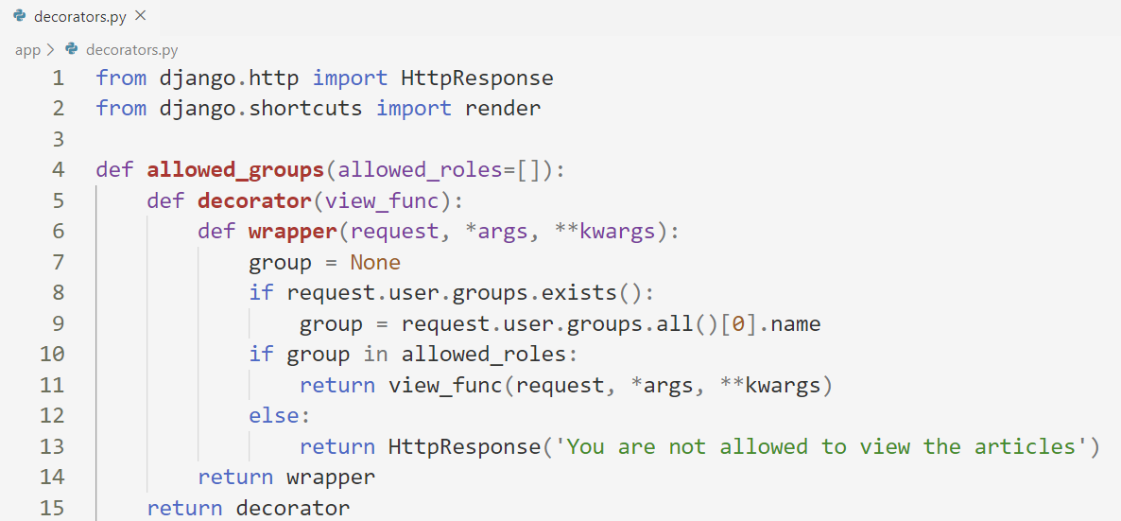
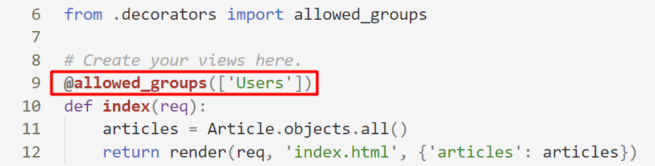
Example: Creating Custom Decorators

Slide 25

Demo
Live Exercise in Class

Slide 26

Summary
Authentication is the act of proving an assertion, such as the identity of a computer system user
Authorization includes the process through which an administrator grants rights to authenticated users
Notes:
26

Slide 27
Questions?
Notes:
27

Slide 28

License
This course (slides, examples, demos, exercises, homework, documents, videos and other assets) is copyrighted content
Unauthorized copy, reproduction or use is illegal
© SoftUni – https://softuni.org
© Software University – https://softuni.bg
Notes:
28

Slide 29
Trainings @ Software University (SoftUni)
Software University – High-Quality Education, Profession and Job for Software Developers
softuni.bg, softuni.org
Software University Foundation
softuni.foundation
Software University @ Facebook
facebook.com/SoftwareUniversity
Software University Forums
forum.softuni.bg
Notes:
29

