Slide 1

Class-Based-Views Deep Dive
Understanding how CBV's work
Class
SoftUni Team
Technical Trainers
Software University
https://softuni.org

Slide 2
Table of Contents
Diving into CBV's inheritance structure
CBV dispatch()
The get_object method
More about get_context_data()
The next step - render_to_response
2
Notes:
2

Slide 3
Have a Question?
sli.do
#python-web
Notes:
3

Slide 4

Diving into CBV's inheritance structure
CBV

Slide 5
CBV's inheritance structure
We will take as example a Detail View and we will walk through a single GET request
Class-Based-Views (CBV's) use class inheritance
They also use the "mixin" pattern
You can create classes with related functionality
You can include that class as parent of another class

Slide 6
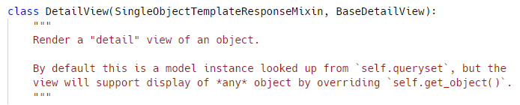
CBV's inheritance structure
The DetailView is defined in django/views/generic/details.py file
We see here that DetailView doesn't define anything
It inherits from SingleObjectTemplateResponseMixin and BaseDetailView

Slide 7
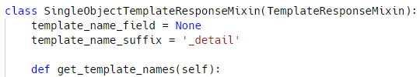
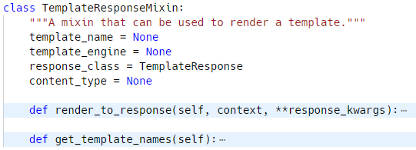
CBV's inheritance structure
Scrolling up in the same file, we can inspect the SingleObjectTemplateResponseMixin
It inherits from TempleteResponseMixin

Slide 8
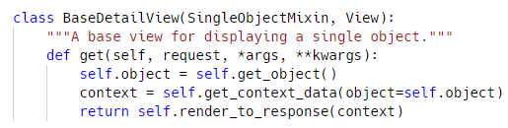

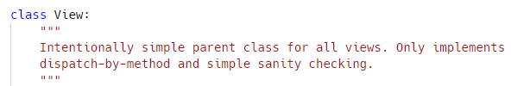
CBV's inheritance structure
Going a step back, it is now time to check out the BaseDetailView, and it inherits from two things
SingleObjectMixin
View

Slide 9
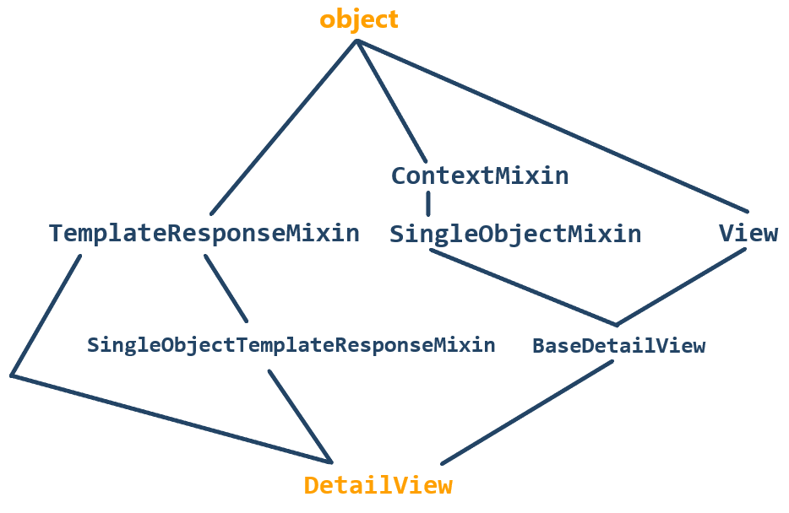
CBV's inheritance structure
Finally, we find that ContextMixin, TemplateResponseMixin and View all inherit from object

Slide 10
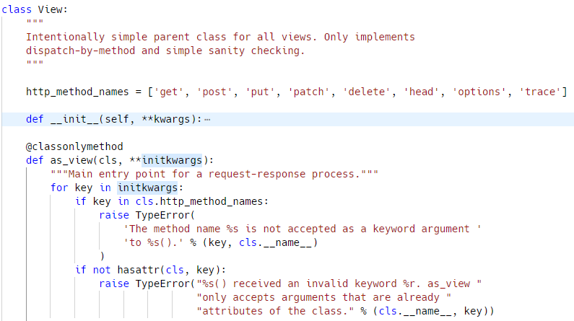
Understanding the View class
Let us now inspect the View class
We define a @classonlymethod
This means it is only available on the class and not on an instance
It iterates over initkwargs and makes validations

Slide 11
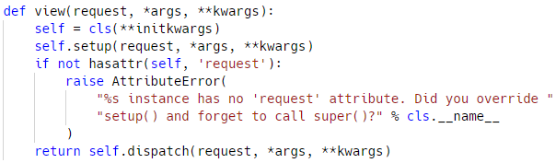
Understanding the View class
Creating a function that wraps around an instance of our class, and executes dispatch() on that instance
Next, we have a view method
It accepts request, *args, **kwargs
It binds self to the class attributes **initkwargs
The important part is next
It binds self.request = request
It binds self.args = args
It binds self.kwargs = kwargs

Slide 12

CBV dispatch()
CBV

Slide 13
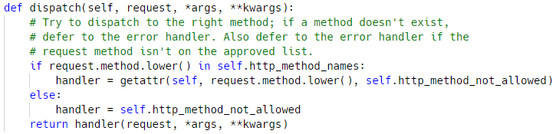
CBV dispatch()
Conditional check to see if the request.method is in the http_method_names
In our case, the method will be GET
So, we call self.get()
But self.get() does not exist in the View class
It exists in the BaseDetailView class

Slide 14
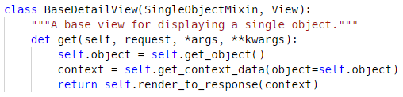
CBV dispatch()
get() accepts the request, *args, **kwargs
It binds self.object to self.get_object
It binds context to self.get_context_data
It returns self.render_to_response(context)
The get_object() method is found in the SingleObjectMixin class

Slide 15
The get_object method
get_object

Slide 16
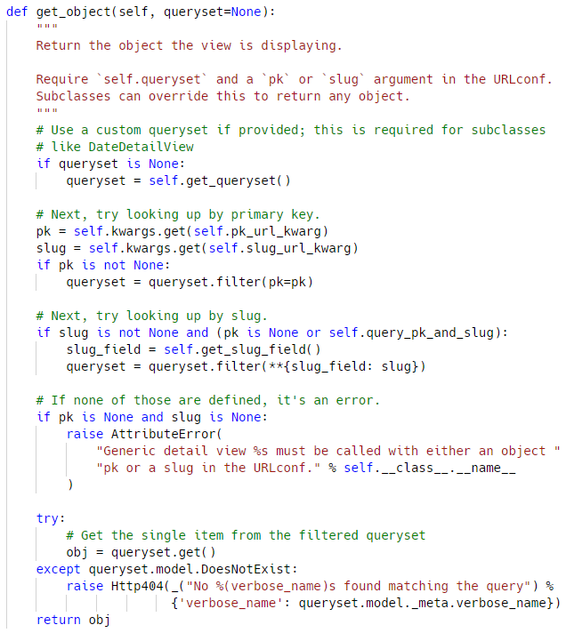
The get_object method
What does get_object() do?
If we don't have a queryset, we set queryset to the value of self.get_queryset()
We set our pk (primary key) to what is in self.kwargs
We got this from our dispatch() method and on that we built an instance of self and we set self.request, args, kwargs to be the args and kwargs that were passed into that function
We set pk to the pk_url_kwarg value, or None
We do the same for slug
Next, let's look what get_queryset() does

Slide 17
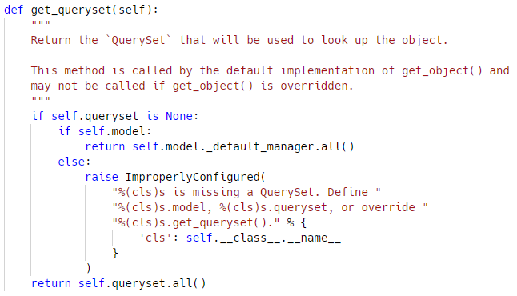
The get_queryset method
If there is not a queryset, then go to the model and get the _default_manager and call the all() method on it
Otherwise, if you don't have a model or queryset then an ImproperlyConfigured error is thrown that says "we have no idea what you are looking for"

Slide 18
More about get_context_data
get_context_data

Slide 19
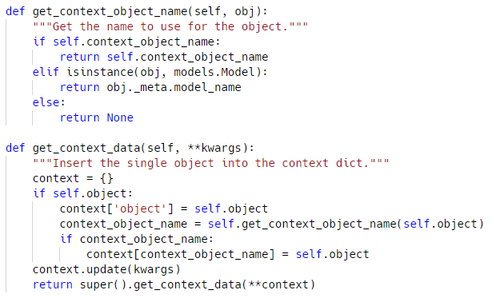
More about get_context_data
Going back to our BaseDetailView, the next thing it calls is get_context_data()
We set our context to an empty dictionary
If self.object exists
Set context['object']=self.object
Set context_object_name to the return of get_context_object_name
If we have a context_object_name, return it
Else if our object is an instance of a Model, return the name of the model
Else return None
Lastly, we call super for the .get_context_data(**context)

Slide 20
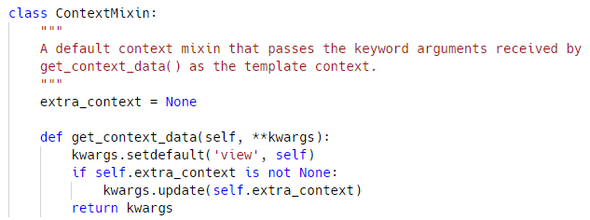
More about get_context_data
So, all this does is take the kwargs and says
If we don't have the view object itself in our kwargs, then and add it, and return kwargs
This ensures that the actual view itself is included as part of the context that gets passed to our template
What that means is that in the context of your template you can refer to your view class that is powering that template

Slide 21

Next step: render_to_response

Slide 22
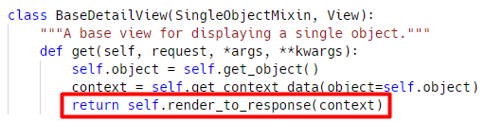
The render_to_response
Let's go back to our BaseDetailView and look at the get() method again
The last thing that happens is
We call the render_to_response method and pass the context
So, let's look at render_to_response

Slide 23
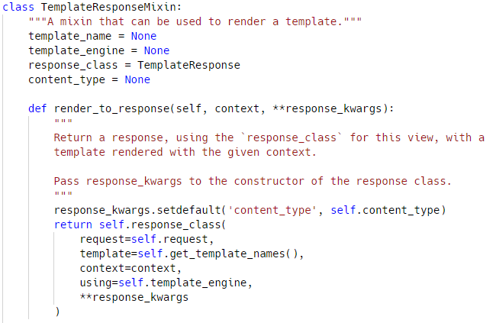
The render_to_response
response_kwargs are set to {"content_type": self.content_type}
We return the value of self.response_class()
Passing in request
template
context
using (which template engine)
any **response_kwargs
get_template_names() returns a list of templates to be used for the request
Let us now look at that function

Slide 24
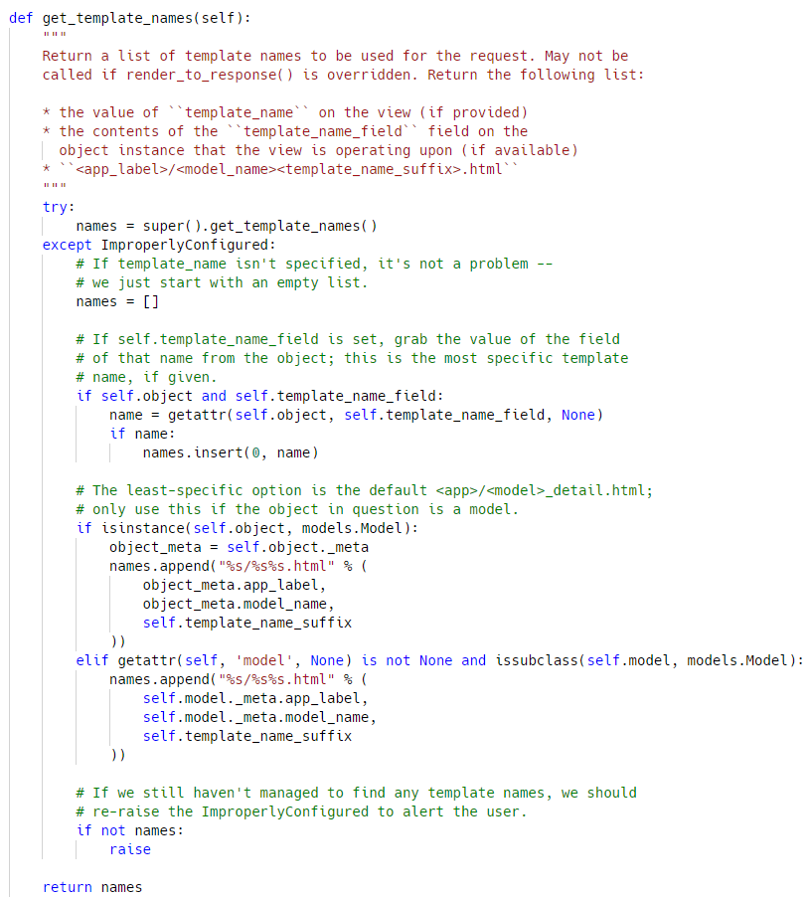
The get_template_names() method
We try setting names to the super of get_template_names()
If that doesn't work, an ImproperlyConfigured error is raised
We check to see if this instance has an object attribute, and a template_name_field
If it has both of those:
Set name to be the attribute on self.object that matches the template_name_field
If name is set, it's inserted into the front of names
If self.object is an instance of models.Model append self.object._meta.app_label, self.object._meta.model_name, self.template_name_suffix
Return the names

Slide 25

Practice Time
Using Class-Based-Views

Slide 26

Summary
You should now be able to understand Class-Based-Views on deeper level
To practice, try redoing your older projects and use CBV's instead of function bases ones
Notes:
26

Slide 27
Questions?
Notes:
27

Slide 28

License
This course (slides, examples, demos, exercises, homework, documents, videos and other assets) is copyrighted content
Unauthorized copy, reproduction or use is illegal
© SoftUni – https://softuni.org
© Software University – https://softuni.bg
Notes:
28

Slide 29
Trainings @ Software University (SoftUni)
Software University – High-Quality Education, Profession and Job for Software Developers
softuni.bg, softuni.org
Software University Foundation
softuni.foundation
Software University @ Facebook
facebook.com/SoftwareUniversity
Software University Forums
forum.softuni.bg
Notes:
29

