Slide 1
TrustedAI Hackathon
AttritionIQ
Turnover Prediction as a Service
Predict who will leave. Understand why. Act before it happens.
Team 33 Luka G. | Hugo T. | Taha I. | Aurelien KJ. | Roman S.
Capgemini x ESILV - March 2025

Slide 2
Context & Positioning
Who we are and why this market needs us now
Who We Are
Why Now
SaaS provider
External AI vendor specialising in HR workforce analytics, delivered as a subscription platform.
40%
considered quitting in 2023 (McKinsey Global Survey). Post-pandemic attrition has not normalised.
of workers globally
Target clients
HR Directors, CHROs and HR Business Partners in mid-to-large companies (200-5,000 employees) in France and the EU.
3-6
for a disengaged employee to resign after the decision is made — an invisible window HR teams are missing.
months average
Core industries
Logistics, healthcare, manufacturing, finance — sectors with structurally high voluntary turnover.
0
in most HR stacks today. HRIS platforms record events; none predict them before they happen.
predictive tools
DNA
Privacy-first. GDPR and EU AI Act compliance by design. No raw personal data ever leaves the client infrastructure.
GDPR +
New regulations require explainability and fairness for AI used in employment decisions — creating a compliance need.
EU AI Act (2024)

Slide 3
The Real Cost of Turnover
What companies actually lose when an employee walks out the door
1
2
3
4
5
Recruitment
Onboarding
Lost Productivity
Team Disruption
Employer Brand
3-5k EUR
2-4k EUR
6-18 months
Multiplier x1.5
Long-term
Job boards, agency fees, sourcing time, interview rounds
Training, HR admin, equipment, buddy time, access setup
New hire operates at 25% capacity for months. Team carries the load.
Remaining employees absorb extra work, morale drops, attrition risk rises
Glassdoor reviews, referral network damage, harder future hiring
Total cost to replace one employee: 50% to 200% of annual salary - For a 500-person company losing 15% per year at avg 45k EUR salary: ~3.4M EUR/year in turnover costs

Slide 4
Why AttritionIQ?
The business case for a predictive retention platform
Without AttritionIQ
With AttritionIQ
Resignation discovered on the day of notice
Risk identified weeks or months in advance
No visibility on who is at risk or why
Per-employee SHAP explanation: engagement, salary, tenure
Reactive HR conversations — too late to act
Prioritized HR action plan for each at-risk profile
Turnover costs absorbed silently every quarter
ROI visible: cost of churn vs. cost of retention action
Manager intuition replaces data-driven retention
Structured, explainable, auditable decision process
GDPR and EU AI Act compliance unclear
GDPR-compliant by design, EU AI Act ready
Setup:
15-25k EUR
Annual licence:
from 8k EUR/yr
Break-even:
~3-5 retained employees
Typical ROI:
x5 to x15
one-time
+ 1 EUR/emp/month
pays for itself
year 1

Slide 5
The Problem
50-200%
3 months
0
of annual salary
average notice lag
early warnings
cost to replace one employee
from disengagement to resignation
in most HR systems today
HR teams only learn about a resignation when it is already decided.
Most organisations have no systematic way to identify who is at risk, why, or what to do about it. Existing HR tools track what happened. AttritionIQ predicts what will happen next - weeks or months in advance.
Our platform shifts HR from reactive to predictive, reducing turnover costs and giving HR business
partners a data-backed tool for conversations with management.

Slide 6
Our Solution
AttritionIQ is an external AI provider delivering turnover prevention as a SaaS platform.
01
Anonymized Risk Scoring
02
Risk Ranking
A statistical probability score per employee, computed from behavioural and organisational signals. No names - hashed IDs only.
Employees ranked by attrition probability. Three tiers: Low / Medium / High. HR gets an immediate priority list.
03
Cause Analysis (SHAP)
04
Recommended Actions
Per-employee SHAP explanation: which factors drive the risk - engagement gap, absences, compensation, tenure milestone.
Prioritised HR interventions mapped to each employee's specific risk drivers: 1:1 scheduling, comp review, project assignment.

Slide 7
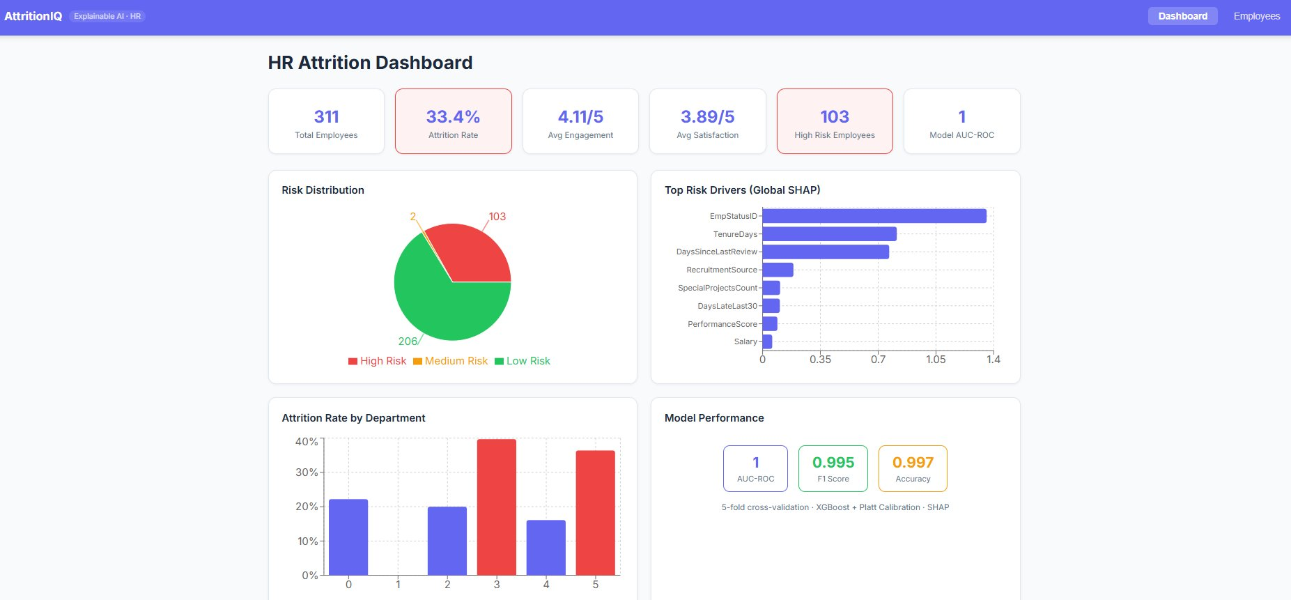
Live Dashboard
Real-time KPIs, risk distribution, global SHAP feature importance and department benchmarking

Slide 8
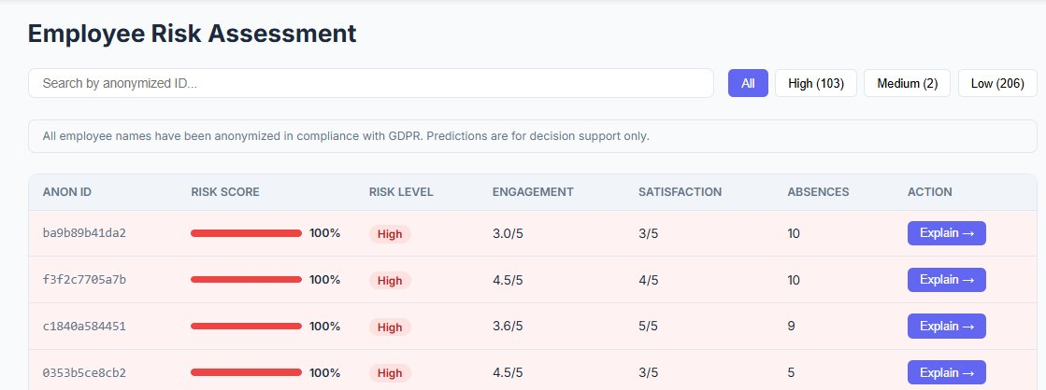
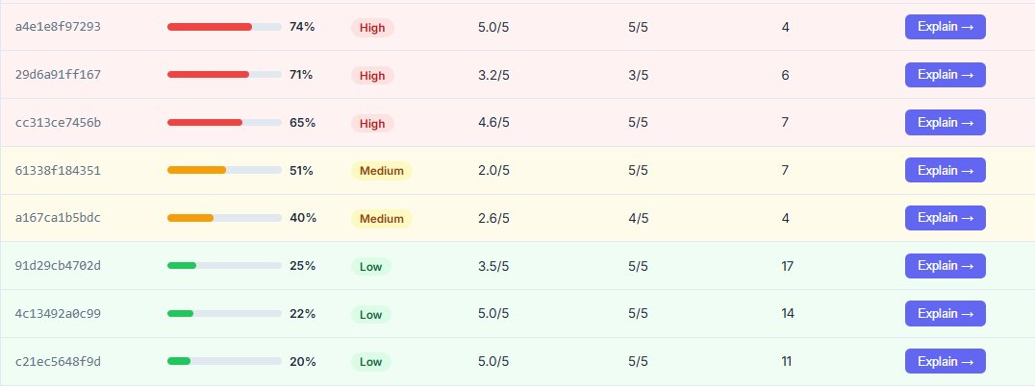
Employee Risk Assessment
Ranked list of all employees by attrition probability - filterable by risk tier - anonymized IDs only

Slide 9
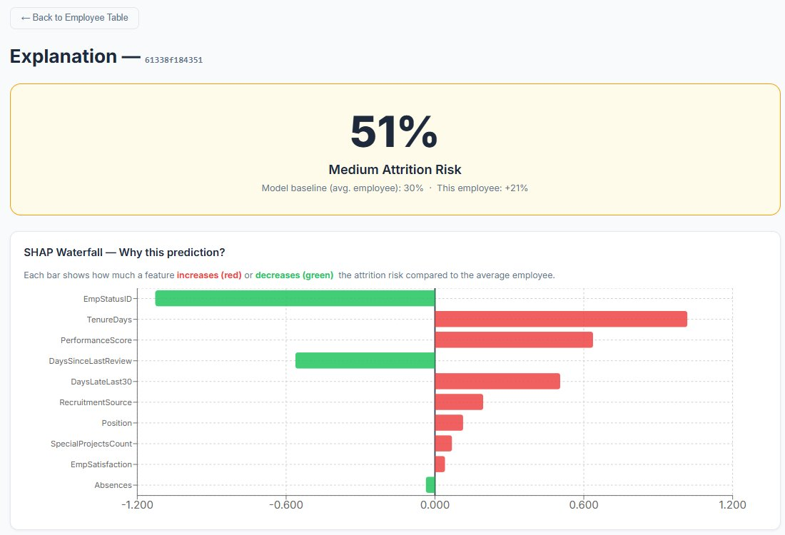
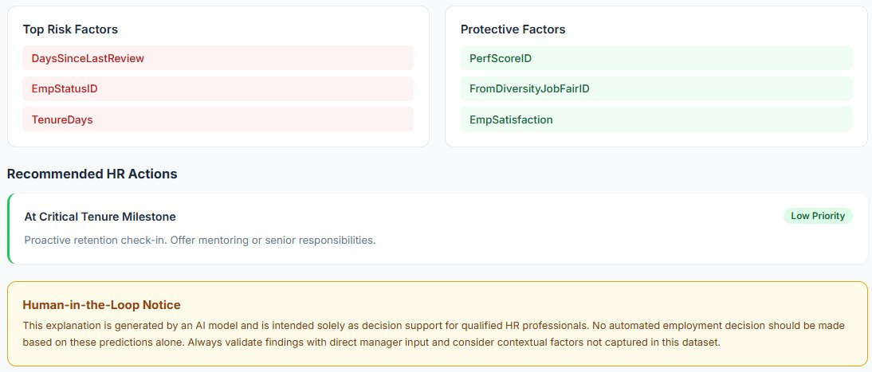
Per-Employee SHAP Explanation
Why is this employee at risk? Each bar shows how much a feature increases or decreases their attrition probability vs. the average.
100% - High Risk
51% - Medium Risk
Baseline (avg. employee): 30% - Individual delta computed per employee

Slide 10
Responsible AI by Design
Compliance and ethics built into every layer of the pipeline - not added as an afterthought.
GDPR Compliance
Anti-Discrimination
Names, DOB, ZIP, state removed before training
Employee IDs one-way hashed (SHA-256)
No data leaves the local environment
Data minimization enforced in preprocessing
Sex, Gender, Race, Marital status excluded from model
EU AI Act compliance - no protected attributes as features
Bias audit across performance score subgroups
Fairness verified before deployment
Human-in-the-Loop
Cybersecurity
Mandatory disclaimer on every prediction screen
Predictions are decision support, not verdicts
No automated employment decisions
HR manager validation required for all actions
API key authentication on all endpoints
Pydantic strict input validation
Secrets in .env - never in Git
CORS restricted to local frontend only

Slide 11
Technical Architecture
Full-stack containerized system - React + FastAPI + Logistic Regression + SHAP - Docker Compose deployment
HR Data (CSV)
GDPR Pipeline
Logistic Regression
FastAPI Backend
React Dashboard
311 employees
36 raw features
PII removal
ID hashing
Feature engineering
Calibrated proba.
C=0.1, balanced
SHAP LinearExplainer
Auth, validation
Input sanitization
REST endpoints
Risk table
SHAP waterfall
HR actions
Model Choice - Logistic Regression
Deployment
Selected over XGBoost for 3 reasons: (1) 311-row dataset - tree models overfit and produce extreme 0/1 scores; (2) Naturally calibrated probabilities - a 60% score means genuine 60% risk; (3) SHAP LinearExplainer produces mathematically consistent explanations.
Docker Compose orchestration. Backend auto-runs GDPR preprocessing and model training on first launch (~60s). Frontend proxies all API calls through Vite dev server to avoid CORS issues. Zero external dependencies - fully air-gapped.

Slide 12
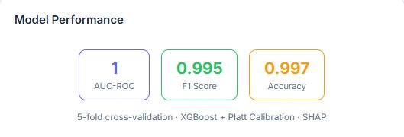
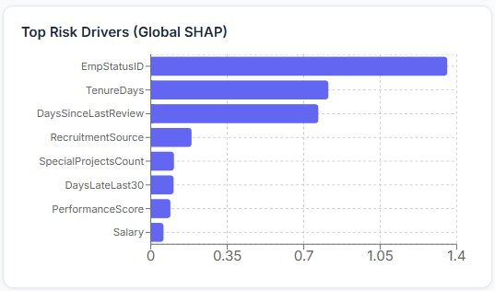
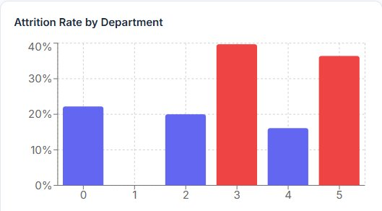
Model Performance & Bias Audit
5-fold stratified cross-validation - Logistic Regression - calibrated probabilities
Known Limitations
311 rows - limited generalization to large orgs
US dataset - EU labor context differs
Termd flag mixes voluntary + involuntary exits
Static snapshot - no temporal dimension

Slide 13
AttritionIQ
Predict who will leave. Understand why. Act before it happens.
GDPR Compliant
Explainable AI (SHAP)
Human-in-the-Loop
Team 33 - Capgemini x ESILV - TrustedAI Hackathon - March 2025

