Slide 1
ACL 2021
Natural language processing
DefSent: Sentence Embeddings using Definition Sentences
Hayato Tsukagoshi, Ryohei Sasano, Koichi Takeda
Proceedings of the 59th Annual Meeting of the Association for Computational Linguistics and the 11th International Joint Conference on Natural Language Processing
Instructor Mas. Nguyễn Thị Quý

Slide 2
Introduction
Method
Experiment
Conclusion

Slide 3
Introduction
Method
Experiment
Conclusion

Slide 4
What is sentence embedding
Sentence embedding represent sentences as dense vectors in low dimensional space.
Semantic vector space
The school children head home.
Children going home from school.
The children are at the library.
The children are walking in the afternoon.
Notes:
Natural Language Inference which is also known as Recognizing Textual Entailment (RTE) is a task of determining whether the given “hypothesis” and “premise” logically follow (entailment) or unfollow (contradiction) or are undetermined (neutral) to each other.

Slide 5

Introduction
Sentence embedding methods using natural language inference (NLI) datasets have been successfully applied to various tasks.
These methods are only available for limited languages due to relying heavily on the large NLI datasets
In this paper, They propose DefSent, a sentence embedding method that uses definition sentences from a word dictionary
→ This have more applicable uses
Notes:
Natural Language Inference which is also known as Recognizing Textual Entailment (RTE) is a task of determining whether the given “hypothesis” and “premise” logically follow (entailment) or unfollow (contradiction) or are undetermined (neutral) to each other.

Slide 6
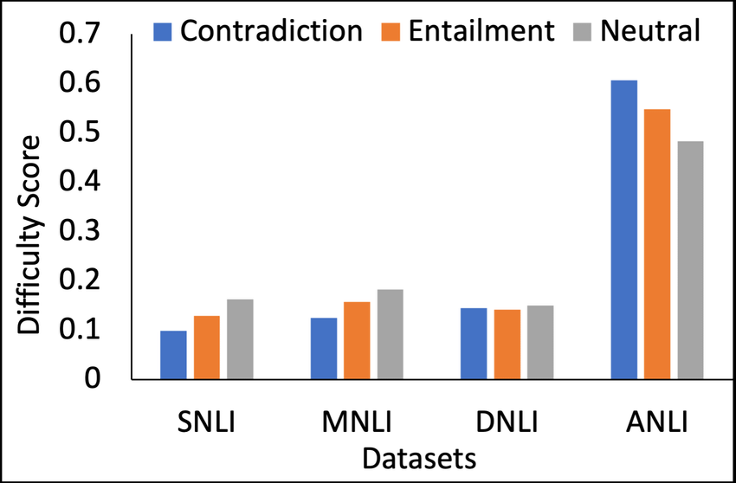
NLI dataset
• Neutral
a: Jon walked back to the town to the smithy.
b: Jon traveled back to his hometown.
• Contradicts
a: Tourist Information offices can be very helpful.
b: Tourist Information offices are never of any help.
• Entails
a: I’m confused.
b: Not all of it is very clear to me.
Notes:
Natural Language Inference which is also known as Recognizing Textual Entailment (RTE) is a task of determining whether the given “hypothesis” and “premise” logically follow (entailment) or unfollow (contradiction) or are undetermined (neutral) to each other.

Slide 7
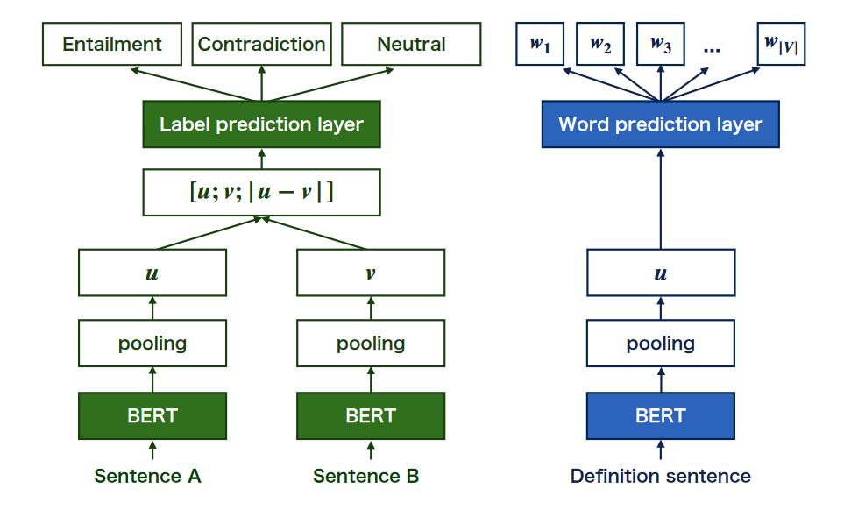
Sentence-BERT (left) and DefSent (right).
Notes:
Defsent is similar to the model proposed by Hill
et al. (2016) in that it generates sentence embed-
dings so that the embeddings of a definition sen-w|V|
Definition sentence
w1 w2 w3 ...
Sentence B
BERTBERT
pooling pooling
vu
ContradictionEntailment Neutral
Label prediction layer
[u; v; | u − v | ]
pooling
u
Word prediction layer
BERT
Sentence A
Figure 1: Sentence-BERT (left) and DefSent (right).
tence and the word it represents are similar. How-
ever, while Hill et al. (2016)’s model is based on
recurrent neural network language models, Def-
Sent is based on pre-trained language models such
as BERT (Devlin et al., 2019) and RoBERTa (Liu
et al., 2019), with a fine-tuning mechanism as well

Slide 8
Introduction
Method
Experiment
Conclusion

Slide 9
Sentence-BERT (left) and DefSent (right).
Notes:
Defsent is similar to the model proposed by Hill
et al. (2016) in that it generates sentence embed-
dings so that the embeddings of a definition sen-w|V|
Definition sentence
w1 w2 w3 ...
Sentence B
BERTBERT
pooling pooling
vu
ContradictionEntailment Neutral
Label prediction layer
[u; v; | u − v | ]
pooling
u
Word prediction layer
BERT
Sentence A
Figure 1: Sentence-BERT (left) and DefSent (right).
tence and the word it represents are similar. How-
ever, while Hill et al. (2016)’s model is based on
recurrent neural network language models, Def-
Sent is based on pre-trained language models such
as BERT (Devlin et al., 2019) and RoBERTa (Liu
et al., 2019), with a fine-tuning mechanism as well

Slide 10
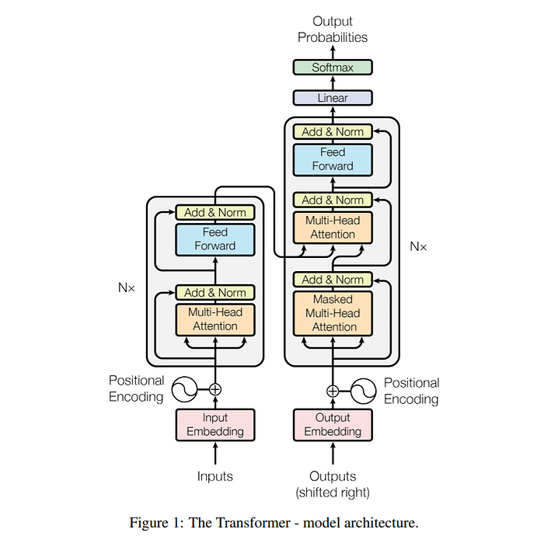
BERT
BERT stand for: Bidirectional Encoder Representation from Transformer
Transformers are made up of stacks of transformer blocks
Simple linear layers feedforward networks, and self-attention layers
Notes:
Layer normalization (or layer norm) is one of many forms of normalization thatlayer norm can be used to improve training performance in deep neural networks by keeping the values of a hidden layer in a range that facilitates gradient-based training

Slide 11
BERT
BERT stand for: Bidirectional Encoder Representation from Transformer
Transformers are made up of stacks of transformer blocks
Simple linear layers feedforward networks, and self-attention layers
Notes:
Layer normalization (or layer norm) is one of many forms of normalization thatlayer norm can be used to improve training performance in deep neural networks by keeping the values of a hidden layer in a range that facilitates gradient-based training

Slide 12
BERT
BERT stand for: Bidirectional Encoder Representation from Transformer
Transformers are made up of stacks of transformer blocks
Simple linear layers feedforward networks, and self-attention layers
Notes:
Layer normalization (or layer norm) is one of many forms of normalization thatlayer norm can be used to improve training performance in deep neural networks by keeping the values of a hidden layer in a range that facilitates gradient-based training

Slide 13
BERT
BERT stand for: Bidirectional Encoder Representation from Transformer
Transformers are made up of stacks of transformer blocks
Simple linear layers feedforward networks, and self-attention layers
Notes:
Layer normalization (or layer norm) is one of many forms of normalization that layer norm can be used to improve training performance in deep neural networks by keeping the values of a hidden layer in a range that facilitates gradient-based training

Slide 14
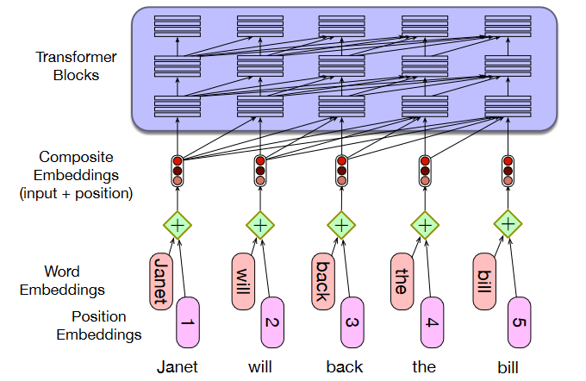
BERT
Notes:
Layer normalization (or layer norm) is one of many forms of normalization thatlayer norm can be used to improve training performance in deep neural networks by keeping the values of a hidden layer in a range that facilitates gradient-based training

Slide 15
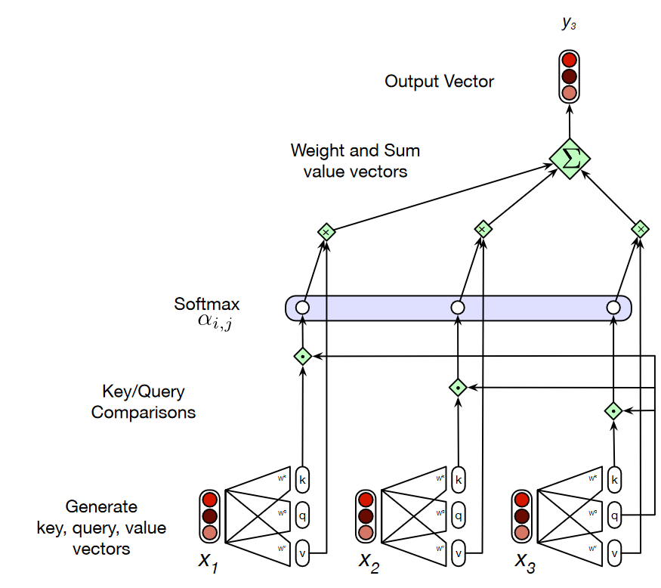
BERT
Notes:
Layer normalization (or layer norm) is one of many forms of normalization thatlayer norm can be used to improve training performance in deep neural networks by keeping the values of a hidden layer in a range that facilitates gradient-based training

Slide 16
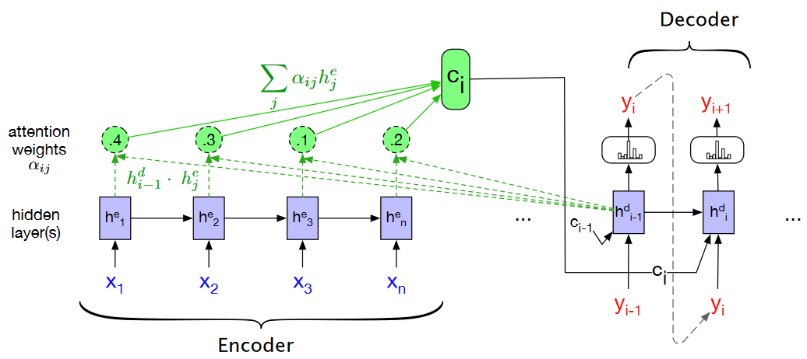
Transformer

Slide 17
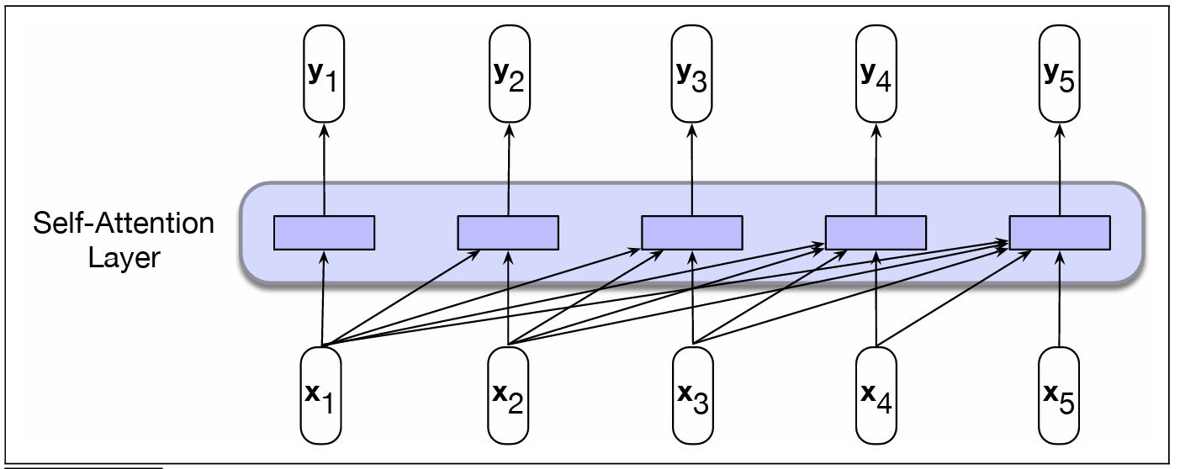
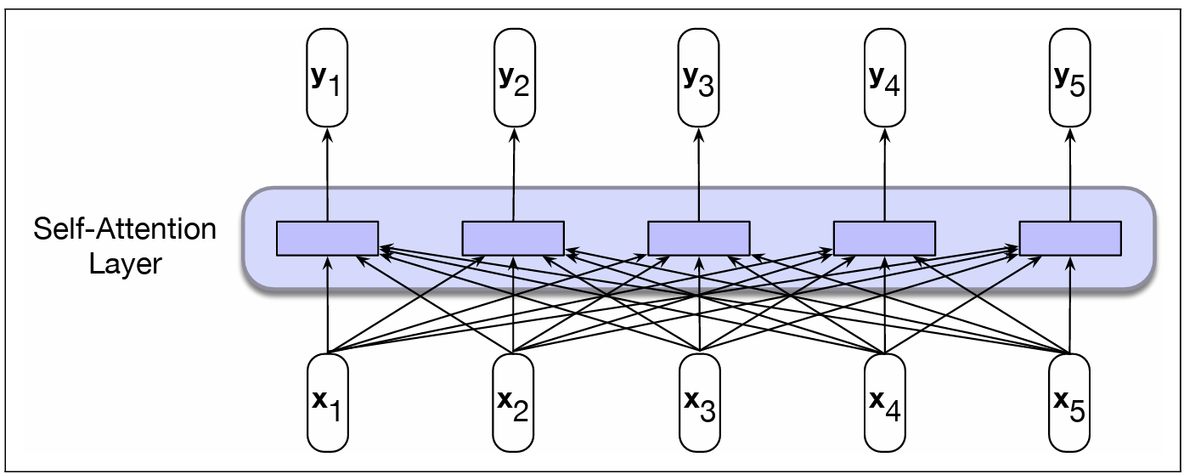
Self- Attention
Backward-looking self-attention model
Bidirectional self-attention model
Compare with LSTMs : Can scalable, run paralel → Reduce time and utilize computation

Slide 18
Masked Language Model
Masked Language Modeling (MLM): learns to perform a fill-in-the-blank task, technically called the cloze task
In BERT, 15% of the input tokens in a training sequence are sampled for learning

Slide 19
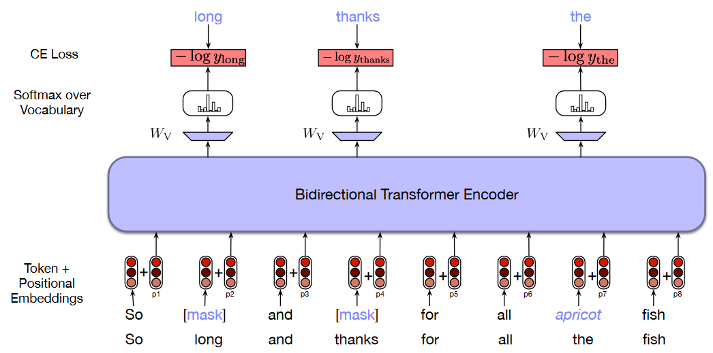
Masked Language Model

Slide 20
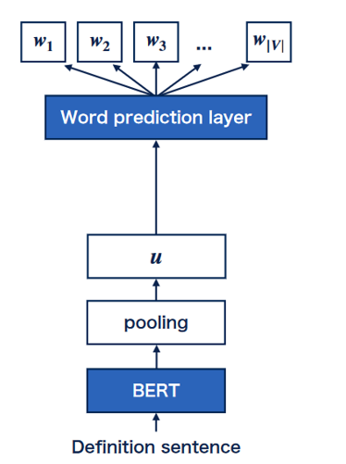
DefSent
Using Cross-entropy as loss function to train
CLS, Mean, Max
Notes:
it is impossible to obtain probabilities for out-of-vocabulary (OOV) words. Therefore, we cannot calculate losses of these OOV words in a straightforward way.1 In our

Slide 21
RoBERTa
Training the model longer, with bigger batches, over more data;
Removing the next sentence prediction objective;
Training on longer sequences
Dynamically changing the masking pattern applied to the training data.

Slide 22
Introduction
Method
Experiment
Conclusion

Slide 23
Word prediction
Oxford Dictionary dataset from Learning to Describe Unknown Phrases with Local and Global Contexts
Shonosuke Ishiwatari, Hiroaki Hayashi, Naoki Yoshinaga, Graham Neubig, Shoetsu Sato, Masashi Toyoda, Masaru Kitsuregawa
NAACL 2019
All | Words | Definitions | Avg. length
Train | 29,413 | 97,759 | 9.921
Dev | 3,677 | 12,127 | 9.874
Test | 3,677 | 12,433 | 9.846
In BERT vocab. | Words | Definitions | Avg. length
Train | 7,732 | 54,142 | 9.531
Dev | 936 | 6,544 | 9.512
Test | 979 | 6,930 | 9.551
In RoBERTa vocab. | Words | Definitions | Avg. length
Train | 7,269 | 53,935 | 9.376
Dev | 901 | 6,625 | 9.372
Test | 925 | 6,945 | 9.41

Slide 24
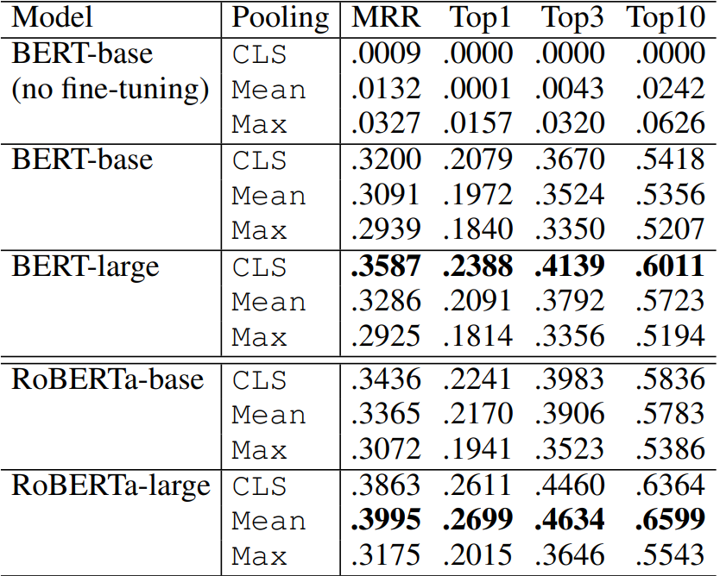
Word prediction

Slide 25
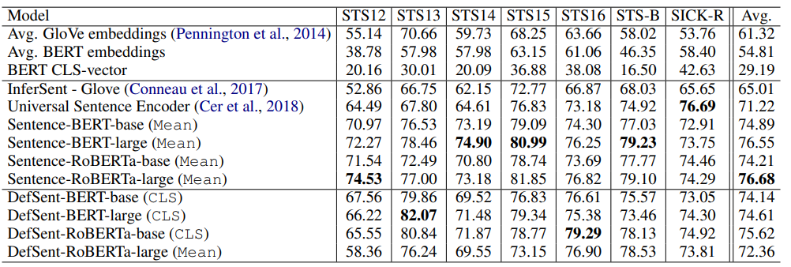
Semantic Textual Similarity(STS)

Slide 26
Semantic Textual Similarity(STS)
sts12 | sts13 | sts14 | sts15 | sts16 | stsB | sickR | avg mode
66.448 | 79.946 | 68.042 | 76.941 | 75.009 | 76.743 | 71.589 | 73.531
65.996 | 82.346 | 72.274 | 78.666 | 75.315 | 78.881 | 70.791 | 74.896
63.519 | 81.728 | 71.966 | 78.216 | 74.727 | 77.722 | 70.644 | 74.075
64.446 | 82.001 | 69.375 | 80.390 | 74.265 | 75.214 | 72.743 | 74.062
60.849 | 82.076 | 73.009 | 80.055 | 76.625 | 79.514 | 73.213 | 75.049
57.379 | 80.675 | 72.122 | 77.572 | 74.722 | 77.552 | 71.989 | 73.144
66.431 | 80.958 | 71.950 | 80.120 | 78.598 | 80.348 | 74.349 | 76.108
59.968 | 77.366 | 68.844 | 76.478 | 76.815 | 78.992 | 72.453 | 72.988
63.560 | 77.626 | 68.012 | 77.534 | 78.222 | 80.356 | 73.770 | 74.154
64.413 | 79.298 | 72.893 | 75.870 | 76.984 | 80.204 | 74.776 | 74.920
54.017 | 70.686 | 66.853 | 73.120 | 73.636 | 80.527 | 73.906 | 70.392
61.099 | 79.687 | 71.361 | 76.857 | 78.685 | 80.693 | 72.933 | 74.473

Slide 27
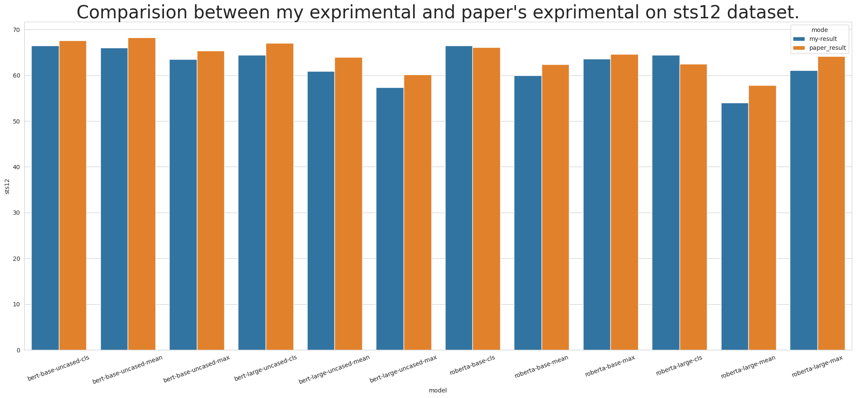
Semantic Textual Similarity(STS)

Slide 28
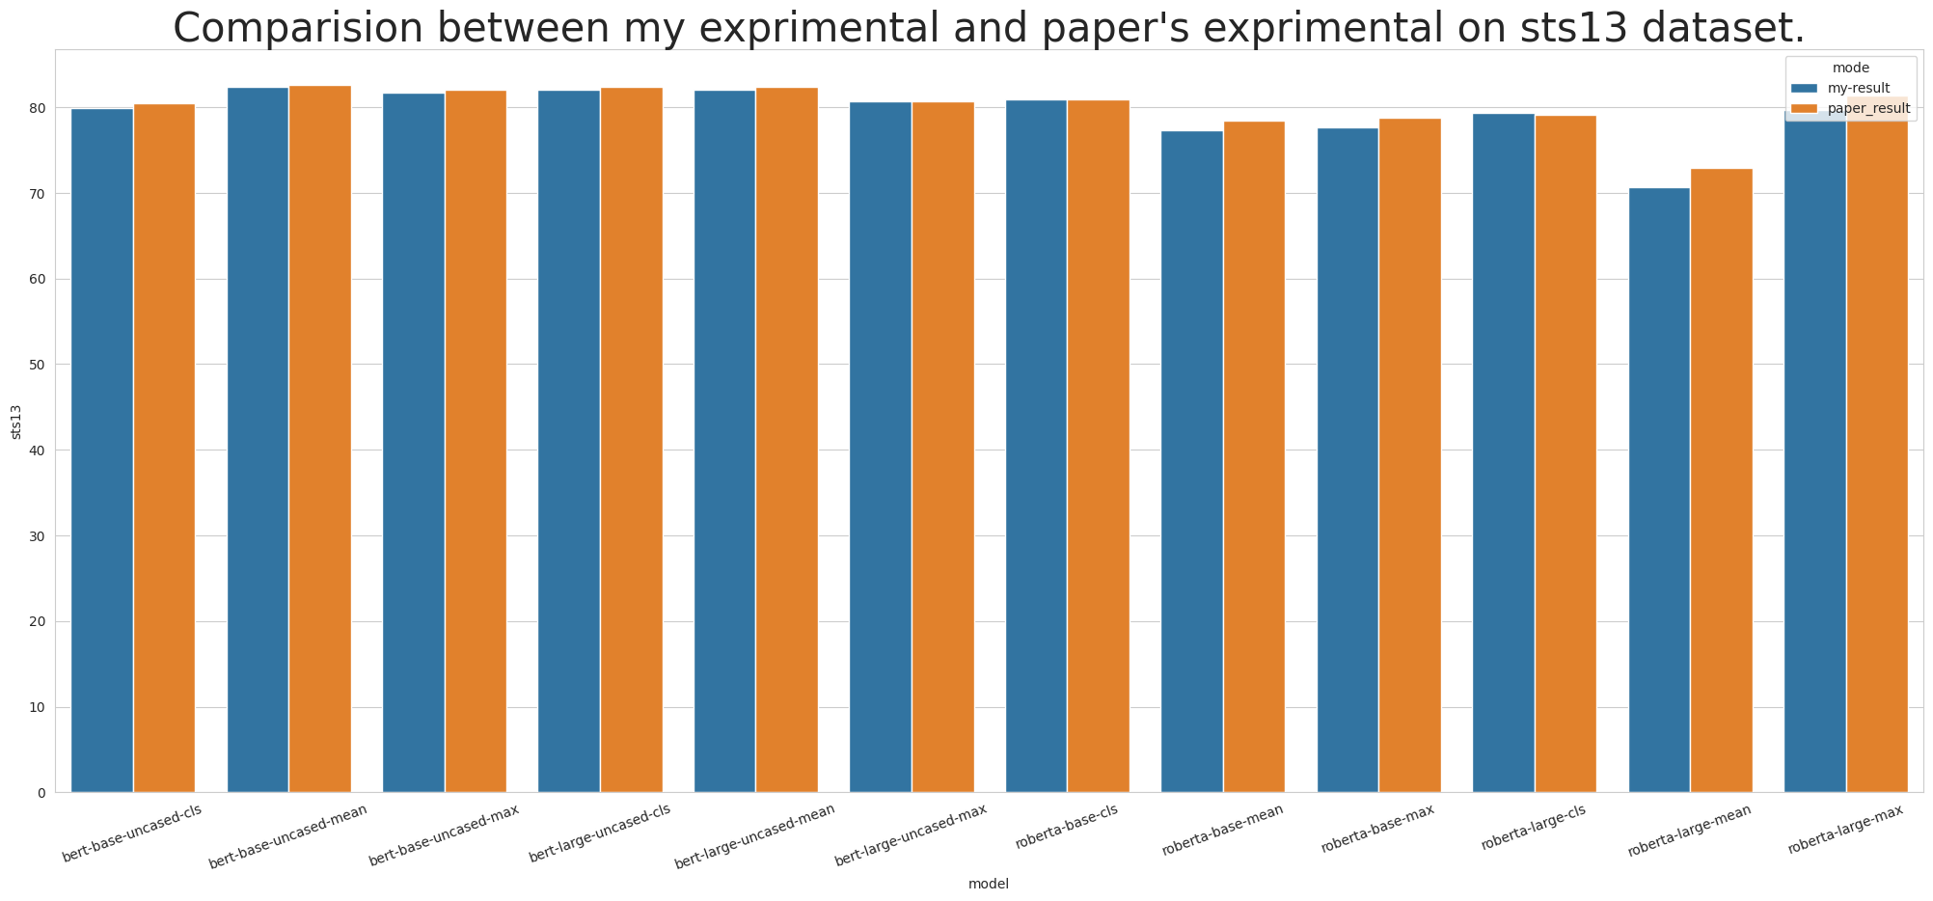
Semantic Textual Similarity(STS)

Slide 29
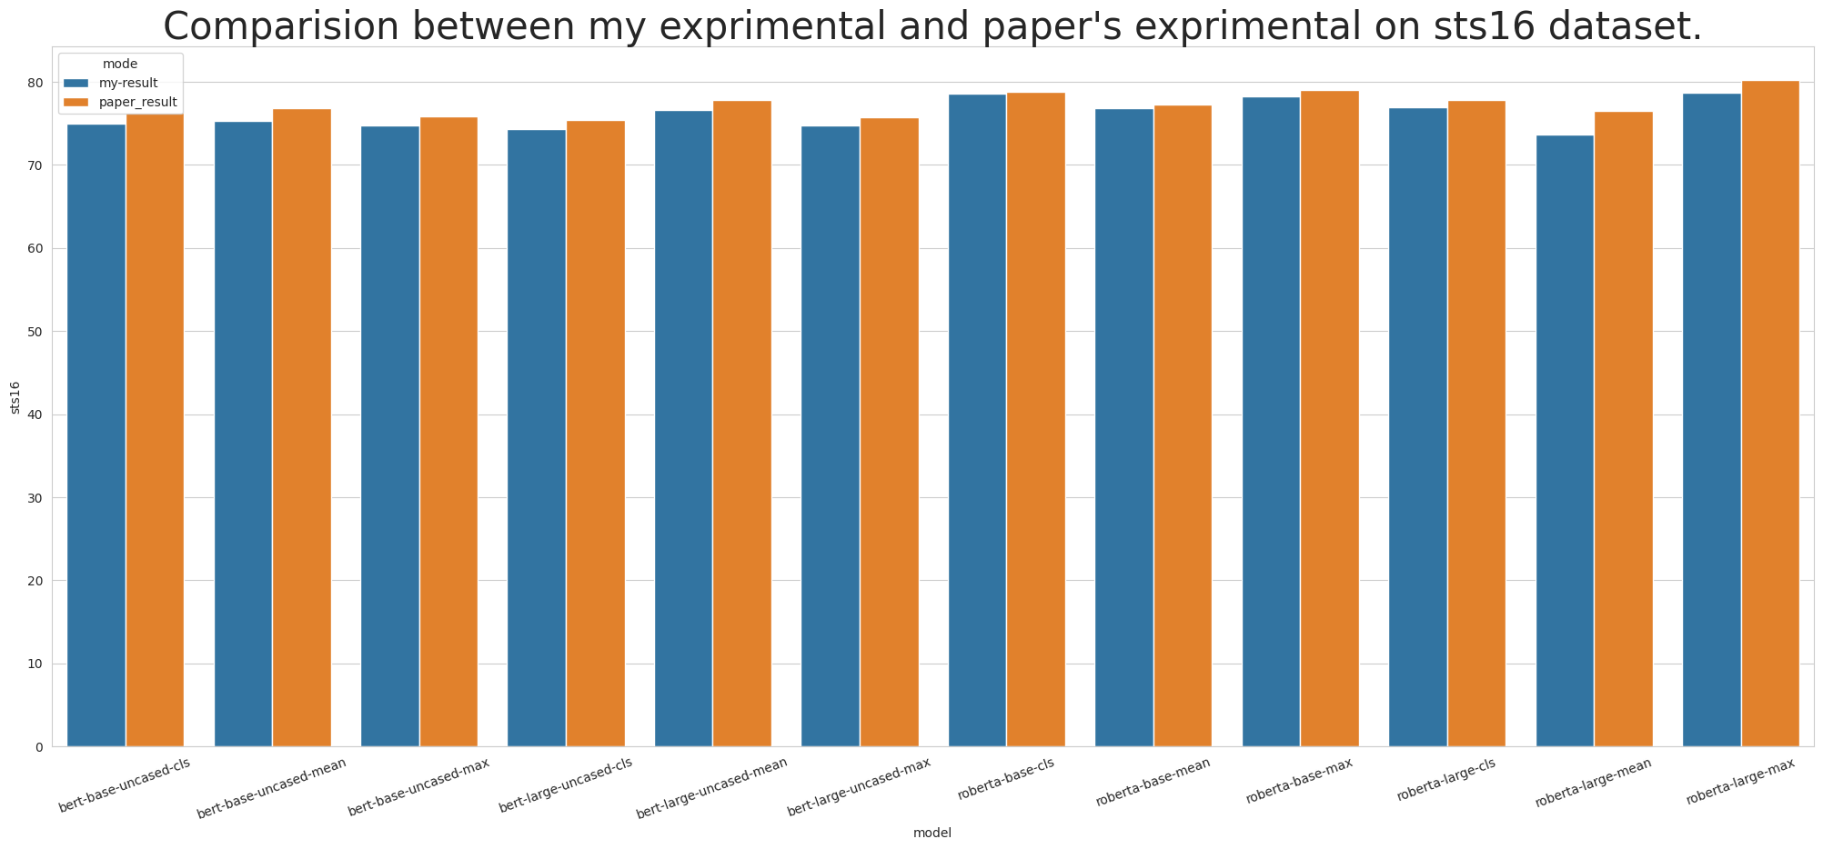
Semantic Textual Similarity(STS)

Slide 30
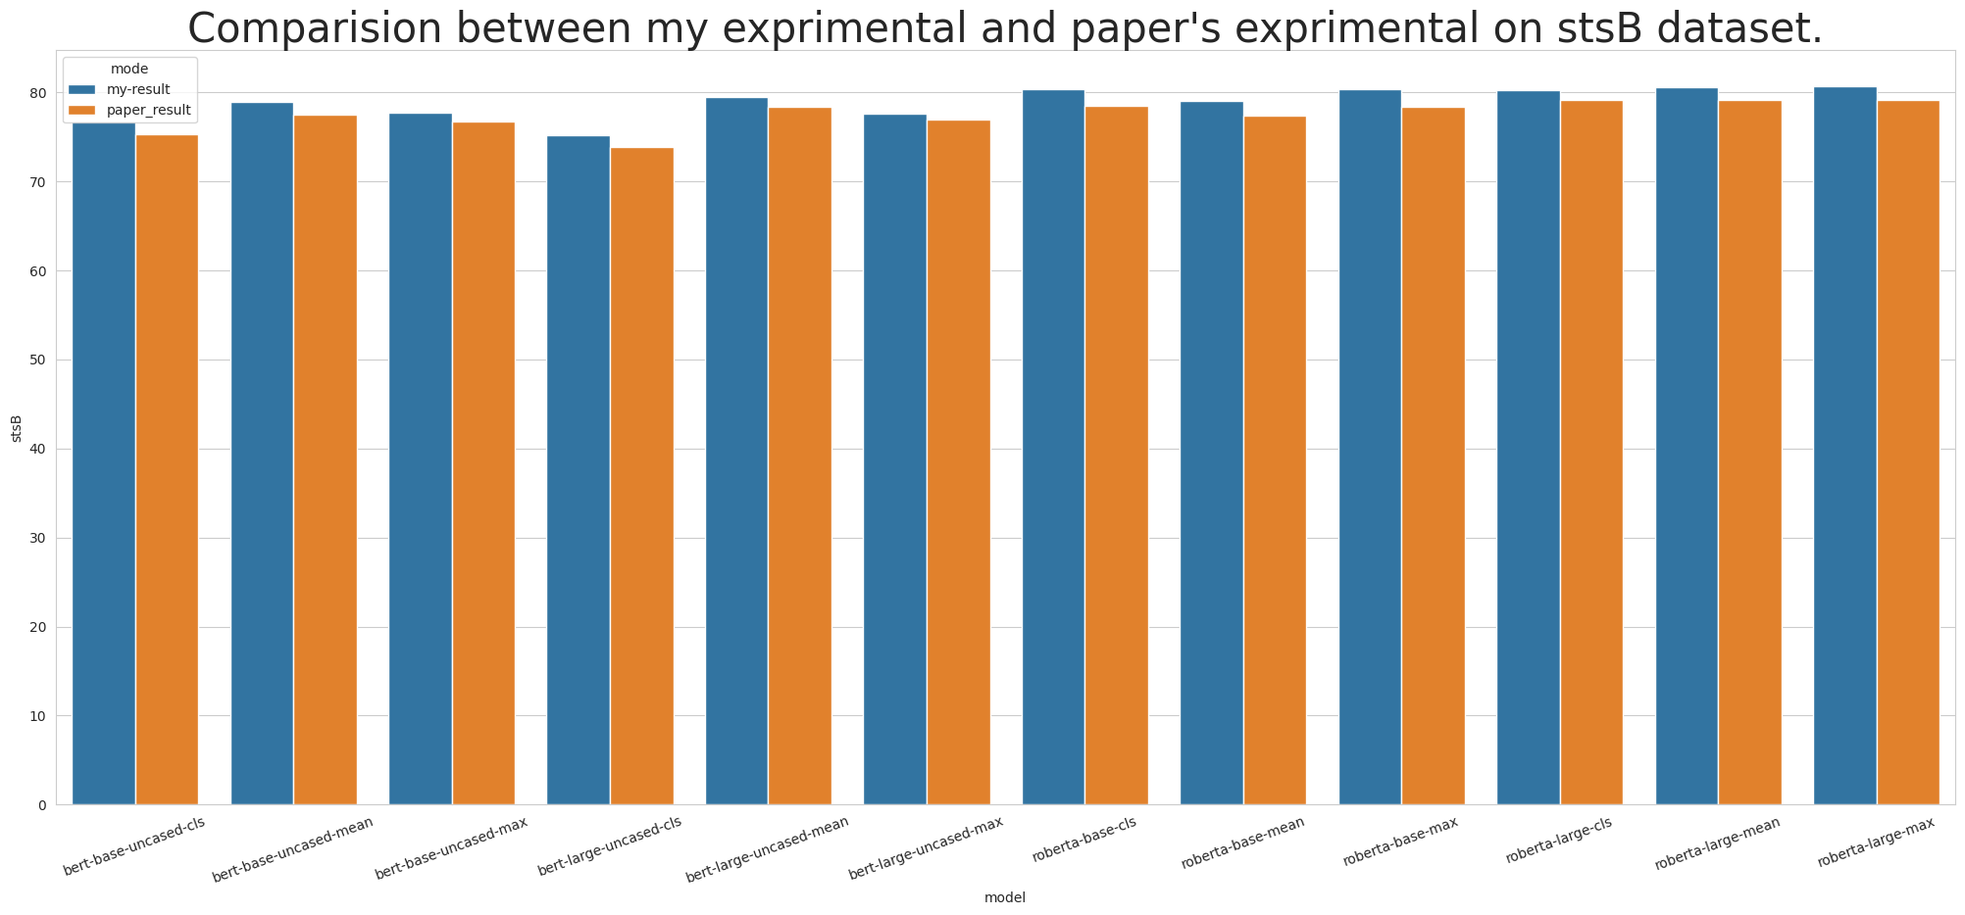
Semantic Textual Similarity(STS)

Slide 31
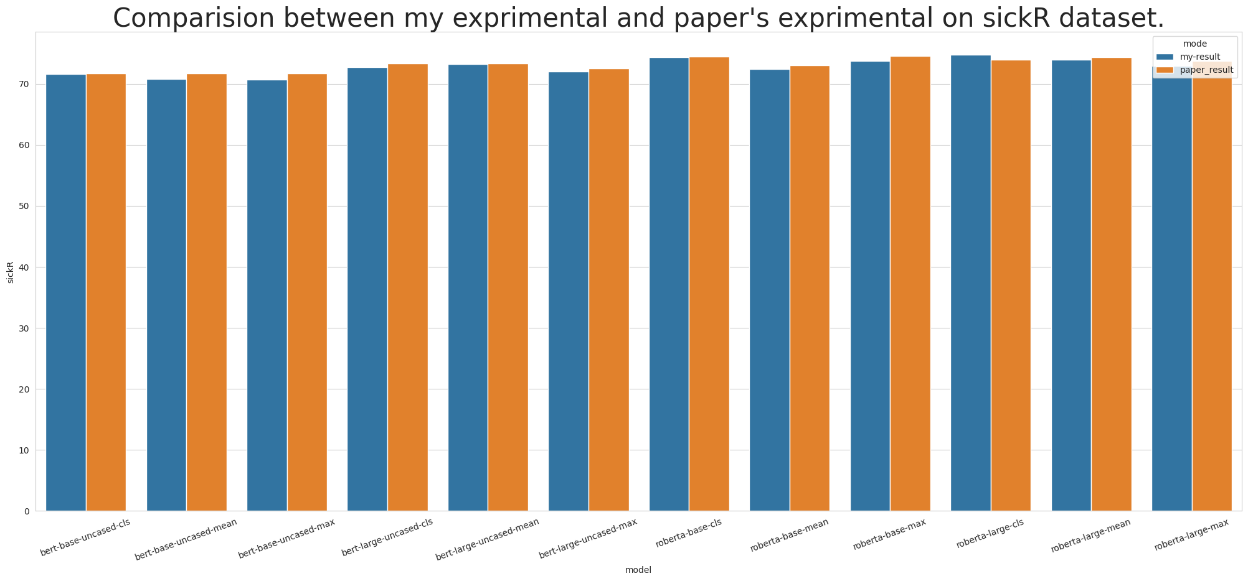
Semantic Textual Similarity(STS)

Slide 32
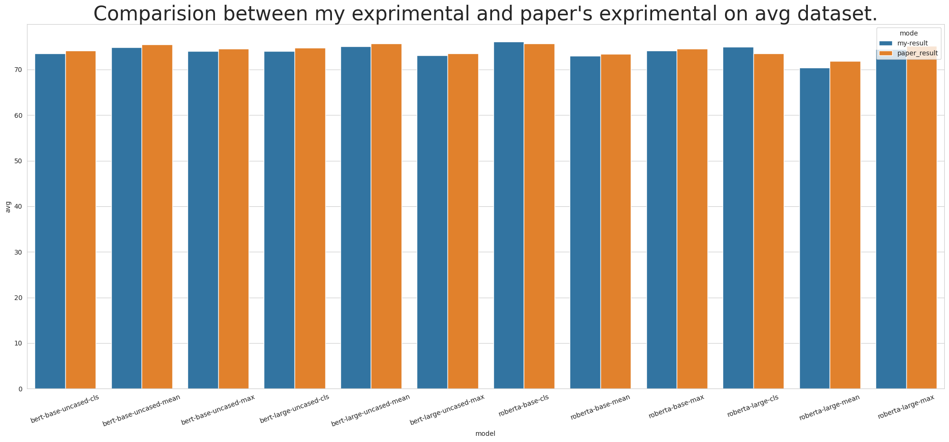
Semantic Textual Similarity(STS)

Slide 33
SentEval (Facebook researcher)
Task | Type | #train | #test | needs_train | set_classifier
MR | movie review | 11k | 11k | 1 | 1
CR | product review | 4k | 4k | 1 | 1
SUBJ | subjectivity status | 10k | 10k | 1 | 1
MPQA | opinion-polarity | 11k | 11k | 1 | 1
SST | binary sentiment analysis | 67k | 1.8k | 1 | 1
SST | fine-grained sentiment analysis | 8.5k | 2.2k | 1 | 1
TREC | question-type classification | 6k | 0.5k | 1 | 1
SICK-E | natural language inference | 4.5k | 4.9k | 1 | 1
SNLI | natural language inference | 550k | 9.8k | 1 | 1
MRPC | paraphrase detection | 4.1k | 1.7k | 1 | 1

Slide 34
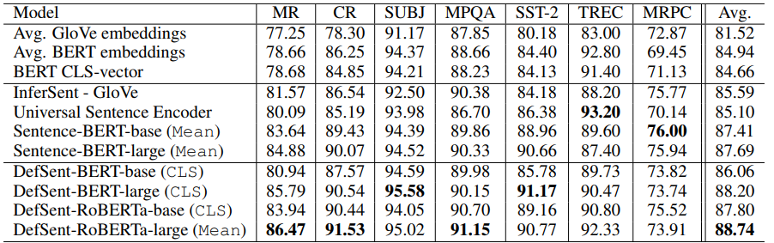
SentEval (Facebook researcher)
Paper experiment

Slide 35
SentEval (Facebook researcher)
model | MR_acc | CR_acc | SUBJ_acc | MPQA_acc | SST2_acc | TREC_acc | MRPC_acc | SICKEntailment_acc | avg_acc
defsent-bert-base-uncased-cls | 80.64 | 86.6 | 93.78 | 89.37 | 85.45 | 84.2 | 72.93 | 81.14 | 84.26375
defsent-bert-base-uncased-mean | 81.53 | 87.31 | 94.37 | 89.68 | 86.16 | 88.8 | 75.77 | 82.61 | 85.77875
defsent-bert-base-uncased-max | 80.5 | 86.49 | 94.03 | 89.73 | 85.56 | 85.8 | 73.33 | 82.24 | 84.71
defsent-bert-large-uncased-cls | 85.24 | 90.09 | 95.06 | 89.7 | 90.55 | 91 | 73.62 | 81.73 | 87.12375
defsent-bert-large-uncased-mean | 84.39 | 88.95 | 94.8 | 89.86 | 89.95 | 87.8 | 74.61 | 78.91 | 86.15875
defsent-bert-large-uncased-max | 83.08 | 88.93 | 93.56 | 89.74 | 87.31 | 84.6 | 76.17 | 81.73 | 85.64
defsent-roberta-base-cls | 83.55 | 88.79 | 92.91 | 90.54 | 89.95 | 87.6 | 74.9 | 81.57 | 86.22625
defsent-roberta-base-mean | 84.16 | 89.46 | 93.88 | 90.07 | 89.9 | 88.6 | 75.88 | 81.69 | 86.705
defsent-roberta-base-max | 83.79 | 88.85 | 93.29 | 90.45 | 89.46 | 92 | 77.91 | 82.59 | 87.2925
defsent-roberta-large-cls | 84.45 | 89.09 | 94.31 | 90.91 | 90.06 | 93.6 | 72.87 | 82.32 | 87.20125
defsent-roberta-large-mean | 85.03 | 90.81 | 94.71 | 90.9 | 90.06 | 92.8 | 73.33 | 80.82 | 87.3075
defsent-roberta-large-max | 84.36 | 90.38 | 93.84 | 91.04 | 89.13 | 86.8 | 76.75 | 82.57 | 86.85875
My experiment

Slide 36
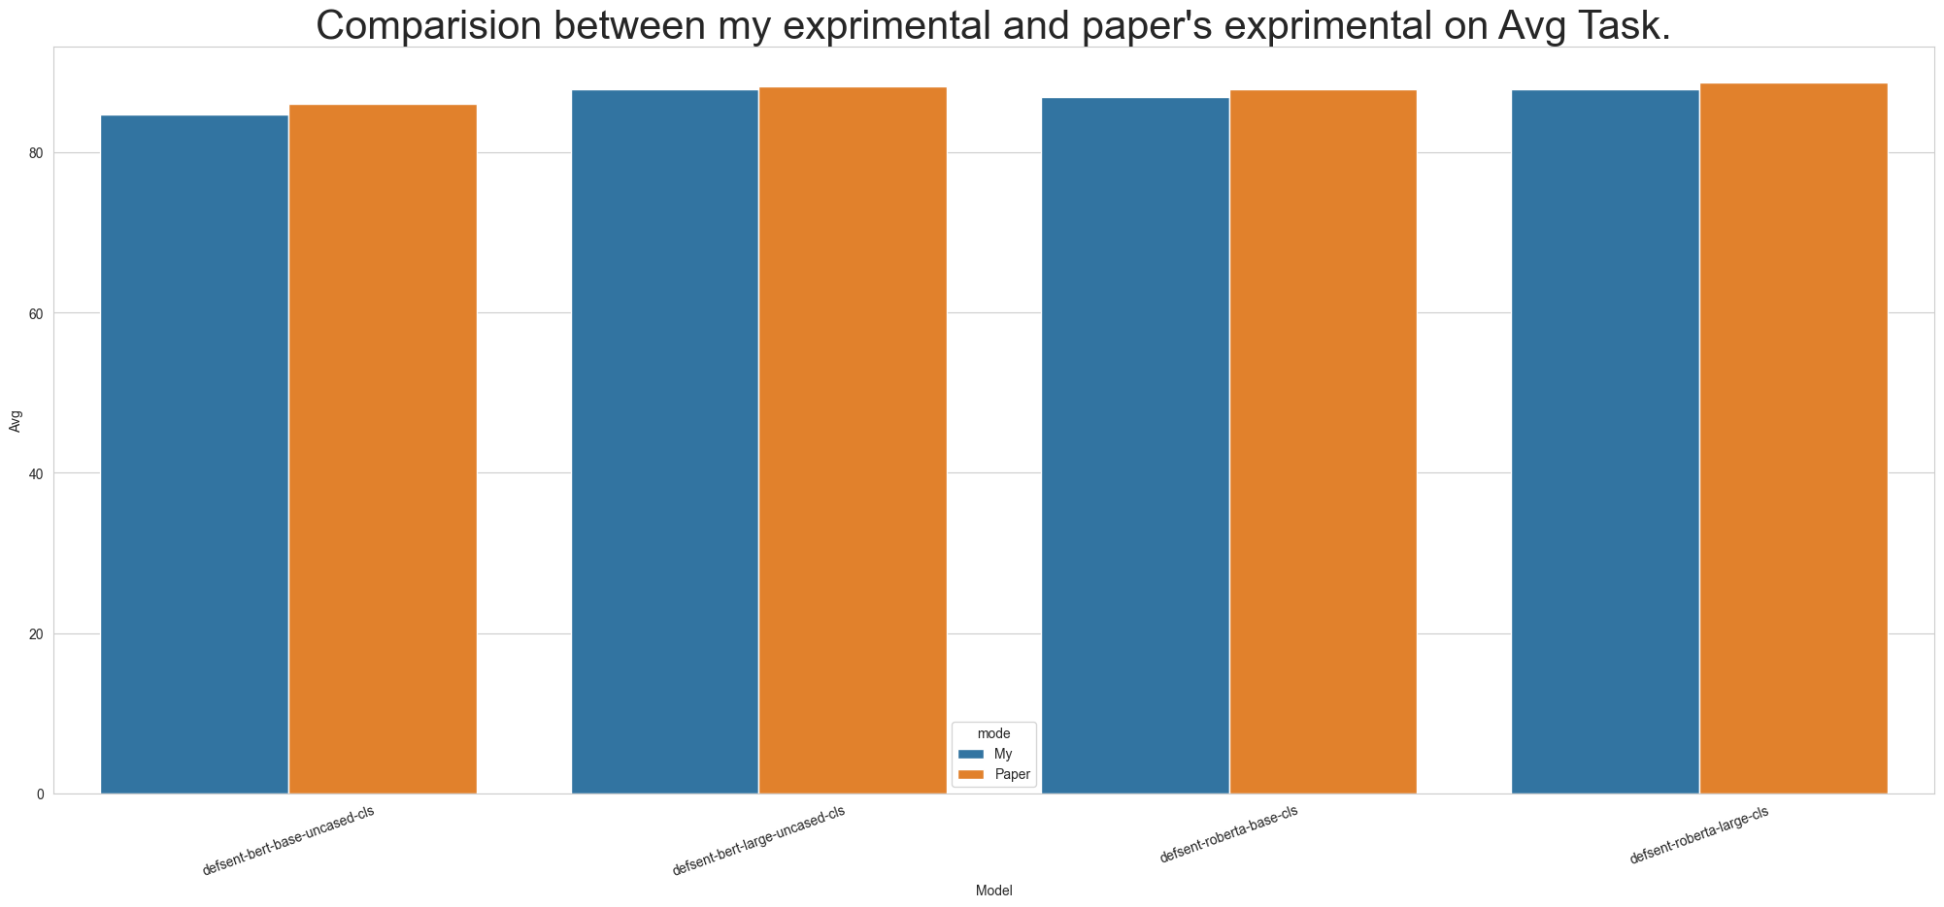
SentEval (Facebook researcher)

Slide 37
Link(Repo)
Github

Slide 38
Introduction
Method
Experiment
Conclusion

Slide 39

Conclusion
In this paper, DefSent, a sentence embedding method using a dictionary, and demonstrated its effectiveness through a series of experiments.
DefSent is based on dictionaries developed for many languages, so it does not require new language resources when applied to other languages.
In future work, we will evaluate the performance of DefSent when it is applied to languages other than English.

Slide 40

Thanks for your listening

