Slide 1
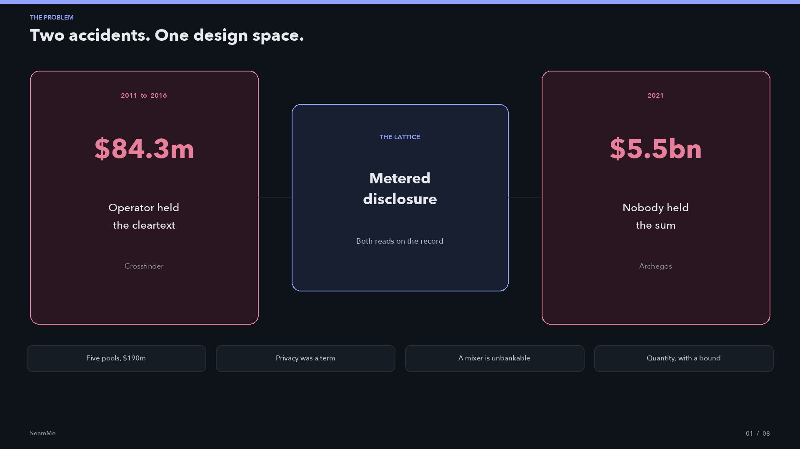
Notes:
Open on the two accidents. Credit Suisse Crossfinder, 2016, $84.3m: the operator held subscriber orders in the clear. Archegos, 2021, $5.5bn at Credit Suisse: privacy hid the sum from every prime and from the supervisor. Most venues fix one by causing the other. SeamMe refuses the choice. Disclosure is metered. Both reads are on the record. The receipt is the thing a competitor cannot copy.

Slide 2
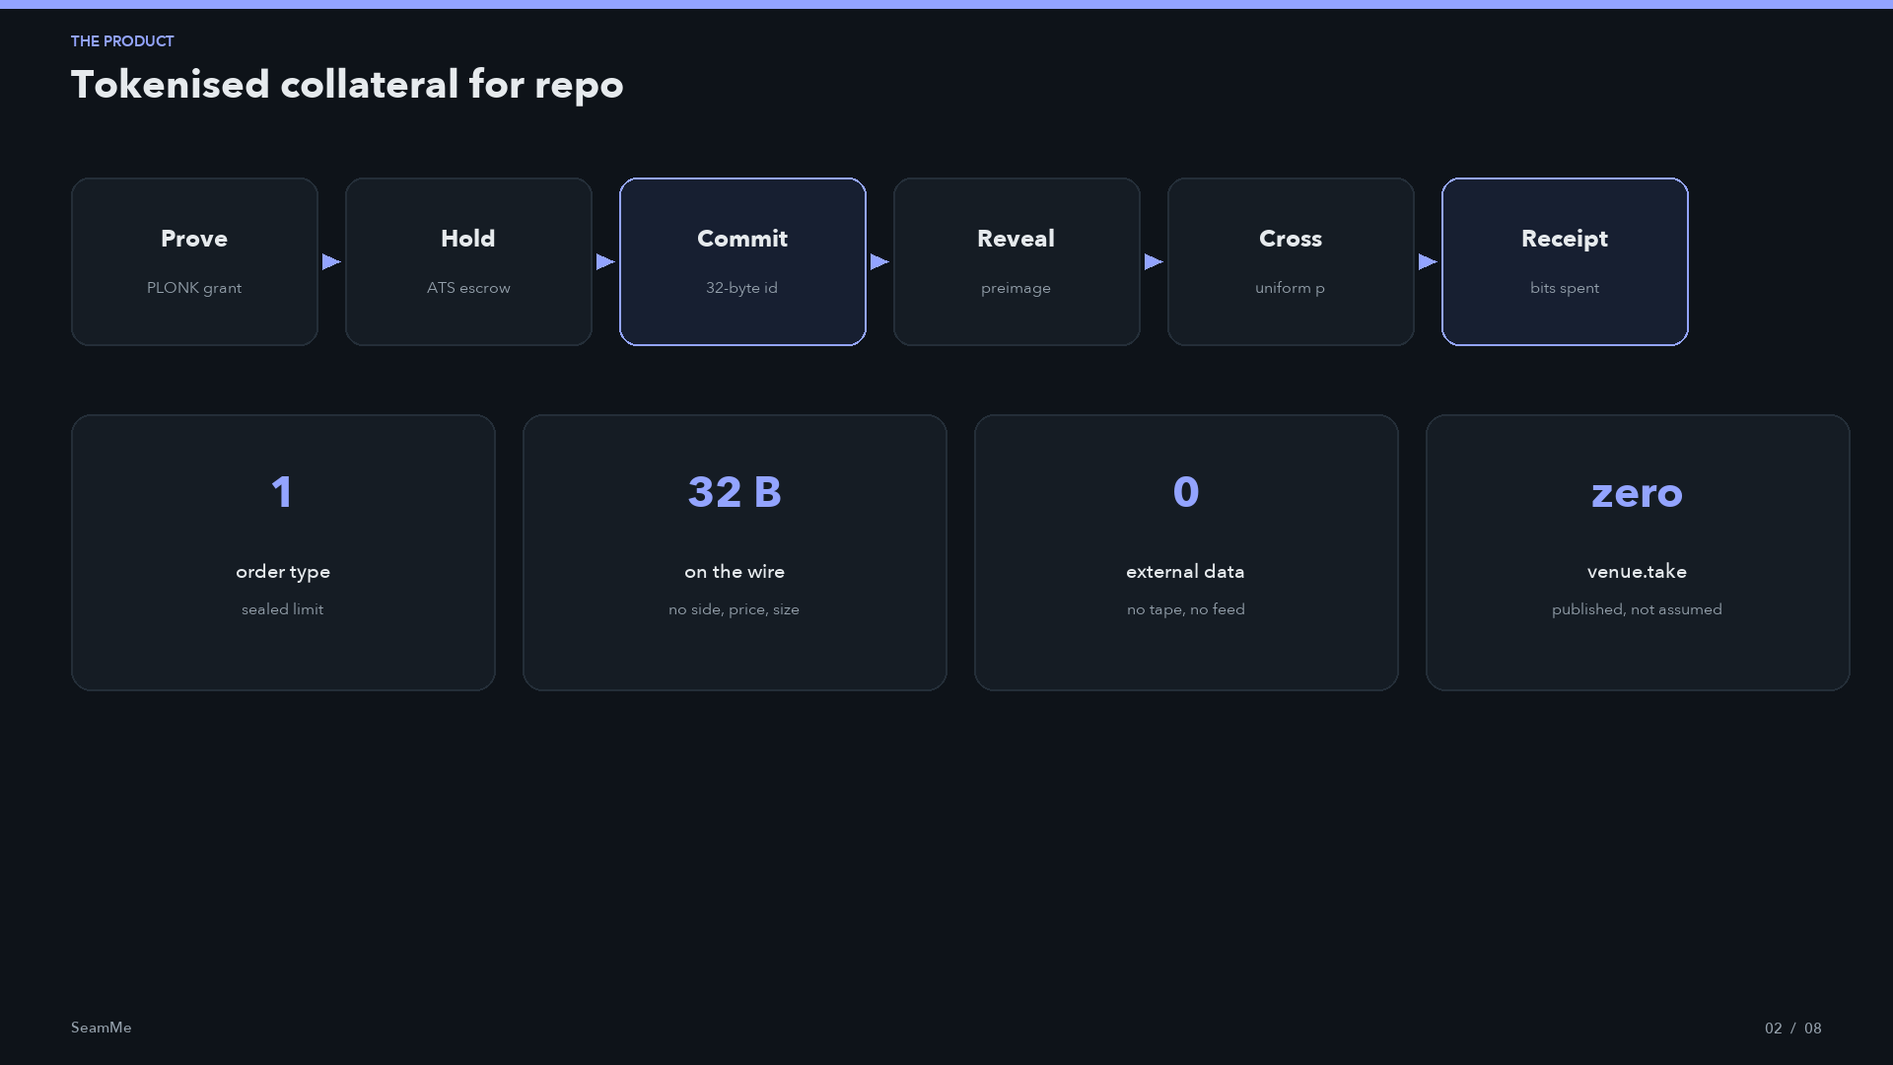
Notes:
One sentence: a secondary market in tokenised collateral for repo, on Hedera, through Hashgraph's Asset Tokenization Studio. One order type. No tape. Commitments are thirty-two bytes because gossip reaches twenty-nine operators before any contract runs. Venue take is published as zero. Live bond is SEAMC from Hashgraph's own factory. One printed round at a uniform 100 against 95 and 105.

Slide 3
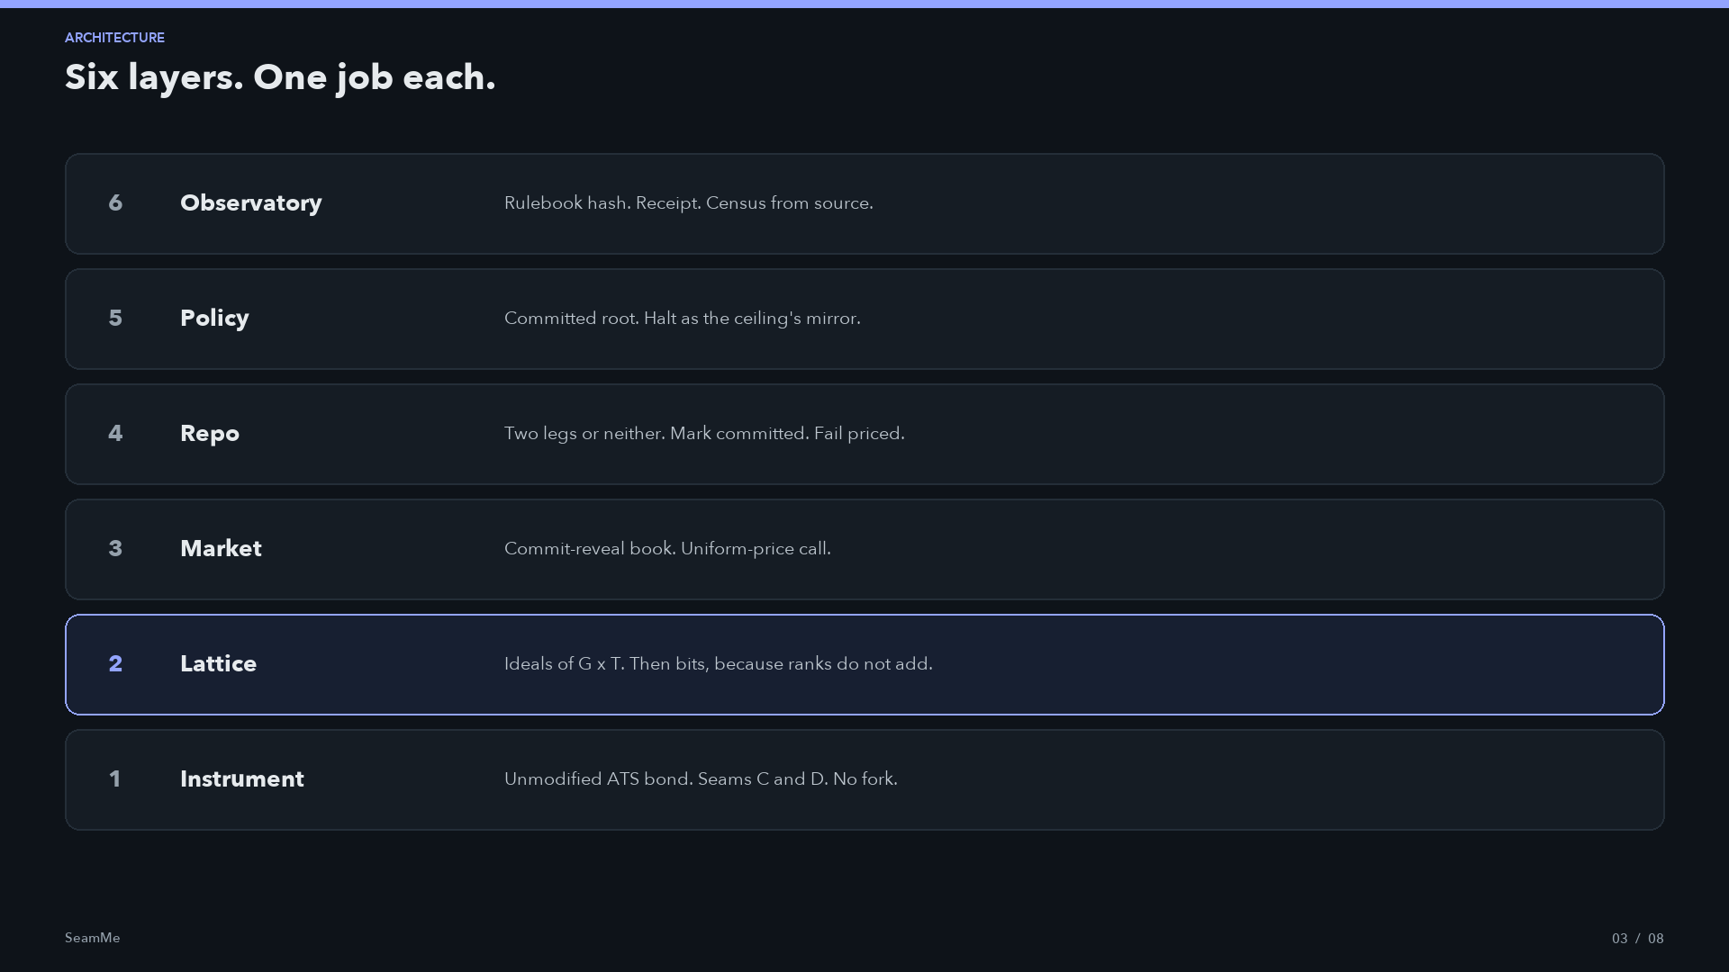
Notes:
Read from the instrument up. ATS is unmodified. We occupy seam D for eligibility and seam C for compliance. The lattice sits on the transfer path because a check is 42 gas. The book never puts a price on the wire. The vault never stores the mark in the clear. Policy is a committed root. The supervisor seat is held by VolumeCap. Three clocks, never derived from each other.

Slide 4
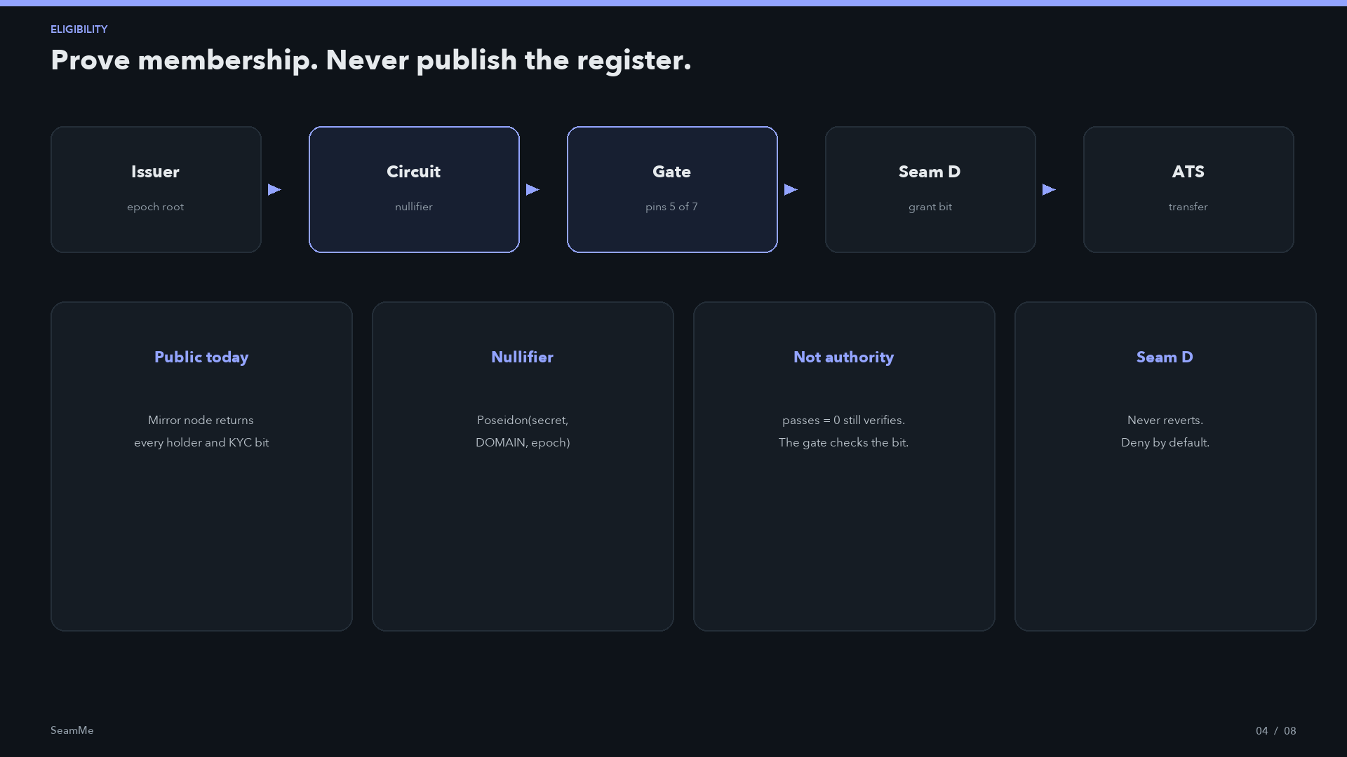
Notes:
Hedera already publishes the holder register of live tokenised funds. Concealing an order on top of that is theatre. The circuit proves membership, policy, and freshness. It reveals a nullifier and a passes bit. Five of seven public signals are attacker-chosen. The gate pins all five before it spends the pairing. getKycStatus never reverts because a revert on seam D bricks the token. A grant in epoch e grants nothing in e+1.

Slide 5
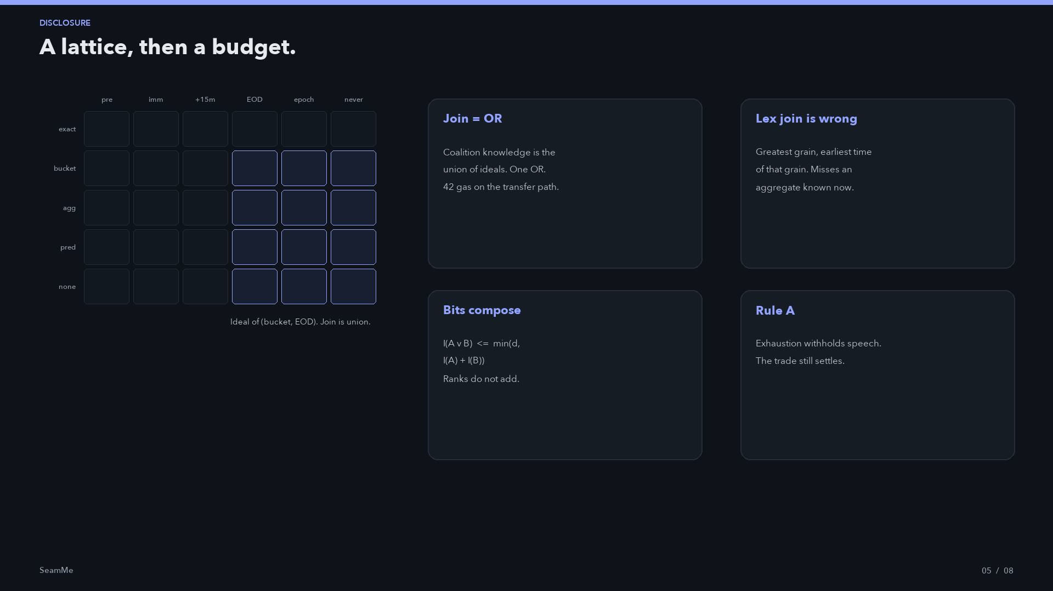
Notes:
Do not call this fuzzy algebra. Fuzzy membership invents a score in 0 to 1 with no operational meaning. The object is Birkhoff: order ideals of G times T-op. Five grains, six times, thirty cells, a uint32. Join is union. The lattice cannot see collusion because a union of subsets stays a subset. k predicates over 2^k determine the value exactly and still join to one predicate. Information in bits does compose. Metered rows are 13, 14, 15. Budget is domainBits minus one.

Slide 6
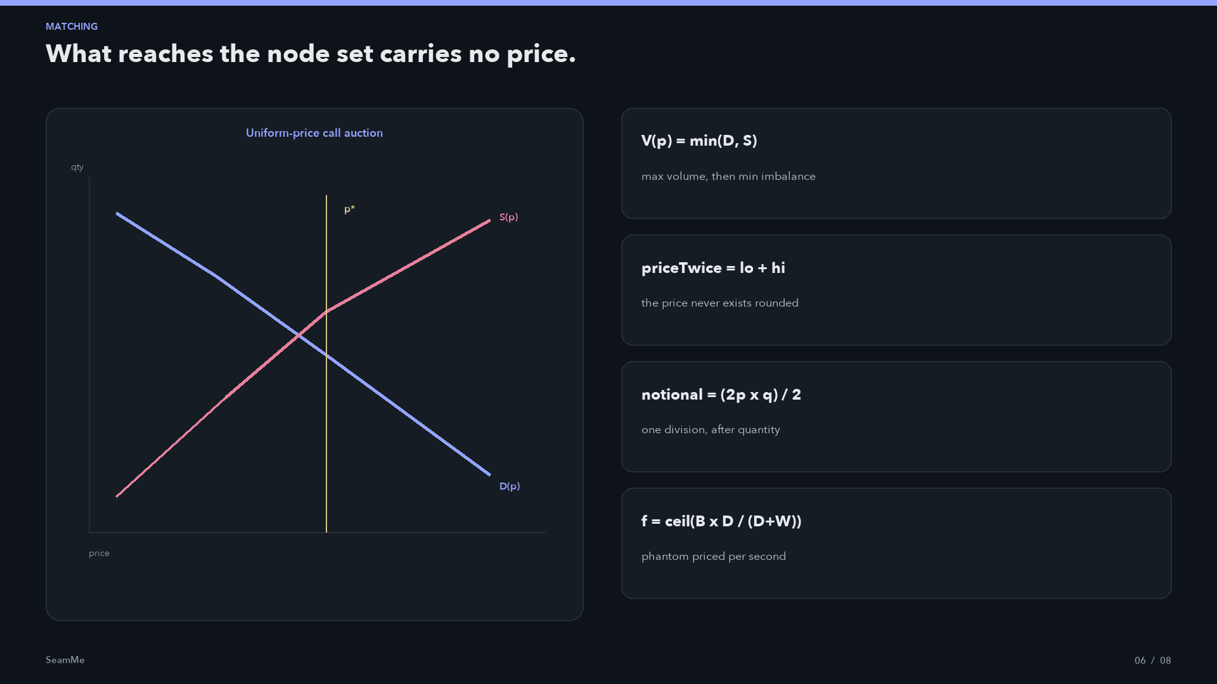
Notes:
Hedera has no public mempool. A submitted transaction is still gossiped in full to twenty-nine named operators before it is ordered. A plain limit order is already disclosed. Commitment is keccak of domain, committer, side, price, qty, salt. Cancel and reveal windows partition the lifetime and never overlap. Resting seven rounds roughly doubles crossings and spends one exact disclosure rather than one per round. Axe grid is 2048 cells, one bit per probe, not deployed.

Slide 7
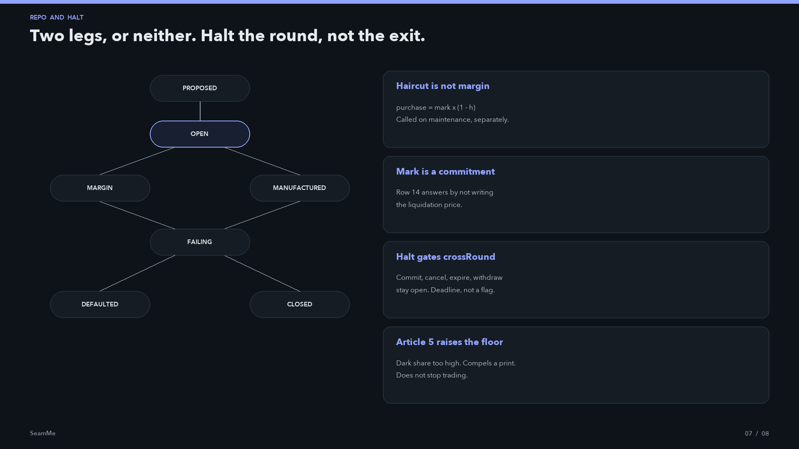
Notes:
A repo is a sale and a repurchase. Title passes. Economically it is a secured loan. Haircut and maintenance are distinct. Accrual rounds up on ACT/365. FAILING is not default. CSDR Article 7 penalty accrues from maturity, payee the counterparty. Narrowing disclosure is immediate. Halting is the deprivation, so it is budgeted and self-expiring. In this deployment VolumeCap holds the supervisor seat. The breaker cannot stop the round that breached it.

Slide 8
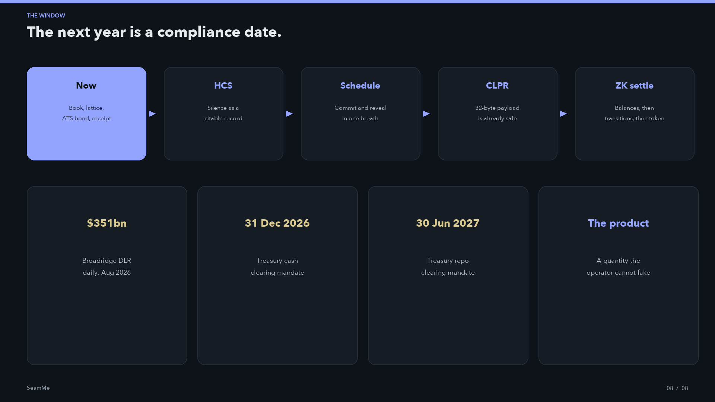
Notes:
Broadridge already clears hundreds of billions a day on membership privacy. The SEC dates are 31 December 2026 and 30 June 2027. HCS cannot be called from a contract. HIP-478 specifies a relay. The novel record is silence: I acted, I told you nothing, here is the row and the budget. HIP-1535 stores payloads in plaintext and hands confidentiality to the application. Our commitment is that answer today. ZK settlement is a different circuit class and is not claimed. Close on the sentence: a venue whose operator reads the cleartext has no quantity to print.

