Slide 1


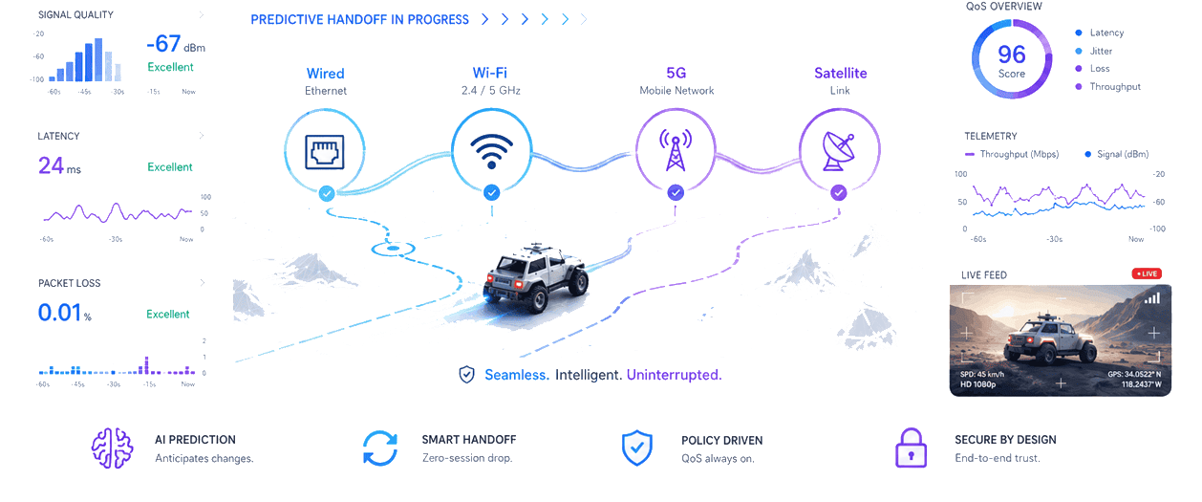
CONTINUA
ACCESS
TRAFFIC
GOAL
4
5
1
Predictive Network Continuity
wired to satellite
mission classes
continuous session
The network changes. The session does not.
PROPOSAL DECK
by Team Kanban
Advanced Technology Pioneers 2026
Notes:
[Sources] - User-provided dashboard concept image: Image (30) (1) (1).png - https://challengeon.atrc.ae/en/challenges/atp2026/pages/edge-challenge-statement?lang=en [/Sources] Dashboard values are illustrative and not experimental results.

Slide 2
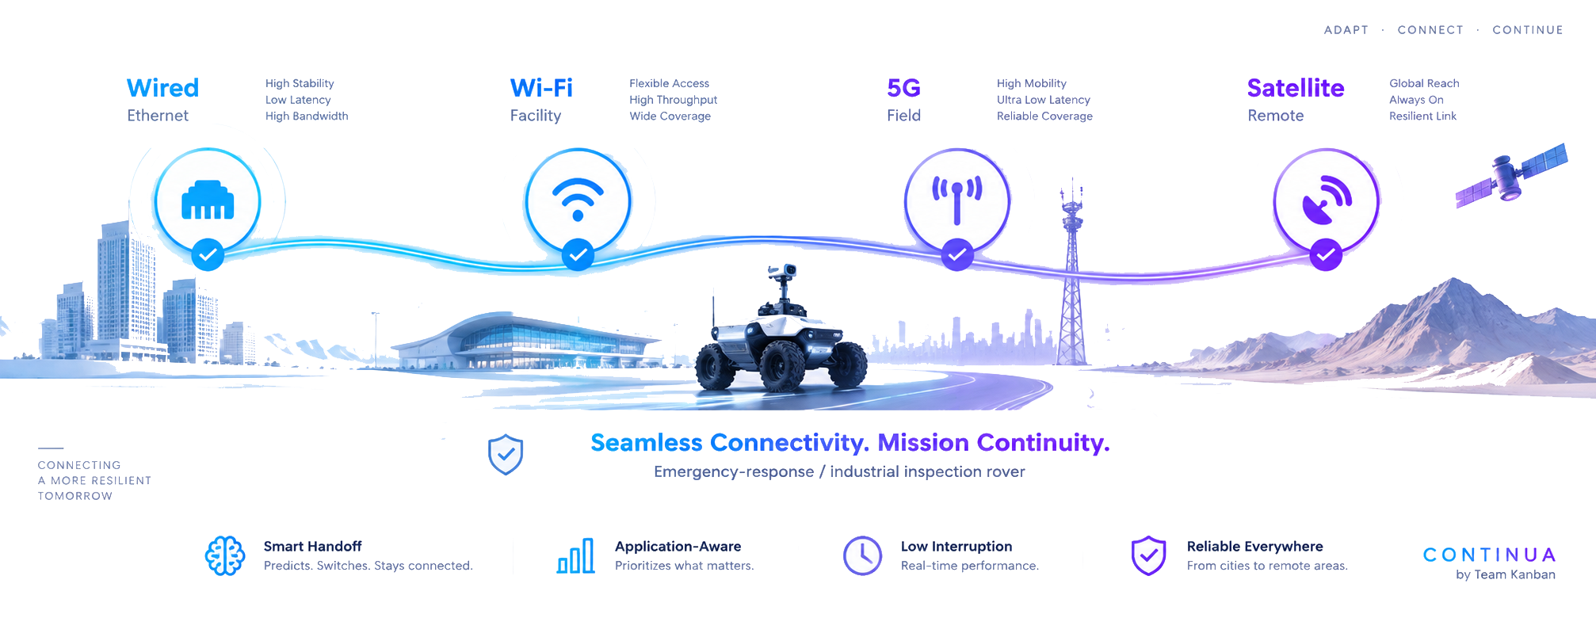
EXECUTIVE SUMMARY
One session. Four networks. Zero operator disruption.
CONTINUA keeps critical applications usable as a mobile user transitions across heterogeneous access networks.
How might we keep a user's experience unbroken as they move between Wi-Fi, mobile, satellite and wired networks?
CONTINUA in one sentence
An application-aware continuity layer that predicts link degradation, prepares the next path before failure, and protects critical traffic during the handoff.
PREDICT
PRE-WARM
PRIORITIZE
Prototype
Simulation
Predictive model
Comparative results
agent + gateway + dashboard
repeatable multi-access scenarios
short-horizon QoE risk
baselines + application metrics
CONTINUA | TEAM KANBAN
02
Notes:
[Sources] - https://challengeon.atrc.ae/en/challenges/atp2026/pages/edge-challenge-statement?lang=en - User-provided proposal requirements screenshot: 952415a6-26c6-4f82-917a-81200157d637.png [/Sources]

Slide 3


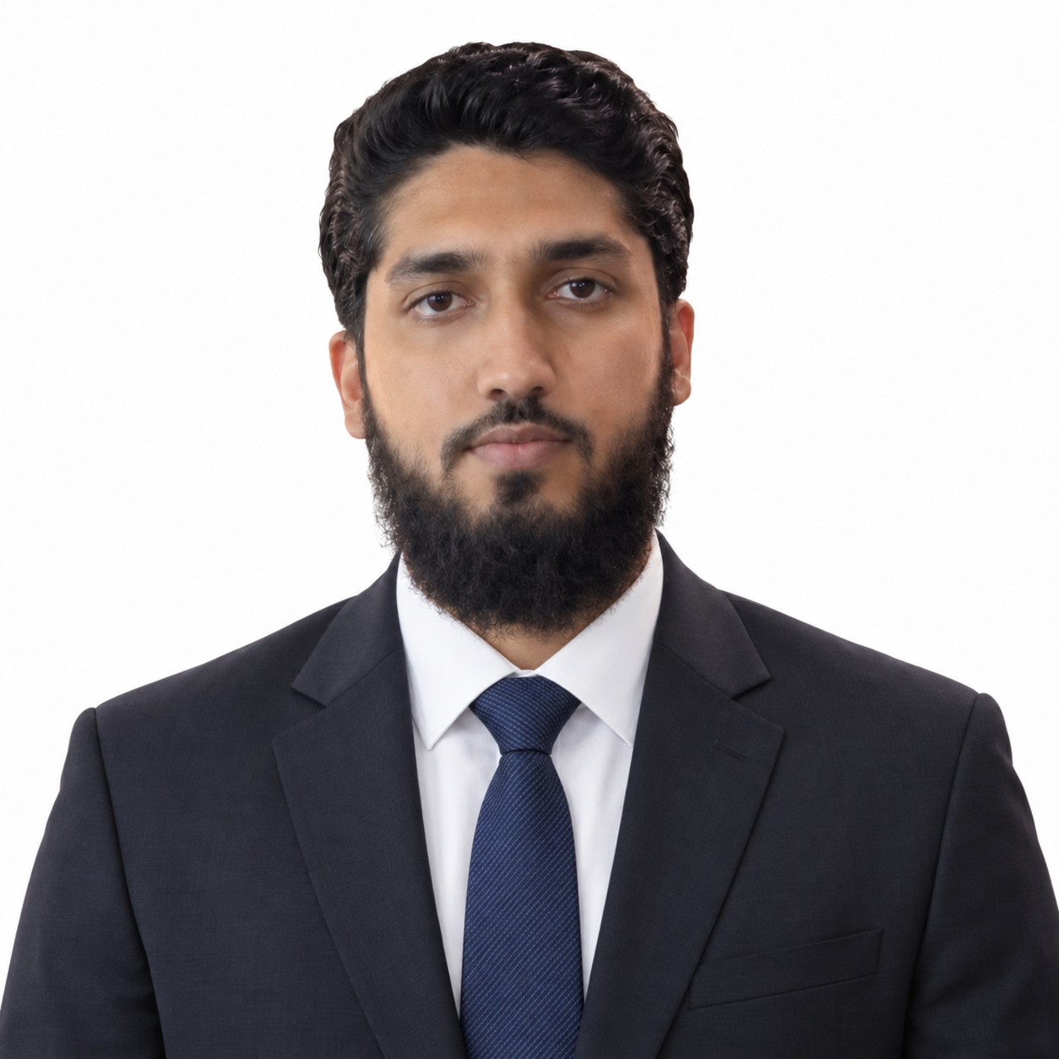
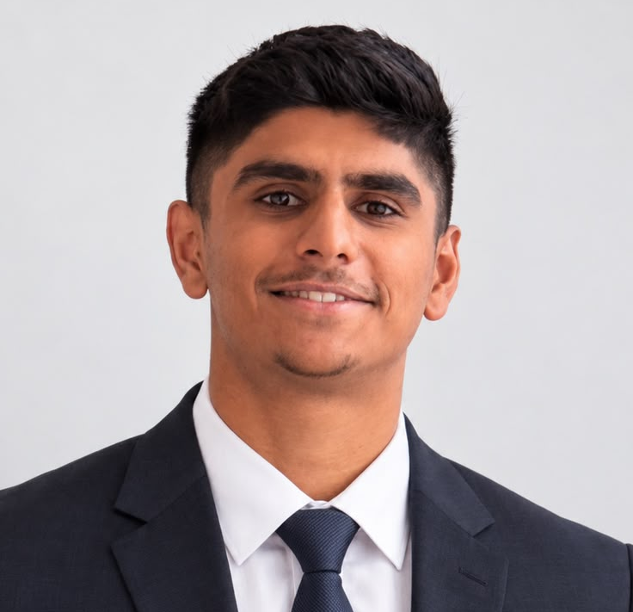
TEAM OVERVIEW
Team Kanban combines product, AI, networking and experimental rigor.
Awaiz Ahmed
Simulation & Experiment Lead
AA
Mininet-WiFi, tc netem, automation, statistics
Technical & Product Lead
BSc Software Engineering + Software Development student
Mahra Alshamsi
CORE CAPABILITIES
AI/ML & QoE prediction
Network & 5G Lead
MPTCP, QoS, Linux routing, wireless systems
Python & Linux
ROS & robotics integration
Mohammad Umar
FastAPI & Next.js
Docker & cloud-native delivery
Research & Experience Lead
Network engineering
literature, usability, documentation, demo narrative
Leads architecture, model, integration, dashboard and pitch.
Obaid Mukkadam
CONTINUA | TEAM KANBAN
03
Notes:
[Sources] - User-provided CV: Awaiz CV(8).pdf - https://challengeon.atrc.ae/en/challenges/atp2026 - https://challengeon.atrc.ae/en/challenges/atp2026/agreements?lang=en [/Sources] Team-member names are placeholders until the final roster is confirmed.

Slide 4
PROBLEM & USE CASE
The handoff is brief. The mission impact is not.
Use case: a mobile response or inspection platform moves from a command facility into remote terrain.
Mission traffic is not equal
Command & safety
CRITICAL
Telemetry
CRITICAL
Live video
IMPORTANT
Voice
IMPORTANT
Logs & files
OPPORTUNISTIC
Operator should never need to reconnect or regain control
Session reset
Command delay
Video freeze
Telemetry gaps
operator re-authenticates or restarts the application
control messages miss operational deadlines
situational awareness drops during a transition
the latest state becomes stale or incomplete
CONTINUA | TEAM KANBAN
04
Notes:
[Sources] - https://challengeon.atrc.ae/en/challenges/atp2026/pages/edge-challenge-statement?lang=en [/Sources] The use case is a team-selected scenario, as permitted by the open challenge brief.

Slide 5
RESEARCH & GAP
Connectivity mechanisms exist. Mission-aware continuity is still missing.
CONTINUA adapts standards-based multipath concepts to predictive, application-aware field operations.
BASELINE 0
BASELINE 1
REFERENCE
OUR ADAPTATION
Single-path routing
Multipath TCP
Steering / redundancy
CONTINUA
WHAT IT GIVES US
WHAT IT GIVES US
WHAT IT GIVES US
WHAT IT GIVES US
Simple and universally available.
One reliable byte stream can use multiple subflows and fail over between paths.
Traffic can be steered, switched, split or duplicated across accesses.
Predicts risk, pre-warms the next path and applies a different policy to each traffic class.
WHAT IS STILL MISSING
WHAT IS STILL MISSING
WHAT IS STILL MISSING
WHY IT FITS
Route or source-address changes can interrupt active sessions; switching usually begins after degradation is visible.
The transport layer alone does not know which application is mission-critical or what future path risk looks like.
Full deployment can be complex, while always-on duplication can waste scarce or costly bandwidth.
Built on open standards and testable in software emulation before field deployment.
Standards-aligned foundation: IETF RFC 8684 (MPTCP) | Linux MPTCP | 3GPP TS 24.193 (ATSSS)
CONTINUA | TEAM KANBAN
05
Notes:
[Sources] - https://www.rfc-editor.org/rfc/rfc8684.html - https://docs.kernel.org/networking/mptcp.html - https://portal.3gpp.org/desktopmodules/Specifications/SpecificationDetails.aspx?specificationId=3607 - https://www.etsi.org/deliver/etsi_ts/124100_124199/124193/19.05.00_60/ts_124193v190500p.pdf [/Sources]

Slide 6
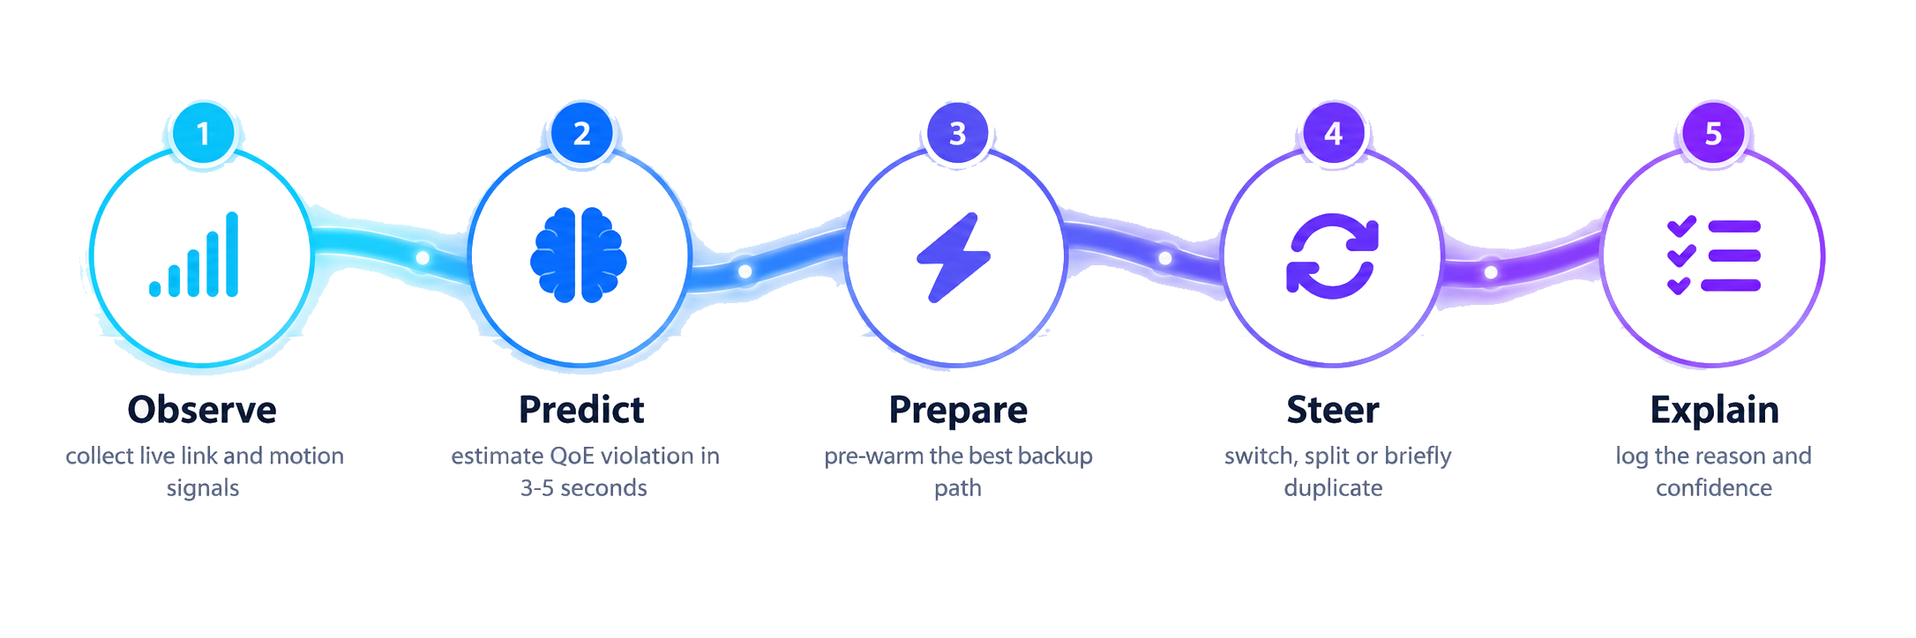
PROPOSED SOLUTION
CONTINUA turns live telemetry into proactive handoff decisions.
A closed-loop controller observes every link, predicts near-term QoE risk and takes the least disruptive action.
INPUTS
RTT | jitter | packet loss | throughput
Wi-Fi RSSI | interface state | motion | cost
ACTIONS
Pre-warm backup | switch primary | split traffic
briefly duplicate critical packets | adapt video | pause logs
COMMAND
TELEMETRY
VIDEO
LOGS
PATH SCORE = QoE FIT - PREDICTED RISK - COST - HANDOFF PENALTY
lowest latency + brief duplication
freshest-data policy
predictive switch + adaptive bitrate
cheapest / highest throughput
CONTINUA | TEAM KANBAN
06
Notes:
[Sources] - https://docs.kernel.org/networking/mptcp.html - https://www.rfc-editor.org/rfc/rfc8684.html - https://www.etsi.org/deliver/etsi_ts/124100_124199/124193/19.05.00_60/ts_124193v190500p.pdf [/Sources] The score and policy logic are the proposed team adaptation, not an external standard.

Slide 7
SYSTEM DESIGN
A deployable continuity layer - not a replacement for existing networks.
The first prototype runs entirely in software and can later map onto physical routers, gateways or mobile platforms.
CONTROL PLANE
Link Monitor
QoE Predictor
Policy Engine
Decision Log
No specialized hardware required
Mobile platform
CONTINUA agent
Multi-access paths
Continuity gateway
Operator
Control
Telemetry
Video
Voice
Logs
Flow classifier
MPTCP / UDP relay
Local policy executor
Wired
Wi-Fi
5G
Satellite
Stable endpoint
Encrypted tunnel
Duplicate suppression
Session state
Console
Live feed
Alerts
Authenticated peers
Encrypted transport
Least-privilege agent
Auditable decisions
CONTINUA | TEAM KANBAN
07
Notes:
[Sources] - https://docs.kernel.org/networking/mptcp.html - https://www.rfc-editor.org/rfc/rfc8684.html [/Sources] The UDP session relay, control-loop composition and gateway functions are proposed system-design elements.

Slide 8
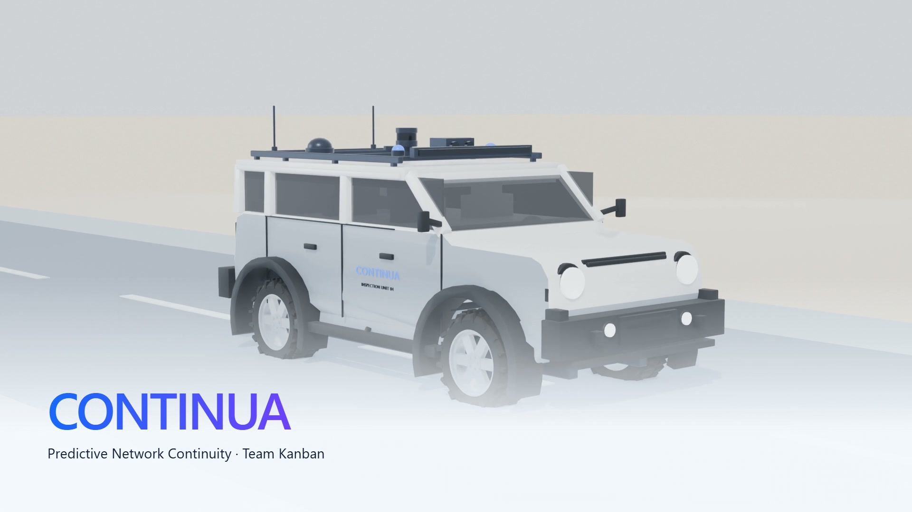
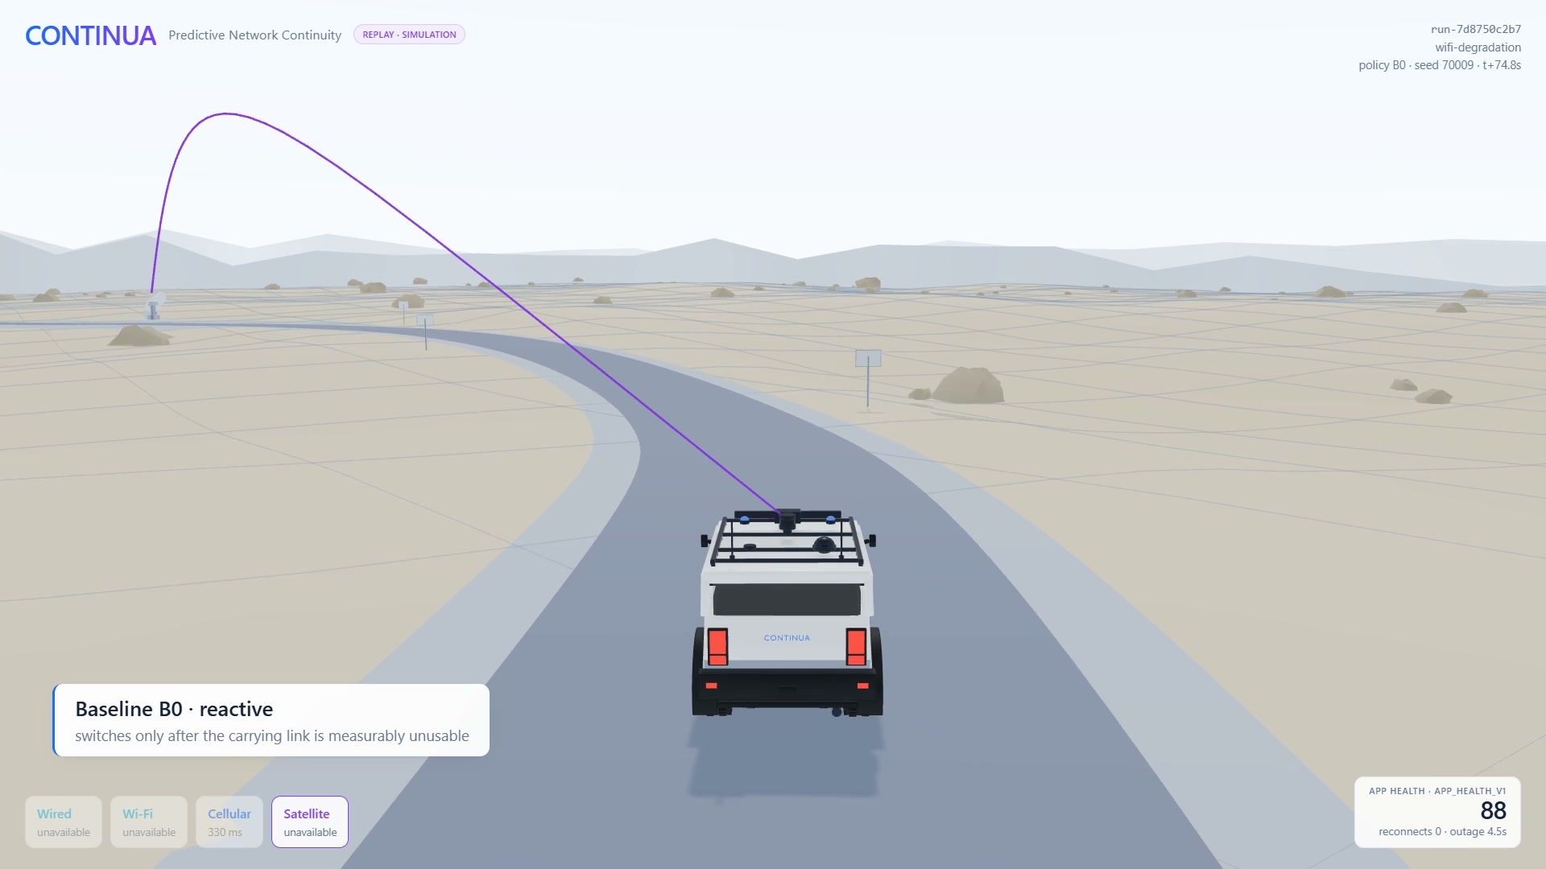
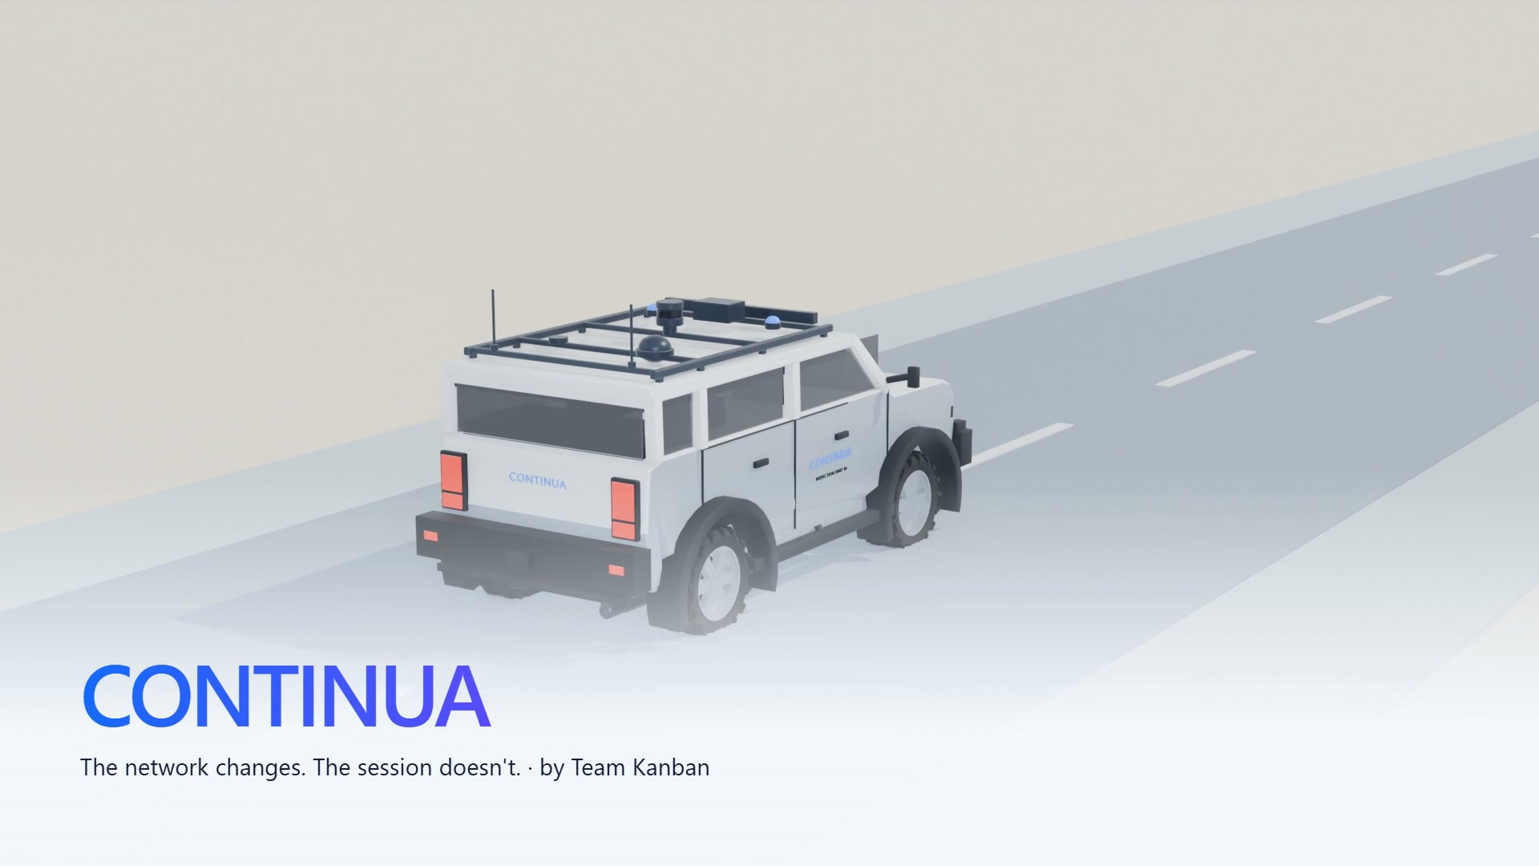
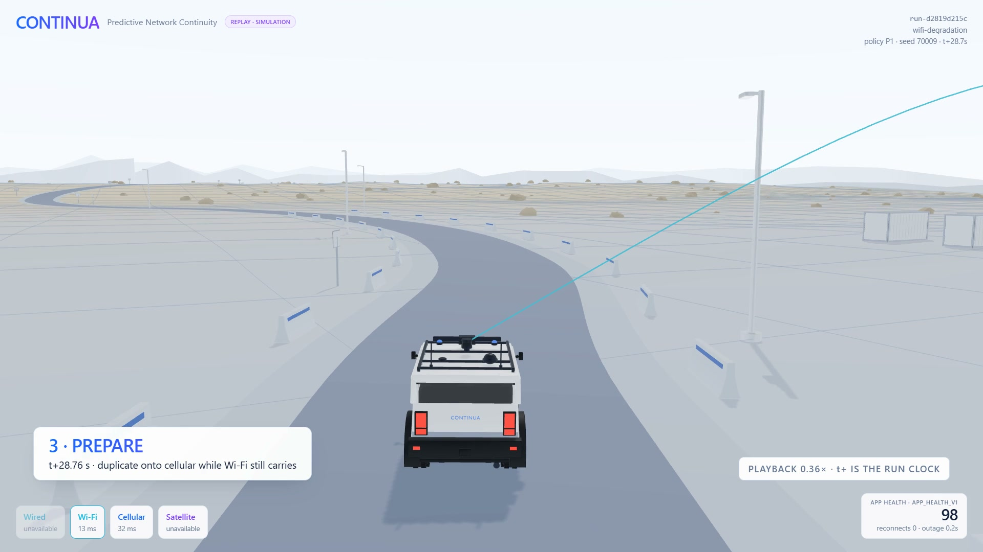
WORKING PROTOTYPE
A working prototype: visible, stressable and measured.
The dashboard visualizes logged handoff events, application health and the reasoning behind every network decision. Live at continua.kanbanstudios.ae
01
Live multi-link state
Wired, Wi-Fi, 5G and satellite visible together.
02
Predictive handoff
The next path is prepared before the current link fails.
03
Application-aware QoS
Latency, loss, throughput and service health stay visible.
04
Operator mission view
Live feed, vehicle state and transition status in one place.
CONTINUA | TEAM KANBAN
08
Notes:
[Sources] - User-provided dashboard concept image: Image (30) (1) (1).png - https://challengeon.atrc.ae/en/challenges/atp2026/pages/edge-challenge-statement?lang=en [/Sources] The interface is a visual mock-up. The final submission should connect it to logged emulator events before claiming measured performance.

Slide 9
IMPLEMENTATION & EXPERIMENTS
Evidence first: repeatable emulation, clear baselines, application-level QoE.
Because no sponsor dataset is provided, every assumption, network profile and workload is explicitly documented.
ASSUMPTIONS
PROTOTYPE STACK
EXPERIMENTAL DESIGN
No live operator network or private sponsor data is required.
Linux MPTCP and network namespaces
B0: single-path TCP with route switching
Four access types are represented by controlled Linux profiles.
Mininet-WiFi for movement and AP handovers
B1: reactive / default MPTCP
Identical mobility and workload traces are used for each mechanism.
tc netem for delay, loss, jitter and rate profiles
P1: CONTINUA predictive policy
Dashboard values become evidence only after logged experiment runs.
Python, scikit-learn, FastAPI, Next.js and WebSockets
20+ repeated runs per core scenario, fixed seeds and confidence intervals
SCENARIOS
Gradual Wi-Fi fade
Sudden link outage
5G congestion
Satellite fallback
Flapping link
METRICS
interruption time
p95 command latency
deadline misses
video stall time
telemetry age
satellite MB
unnecessary handoffs
Simulation results are measured and reproducible. Linux MPTCP and Mininet-WiFi emulation remain planned; they are not verified on the current host.
CONTINUA | TEAM KANBAN
09
Notes:
[Sources] - https://docs.kernel.org/networking/mptcp.html - https://mininet-wifi.github.io/ - https://mininet-wifi.github.io/mobility/ - https://www.man7.org/linux/man-pages/man8/tc-netem.8.html - https://challengeon.atrc.ae/en/challenges/atp2026/pages/edge-challenge-statement?lang=en [/Sources]

Slide 10
IMPACT & ROADMAP
From working prototype to field-ready continuity.
Success means better mission experience, smarter use of scarce links and evidence that can be reproduced.
Mission continuity
Efficient bandwidth
Explainable automation
TARGET
Keep critical control, telemetry and video usable as the access network changes.
Use satellite and duplicated traffic only when risk and application priority justify it.
Show operators what changed, why a handoff occurred and how confident the system was.
Zero application reconnects in supported handoffs
BUILD ROADMAP - COMPLETE
SUCCESS DEFINITION
Lower interruption and command deadline misses than baselines
Lower satellite use than always-on redundancy
01
02
03
04
05
Baseline & emulator
MPTCP & gateway
Predictor & policy
Dashboard integration
Experiments & video
AI USE DECLARATION
AI tools support ideation. The team does coding, documentation and validates every architecture decision, experiment, result and conclusion.
CONTINUA
The network changes. The session does not.
by Team Kanban
CONTINUA | ADVANCED TECHNOLOGY PIONEERS 2026
10
Notes:
[Sources] - https://challengeon.atrc.ae/en/challenges/atp2026/pages/edge-challenge-statement?lang=en - User-provided proposal instruction screenshot: 952415a6-26c6-4f82-917a-81200157d637.png [/Sources] All performance statements on this slide are targets to be validated through experiments.

