Slide 1


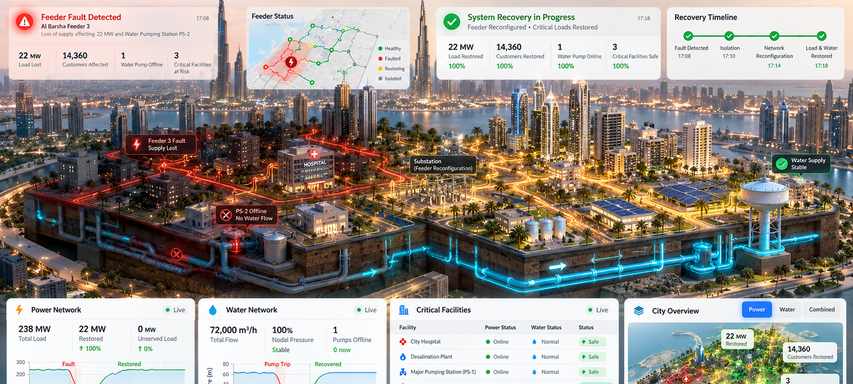

2026 INTERNATIONAL NEAR EAST CONFERENCE
ON ELECTRICAL & ENERGY SYSTEMS
21–23 OCTOBER 2026 • DUBAI, UNITED ARAB EMIRATES
ENCIRRA
Coupled Power + Water
One fault. Connected consequences. Verified recovery decisions.
Resilience Digital Twin
UNDERGRADUATE INNOVATION CHALLENGE
Huda Mueen
Awaiz Ahmed
Mohammad Umar
Bilal Feroz
hudamueen2407@gmail.com
202310183@aau.ac.ae
202240077@aau.ac.ae
202310641@aau.ac.ae
Al Ain University • Abu Dhabi, United Arab Emirates
TEAM KANBAN / 4 AUTHORS
WHY CROSS-DOMAIN RECOVERY MATTERS
FEEDER OUTAGE
PUMP DISRUPTION
WATER-SERVICE RISK
01
Power supply interrupted
02
Electrical-to-hydraulic link
03
Head / demand may decline
Context & Research Question
ENCIRRA Digital Twin
01
05
THE ENGINEERING GAP
VISUALIZING TWO INTERDEPENDENT NETWORKS
Restoring electrical load is not the same as restoring essential urban services.
A feeder fault can interrupt a dependent pump even after other loads recover. Power-only decisions may overlook pressure head, tank storage and critical water demand.
The Coupled Infrastructure Model
FIGURE 1 / ELECTRICITY → PUMP → WATER
02
ELECTRICAL
COUPLING
HYDRAULIC
Power network
Electric pump
Water network
Bus and feeder state
Electrical supply gate
Tank / reservoir levels
FAULT / ISOLATED
ENERGIZED FEEDER
WATER INFRASTRUCTURE
Voltage / line loading
Pump availability
Pressure-driven demand
Figure 2. Interactive 3D twin view: feeder state, pumping dependency and below-ground water infrastructure.
Evaluation Design
Switching topology
Power-to-flow linkage
Critical service nodes
06
COMMON SCENARIO / THREE RECOVERY POLICIES
P_pump [kW] = ρ g Q H / (1000 η)
01
02
03
Bus energized?
NO ACTION
GRID-ONLY
ENCIRRA
Q [m³/s] · H [m] · η [–] · ρ [kg/m³]
Controls pump operating state
Fault remains; track the electrical and hydraulic consequences.
Prioritize feasible electrical load restoration.
Rank plans by coupled power–water service and verified feasibility.
Methods & Computational Workflow
Synthetic case specification: feeder interruption → pump supply loss → critical-node head response. Identical scenario inputs for all policies.
03
PROPOSED ALGORITHM / THREE-STRATEGY EXPERIMENT
Quantitative Indicators
01
02
03
07
FAULT SCENARIO
AC POWER FLOW
PUMP DEPENDENCY
INDICATOR • EXACT DEFINITION • UNIT
Seeded feeder event + demand profile
Compute bus V, current and loading
Map source bus to pump availability
INDICATOR
FORMULA / MEASUREMENT
UNIT
Synthetic inputs
pandapower
Power → water link
Load restored
R_L = 100 (P_post − P_fault) / (P_pre − P_fault)
%
04
05
06
Water demand served
WDS = 100 Σq_del,j / Σq_req,j
%
HYDRAULIC RUN
RECOVERY SEARCH
VERIFY + REPORT
Critical coverage
C = 100 Σ(w_k I_k^P I_k^W) / Σw_k
%
Resolve pressures, tanks, delivered flow
Enumerate / optimize switching actions
Check topology + re-solve both models
Minimum pressure head
h_min(t) = min_j [H_j(t) − z_j]
m
WNTR / EPANET
OR-Tools CP-SAT
NetworkX + AC/PDD
Optimization & Independent Checks
Head recovery time
T_rec = t_stable(h ≥ h_req) − t_fault
min
04
Constraint violations
N_viol = Σ 1[constraint violated]
count
OBJECTIVE / PROPOSED CONSTRAINED RECOVERY
Switch operations
N_sw = Σ |s_e,post − s_e,fault|
actions
min J = α (1 − R_L/100) + β (1 − C/100) + γ (1 − WDS/100) + λ N_sw
Service-loss penalties + switching effort; α, β, γ, λ are scenario-defined nonnegative weights.
P: served power [kW] • q: delivered/required flow [m³/h] • H,z,h: hydraulic head/elevation/pressure head [m] • I: binary compliance • w: criticality weight
HARD CONSTRAINTS / RE-SOLVE EACH CANDIDATE
ELECTRICAL
V_min ≤ V_i ≤ V_max (p.u.) | line loading ≤ 100%
Current Research Status
HYDRAULIC
h_j(t) ≥ h_req,j (m) at specified critical nodes
08
TOPOLOGY
Faulted segment isolated; switching configuration feasible
IMPLEMENTED
ONGOING VALIDATION
CP-SAT proposes • NetworkX validates topology • pandapower + WNTR re-solve physics
Interactive 3D twin
Full-scale scenario benchmarks
No unverified restoration percentages or recovery-time values are presented.
CONTRIBUTION
A grid-safe recovery is not necessarily a water-safe recovery.
Encirra links dependency modeling, constrained switching decisions and independent dual-network checks.
REFERENCES & CONTACT
SCAN TO EXPLORE ENCIRRA
[1] pandapower: pandapower.readthedocs.io [2] EPA WNTR: usepa.github.io/WNTR/
[3] EPA EPANET: epa.gov/water-research/epanet [4] OR-Tools: developers.google.com/optimization
encirra.kanbanstudios.ae
2026 NEECON • Dubai, UAE • Undergraduate Innovation Challenge
Built by Team Kanban
Notes:
[Sources]
Conference identity and logo: user-supplied NEECON poster template.
Digital twin visualization: user-provided Encirra reference image.
Mathematical indicator definitions and evaluation design: newly authored for this poster; proposed metrics, not empirical results.
Pandapower: https://pandapower.readthedocs.io/
EPA WNTR: https://usepa.github.io/WNTR/
EPA EPANET: https://www.epa.gov/water-research/epanet
OR-Tools: https://developers.google.com/optimization
Author names and emails supplied by the user.
[/Sources]

