Slide 1
FIBERBLAZE
Workforce Management
Master blueprint & delivery roadmap
Recovered September 2026 baseline • Consolidated November 2026 update
DESIGN REVIEW / ENGINEERING HANDOVER

Slide 2
FIBERBLAZE / WORKFORCE MANAGEMENT
What we are building
One operating platform for dispatch, field execution, verification and reporting.
Field technicians
Operations management
Shared system of record
Assigned jobs and navigation
Verified subscriber / NAP data
Camera-only evidence & diagnostics
Offline capture and safe synchronization
Excel dispatch and reassignment
Live / last-known technician map
Supervisor evidence review
KPI reporting and audit
Single authenticated backend
PostgreSQL and media storage
Controlled integration gateway
Paperless operations roadmap
BETA: Preserve Excel and signed hard-copy compatibility
Working blueprint • 06 November 2026 • Not production-approved
02

Slide 3
FIBERBLAZE / WORKFORCE MANAGEMENT
Reference system architecture
Separate experiences, centralized rules, controlled external access.
Management portal
Technician mobile
Next.js • Job Controller / Supervisor / Admin
Expo / Android • Field workflow
↓
NestJS API + REST / WebSocket + JWT / RBAC
↓
Prisma / PostgreSQL
Evidence storage
Integration gateway
Work orders, people, location and audit
Photos, signatures and files
CRM, inventory and approved provisioning
Working blueprint • 06 November 2026 • Not production-approved
03

Slide 4
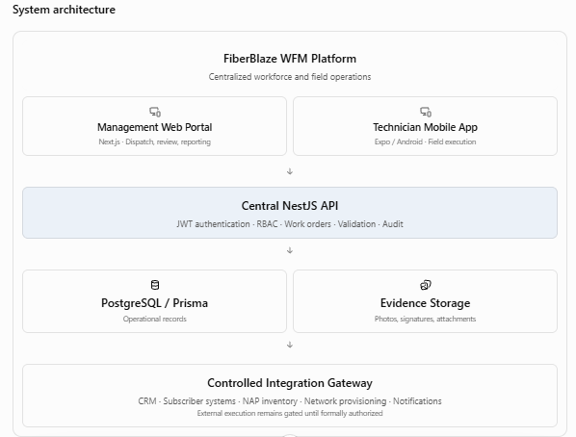

Slide 5
FIBERBLAZE / WORKFORCE MANAGEMENT
Users, roles and permissions
Least-privilege access; no direct billing or network commands from client apps.
TECHNICIAN
Execute assigned work orders, GPS, photos, offline queue
JOB CONTROLLER
Import, assign, dispatch and monitor field activity
SUPERVISOR
Review exceptions, evidence, qualified corrections
ADMINISTRATOR
Manage roles, configuration and governance
FUTURE INTAKE / CRM
Digital subscriber application, supporting documents, signatures
Working blueprint • 06 November 2026 • Not production-approved
04

Slide 6
FIBERBLAZE / WORKFORCE MANAGEMENT
Work-order lifecycle
Simple technician statuses, with administrative actions kept separate.
ASSIGNED
→
WORKING
→
COMPLETED
Alternative close-out from WORKING
FB-ISSUE
CUST-ISSUE
Provider-side / network / system dependency
Customer unavailable / reschedule / access issue
Cancellation: controller / administrative action only
Working blueprint • 06 November 2026 • Not production-approved
05

Slide 7




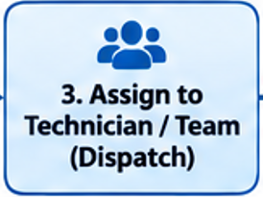








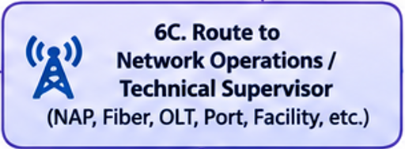





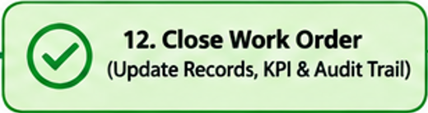
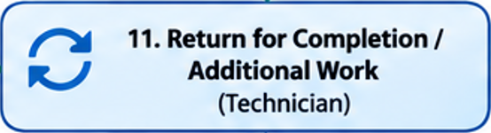
YES
NO
Subscriber Issue
Network Issue
NO
YES

Slide 8
FIBERBLAZE / WORKFORCE MANAGEMENT
Three core field workflows
Every outcome requires reason, timestamp and suitable proof.
01 Repair
02 New installation
03 Transfer / address change
Troubleshoot subscriber concern
Use trusted location and NAP records
Capture post-work measurements
Document repair or issue outcome
Verify subscriber location
Identify NAP, port, tag, ONU/modem
Capture signal and installation evidence
Retain subscriber sign-off
Old site and new site separately
Do not release old port prematurely
Validate new installation / readings
Preserve old service-location history
Working blueprint • 06 November 2026 • Not production-approved
06

Slide 9
FIBERBLAZE / WORKFORCE MANAGEMENT
GPS, map and evidence integrity
Verified records are reused; disagreement triggers review, not silent replacement.
Location & dispatch safeguards
Field evidence & offline safeguards
Unverified coordinates → field capture
Verified subscriber / NAP → reuse
Mismatch → pending supervisor review
Nearby technicians → suggestion, not auto-assignment
Stale / offline GPS is never shown as live
Camera-only mandatory work-order photos
Reason-driven proof and structured measurements
Signature and attachment attribution
Offline queue with idempotent synchronization
No duplicate completion or conflicting overwrites
Tracking ends on authorized logout / session completion
Working blueprint • 06 November 2026 • Not production-approved
07

Slide 10
FIBERBLAZE / WORKFORCE MANAGEMENT
Excel-to-paperless transition
Move gradually from existing operations to digital intake and completion.
CURRENT BETA
Excel upload → map columns → validate → preview → dispatch
Signed hard-copy work order remains accepted during beta
TRANSITION
Digital evidence, field measurements and review
Controlled customer signature and audit records
TARGET
Digital inquiry / new application → approval → work order
Authorized provisioning and electronic completion record
Working blueprint • 06 November 2026 • Not production-approved
08

Slide 11
FIBERBLAZE / WORKFORCE MANAGEMENT
Recovered engineering checkpoints
Historical evidence is preserved; current HEAD and deployment still require fresh verification.
Original September blueprint
RECOVERED
Management web + NestJS / database foundations
DEVELOPED
Web management contract suite
16 / 16 PASS
WebSocket JWT / origin controls
TESTED
PostgreSQL 16 isolation and authenticated access
TESTED
Phase 5E mobile / offline / signature
OPEN FINDINGS
Cloudflare hosting + remote login
IN PROGRESS
Note: statuses are recovered project history, not new test execution.
Working blueprint • 06 November 2026 • Not production-approved
09

Slide 12
FIBERBLAZE / WORKFORCE MANAGEMENT
Remaining release gates
Production remains NO-GO until all required evidence and approvals are complete.
01
Checkpoint recovery
Confirm exact branch / HEAD, test receipts and unresolved findings
02
Cloud login & connectivity
HTTPS API reachability, CORS, JWT, persistent database and environment
03
Real-device technician acceptance
Offline / online, GPS, camera-only proof, signatures and conflict cases
04
End-to-end operations
Excel import → dispatch → field execution → approval → reports
05
Paperless and external permissions
Formal sign-off on customer data, signatures and provisioning controls
06
Restricted beta release
Security, backup/restore, incident / rollback plan and management approval
Working blueprint • 06 November 2026 • Not production-approved
10

Slide 13
FIBERBLAZE / WORKFORCE MANAGEMENT
Next recommended engineering milestone
WFM-CF — Cloud Hosting and End-to-End Login Recovery
Immediate engineering priorities
Release discipline
Audit the actual GitHub branch and deployment configuration
Connect Cloudflare frontend to reachable HTTPS NestJS API
Validate API environment, CORS, JWT and browser login
Confirm persisted PostgreSQL and protected application data
Re-run only changed-path tests; preserve accepted receipts
Isolated staging on Cloudflare account #2
No unapproved live billing/network writes
Synthetic data first; restricted field pilot later
Document rollback, ownership and release sign-off
NEXT GATE: restore cloud login securely before additional production-facing development
Working blueprint • 06 November 2026 • Not production-approved
11

