Slide 1
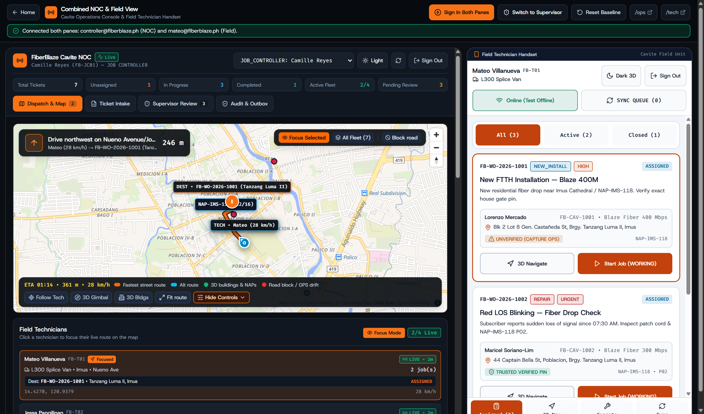
Cavite Field System Proposal
FiberBlaze Cavite | 01 / 08
FiberBlaze Cavite
Field Dispatch & Tech App
One simple system that connects our Cavite office and field techs. Upload daily Excel job lists in seconds, watch a tech's live road route, check open fiber box ports before sending a crew, and let techs finish jobs on their phones even when mobile data drops.
What Is Ready Today
• Covers 5 Cavite areas: Bacoor, Imus, Dasmariñas, General Trias, and Silang
• Two connected screens: Office Dispatch Screen (/ops) + Field Tech Phone App (/tech)
• Safe test mode holds billing and network changes until a supervisor approves them
• Fully tested: 40 system checks and 10 start-to-finish job tests all pass
Live split screen (/demo): Office dispatch map on the left, field tech phone app on the right

Slide 2
Today's Problems
FiberBlaze Cavite | 02 / 08
What Slows Our Cavite Teams Down Today
Four daily problems that waste time for dispatchers, field techs, and customers.
Slow Excel & Phone Dispatch
42 minutes lost per batch
Customer job orders arrive in Excel sheets every morning. Dispatchers copy rows by hand and call techs one by one to ask where they are.
Wrong Travel Time Estimates
28% late arrivals in inner streets
Straight-line map distance ignores rivers, gated subdivisions, and traffic on Aguinaldo Highway, Nueno Ave, and Molino Blvd.
Weak Fiber Signals & Port Mix-Ups
Repeat visits for the same customer
Paper job slips let techs close a ticket even when the fiber light signal is too weak, or unplug an old port before a customer move is finished.
Dead Zones Inside Subdivisions
Lost job photos and double entries
When mobile signal drops inside thick concrete subdivisions, techs lose their job photos or accidentally send the same report twice.

Slide 3
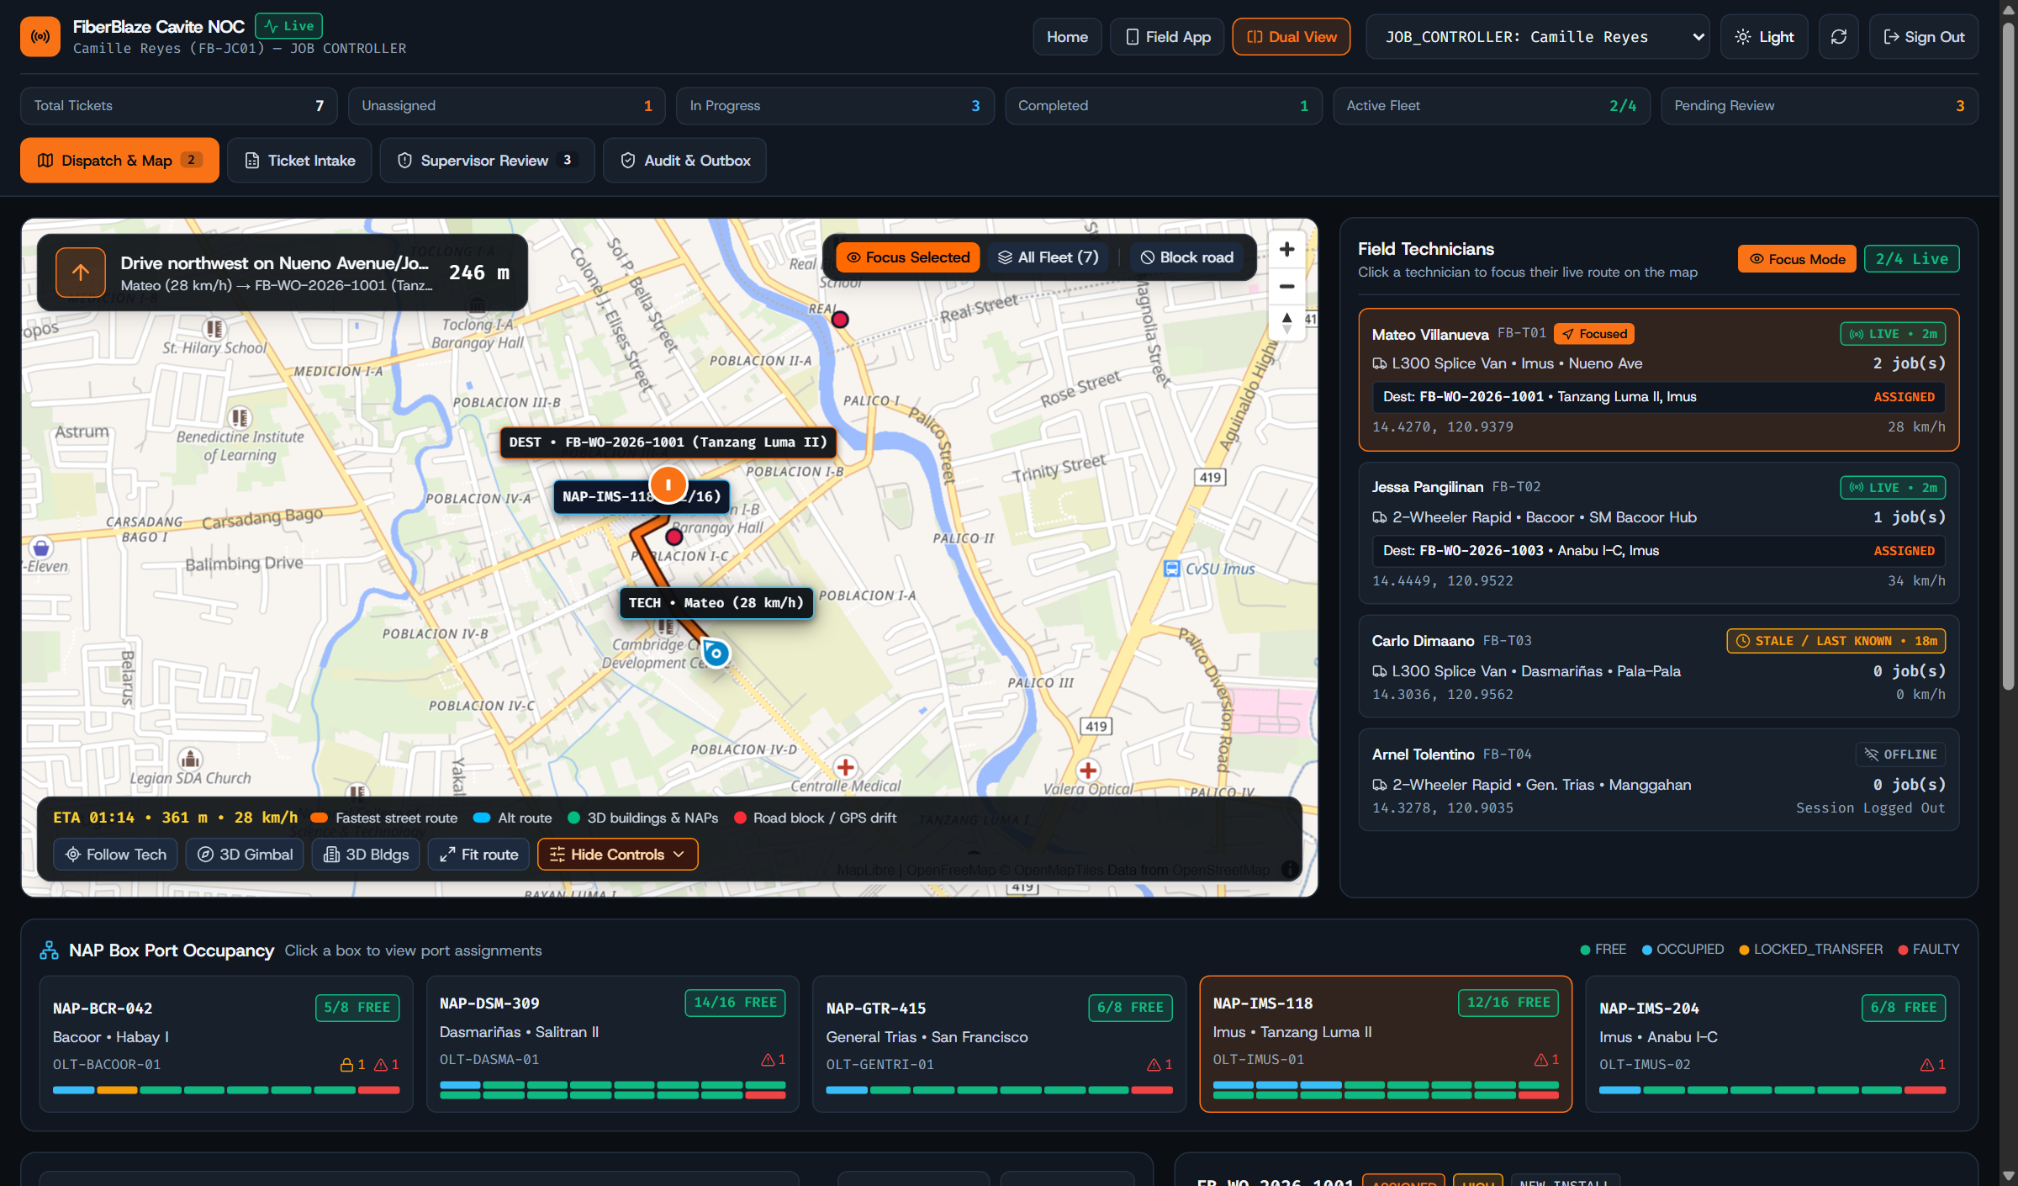
Office Dispatch (/ops)
FiberBlaze Cavite | 03 / 08
See Where Every Tech Is and Where They Are Going
Focus on one job at a time to watch the tech's live street route, speed, and fiber box ports.
Map Focus Mode
Click any ticket or tech to hide map clutter and see only that tech, their speed, the customer house pin, and their live road route.
Clear Port Colors on Every Box
See right away which ports are free, used, broken, or saved for a house move on every 8-port and 16-port box in Cavite.
Real Road Travel Time
Picks the best tech based on actual street driving time and how many jobs they already have, not a straight line on the map.
Focus Mode on the office map: shows only the selected job, the assigned tech's live route, and the fiber box

Slide 4
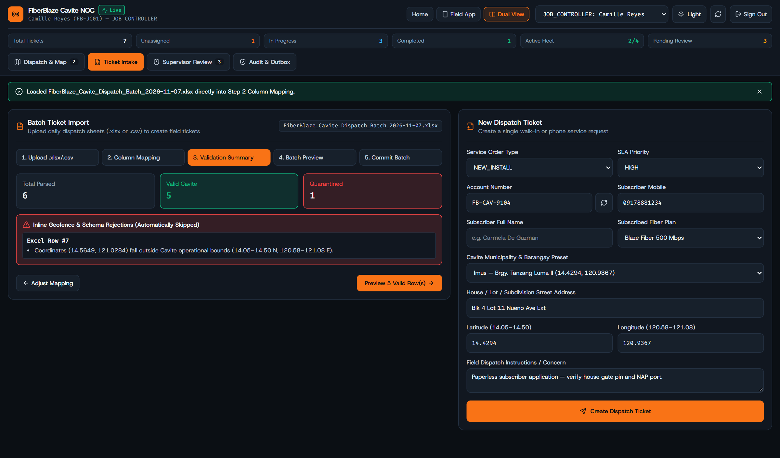
Adding Job Tickets
FiberBlaze Cavite | 04 / 08
Turn Daily Excel Sheets Into Clean Job Tickets
Dispatchers keep using their normal Excel files while the system catches bad map pins right away.
Drop In Your Daily Excel File
Reads standard .xlsx and .csv files in seconds and fills in the customer name, barangay, job type, and urgency.
Stops Wrong Map Coordinates
Catches rows with map pins outside Cavite before they ever get sent to a field tech, so crews never drive to a bad pin.
Quick Form for Walk-In & Phone Calls
Includes a simple 1-minute form with ready-made Cavite barangay pins for urgent repair calls or walk-in customers.
Excel upload screen: matches spreadsheet columns automatically and flags pins outside Cavite

Slide 5
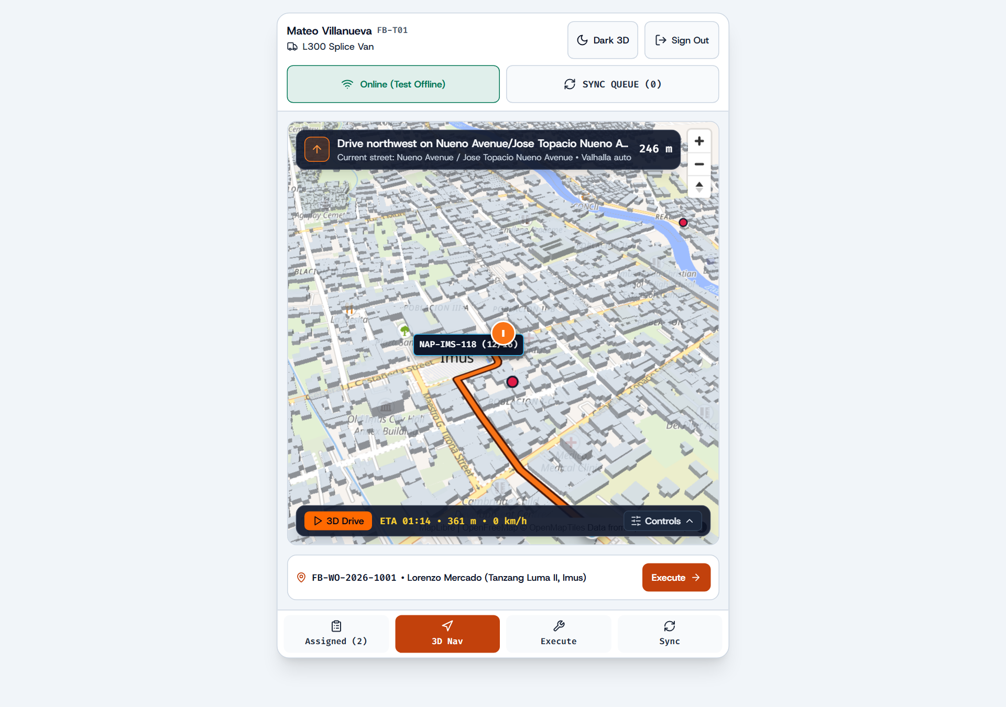
Field Tech App (/tech)
FiberBlaze Cavite | 05 / 08
Clear 3D Street Directions & 1-Tap Road Detours
Helps riders and van crews find the right house gate fast and go around blocked roads.
Easy-to-Spot 3D Buildings
Shows 3D building shapes so techs can quickly spot corner houses, landmarks, and subdivision gates in busy areas.
1-Tap Detour When a Road Is Blocked
If a street is closed for roadwork or flooding, the tech taps the map once and gets a new route right away.
Fast & Smooth on Any Phone
Built to run smoothly without freezing the screen or draining the battery, even on older budget Android phones.
Field tech 3D map: shows 3D houses and buildings, next turn distance, and road-block detours

Slide 6
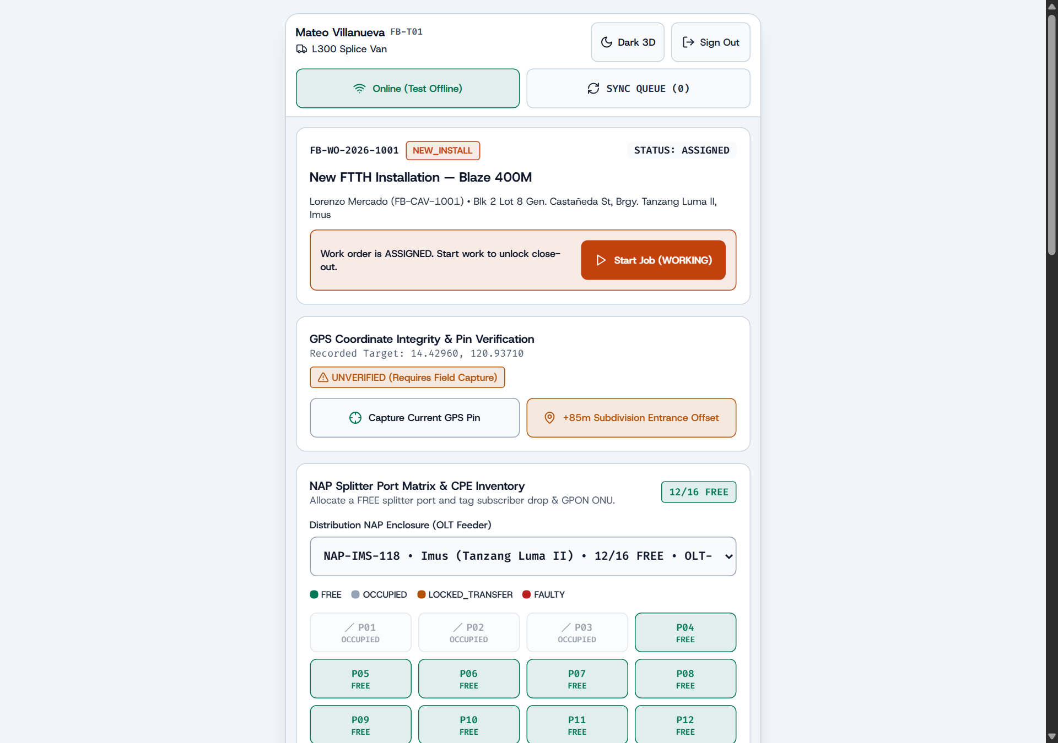
Finishing the Job
FiberBlaze Cavite | 06 / 08
Fiber Signal Checks, Port Locks & Offline Saving
Makes sure the internet line is strong before the tech leaves and saves everything if signal drops.
Automatic Fiber Light Check
Good signal (-8 to -25 dBm) closes the job. Weak signal (-25.1 to -27.9 dBm) asks a supervisor to check. Bad signal blocks close-out.
Protects Customer Port During a Move
When a customer moves to a new house, their old fiber port stays locked until the new line passes its signal test.
Works Without Mobile Data
If mobile signal drops, the phone saves the photos, readings, and signature, then sends them once when signal comes back.
Job finish screen: checks fiber light level, shows port buttons, and stamps the photo and signature

Slide 7
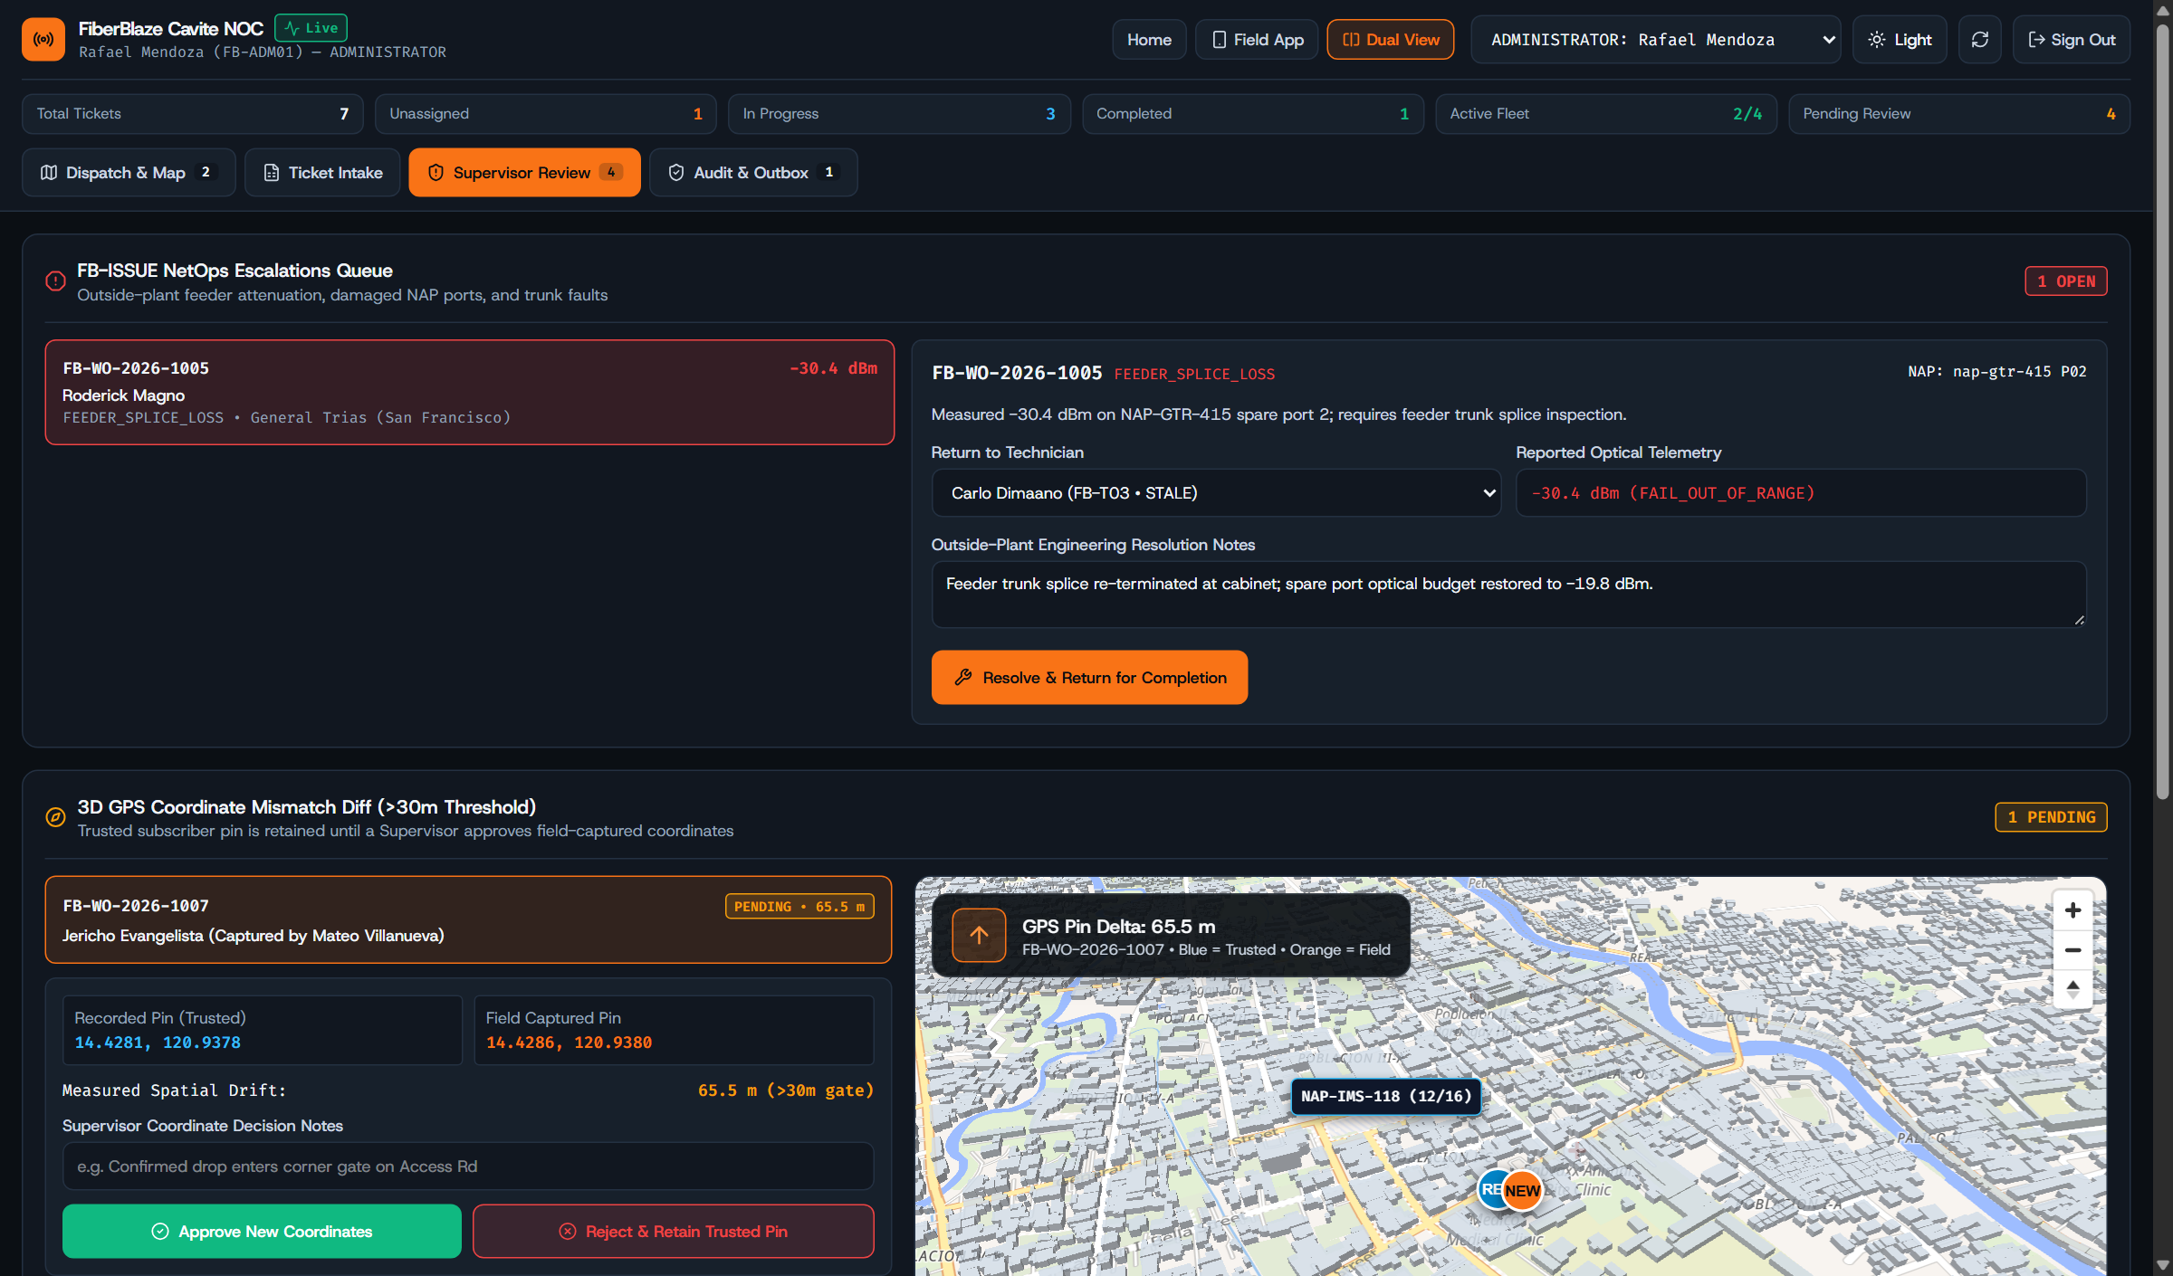
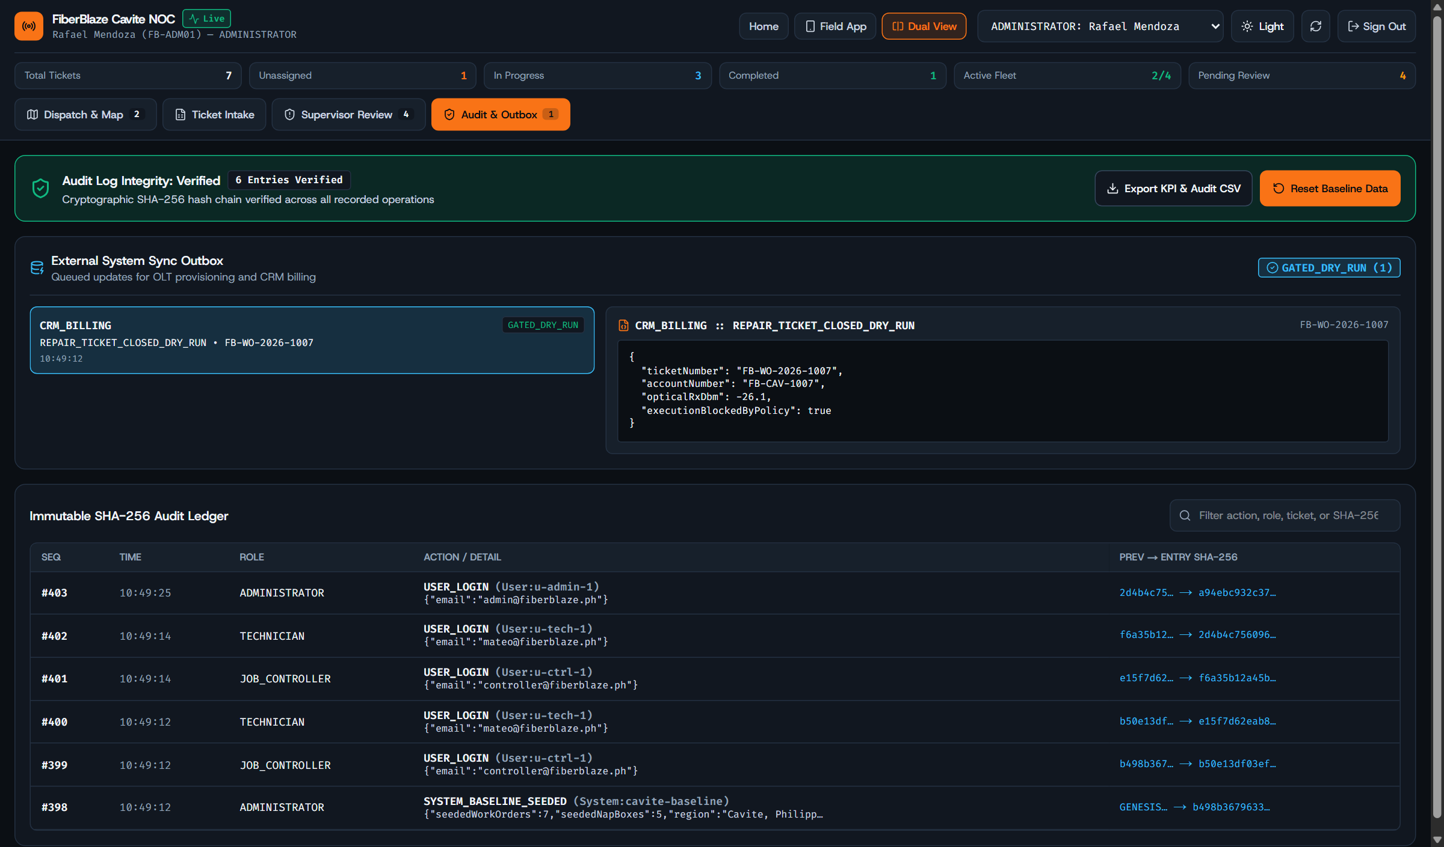
Supervisor Checks
FiberBlaze Cavite | 07 / 08
Supervisor Review & Complete Change History
Supervisors check moved house pins and outside line repairs before anything goes to billing.
Supervisor screen: shows the old pin vs. new pin when a tech marks a house more than 30 meters away
History & Safe Queue: records who changed what and holds billing updates in safe test mode

Slide 8
Results & Rollout Plan
FiberBlaze Cavite | 08 / 08
What We Gain & How We Roll It Out in 12 Weeks
Start safely alongside our current Excel sheets in Imus and Bacoor, then expand across Cavite.
Fixed on First Visit
94%
Up from 76% by checking fiber light levels on site
Average Repair Time
1.3 hrs
Down from 2.4 hrs by sending the closest tech by road
Morning Dispatch Time
< 2 min
Down from 42 min of copying Excel rows and calling techs
Cut-Off Move Customers
0
Old port is kept safe until the new house line works
Weeks 1–4 | Step 1: Safe Trial in Imus & Bacoor
Upload daily Excel sheets into the system while keeping paper job slips as a backup for field crews.
Weeks 5–8 | Step 2: Expand to Dasmariñas & General Trias
Turn on required fiber meter photos, customer phone signatures, and supervisor checks for moved pins.
Weeks 9–12 | Step 3: Full Cavite Launch
Retire paper slips and connect the approved job queue directly to customer billing and network equipment.

