Slide 1
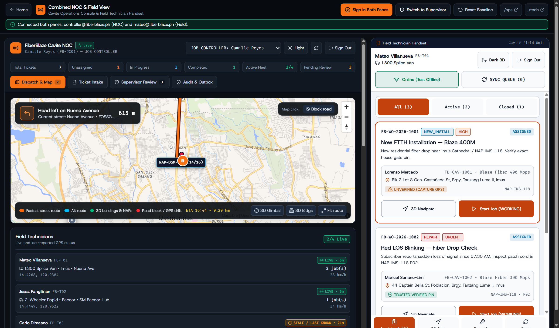
Cavite Field Service & Dispatch Proposal
FiberBlaze Cavite | 01 / 08
FiberBlaze Cavite
Field Operations & Dispatch System
Connecting the Cavite Network Operations Center and field technicians in one live loop: batch spreadsheet intake, street-accurate ETA routing, NAP port protection, and offline field close-out.
Pilot Scope & Operational Readiness
• Coverage: Bacoor, Imus, Dasmariñas, General Trias, and Silang
• Workspaces: NOC Dispatch Console (/ops) + Field Mobile App (/tech)
• Safety Gate: External CRM and OLT updates held in dry-run queue during pilot
• Verification: 40 unit tests and 10 end-to-end workflow checks passing
Live Dual View (/demo): NOC Dispatch Console (left) synced with Field Handset (right)

Slide 2
Operational Problem
FiberBlaze Cavite | 02 / 08
What Slows Down Cavite Field Operations Today
Four day-to-day bottlenecks between dispatchers, outside-plant engineers, and field crews.
Manual Spreadsheet Dispatch
42 min average delay per batch
Daily customer orders arrive in raw Excel sheets. Job controllers copy rows by hand and call technicians on the phone to guess who is closest.
Dense Subdivision & Alley Routing
28% late arrivals in inner barangays
Straight-line distance ignores river crossings, gated subdivisions, and roadworks along Aguinaldo Highway, Nueno Ave, and Molino Blvd.
Unverified Optical Readings & Port Conflicts
Repeat truck rolls on weak drops
Paper job orders allow completion without checking if GPON signal is below -27.9 dBm or if a customer transfer accidentally releases an active port early.
Dead-Zone Signal Drops Inside Subdivisions
Lost close-out photos and duplicate posts
When mobile data drops inside dense concrete subdivisions, technicians lose captured photos or submit duplicate updates when signal returns.

Slide 3
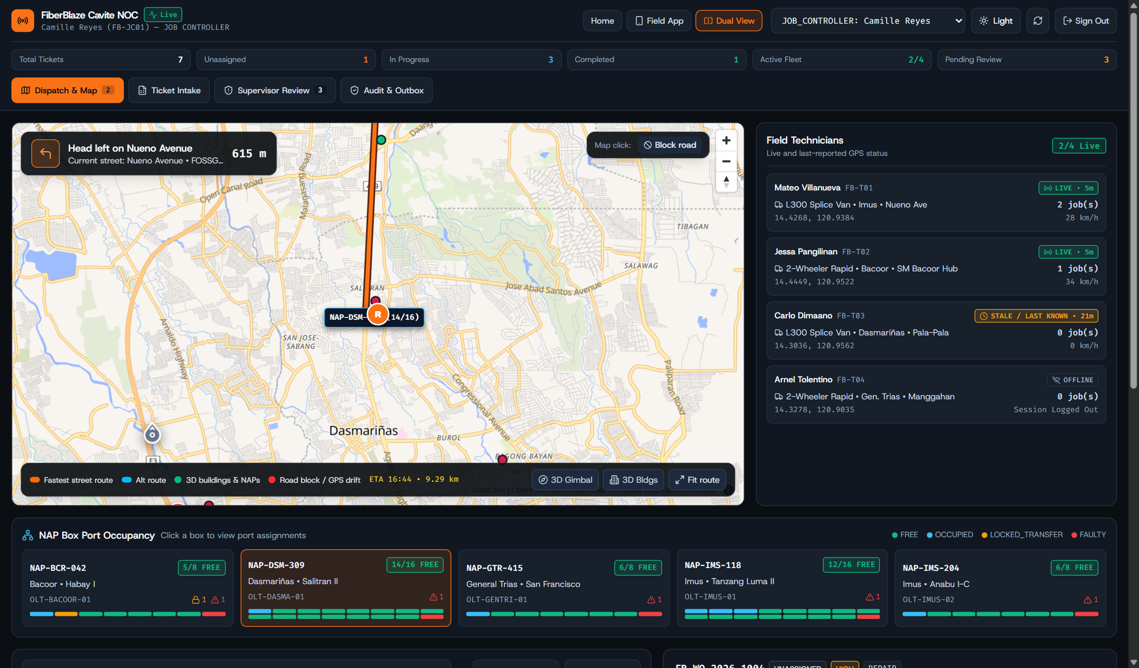
Operations Console (/ops)
FiberBlaze Cavite | 03 / 08
NOC Fleet Dispatch & NAP Port Occupancy
One screen for live technician GPS status, NAP splitter port inventory, and street-ETA dispatch.
Honest GPS Status
Distinguishes live GPS fixes from last-known stale locations and immediately halts tracking when a technician signs out.
8/16-Port NAP Box Inventory
Shows free, occupied, faulty, and transfer-locked ports across Bacoor, Imus, Dasmariñas, and General Trias.
Street-ETA Technician Ranking
Recommends technicians by actual road driving time and active workload instead of straight-line radius.
NOC Dispatch & Map tab: Cavite street route, technician GPS status, and 8/16-port NAP occupancy

Slide 4
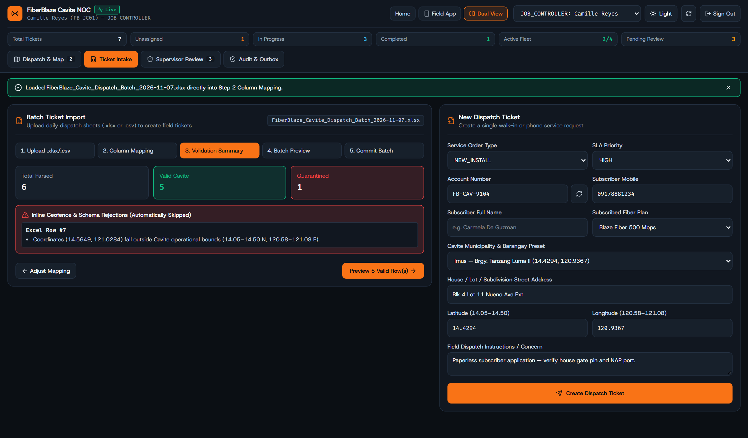
Ticket Intake
FiberBlaze Cavite | 04 / 08
Moving From Raw Spreadsheets to Validated Field Tickets
Job controllers keep their existing Excel sheets while the wizard catches bad coordinates before dispatch.
Direct .xlsx and .csv Upload
Reads daily dispatch workbooks directly in the browser and maps columns to subscriber, barangay, workflow, and SLA priority.
Cavite Boundary Quarantine
Flags rows with coordinates outside Cavite (14.05–14.50 N, 120.58–121.08 E) so bad pins never reach field crews.
Walk-In & Phone Ticket Form
Includes a single-ticket intake form with Cavite barangay presets for urgent repairs or walk-in applications.
Batch Ticket Import Wizard: automatic column mapping and Cavite boundary check

Slide 5
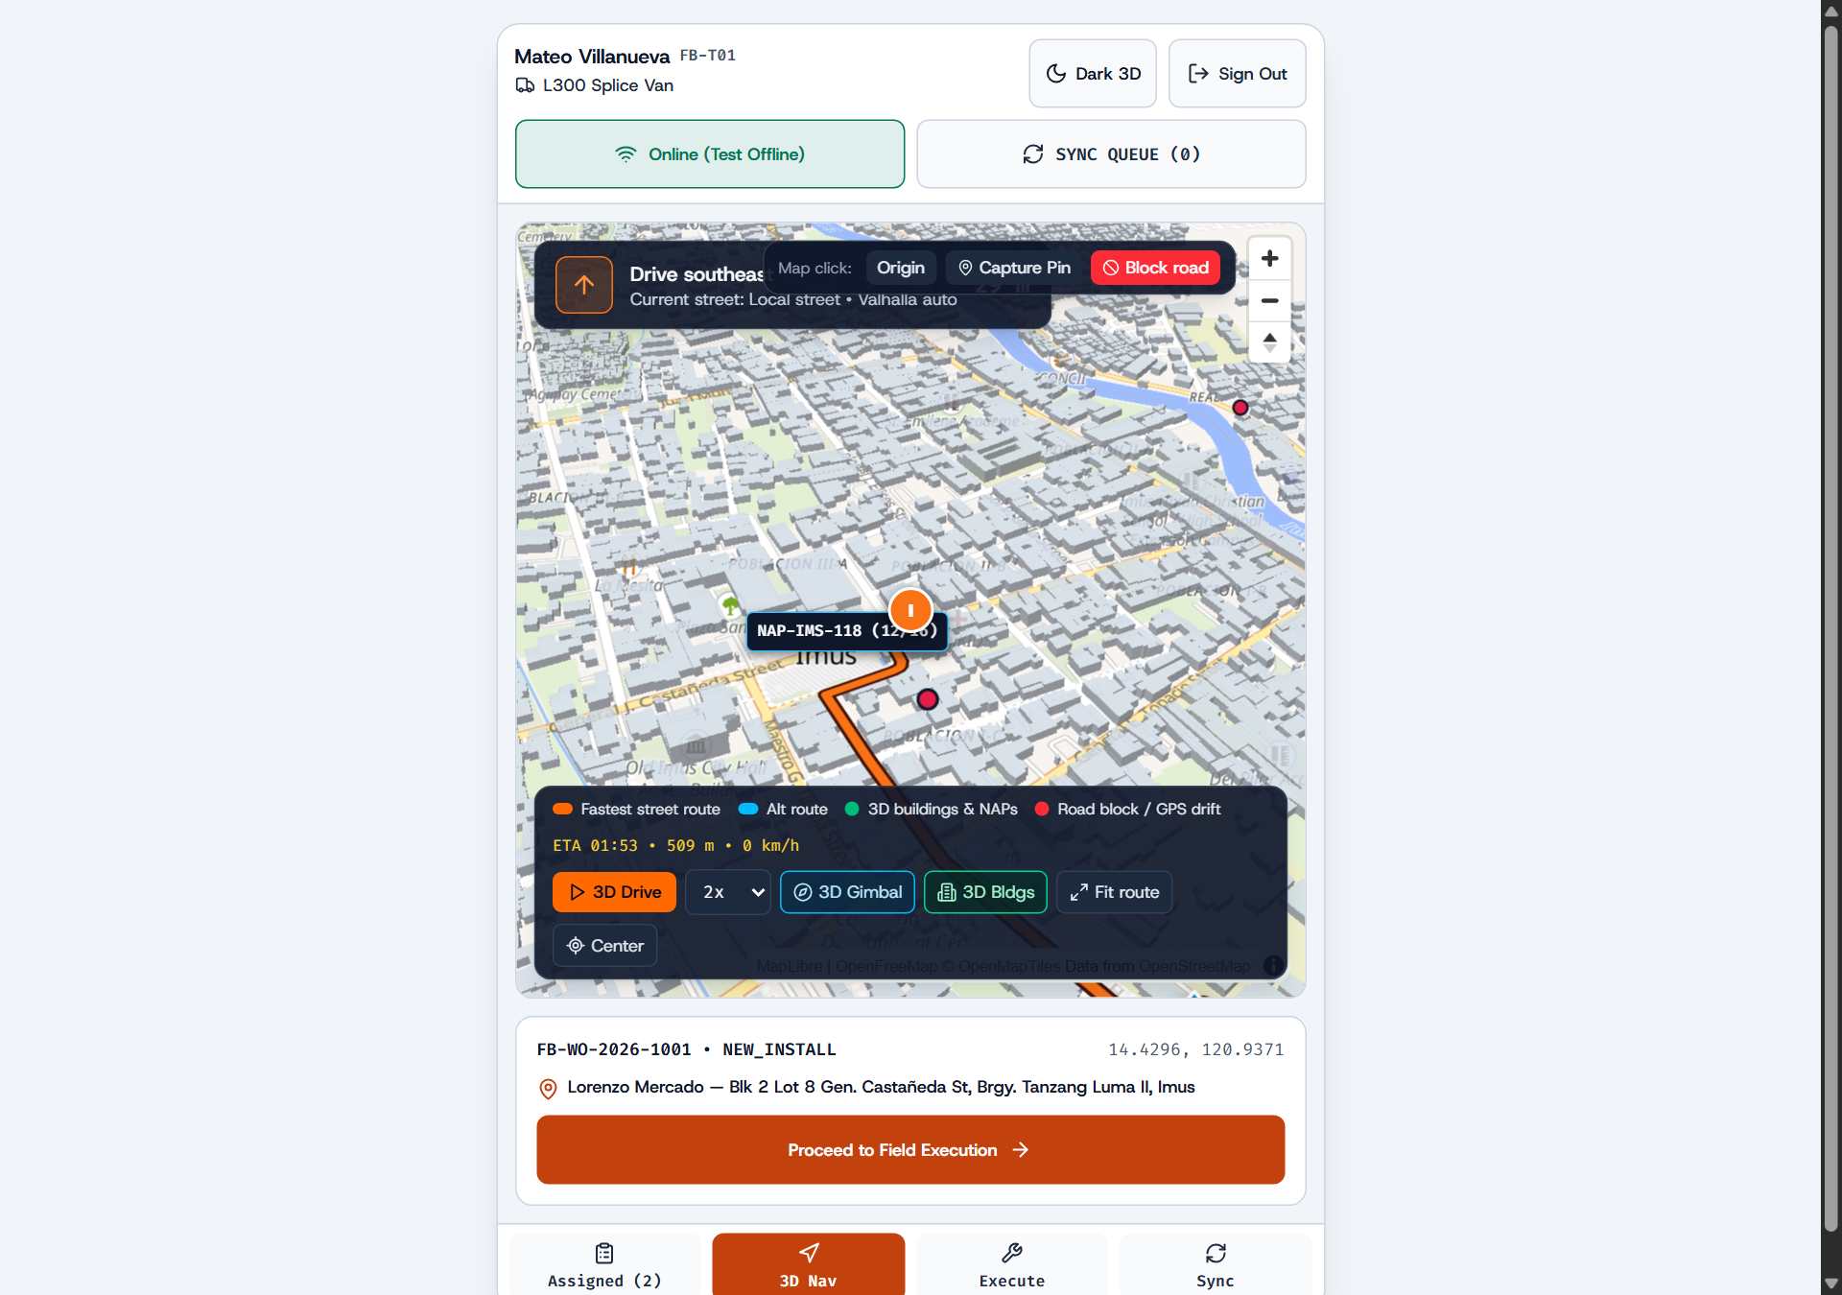
Field Mobility (/tech)
FiberBlaze Cavite | 05 / 08
Turn-by-Turn 3D Cavite Navigation & Live Detours
Built on the proven RiderNav 3D street engine with extruded buildings and instant obstacle rerouting.
3D Building Landmarks
Extruded building footprints help technicians spot corner lots and subdivision gates in dense areas like Imus and Bacoor.
One-Tap Road-Block Rerouting
When a barangay road is blocked by construction or flooding, tapping the map calculates a street detour immediately.
Smooth on Low-End Handsets
Throttled camera tracking and pooled map markers keep rendering smooth without draining battery or freezing the browser.
Technician 3D Navigation tab: extruded Cavite buildings, turn HUD, and road-block rerouting

Slide 6
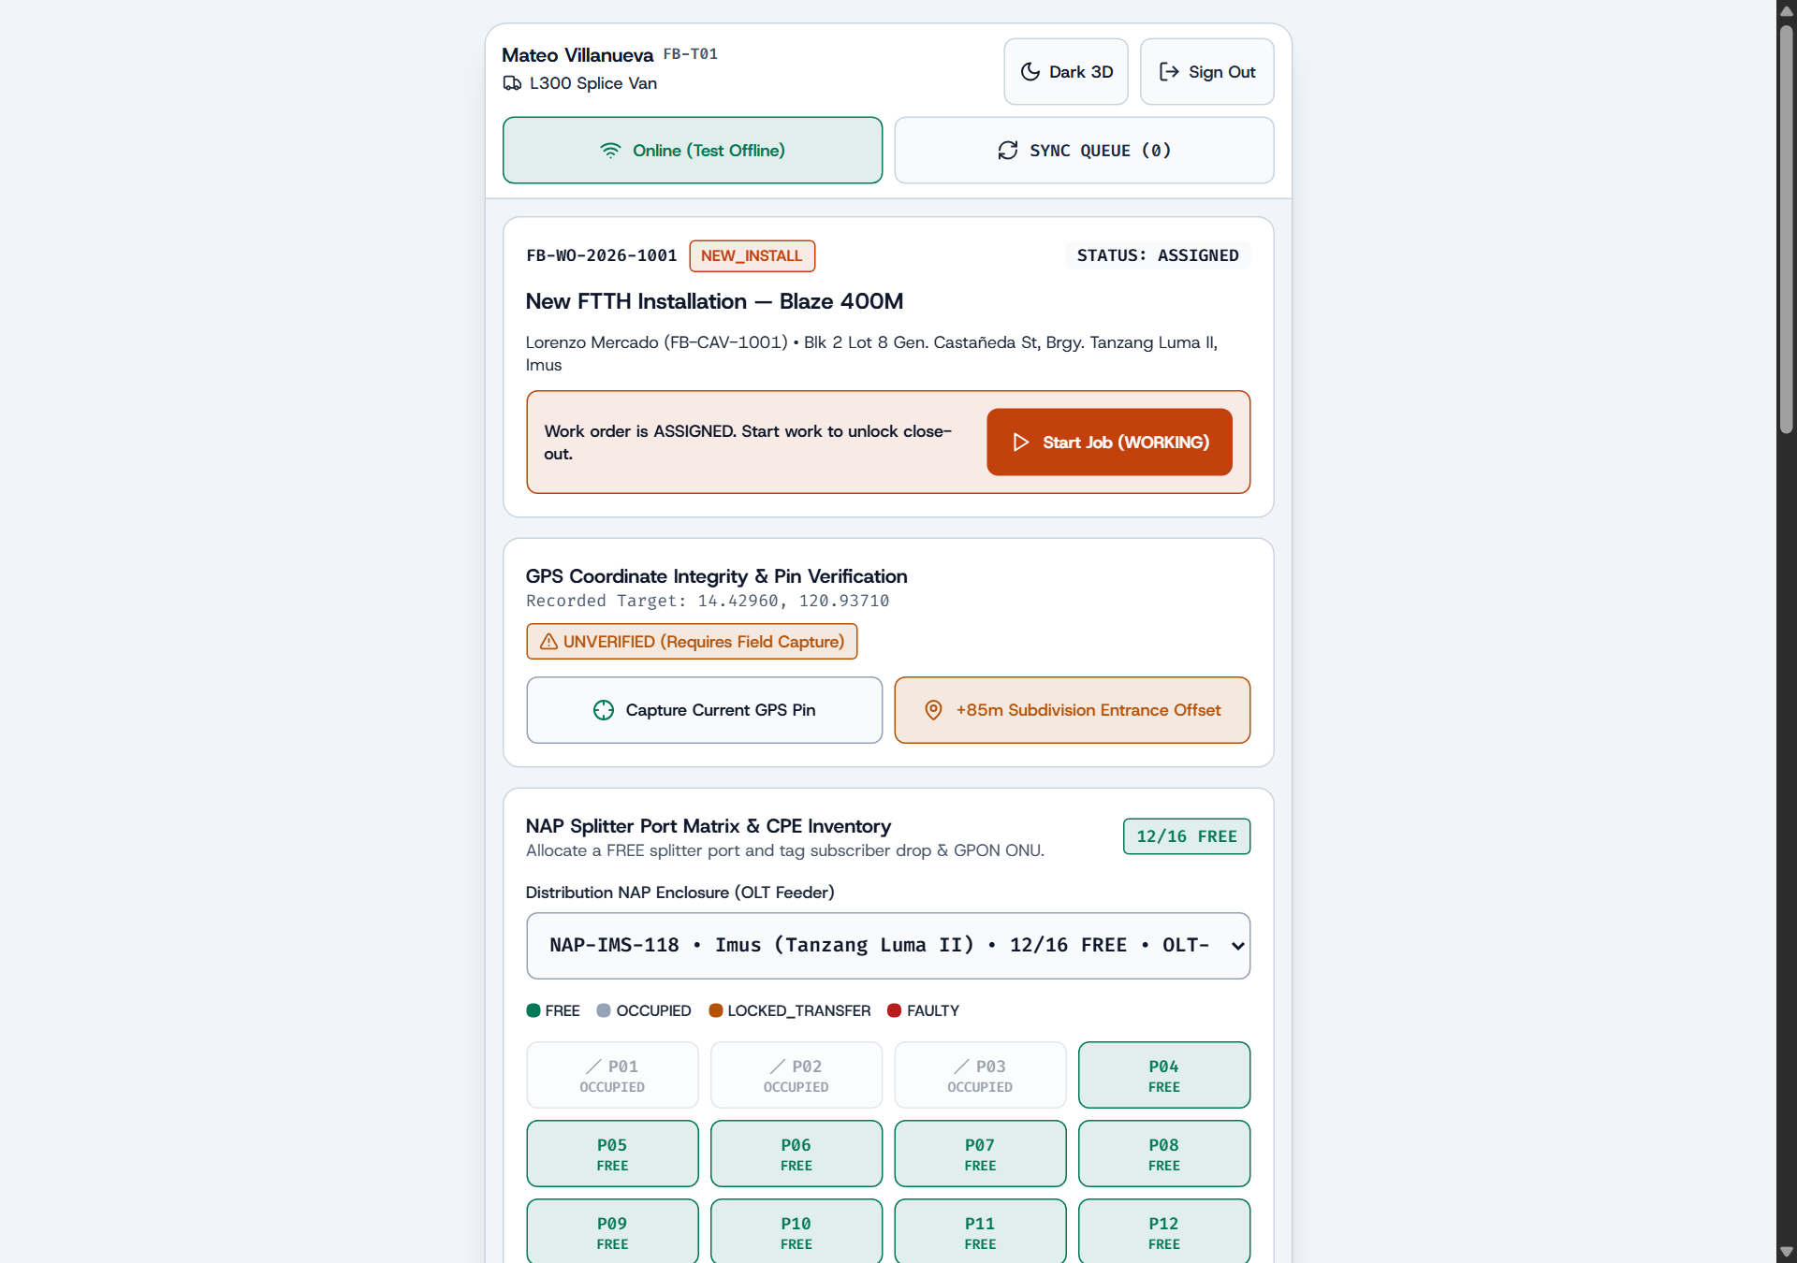
Field Execution & Offline Sync
FiberBlaze Cavite | 06 / 08
Optical Signal Guardrails & Transfer Port Protection
Enforces GPON signal thresholds on site and preserves every action when mobile signal drops.
GPON Optical Power Checks
Pass (-8 to -25 dBm) completes normally; marginal (-25.1 to -27.9 dBm) flags supervisor review; fail (<-27.9 dBm) blocks completion.
Transfer Old-Port Lock
For customer relocations, the old NAP port stays locked until the new site passes optical testing—preventing stranded subscribers.
Offline Queue with Replay Protection
Stores field close-outs in IndexedDB during dead zones and syncs with unique IDs so reconnections never create duplicate records.
Technician Execute tab: GPS pin verification, NAP port selector, and dBm power guardrails

Slide 7
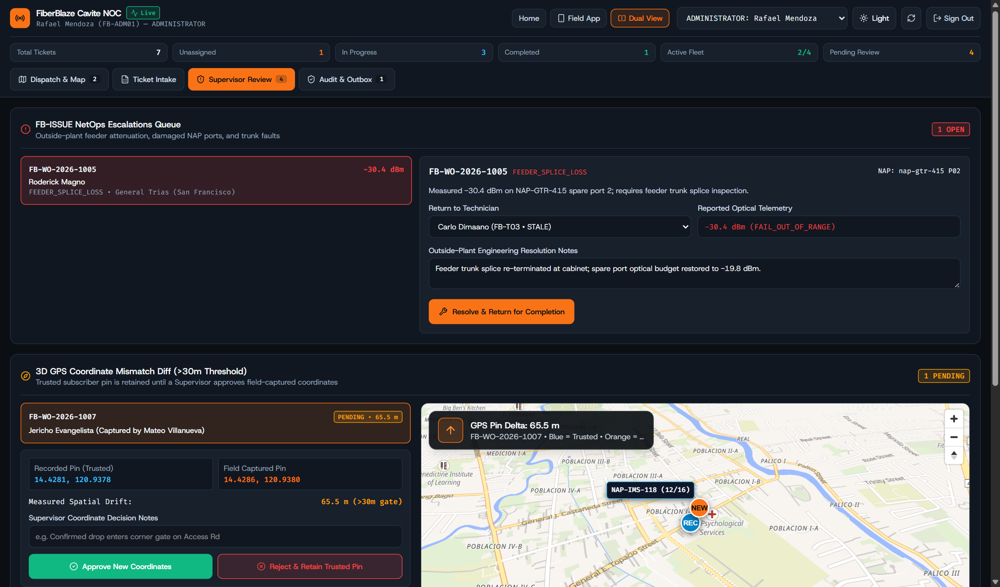
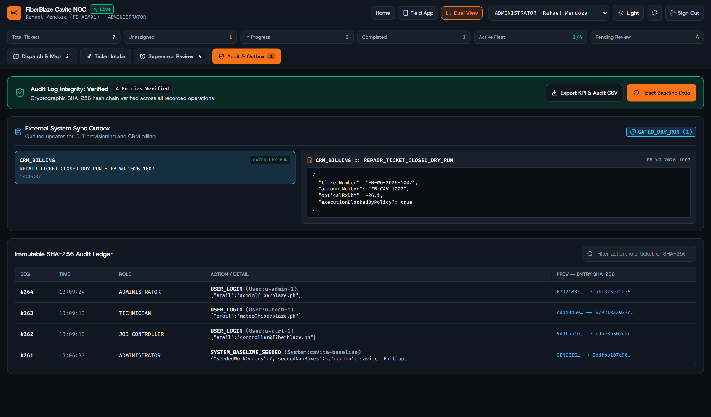
Supervision & Audit
FiberBlaze Cavite | 07 / 08
Supervisor Review, 3D GPS Diff & Signed Audit Ledger
Supervisors verify >30m location offsets and outside-plant faults before records reach billing.
Supervisor Review: FB-ISSUE resolution and >30m 3D GPS coordinate comparison
Audit & Outbox: Tamper-evident SHA-256 operation log and dry-run OLT/CRM outbox

Slide 8
Rollout & Impact
FiberBlaze Cavite | 08 / 08
Expected Operational Gains & 12-Week Cavite Rollout
Phased adoption starting with parallel spreadsheet intake before full paperless cutover.
First-Time-Fix Rate
94%
Up from 76% baseline via on-site dBm checks
Mean Time to Repair
1.3 hrs
Down from 2.4 hrs with street-ETA dispatch
Batch Dispatch Prep
< 2 min
Down from 42 min of manual spreadsheet calls
Stranded Transfers
0
Old NAP port held until new drop passes
Phase 1: Weeks 1–4 | Parallel Beta in Imus & Bacoor
Import daily Excel sheets into the wizard while allowing signed hard-copy fallback for field crews.
Phase 2: Weeks 5–8 | Dasmariñas & General Trias Expansion
Enforce mandatory camera optical proof, digital subscriber signatures, and supervisor >30m pin review.
Phase 3: Weeks 9–12 | Full Cavite Cutover & Live OLT/CRM Link
Switch the external integration outbox from dry-run mode to live CRM billing and OLT port provisioning.

