Slide 1
EAGLESLIST
PRESENTED BY: 5BIT STUDIOS
Notes:
John

Slide 2
GROUP MEMBERS & ROLES
Andrew Owen - Head Manager (Oversees project development, team lead for web service)
Michael MacCallum - Co-Manager (Track meetings and keeps website up to date, GUI team lead)
Mostofa Ansary - Front-end programmer (Implement part of GUI, tester)
Hermilo Calderon - Front-end programmer (Implement part of GUI, testing manager)
John Zachariah - Back-end programmer (Implement parts of web service, responsible for idea)
Notes:
John

Slide 3
OVERVIEW OF PROJECT
Eagleslist is a textbook focused trading program that allows FGCU students to:
Create accounts
Verify user’s email addresses
Post or search used textbooks and other goods that they’re looking to buy or sell
Comments & reviews of course books to rate them by necessity
All transactions will be determined by the students
Professors will be able to:
Verify their faculty email addresses
Provide the ISBNs for class books
We plan on adding special features for textbooks:
Search for books by CRN, or ISBN.
We will not be handling money.
Notes:
Burrito aka Hermilo

Slide 4
FUNCTIONALITY DESCRIPTION
Home
Account
(change password, edit bio)
Search
(books, courses, faculty)
Course
(managed by faculty, viewed by students)
Individual Listing
(post, reply to, edit)
Contact Us
(bug fixes, feedback)
Notes:
Burrito aka Hermilo

Slide 5
SCHEDULE/PLAN
Artifact | Due Dates
Meeting Minutes | Every Thursday at Holmes Hall Room 403/ Student Lounge at 2:30 - 6:30 PM
Project Plan (document) | September 21, 2015
SRS (document) | September 30, 2015
Prototype | October 25, 2015
Design | October 22, 2015
Test Results | November 15, 2015
User’s Manual (document) | November 30, 2015
Source, Executable, Build Instructions | November 30, 2015
Presentation 1 | October 29, 2015
Presentation 2 | December 10, 2015
Notes:
Burrito aka Hermilo

Slide 6
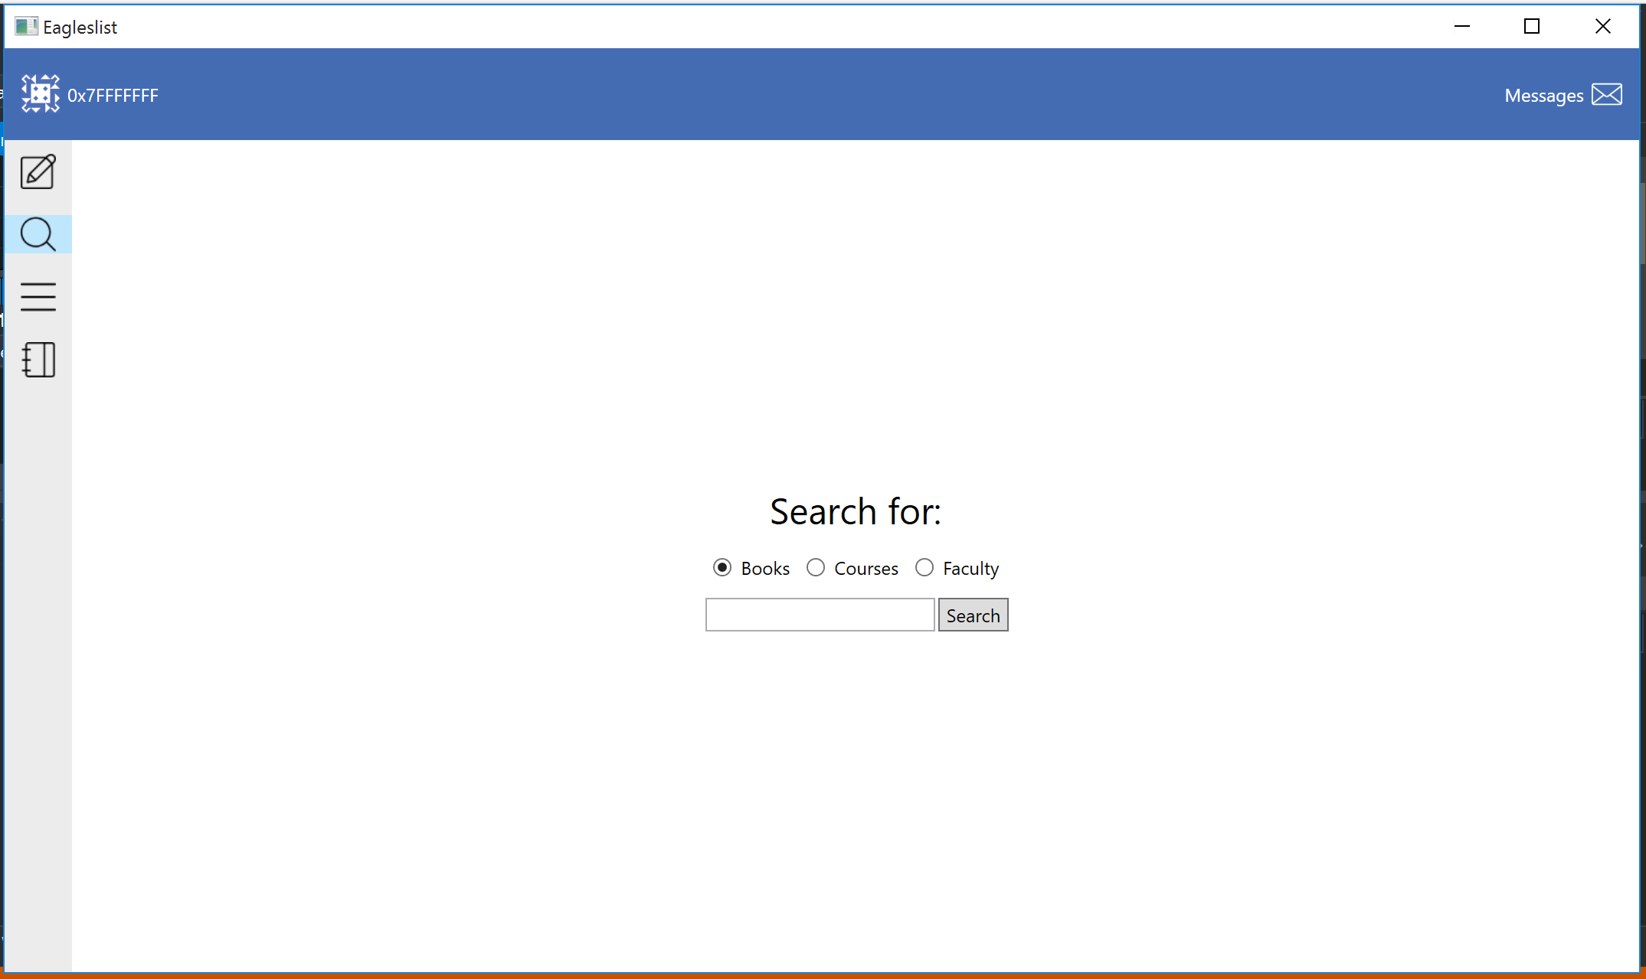
SCREEN IMAGES OF OUR PRODUCT
Notes:
Mick

Slide 7
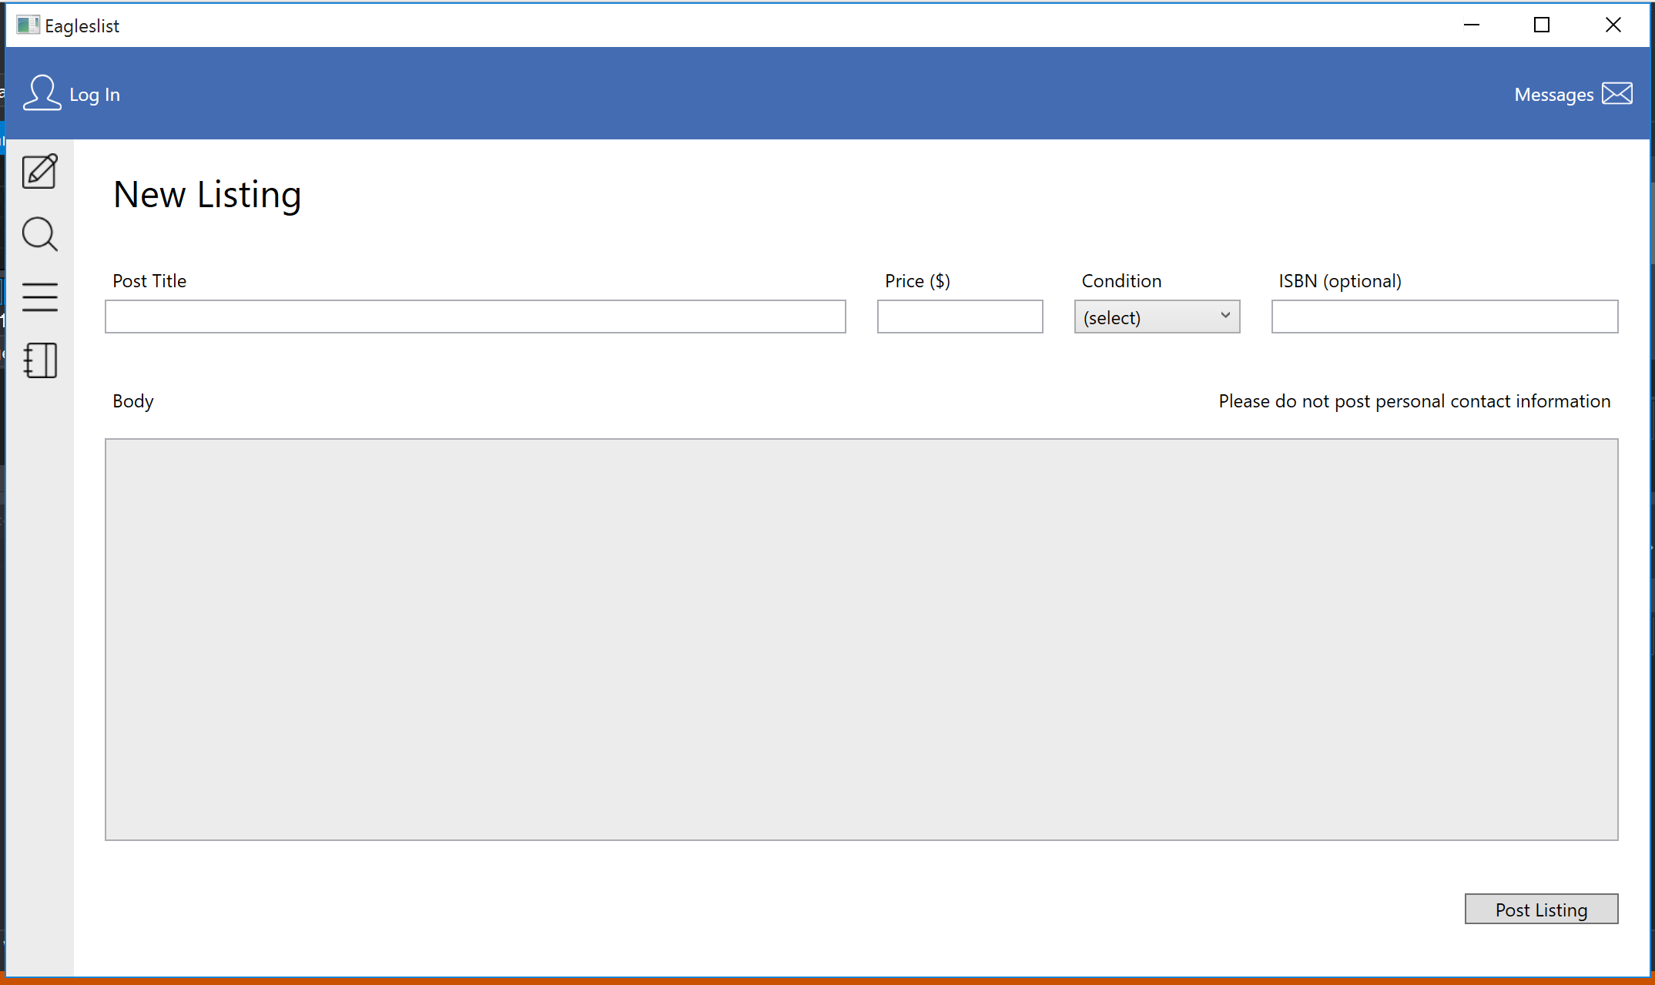
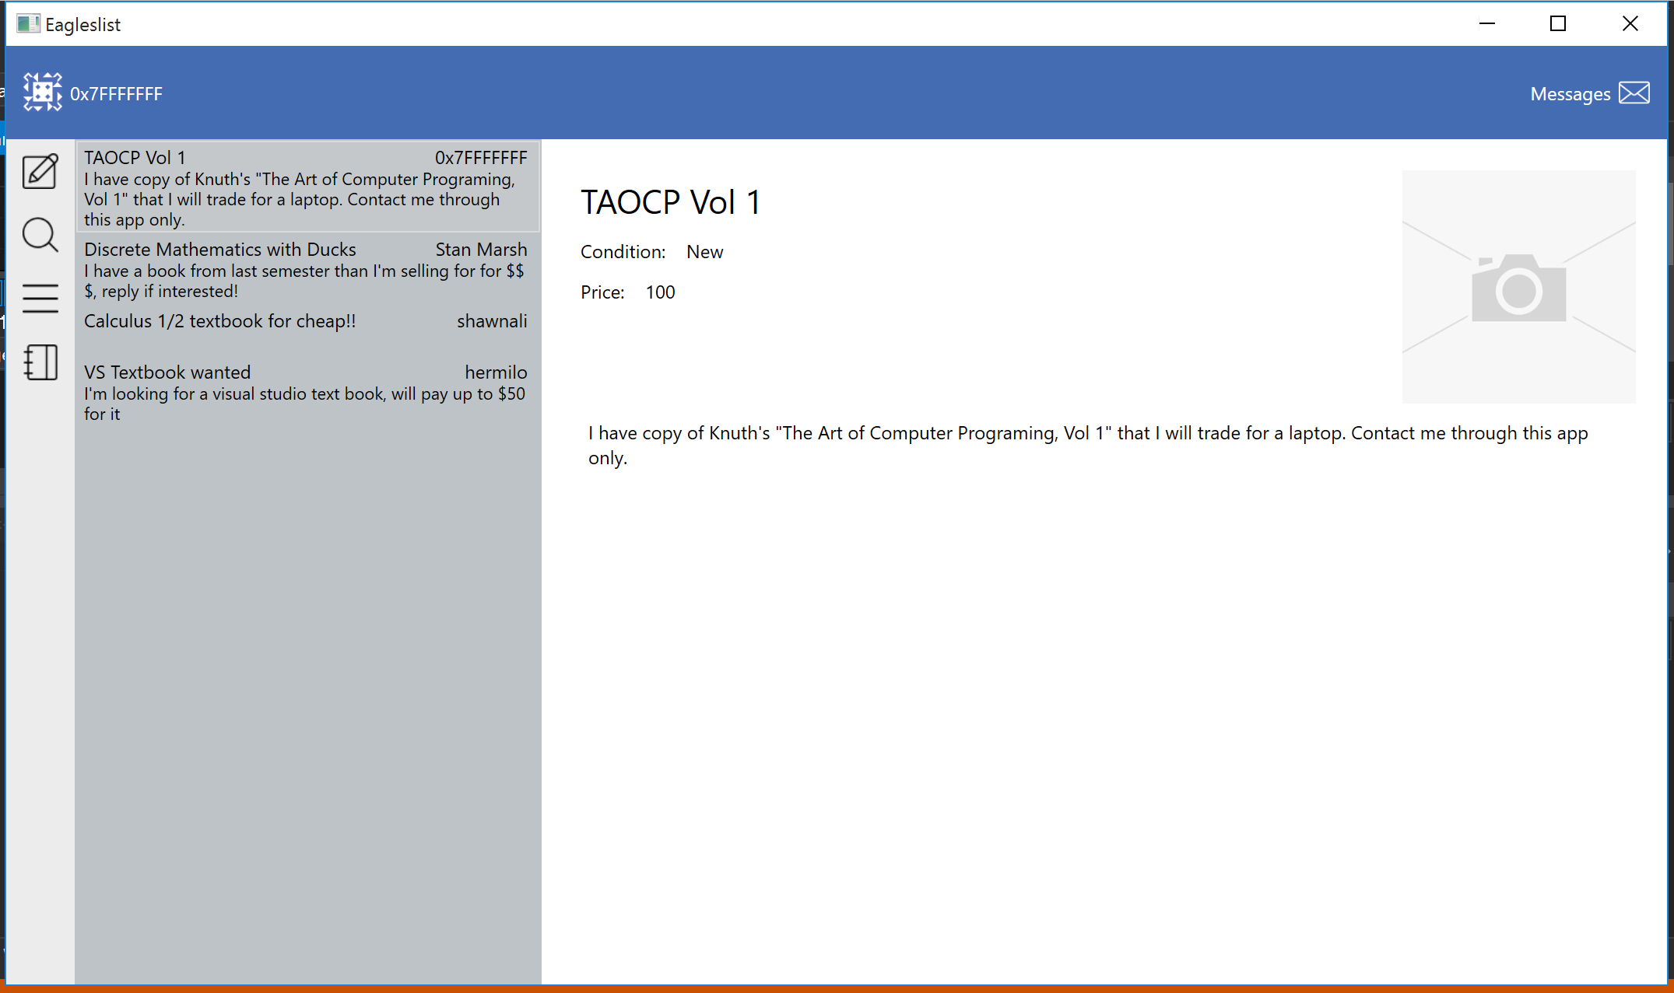
SCREEN IMAGES OF OUR PRODUCT CONT.
Notes:
Mick

Slide 8
VIDEO DEMO OF OUR PRODUCT
https://www.youtube.com/watch?v=Ua1r8aApYrE&feature=youtu.be
Notes:
Mick

Slide 9
OVERVIEW OF THE DESIGN
Frontend
Our program is a C#/WPF desktop application that has the following layout:
An account status bar at the top showing login information and a new message count
Tabs to represent each view that a user can have into this system
Individual listings
Courses
Account management
We chose WPF and C# so we could work outside of Java and learn something new
This means that our client is Windows only
Notes:
Andrew

Slide 10
OVERVIEW OF THE DESIGN CONT.
Backend
Webservice written in Go
Talks to a PostgreSQL database
Hosted on Digital Ocean
Verification emails will be sent via postfix
Other than postfix, this stack can be port from windows to linux
Notes:
Andrew

Slide 11
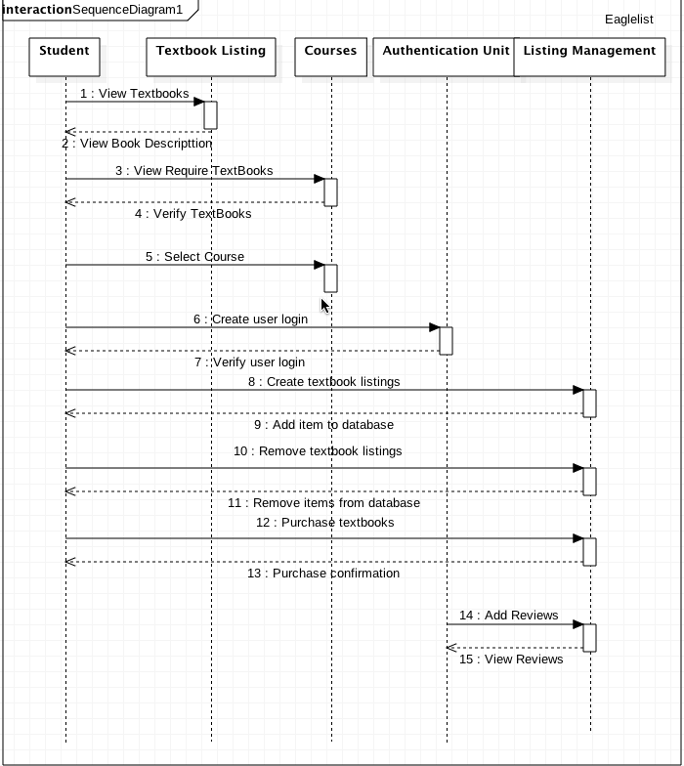
SEQUENCE DIAGRAM
Notes:
Mostafa

Slide 12
NEXT TASK STEPS
We are currently working on implementing:
Account creation functionality, as well as email verification
Advanced search options
More refined filters
Match textbooks with courses
The ability to assign accounts as moderators, with unique administrative powers
A messaging system to keep track of replies to personal listings
Notes:
Mostafa

Slide 13
THE END
If you have any questions, feel free to ask. We would love to hear your comments or concerns.
Thank you!
Notes:
Mostafa

