Slide 1
EAGLESLIST
PRESENTED BY: 5BIT STUDIOS
https://5-bit.github.io

Slide 2
OVERVIEW OF PROJECT
Eagleslist is a textbook focused trading program
FGCU students are able to:
Create accounts
Verify user’s email addresses
Post or search used textbooks and other goods that they’re looking to buy or sell
Comments & reviews of textbooks to rate them by necessity
All transactions will be determined by the students
Professors are able to:
Verify their faculty email addresses
Provide the ISBNs for class books

Slide 3
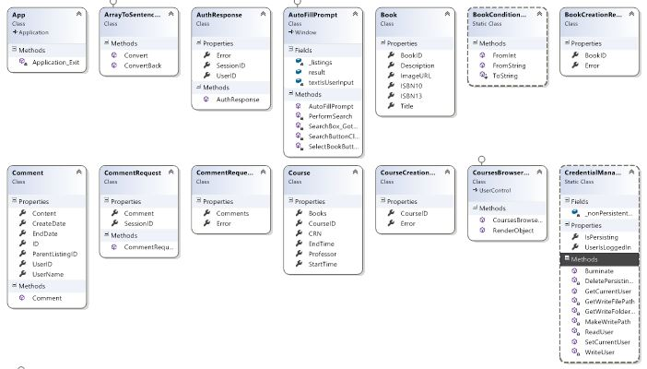
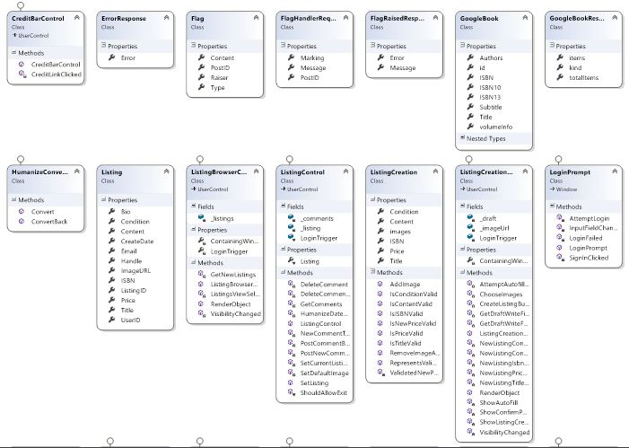
CLASS DIAGRAM

Slide 4
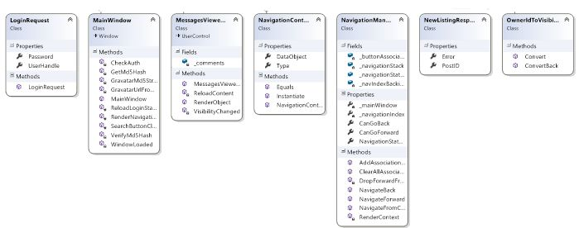
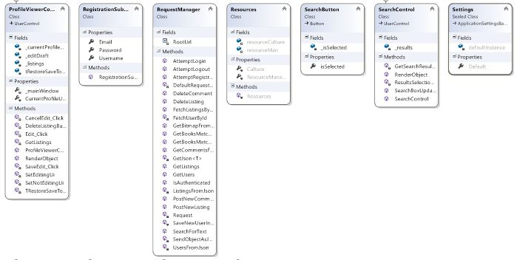
CLASS DIAGRAM

Slide 5
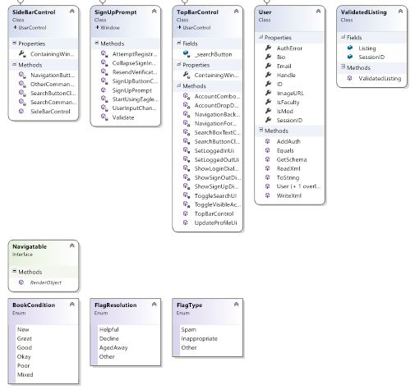
CLASS DIAGRAM

Slide 6
GROUP MEMBERS & ROLES
Andrew Owen - Head Manager (Oversees project development, team lead for web service)
Michael MacCallum - Co-Manager (Track meetings and keeps website up to date, GUI team lead)
Mostofa Ansary - Front-end programmer (Implement part of GUI, tester)
Hermilo Calderon - Front-end programmer (Implement part of GUI, testing manager)
John Zachariah - Back-end programmer (Implement parts of web service, responsible for idea)
Notes:
Andrew and Mick did everything and we did the paperwork. No pain no gain. Go Eagles.

Slide 7
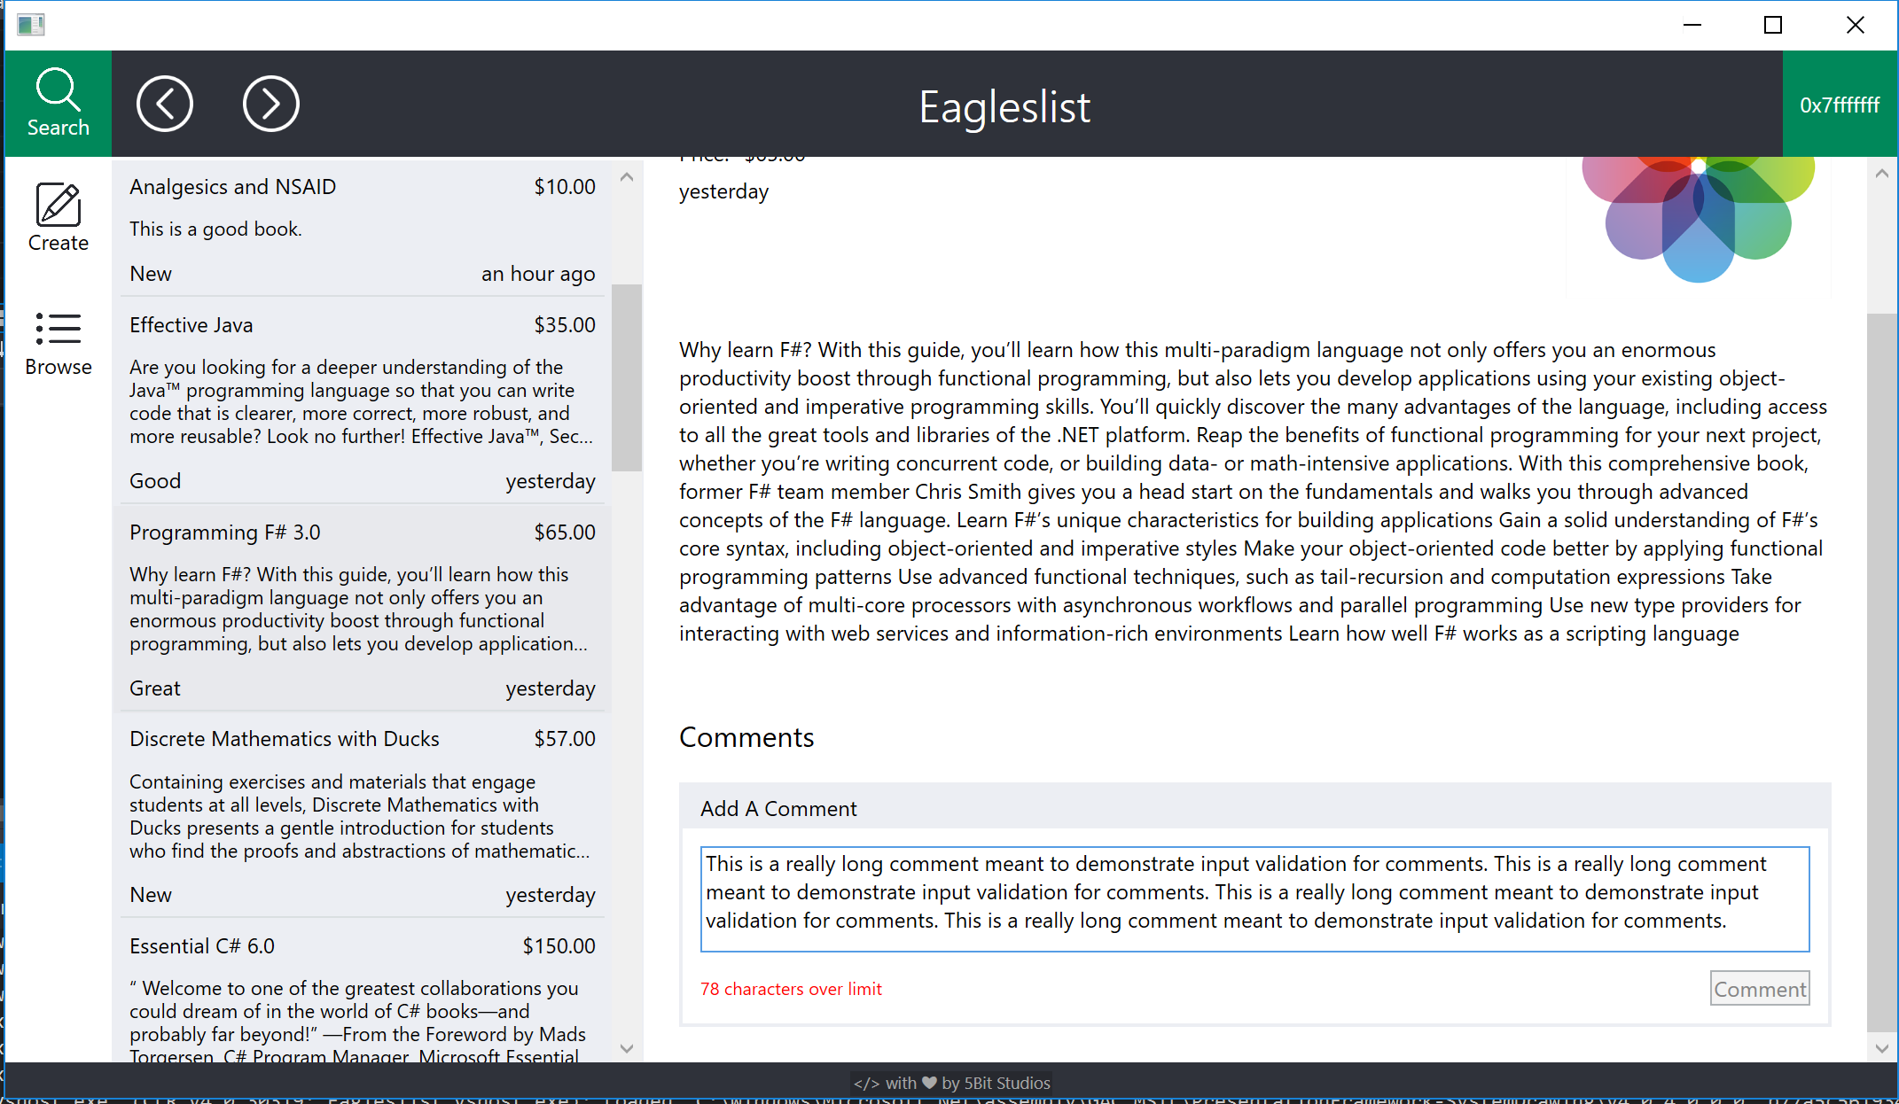
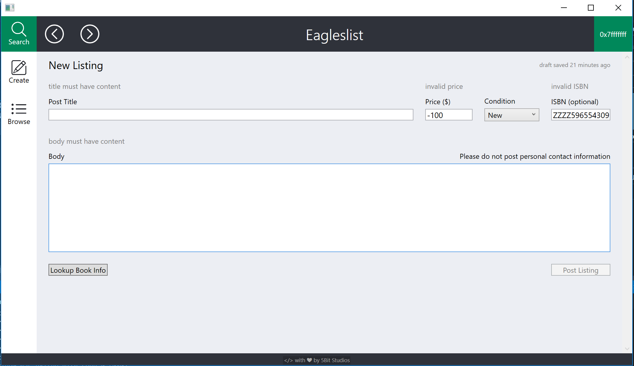
DEMO (Invalid inputs)
invalid comment
invalid listing

Slide 8
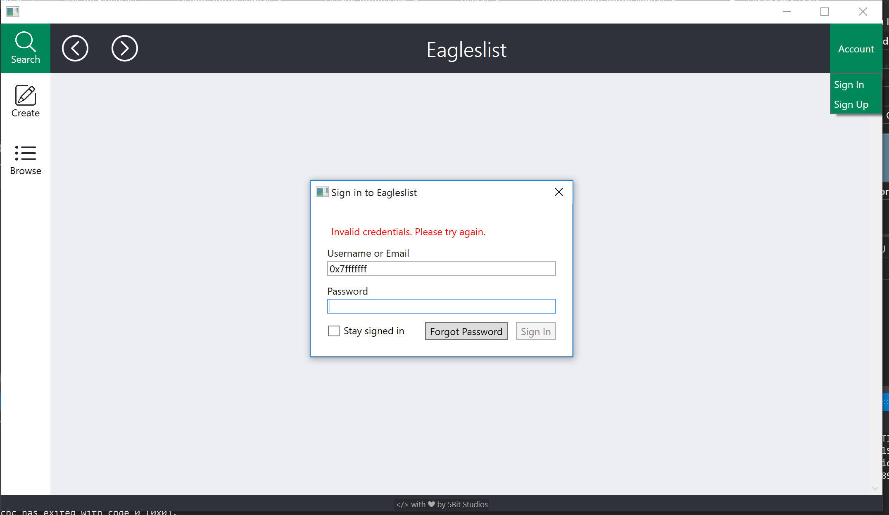
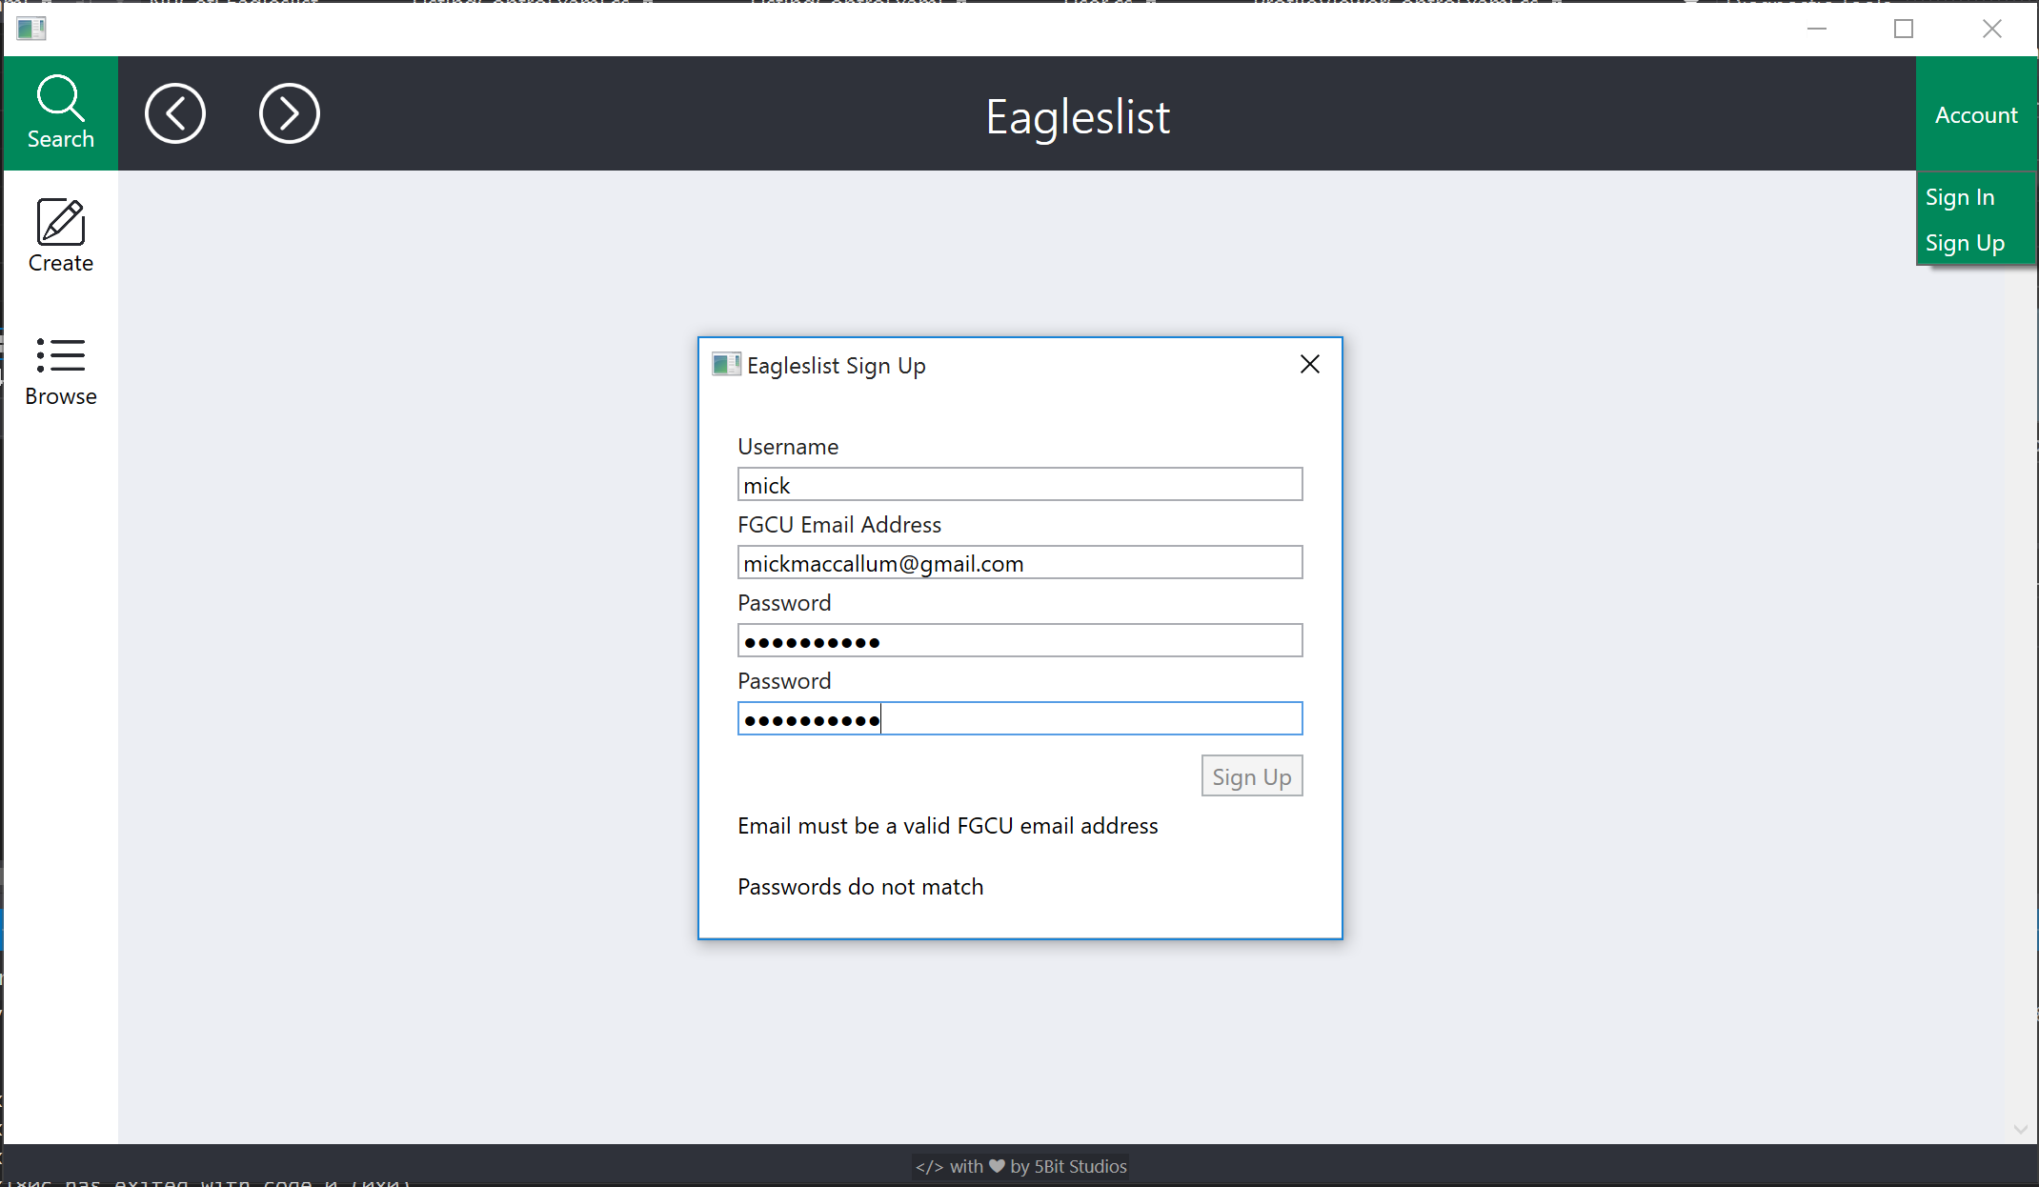
DEMO (Invalid inputs) CONT.
Invalid login credentials
Invalid sign-up info

Slide 9
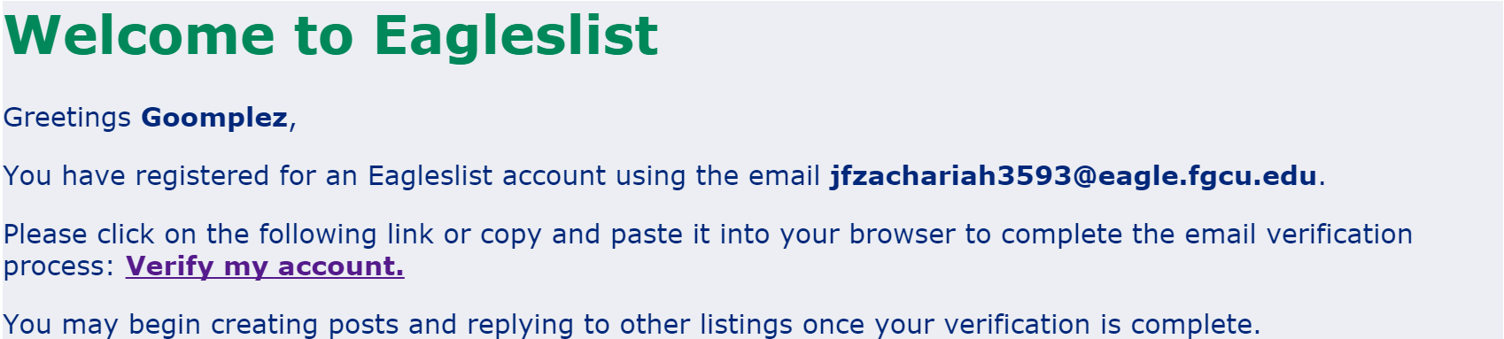
TEST RESULTS

Slide 10
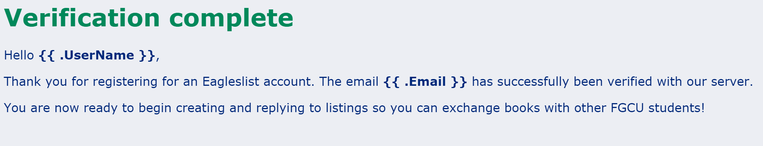
TEST RESULTS (cont.)

Slide 11
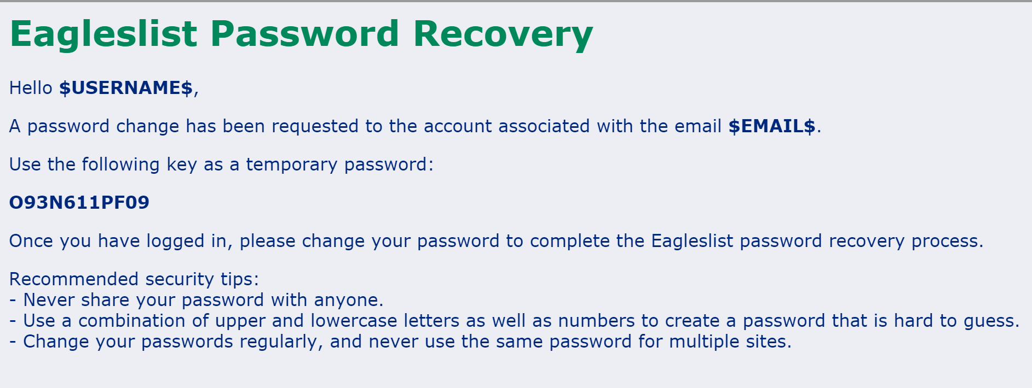
TEST RESULTS (cont.)

Slide 12
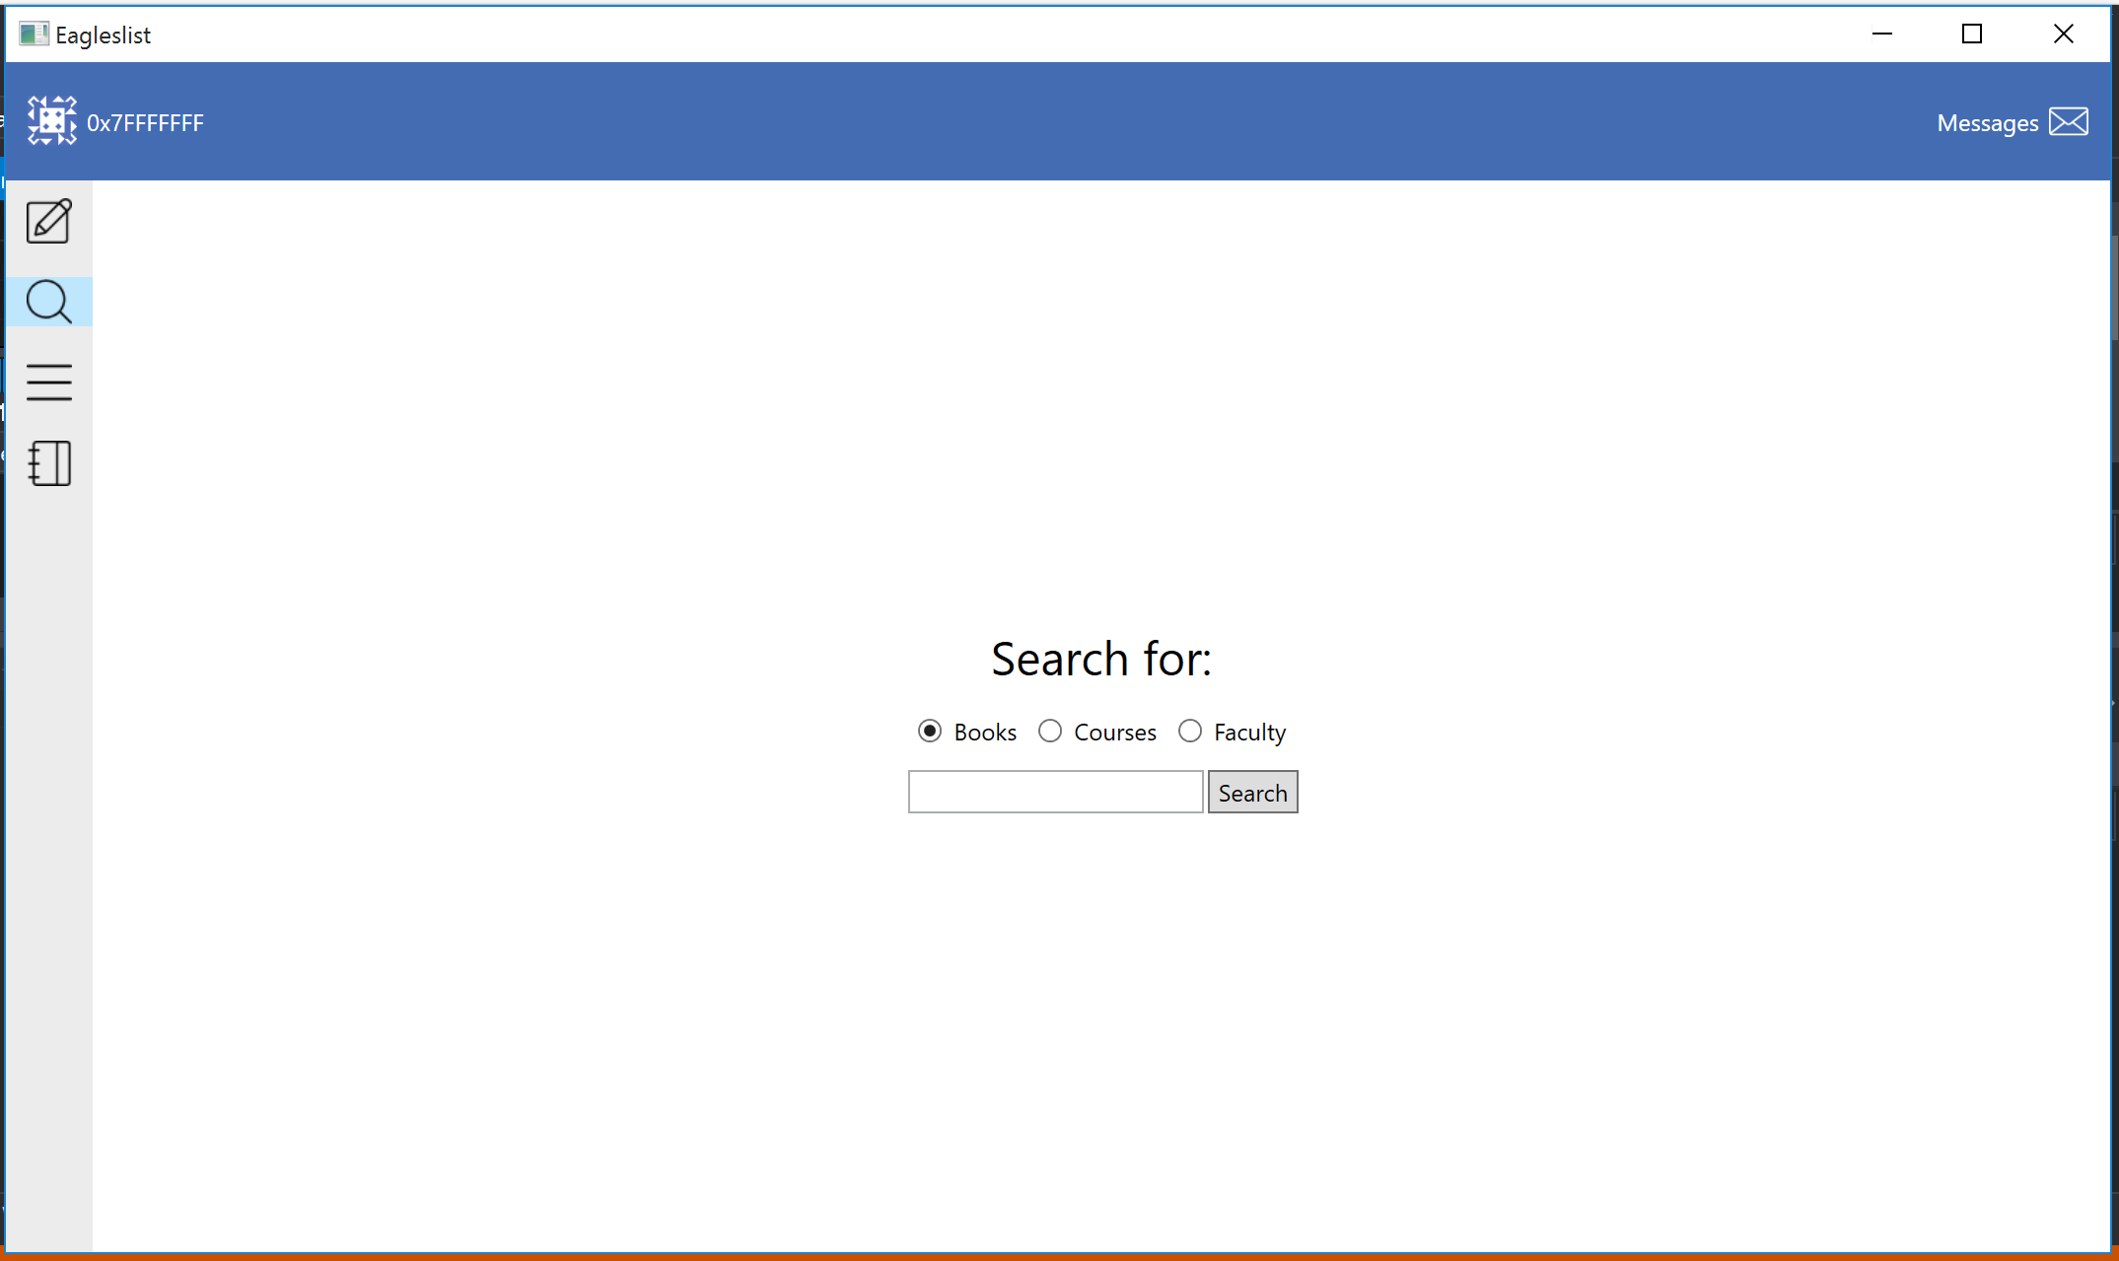
SCREEN IMAGES OF OUR PRODUCT (Before)

Slide 13
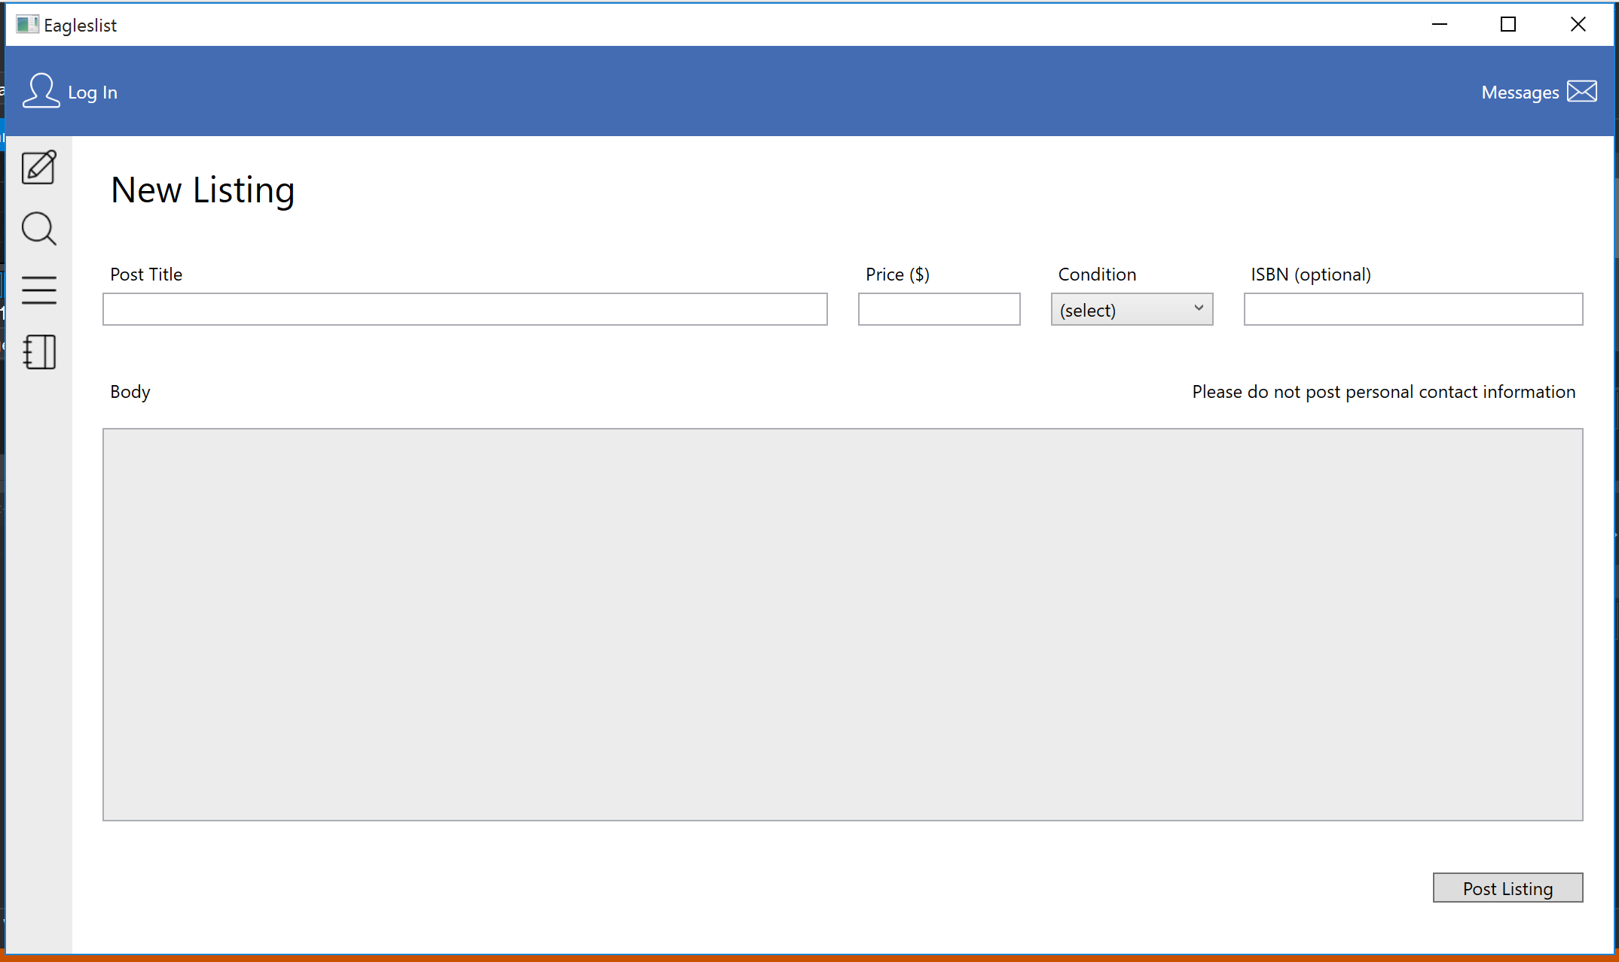
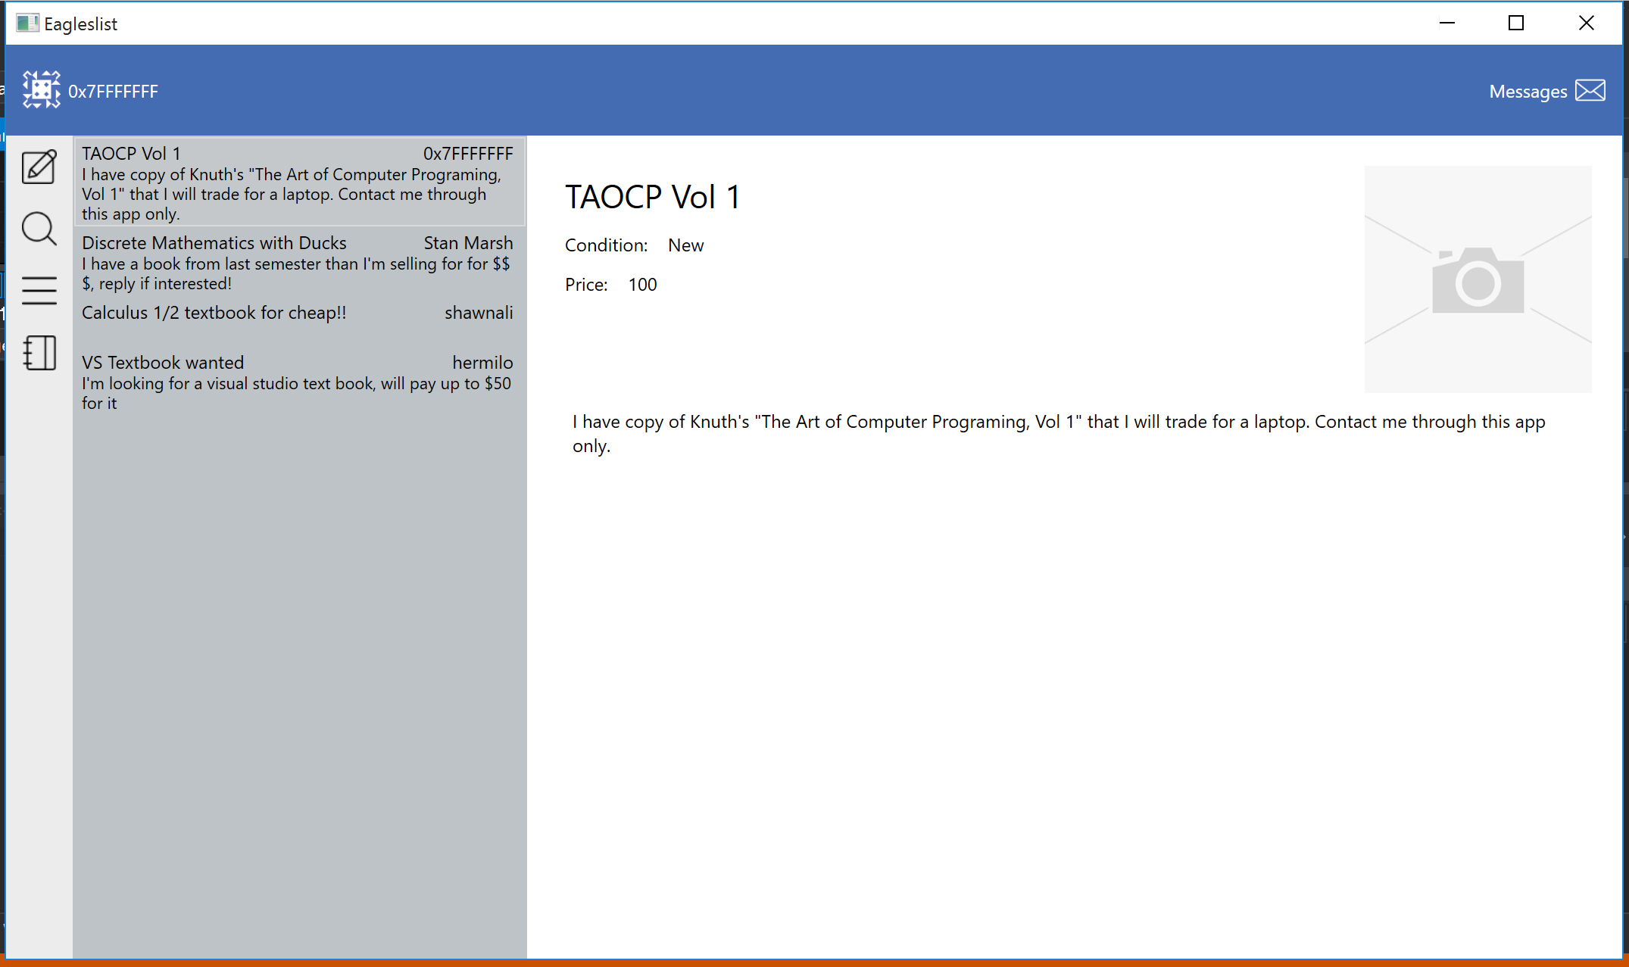
SCREEN IMAGES OF OUR PRODUCT (Before)

Slide 14
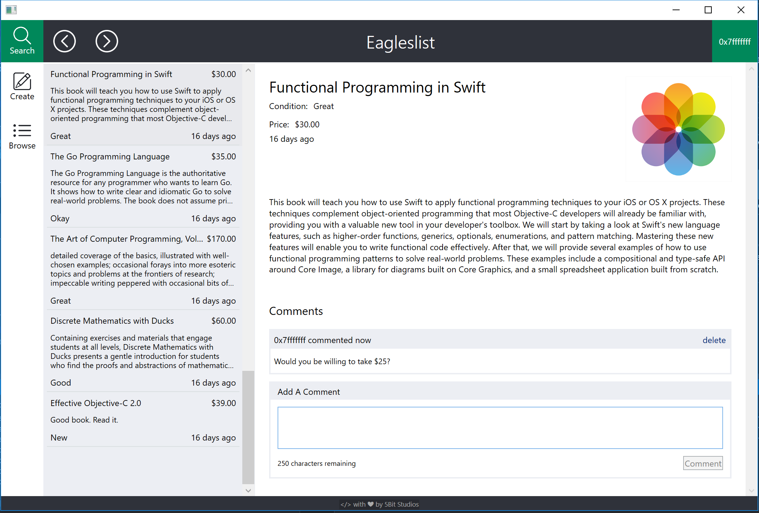
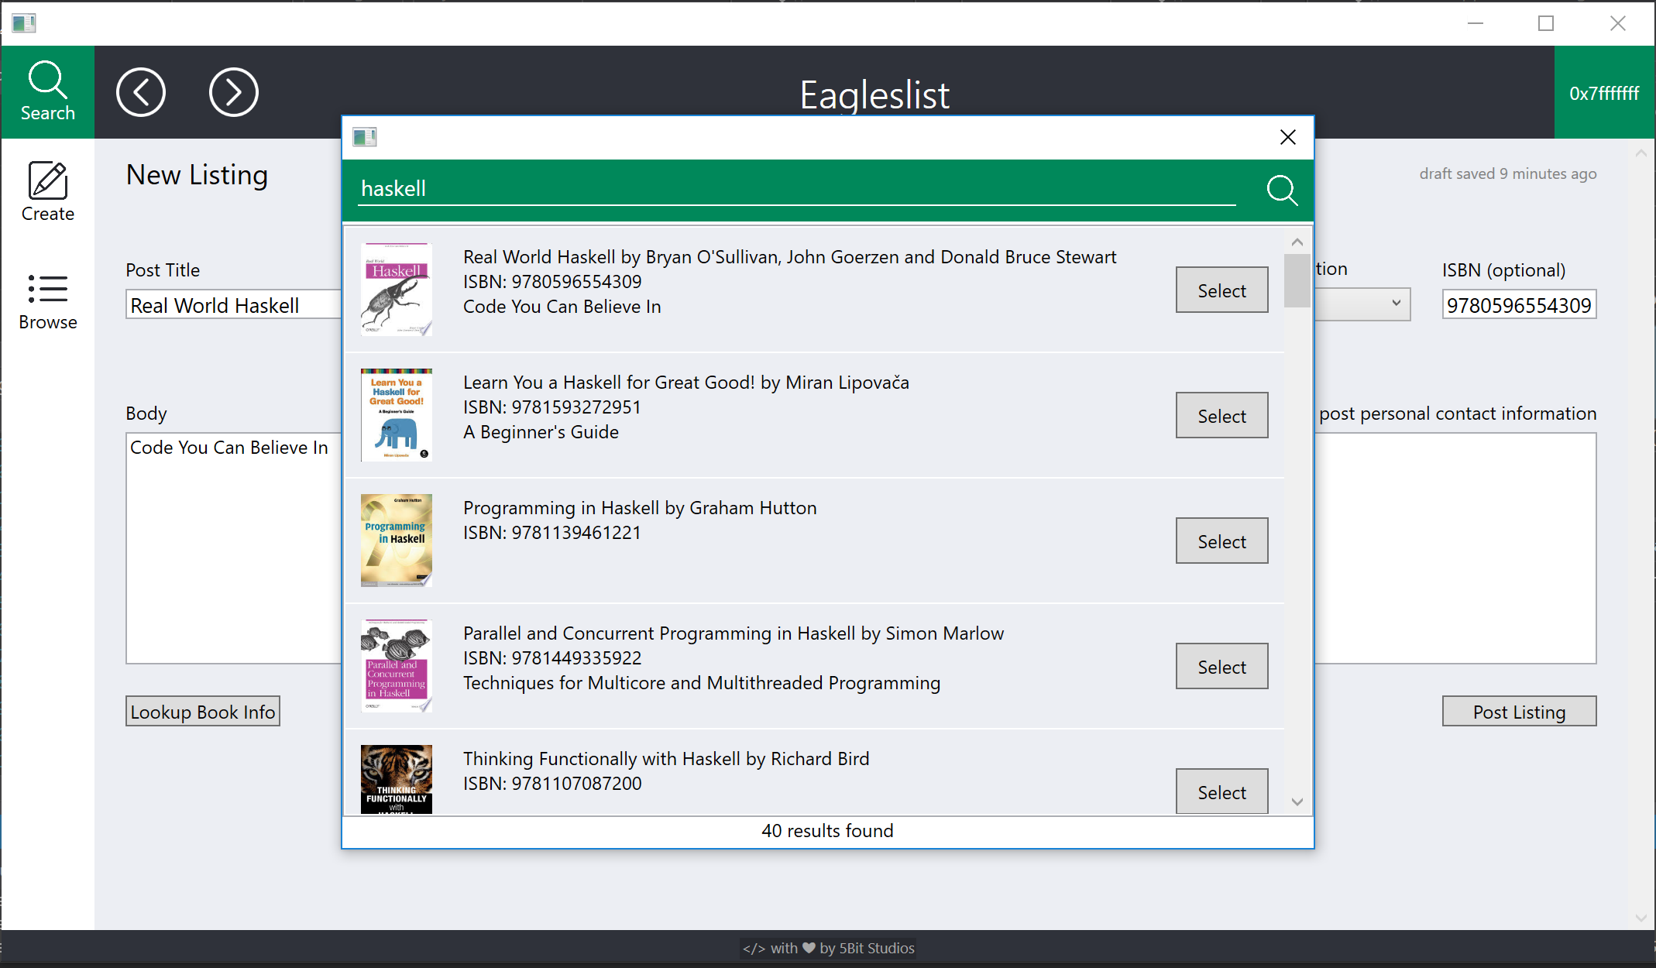
SCREEN IMAGES OF OUR PRODUCT (After) with Valid Inputs
Browse Listings Page
Auto-fill Book Information

Slide 15
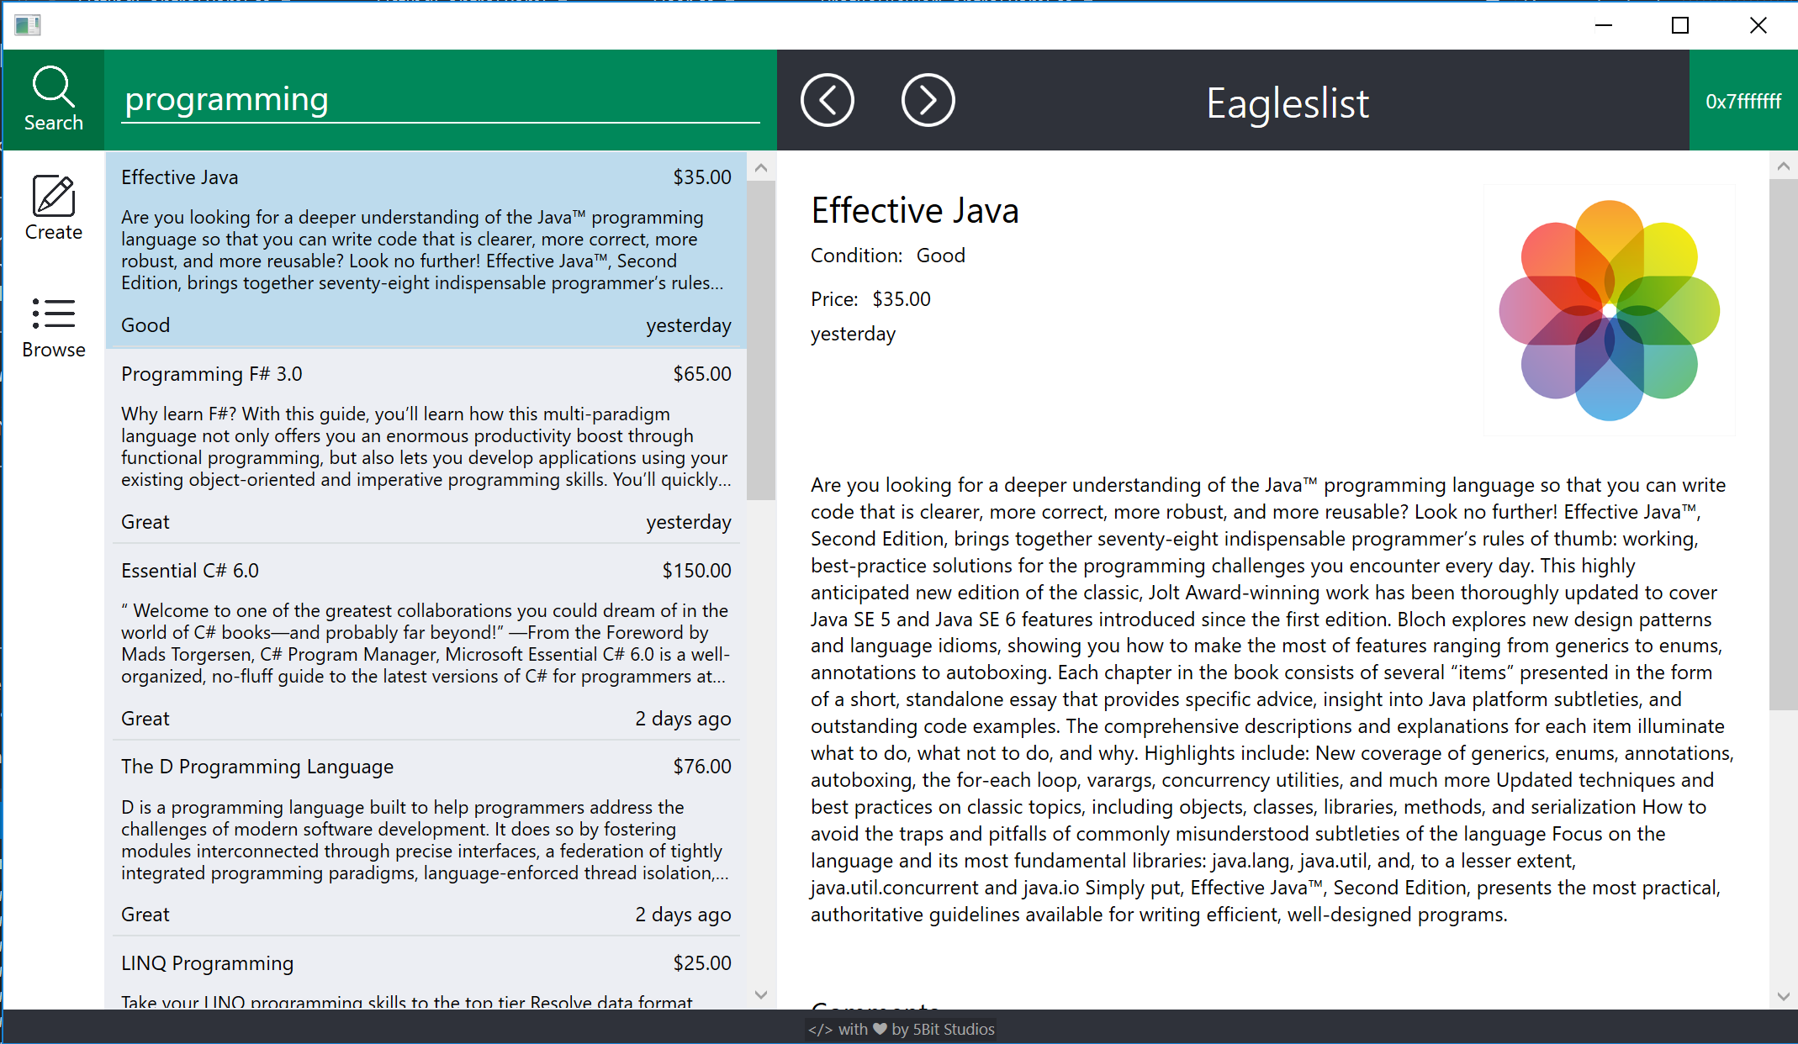
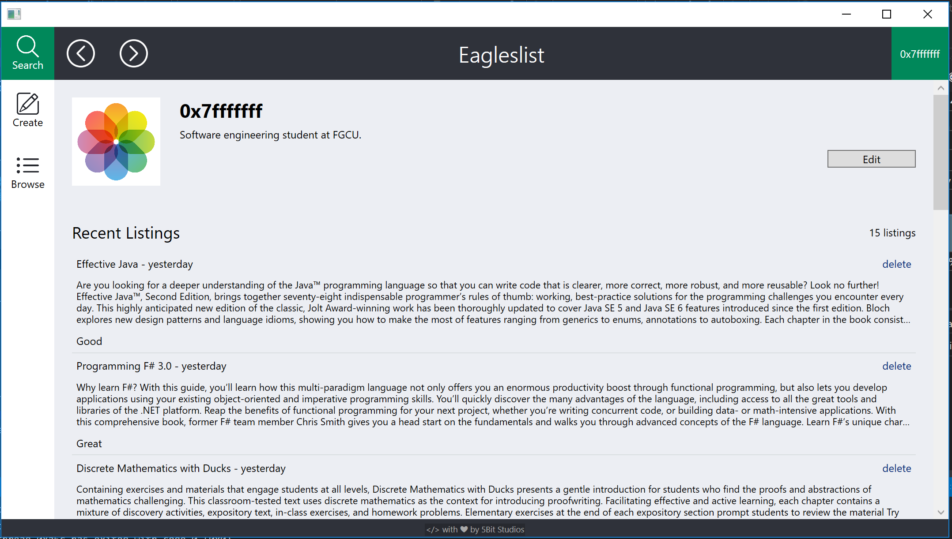
SCREEN IMAGES OF OUR PRODUCT (After) with Valid Inputs CONT.
Listing Search
Profile Page

Slide 16
OVERVIEW OF THE DESIGN
Frontend
Our program is a C#/WPF desktop application that has the following layout:
An account status bar at the top showing login information and a search button
Tabs to represent each view that a user can have into this system
Browse listings
Search listings
Account management
We chose WPF and C# so we could work outside of Java and learn something new
This means that our client is Windows only

Slide 17
OVERVIEW OF THE DESIGN CONT.
Backend
Webservice written in Go
Talks to a PostgreSQL database
Hosted on Digital Ocean
Verification emails will be sent via postfix
Other than postfix, this stack can be ported from windows to linux

Slide 18
PROJECT LEGACY
Summary of Roles: Andrew Owen - Head Manager, Michael MacCallum - Co-Manager, Mostofa Ansary - Front-end programmer, Hermilo Calderon - Front-end programmer, and John Zachariah - Back-end programmer.
We did not meet all of the requirements and fell short on all moderation functionality.
Known problems: there are some general layout and formatting problems that need to be fix, we need better error handling and to show more descriptive error messages to users. We don’t have support for multiple books per listing and course listings yet either.
We did follow the schedule/plan that we needed to in order to complete the project.

Slide 19
THE END
If you have any questions, please feel free to ask.
Thank you!

